Slide 1
Les indispensables de l'administration pour les nouveaux administrateurs dans Lightning Experience
(éditions Enterprise et Unlimited)
Notes:
Enterprise, Performance, and Unlimited Editions –
Characters in ADX201:
Company: AW Computing
John Wiseman - CEO
Brent Bassi - VP Finance
Allison Wheeler - VP Global Sales
Conner McCoy - VP Marketing
Noah Larkin - VP Services
Ling Wu - VP Human Resources
Desmond Castillo - Head of Legal Counsel
Phil Smith - Sales Rep
Matt Wilson - Sales Rep
An Lin - APAC Sales Director
Fumiko Suzuki - APAC Sales Rep
Jin Chang - APAC Sales Rep
Yuko Ishikawa - Sales Ops
Courtney Brown - Sales Ops
Tony Jenkins - Sales Ops
Alan Wong - Sales Ops
Roberta Spada - Customer Support Director
Tim Howe - Customer Support Rep
Robin Kramer - Customer Support Rep
Cara Ng - Customer Support Rep
Amy Daniels - Sales Engineer
Kevin Bailey - Sales Engineer

Slide 4
Fondamentaux administratifs pour les nouveaux administrateurs
À la fin de cette formation, vous serez en mesure de mettre en place et de personnaliser une organisation Salesforce avec des fonctionnalités essentielles telles que les clouds Ventes, Service et Collaboration. Plus particulièrement, vous serez en mesure :
De créer des nouveaux utilisateurs avec un accès approprié et les autorisations requises pour travailler avec les données Salesforce.
De personnaliser l'application Salesforce afin qu'elle reflète vos besoins commerciaux, de la définition de devises à la création de champs personnalisés.
D'importer et d'exporter des donnés depuis Salesforce. Garantir la propreté des donnés par le biais des règles de workflow.
De créer des tableaux de bord et des rapports afin que vous, et vos utilisateurs, puissiez analyser les données au sein de Salesforce.
D'automatiser les processus métier, la génération de pistes ainsi que la création, l'attribution et la remontée des cas.
D'améliorer la collaboration, le partage et l'échange de connaissances au sein de votre entreprise.

Slide 5
Fondamentaux administratifs pour les nouveaux administrateurs
Introductions et vue d'ensemble
Module 1 :
Navigation dans l'application
Module 2 :
Préparation de votre organisation pour vos utilisateurs
Module 3 :
Création et gestion des utilisateurs
Module 4 :
Sécurité et accès aux données
Module 5 :
Personnalisations des objets
Module 6 :
Gestion des données
Module 7 :
Rapports et tableaux de bord
Module 8 :
Automatisation
Module 9 :
Gestion du processus de support
Module 10 :
Synthèse

Slide 6
Introductions et Vue D’ensemble

Slide 7
Introductions et vue d'ensemble
À la fin de cette introduction :
Vous serez familier avec les services, les didacticiels et vos camarades de classe.
Vous connaîtrez mieux votre nouvelle entreprise, AW Computing.
Notes:
Teaching Points
Extra Material
Suggestions

Slide 8
Introductions et vue d'ensemble
Introductions
Bienvenue chez AW Computing
Notes:
Teaching Points
Extra Material
Suggestions

Slide 9
Notes:
Teaching Points
Direct students to the emergency exits and any additional safety information. Point out the restrooms, break areas and any other useful areas to be aware of.
Students receive a manual, an exercise guide, and a personal org.
The course follows a lecture format supplemented with demonstrations (referred to as Watch Me: exercises), exercises for both instructor and student (Join Me: exercises) and exercises for the students to do on their own (Your Turn: exercises).
Extra Material
Suggestions
Customize this slide as needed

Slide 10
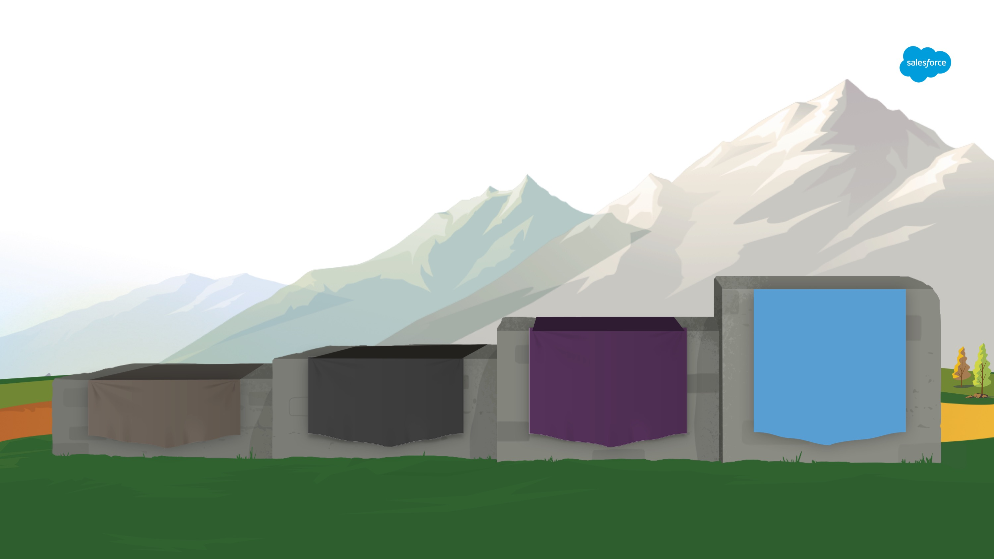



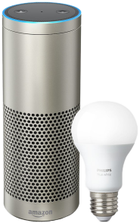



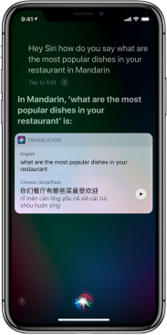









Quatrième révolution industrielle
L'intelligence artificielle transforme toutes les expériences
4e révolution industrielle Intelligence
3e Révolution industrielle Informatique
2e Révolution industrielle Électricité
1ère Révolution industrielle Vapeur
1700
1800
1900
Aujourd'hui
Notes:
Key Messages
In the Fourth Industrial Revolution, artificial intelligence (AI), robotics, and the Internet of Things (IoT) are transforming the customer experience.
The lines between the physical and digital worlds are blurring, especially with technology like voice command, autonomous cars, and smart devices that keep you connected and always-on.
Talk Track Over the last 300 years, our world has seen incredible innovation and unprecedented technological change. Today, we're entering the Fourth Industrial Revolution where artificial intelligence, robotics, and the Internet of Things (IoT) are transforming the customer experience.
AI is making devices and apps smarter
The lines between the physical and digital worlds are blurring
We are seeing incredible new products and services — like connected motorcycles and connected coolers
You can see this change in our everyday lives: shopping via voice command, autonomous cars, and smart devices that keep you connected and always-on. Transition These next-generation technologies are connecting us to our customers in a whole new way. And customer expectations, in turn, are changing. Related Trail The Fourth Industrial Revolution: https://trailhead.salesforce.com/modules/learn-about-the-fourth-industrial-revolution

Slide 11





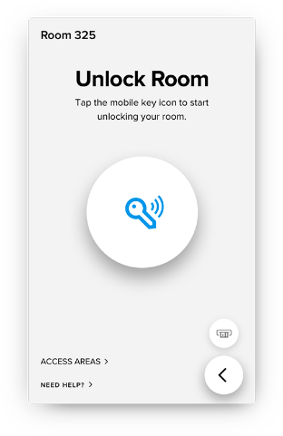

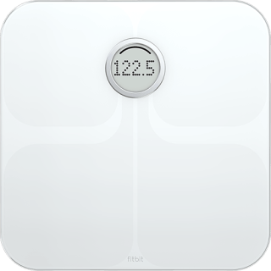






Tous les clients sont connectés
Grâce à des appareils intelligents et toujours allumés ainsi qu'à des interactions en temps réel
Notes:
Key Messages
People are more connected than ever before.
Customers expect your business to be just as smart, always-on, and as connected as they are.
Talk Track Behind every device and interaction is a customer. And in the Fourth Industrial Revolution, every customer is connected. They have fitness monitors and digital personal assistants that keep them connected and informed 24/7. And these customers expect your business to be just as smart, always-on and as connected as they are. [tell a personal story of a connected device/experience or share a customer story i.e. KONE] Transition For businesses, meeting customer expectations is easier said than done. Resource
KONE customer story - https://www.salesforce.com/services-training/customer-support/customers/kone.jsp
Ducati Drives Customer Engagement With Digital Identity - https://www.salesforce.com/video/1779407/

Slide 12
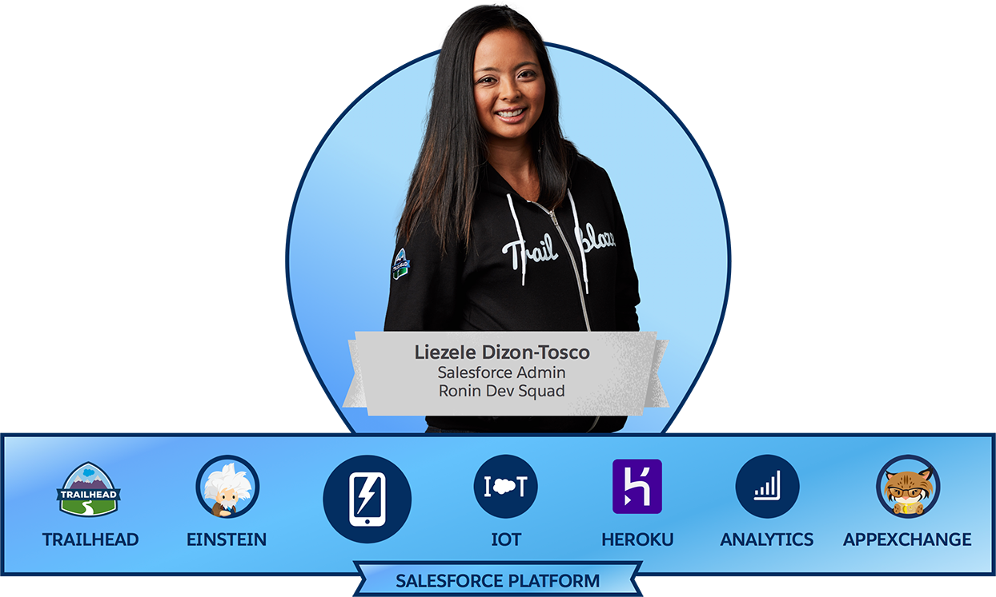


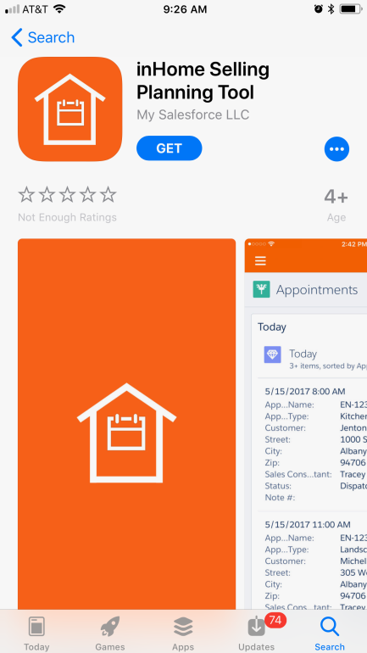
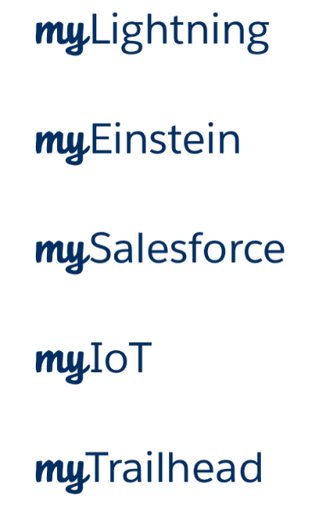

Connectez-vous à Salesforce où que vous soyez grâce à iOS et Android
L'intégralité de votre CRM sur n'importe quel appareil
Temps de réponse 34 % plus rapide
Gérez facilement les approbations, où que vous soyez
Accédez rapidement à votre CRM
Collaborez sans effort avec votre équipe
NOUVEAU
Créez des applications mobiles de marque avec
Source : enquête sur les relations clients de Salesforce réalisée de 2014 à 2017 sur un échantillon aléatoire de plus de 7 000 clients. La taille des réponses par question varie.
Notes:
Key Messages
The Salesforce mobile app is the full CRM solution that goes with you on any device.
With mySalesforce, our customers can create their own custom-branded mobile app.
Talk Track In the Fourth Industrial Revolutions, customers aren't just connected, they're always on the go. Our smartphones go with us everywhere and so should our CRM. With Salesforce mobile, you can drive sales, manage leads, collaborate, and keep all your CRM data current from anywhere. With mySalesforce, you can make the Salesforce app your own — your corporate colors, logo and more. And with our Listing Wizard, you can even list it in the App Store and Google Play as your own. Transition As we've already talked about, phones are one of many devices customers are using.

Slide 13
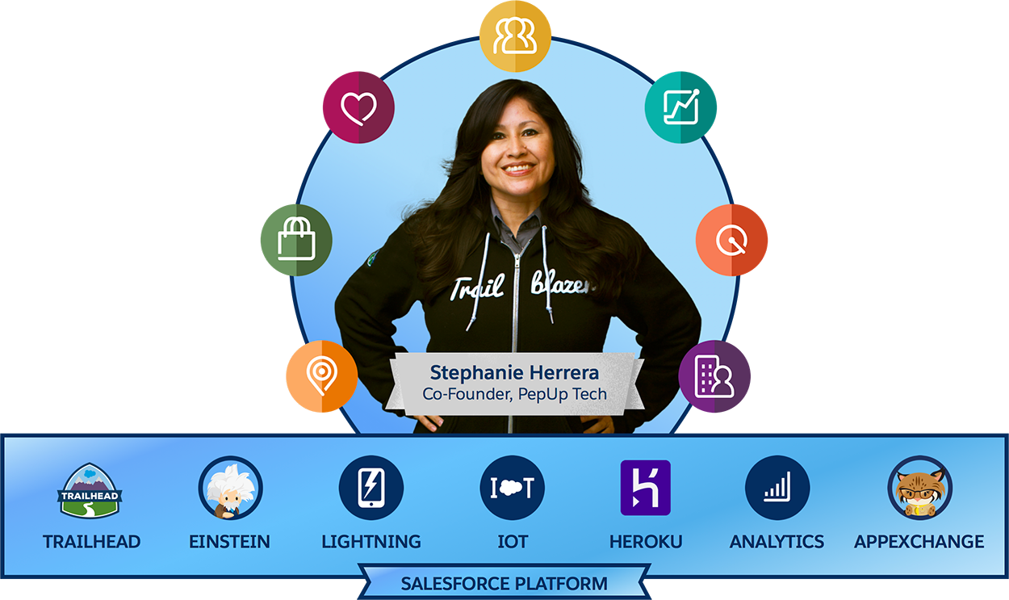

Plate-forme de réussite client pour la quatrième
révolution industrielle
COMMUNITIES
Expériences clients, partenaires et employés
N°1 Plate-forme B2C et B2B
Notes:
Key Message
Salesforce is the #1 B2B and B2C platform.
The Customer Success Platform empowers Trailblazers to drive success in the Fourth Industrial Revolution by providing a single view of the customer.
Talk Track The Customer Success Platform is the #1 B2B and B2C platform. These amazing applications — Marketing, Commerce, Service, Communities, Sales, Collaboration, and Industries — are all built on the Salesforce Platform. You can create a smarter, more personalized experience with our 7 differentiators — Trailhead, Einstein, Lightning, IoT, Heroku, Analytics, and the AppExchange. But the most important part of this is not the technology — it's the people — the Trailblazers. Trailblazers, like Stephanie Herrera, are the true fuel of the platform. Stephanie is a change maker: changing her career, her company, and even her community. Though she didn’t have a background in technology, Stephanie has always had a passion for learning and blazed a trail to become a Salesforce MVP and a Director of Salesforce and Business Systems. She also founded Salesforce Salesforce Saturdays, where she brings together Salesforce enthusiasts to learn new skills with Trailhead. Transition Let’s take a look under the hood to find out what’s new in the Customer Success Platform. Trailblazer Story Stephanie Herrera’s Trailblazer story: https://trailhead.salesforce.com/trailblazers/stephanie-herrera

Slide 14
Introductions et vue d'ensemble
Introductions
Bienvenue chez AW Computing
Notes:
Teaching Points
Extra Material
Suggestions

Slide 15


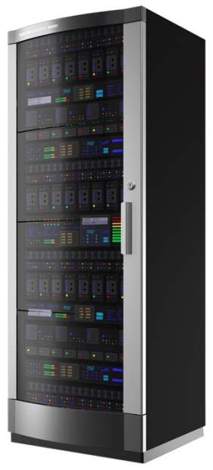


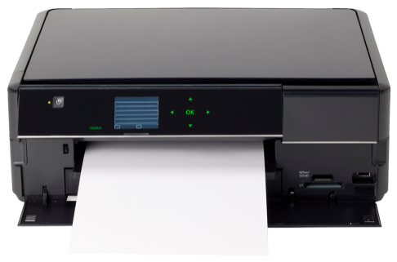
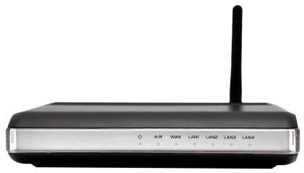
Bienvenue
Félicitations pour votre nouveau rôle d'administrateur Salesforce chez AW Computing !
Nous sommes une entreprise de taille moyenne basée aux États-Unis qui fournit de l'équipement informatique bureautique à la fois aux entreprises et aux particuliers. Nous nous développons à l'international tout en accroissant nos exigences vis-à-vis de notre système Salesforce, mis en œuvre il y a six mois.
1 Market St.
San Francisco, CA 94105
États-Unis
+1.415.901.7901
www.aw-computing.com
Secteur Informatique et produits électroniques
Nombre d'employés 750
Chiffre d'affaires 30 000 000 USD
Propriété Privée
Notes:
Teaching Points
Extra Material: The AW Computing Story
AW Computing is a US-based, medium-sized company supplying office computing equipment (PCs, laptops, printers, accessories) mainly B2B. Up until recently, the main divisions in the company have used different systems, but now the company is expanding into international markets, and is growing its service and support division, they have decided to go for a more integrated solution: Salesforce.
The initial configuration, data migration, and implementation have been done by an outside consultant who is no longer working with AW. The student has been assigned the role of System Administrator, and he/she initially wants to gain an overview of Salesforce and its main features, learn to navigate, and understand what has been set up so far. She/he knows they will primarily be responsible for the day-to-day administration of Salesforce, such as dealing with login issues, bad data, and report requests, so they also want to explore those areas along the way. However, as the company expands, the student admin will also become increasingly involved in configuration as she/he scales Salesforce to meet the company’s increasing demands. This will include such things as setting up new currencies as the company expands internationally, building out the role hierarchy and creating new profiles as they onboard new users, and creating custom fields and page layouts for new data that needs to be tracked.
Suggestions

Slide 16






L'équipe de direction AW Computing
John Wiseman
PDG
Brent Bassi
Vice-président Finances
Allison Wheeler
Vice-présidente Ventes internationales
Conner McCoy
Vice-président Marketing
Noah Larkin
Vice-président Services
Ling Wu
Vice-présidente Ressources humaines
Notes:
Teaching Points
Extra Material: AW Computing – The Team
John Wiseman, CEO
Started the company 10 years ago with Simon Adams (hence the AW name), whom he later bought out. An amiable chap on the surface, but underneath lurks a ruthless business mind. His main concern is making sure he’s getting big bangs for every buck he’s spending on Salesforce, so he’s very focused on adoption, maximizing revenue, and productivity gains. He’ll be breathing down the Administrator’s neck all the way.
Brent Bassi, VP of Finance
The accountant. He’s excited about integrating Salesforce with the existing billing system, and is eager to get his accounts receivables team up and running, with visibility into customer accounts. He’ll be going to the administrator to make sure the fiscal year is set up correctly, set up new currencies, and manage exchange rates.
Allison Wheeler, VP of Global Sales
Allison’s been in sales since she left school, and has a long, proven track record. She used Salesforce in her previous employment, so she knows what it can do. She’ll be making the most demands on the administrator, from ensuring that her (relatively young) sales teams across the globe are able to collaborate, through requests for custom fields to track her critical metrics, to detailed reports.
Conner McCoy, VP of Marketing
Recently promoted to the position and with a lot to prove, Conner wants to use Salesforce to maximize the ROI on his marketing spend. He’ll be going to the administrator to load all of his existing leads, and new purchased leads onto the system, and he’ll be looking to the administrator to automate a large part of the lead management process.
Noah Larkin, VP of Services
As AW computing expands its customer base around the world, Noah is experiencing increasing demands on his teams. He’ll be looking to the administrator to ease some of this pain. He wants to make sure customers get the best “one and done” experience, so he’ll be going to the administrator to ensure his team has access to all the data they need: access to customer accounts, custom fields to track service information at the account level, and automation of the case management process.
Ling Wu, VP of Human Resources
The administrator’s relationship with Ling will be more of a collaborative one. He/she will be going to Ling for the information needed to set up new users, such as their personal details, languages and locales, and hours. But Ling will be making demands of the administrator too, as she needs to manage issues of compliance and confidentiality.
Suggestions

Slide 17
Organigramme RH
PDG
Assistant(e) de direction
VP Finances
VP Ventes internationales
VP Marketing
Vice-président Services
VP Ressources humaines
Directeur financier
Directeur Ventes US
Directeur Ventes
EMEA
Directeur Ventes
APAC
Directeur Opérations commerciales
Directeur Marketing
Directeur Service client
Directeur Ressources humaines
Comptabilité
Commercial US
Commercial EMEA
Commercial APAC
Distributeurs
Agent Service client
Recruteurs
Ingénieurs commerciaux
Opérations commer-ciales
Notes:
Teaching Points
Extra Material
Suggestions

Slide 18

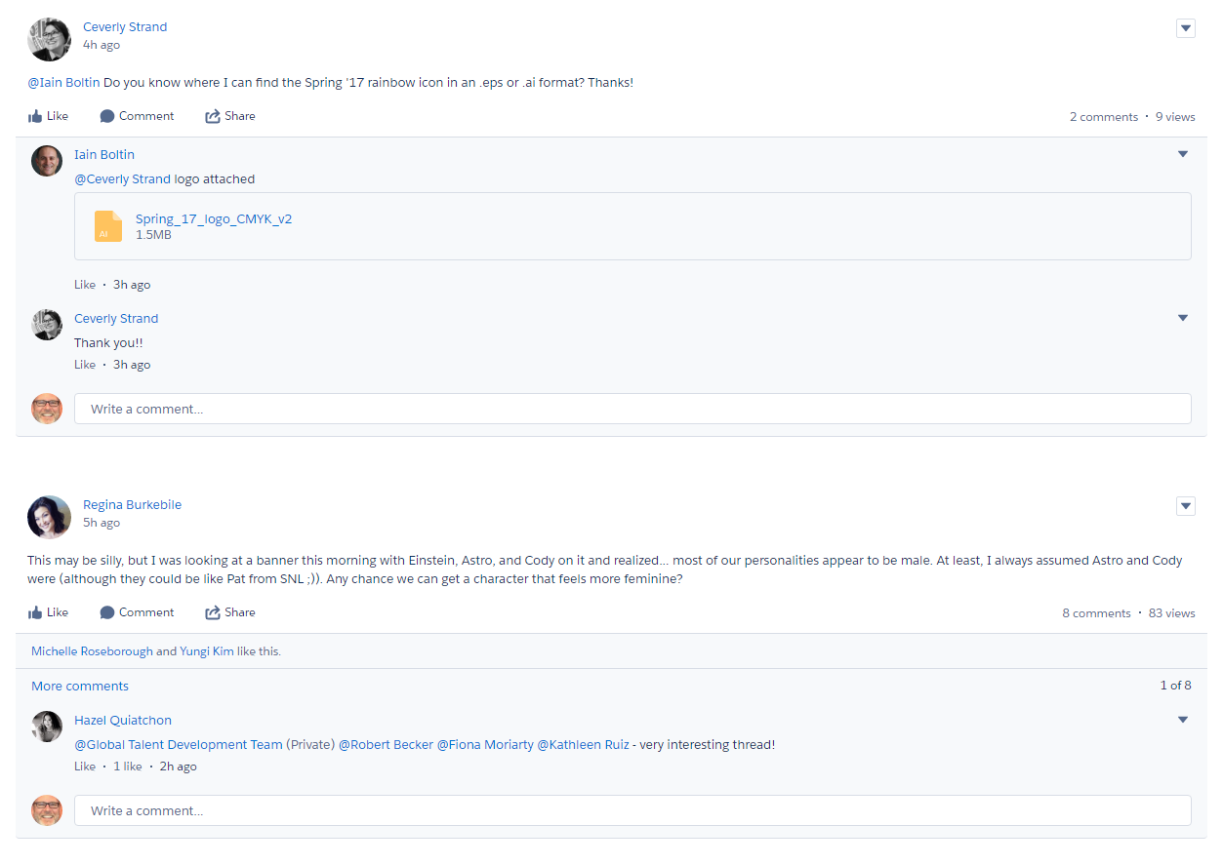

Les RH souhaitent que vous mettiez votre profil Chatter à jour
Ling Wu Il y a 9 heures
Bienvenue chez AW Computing ! Veuillez charger une photo de vous sur votre profil Chatter et remplir la section « À propos de moi ». Je vous ai également ajouté au groupe Boîte à outils du nouvel employé, dans lequel vous trouverez un manuel de l'employé, les réponses à vos questions et vous pourrez prendre des nouvelles des personnes rencontrées lors de l'orientation pour les nouveaux employés.
1 commentaire · 8 affichages
Noah Larkin et Conner McCoy aiment.
Connor McCoy Ce fut un vrai plaisir de vous rencontrer pendant l'orientation des nouveaux employés ! Je suis content d'avoir un contact dans le service informatique - Je suis sûr que cela va s'avérer utile ! J'aime · Il y a 31 minutes
J'aime
Commenter
Partager
Notes:
Teaching Points
We will NOT be uploading photos in class, as it takes too much time. But it is important to stress that in a real Chatter community, photos are very important and should be a best practice for any Chatter users.
Extra Material
Suggestions

Slide 19
Intro : Se connecter
Objectif :
Se connecter à l'organisation Salesforce AW Computing pour démarrer au sein de votre nouveau poste !
5 min
Tâches :
Accédez à la page de connexion Salesforce.
Connectez-vous à l'aide de votre nom d'utilisateur et de votre mot de passe.
URL : login.salesforce.com
Nom d'utilisateur : admin@aw#####.com
Mot de passe : (fourni par le formateur)
Après vous être connecté, vous serez invité à modifier votre mot de passe. Veuillez utiliser le mot de passe fourni par votre formateur ou choisissez un mot de passe dont vous vous souviendrez.
Notes:
Teaching Points
Extra Material
Suggestions

Slide 20
Module 1: Naviguer Dans L’Application

Slide 21
Module 1 : Naviguer dans l'application
À la fin de ce module, vous serez en mesure de :
Décrire la structure de l'organisation Salesforce.
Comprendre la terminologie de base Salesforce.
Naviguer efficacement au sein de Salesforce.
Trouver rapidement des réponses aux questions relatives à Salesforce dans le portail Aide et formation.
Notes:
Teaching Points
Extra Material
Suggestions

Slide 22
Module 1 : Naviguer dans l'application
Modèle de données et navigation
Aide et formation
Vous venez d'accepter le poste d'administrateur chez AW Computing. Vous vous êtes connecté et avez mis votre profil Chatter à jour. Nous passerons ensuite en revue l'interface utilisateur (IU) Salesforce et travaillerons dans le portail Aide et formation.

Slide 23








Naviguer au sein de votre organisation Salesforce
Vous avez hâte de vous plonger dans votre nouveau poste, mais vous devez d'abord bien connaître Salesforce : Quels sont les objets principaux et comment interagissent-ils les uns avec les autres ? Un consultant vous a indiqué que la mise en œuvre initiale s'est déroulée il y a six mois. Le consultant a-t-il créé de nouveaux objets ?
DÉFINITION : Organisation (Org) : déploiement Salesforce qui dispose d'un ensemble d'utilisateurs sous licence. Votre organisation comprend toutes vos données et applications et est séparée de toutes les autres organisations.
Notes:
Teaching Points
Extra Material
Suggestions

Slide 24
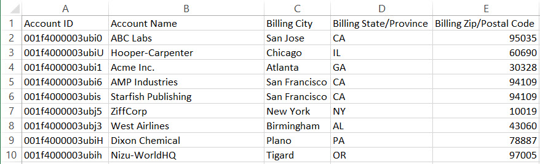
Qu'est ce qu'un objet dans Salesforce ?
Un objet est un tableau de données.
Les champs sont les colonnes.
Les enregistrements sont les lignes.
Notes:
Teaching Points
An object is like a table of data, similar to an excel spreadsheet.
Each row represents a unique, individual record.
Each columns represents a field.
Salesforce displays this information thru a customizable user interface (UI).
This worksheet shows Accounts, illustrating how the worksheet is an Object.
Notice we show a 15 digit Account ID (and not an 18 digit ID), because that's what we point out in the Org.
Extra Material
Suggestions

Slide 25

Définir les objets standard Salesforce et construire le schéma Salesforce
Travaillez au sein de votre groupe avec les cartes fournies afin de trouver une définition de chaque objet, puis dessinez un schéma du modèle de données Salesforce.
Compte
Campagne
Requête
Contact
Piste
Opportunité
Utilisateur
Notes:
Teaching Points (Solution on next slide)
Test what students have learned from the pre-requisites, focusing on just the standard objects to start.
Fill in any gaps of basic terminology + concepts.
Define the following concepts:
The account is a main object in Salesforce. All contacts and opportunities must belong to one (and only one) account.
Contacts have a child-parent relationship with the account object.
Opportunities have a child relationship to the account object.
Leads, lead qualification and conversion:
Campaigns are designed to create new leads which can then be converted into accounts, contacts, and opportunities.
Cases have a child relationship to the account object and a lookup relationship to the Contact object.
Discuss which objects belong to which clouds/apps, including how Chatter applies to all clouds.
Related Lists – allow you to look/navigate down from a parent record to related child records.
Lookup fields – allow you to look/navigate up from a child record to its parent record.
Users, Owners (brief overview – covered in more detail in later modules).
Extra Material
Training & Certification org:
See the Jon Oatham video titled “Object Cards for ADM201 V1” which can be found in the Group Files section of the ADM201 Chatter group in the T&C org.
Download the object cards.
Suggestions
This can be presented using the magnetic cards as a group exercise.

Slide 26
Objets standard
Compte : clients, concurrents et partenaires. Les comptes stockent tous des informations telles que noms, adresses et numéros de téléphone.
Contact : personnes associées à vos comptes professionnels que vous devez suivre dans Salesforce.
Opportunité : actions commerciales que vous souhaitez suivre. Ajouter des opportunités permet également de développer votre canal, qui alimentera à son tour vos prévisions.
Requête : description des retours, problèmes ou questions soulevés par un client. Utilisez les requêtes pour suivre et résoudre les problèmes de vos clients.
Campagne : projet marketing sortant que vous souhaitez planifier, gérer et suivre dans Salesforce.
Piste : un prospect ou une opportunité potentielle.
Notes:
Teaching Points
This slide and the next 2 (the schema exercise and the objects graphic) can be covered in whatever order the instructor finds most useful.
Solutions are only available in Salesforce Classic.
Extra Material
Suggestions

Slide 27



Objets et relations Salesforce
Marketing
Ventes
Service
Personnalisation
Campagne
Compte
Poste
Candidat
Piste
Contact
Candidature
Opportunité
Personne assurant les entretiens
Requête
Propriétaire
=
Utilisateur
Loupe
Notes:
Teaching Points
As of Winter 2018, contacts can be added to multiple accounts if the "Allow users to relate a contact to multiple accounts" setting is turned on in the account settings. Admin needs to Customize both the Account and Contact Page Layouts to display the related contacts related list instead of or in additional to the contacts related list. Please see help and training for the nuances to multiple contacts to accounts.
Explain that the headings along the top (Marketing, Sales, Service) are called apps – logical groupings of objects and tabs – which align with the clouds we talked about in the previous module. Notice that there is some overlap, with some objects featuring in more than one app/cloud. For example, support reps will want to see account and contact information, and sales reps will need to see leads to be aware of any marketing campaigns going on. This is the Salesforce 360 degree view, that allows people working in different functions, teams and departments to see data from other areas, so they get a complete view of the customer, no matter the capacity they are working in.
At this point you can introduce the custom recruiting objects and the idea of a custom app under which to group them. Without going into a lot of detail, explain how the Job Application object is a junction object with two master-detail relationship fields (special type of lookup) that allows many-to-many relationships – an applicant can apply to many positions, and a position can have many applicants.
Extra Material
Suggestions

Slide 28
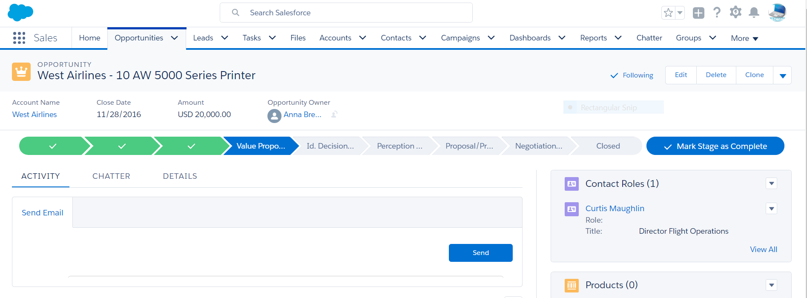
Naviguer dans Lightning
Lanceur d'application
Recherche
Accueil
Favoris
Parcours
Détails
Notes:
We’ll take a quick look at some of the key features of the Lightning Salesforce interface.
Home: Start the day on the new, intelligent Home page. Monitor performance to goal, and get insights on key accounts. Stay on track by seeing exactly what needs doing in the Assistant.
Path: Get your users to adopt and adhere to your company’s processes by using Path. For instance, when sales reps work in the opportunity workspace and the lead workspace, the sales path appears with the stages and guidance you set up. Reps mark stages complete when they’re ready to move to the next one.
Search: Find records faster with improved search, which includes recent records and top results.
Favorites – new in Spring ‘17. Favorites let you quickly access important records, lists, groups, dashboards, and other frequently used pages in Salesforce. They’re similar to bookmarks in a web browser but better because your favorites are available no matter which device or browser you use to log into Lightning Experience. Click the star ( ) to add the current page—for example, all open leads—to your favorites. A highlighted star means you’re on a favorite page. To remove a favorite, click the highlighted star. Your saved favorites are just a click away in your favorites list, where you can find and manage all your favorites.
Details – See all the record Details

Slide 29
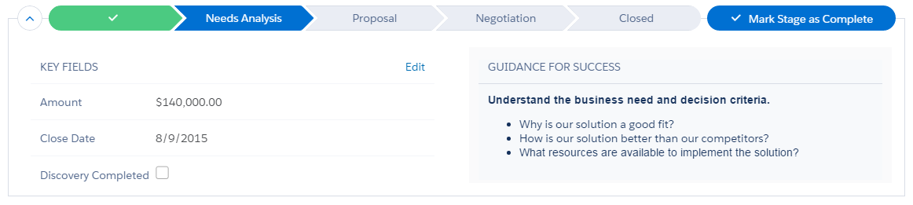
Les parcours guident et affichent la progression
Les parcours guident vos utilisateurs à chaque étape des processus de votre entreprise. Ils aident les utilisateurs à rester concentrés sur les tâches importantes afin de pouvoir travailler plus efficacement.
Les parcours sont utilisés avec les comptes, les pistes, les campagnes, les requêtes, les contrats, les opportunités, les commandes, les devis ou les objets personnalisés.
Les parcours de vente peuvent être personnalisés en deux étapes :
Configurer le processus de vente (quelles étapes apparaissent).
Modifier ce qui apparaît au sein de chaque étape.

Slide 30
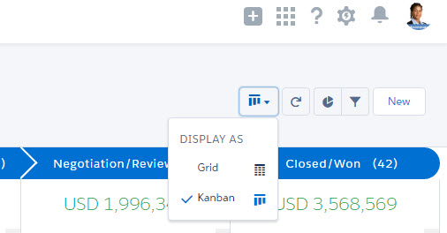

Vue Kanban dans les listes
La vue des listes Kanban est une synthèse visuelle de tous les enregistrements d'un parcours ou d'un regroupement particulier.
Par exemple, en affichant toutes les opportunités en même temps, vous pouvez les glisser-déposer afin de suivre efficacement le canal.
Notes:
Teaching Points:
The Kanban view displays a visual summary for a selection of records. By seeing all your records at once, you can more effectively monitor your work and keep deals moving forward.
This slide describes Opportunities as an example.
If you switch to Kanban for an object that does not have a path, switching to Kanban prompts you to create a grouping. If you would like to change the grouping you have to go to the gear box List View Controls and change the Kanban settings.

Slide 31
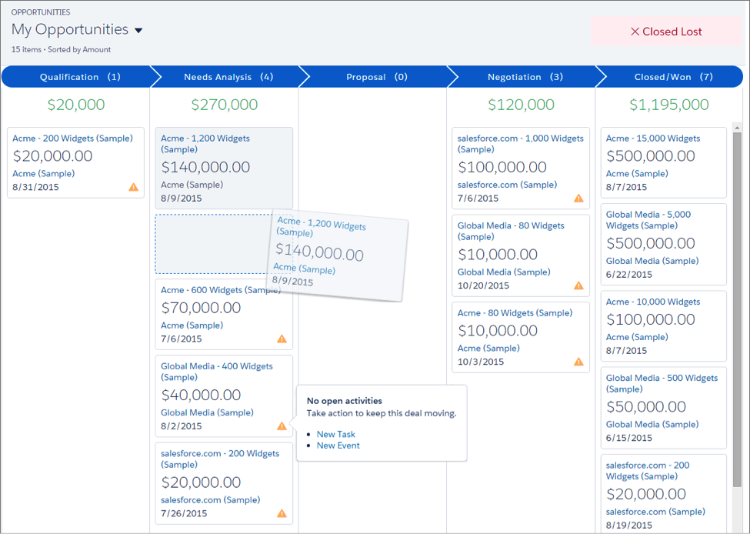
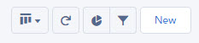
Répartition du tableau Kanban
5
6
Parcours.
Carte représentant chaque vue de liste, opportunité, piste, devis ou enregistrement personnalisé.
Cartes glisser-déposer.
Alertes.
Basculer entre la vue en tableau ou en grille.
Résultats du graphique et du filtre.
1
2
3
4
Notes:
Teaching Points
The Kanban board displays most list views, leads, opportunities, quotes, and custom object records from a particular path. These are sorted by stage and include the sum of the all opportunities for that stage.
The fields shown on the card are the first four fields on the corresponding list view.
Easily move an record by dragging the card to the next stage.
Alerts tell how to keep a deal on track; for example, create a task or event on an opportunity that doesn’t have any open activities. You can then create an activity without navigating away from this view.
Easily toggle between board view and grid view.
Quickly add a chart and/or filter the view to see a specific set of opportunities.
NOTES:
The Kanban is not available from the Recently Viewed list view. Users must select another list view before they can switch to the Kanban.
The Kanban shows the opportunities for only 1 sales path at a time. If your organization uses multiple sales paths, create a separate list view for each and filter it by record type. Make the new list views public so your users can access them.
The Kanban doesn’t let users specify a reason when they change an opportunity’s stage to Closed Lost. If your organization requires users to include a reason, they can still move opportunities to Closed Lost from the Kanban; however, when they switch back to Salesforce Classic, they’ll be prompted for a reason.
Users receive alerts on opportunities with overdue tasks, no open activities, or no activity in the last 30 days. The alert isn’t customizable.
Validation rules still apply when changing the stage of an opportunity using the Kanban view, but users must navigate to the opportunity workspace to address any validation rules.
Dependent picklist fields are ignored when using the Kanban view. Users must navigate to the opportunity workspace to address any dependent fields.

Slide 32
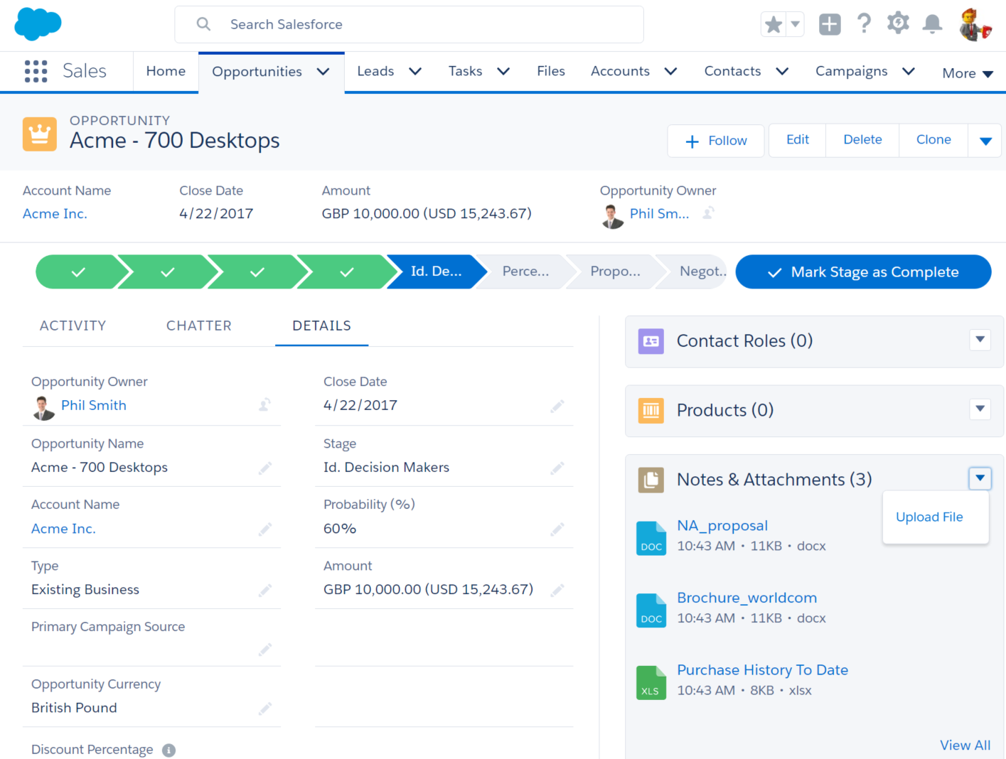


Ajout de fichiers Salesforce à un enregistrement
Joignez des fichiers directement aux enregistrements afin de permettre l'accès, la collaboration et la visibilité.
Notes:
Teaching Points
Increase productivity by attaching Salesforce Files to a record, right from the files card. No Chatter? No problem! You can attach Files Connect files and library files too. This change applies to Lightning Experience only.

Slide 33
REJOIGNEZ-MOI
1-1 : Découverte de l'application
Objectif :
Découvrez l'application en passant en revue les principaux objets dans Salesforce que vous venez de parcourir.
5 min
Tâches :
Parcourez la page d'accueil.
Parcourez les onglets et les applications.
Parcourez les enregistrements.
Notes:
Teaching Points
Use the tour to reinforce the terms and concepts just covered and set the students up for the next exercise (treasure hunt). Keep the tour brief, since all terms and concepts will be covered later in the course as well.
Extra Material
Suggestions

Slide 34
C'EST À VOUS
1-2 : Chasse au trésor
Objectif :
Répondez aux questions en utilisant les techniques de navigation qui viennent d'être présentées :
5 min
Combien de comptes commencent par la lettre « A » ?
Combien de comptes commencent par la lettre « U » ?
Où Allison Wheeler a-t-elle obtenu son diplôme de commerce ?
Quel poste Ling Wu a-t-elle occupé avant de rejoindre AW Computing ?
Combien de membres appartiennent au groupe « Beat Targas! » ?
À quel service/division appartiennent-ils ?
Combien de personnes vous suivent dans Chatter ?
Quels nouveaux champs Yuko Ishikawa demande-t-elle pour la présentation de page de sa page Comptes ?
Détenez-vous des fichiers qui ont été chargés dans l'organisation ? Des fichiers ont-ils été partagés avec vous ? Combien ?
Notes:
Teaching Points
These are some questions you can use to get this contest going. Have students work alone, or in groups, or call them up one at a time.
How many accounts begin with the letter “A”? 12
How many accounts begin with the letter “U”? 3
Where did Allison Wheeler get her business degree? Haas School of Business, 1980
What did Ling Wu do before she started at AW Computing? She worked at our main competitor, Targas, for 4 years.
How many members are in the “Beat Targas!” group? 8
What department/division are they in? Everyone (except the admin) is in Global Sales.
How many people are following you in Chatter? 8
Which new fields in Yuko Ishikawa requesting for her Accounts page layout? Region & Zone fields
Do you own any files that have been uploaded into the org? No
Have any files been shared with you? Yes
How many? 3
Extra Material
Suggestions

Slide 35
Module 1 : Naviguer dans l'application
Modèle de données et navigation
Aide et formation

Slide 36
Aide et formation
Aide et formation propose un accès facile à la documentation, des articles de connaissance, des vidéos ainsi que des options de formation. Vous pouvez accéder à la section Aide et formation de deux façons différentes :
Par le lien Aide et formation situé dans l'interface utilisateur. Cette option vous connecte automatiquement au portail, vous permettant de :
Sélectionner votre rôle dans Mes paramètres afin de recevoir l'aide dont vous avez besoin et des suggestions en matière de formation.
Contacter le Service client.
En naviguant vers help.salesforce.com. Cette option ne vous connecte pas automatiquement au portail, mais vous permet de rechercher des articles de connaissances, des meilleures pratiques, des notes de version et plus encore.
Notes:
Teaching Points
The Help & Training portal is a one-stop shop to access knowledge articles, and access the Success Community and the Dreamforce apps.
Note: For a video on the Help and Training link: https://www.youtube.com/watch?v=-v4E4XBxk_8
Users can log into the portal with the Salesforce username and password.
3. The Contact Support button allows users to:
Open a case
Locate a Salesforce Community
Open a Chat window
Phone Support
4. The search improvements let you:
• See Q&A, Ideas, and Known Issues from the Success Community.
• Use additional filters to quickly refine search results.
• Save your filter choices for a more consistent experience.
• View suggested content across all new sources.
Extra Material
Suggestions

Slide 37
Formation et certification
En tant qu'administrateur, il se peut que vous soyez appelé à former les utilisateurs ou à influencer l'adoption de Salesforce par les utilisateurs. De plus, il vous sera utile de surveiller les mises à jour, améliorations et nouvelles fonctionnalités que Salesforce publie trois fois par an.
La formation en ligne, les notes de version et la documentation sont disponibles dans Aide et formation.
Des vidéos de démonstration How-To (Comment faire pour...) sont disponibles à travers toute l'application.
La communauté Trailblazer est un endroit fantastique pour rencontrer d'autres administrateurs, échanger des idées et poser des questions.
Notes:
Teaching Points
You can also access training resources by selecting Training Options from the Services menu at salesforce.com.
Point out all the training resources available on the new Help & Training portal (log in to the Training and Certification org to show the new portal if necessary):
- The Take Training button
- The Training gadget
Extra Material
Suggestions

Slide 38
REJOIGNEZ-MOI
1-3 : Aide et portail de formation
Objectif :
Utiliser le portail Aide et formation pour localiser la documentation et la formation en ligne.
5 min
Tâches :
Localisez la documentation permettant de personnaliser les paramètres de l'interface utilisateur.
Localisez la formation en ligne.
Notes:
Teaching Points
Extra Material
Suggestions

Slide 39
Contrôle des connaissances
Quel élément dans Salesforce se rapproche d'un tableau de données ?
Quels objets standard ont une relation avec l'objet Compte ?
Comment un utilisateur passe-t-il d'un enregistrement de compte à un enregistrement de contact lié ?
Quelles options sont disponibles dans le portail Aide et formation ?
Notes:
Teaching Points
All English ADX201 classes must use the Knowledge Check Manager in place of this slide. Since this is the first time the students have used Knowledge Check Manager, perform the following steps as a Join Me: - From your ADX201 student org, click the Knowledge Check Manager link in the sidebar. - Click the Start link next to Getting Around the App. - Tell the students they have 5 minutes to complete this knowledge check. - Remind them to click Submit Answers when they are finished. 1. What component in Salesforce is similar to a table of data? An object in Salesforce is like a table of data. Each row represents a record and each column represents a field. 2. Which standard objects have a relationship with the Account object? The Account object has a one-to-many relationship with the Contact, Opportunity, and Case objects. 3. How does a user navigate from an account record to a related contact record? A related list allows a user to navigate from an account record (parent) to a related contact record (child). A lookup field allows a user to navigate from a contact record (child) to its related account record (parent). 4. What options are available from the Help & Training portal? The Help & Training portal provides easy access to documentation, knowledge articles, videos, and training. The Take Training option allows users to take self-paced online training and register for instructor-led courses. The Contact Support option allows users to open a case, phone support, ask a question on Salesforce Answers, and submit an idea on the IdeaExchange.

Slide 40
Module 2: Préparation de Votre Organisation Pour Vos Utilisateurs

Slide 41
Module 2 : Préparation de votre organisation pour vos utilisateurs
À la fin de ce module, vous serez en mesure de :
Décrire les informations saisies dans les paramètres de la société.
Configurer l'année fiscale.
Mettre en place et maintenir les devises.
Mettre en place des tâches, événements et calendriers.
Mettre en place Chatter afin d'aider les utilisateurs à collaborer sur des contrats et des requêtes.
Permettre l'accès mobile grâce à l'application mobile Salesforce.
Notes:
Teaching Points
Extra Material
Suggestions

Slide 42
Module 2 : Préparation de votre organisation pour vos utilisateurs
Dans le premier module, nous avons étudié la structure de Salesforce ainsi que les objets standard et leurs relations, et avons appris comment naviguer dans cet environnement. Pendant ce travail, nous nous sommes familiarisés avec la terminologie de base Salesforce et appris comment utiliser au mieux Aide et formation.
Nous allons maintenant nous assurer que Salesforce est correctement configuré à un niveau global afin de permettre à nos utilisateurs d'utiliser correctement le système.
Création du profil d'entreprise
Configuration de l'interface utilisateur
Création des activités et des calendriers
Création des groupes Chatter
Intégration e-mail de l'application mobile Salesforce
Notes:
Teaching Points
Extra Material
Suggestions

Slide 43
Vision d'ensemble
Profil de la société
Paramètres de l'IU, paramètres du calendrier, Chatter
Profil utilisateur
Enregistre-ment utilisateur
Notes:
Teaching Points
Extra Material
Suggestions

Slide 44


Création du profil d'entreprise
John Wiseman Il y a 17 heures
Disposons-nous de suffisamment de licences pour l'ensemble de nos équipes commerciales internationales ?
1 commentaire · 17 affichages
Noah Larkin aime.
Ling Wu Et à mesure que nous ajoutons des utilisateurs, pouvons-nous nous assurer que les paramètres de langue et de date sont corrects pour les utilisateurs hors États-Unis ? J'aime · Il y a 37 minutes
J'aime
Commenter
Partager
Notes:
Teaching Points
Extra Material
Suggestions

Slide 45
Que sont les paramètres de la société ?
DÉFINITION :
Ensemble de données relatives à votre organisation, saisies pour la plupart au moment de la signature du contrat.
Données d'entreprise
Données financières
Données du service client
Nom et adresse
Contact principal
Année fiscale
Horaires d'ouverture
Localisation par défaut
Devises
Vacances
Devise par défaut
Stockage utilisé
Licences disponibles
PARCOURS D'ACCÈS :
Configuration | Paramètres de la société
Notes:
Teaching Points
Extra Material
Suggestions

Slide 46
Que sont les paramètres régionaux ?
DÉFINITION :
Les paramètres régionaux vous permettent de personnaliser l'affichage des données pour des utilisateurs différents en fonction de leur emplacement géographique.
Paramètres
Régionaux
Langue
Fuseau horaire
Localisation
Langue
Fuseau horaire
Formats de date et d'heure
Heures de début/
fin d'événement
Tous les textes
Formats de chiffres
Ordre des noms
Aide en ligne
Heure dans les champs Date/heure
Adresses
Notes:
Teaching Points
Whiteboard examples of Locale differences:
Date format:
mm/dd/yyyy dd/mm/yyyy
Time format:
1:00 PM 1300
Number format:
1,000 = one thousand 1.000 = one thousand
Name format:
First name, Last name Last name, First name
John Smith = Mr. Smith John Smith = Mr. John
Extra Material
Suggestions

Slide 47
Comment les paramètres régionaux fonctionnent-ils ?
Définissez vos paramètres régionaux au niveau société et utilisateur.
Définissez les paramètres régionaux par défaut pour la maison mère de votre organisation.
Les nouveaux utilisateurs héritent des paramètres par défaut de la société.
Modifiez les paramètres régionaux personnels pour chaque utilisateur, tel que requis.
Profil de la société
(Paramètres par défaut)
Paramètres régionaux = Anglais US
Langue = Anglais
Fuseau = PDT
Enregistrement utilisateur
(Personnel)
Paramètres régionaux = Anglais UK
Langue = Anglais
Fuseau horaire = GMT
Paramètres régionaux = Anglais US
Langue = Anglais
Fuseau = PDT
Paramètres régionaux = Japon
Langue = Japonais
Fuseau horaire = JST
Notes:
Teaching Points
Extra Material
Suggestions

Slide 48
REJOIGNEZ-MOI
2-1 : Vérification du profil de la société
Objectifs :
John Wiseman, PDG, veut savoir combien de licences utilisateurs sont disponibles afin de s'assurer qu'il y en a suffisamment à mesure que les équipes commerciales se développent à l'international.
Ling Wu, Vice-présidente des ressources humaines, veut savoir quels sont les paramètres régionaux , de langue et de fuseau horaire par défaut afin de savoir quelles données supplémentaires fournir quand vous créez des utilisateurs hors États-Unis.
5 min
Tâches :
Examinez le profil de la société pour identifier le nombre de licences utilisateur disponibles.
Passez en revue les paramètres de la société et les paramètres régionaux, de langue et de fuseau horaire par défaut.
Notes:
Teaching Points
The System Overview (under the Environments section in the Setup menu) displays the most-used licenses. You could show this as an alternative to going through the company profile. If you click on the number of licences or click Show All, you go through to the company information page.
Extra Material
Suggestions

Slide 49

Année fiscale et devises
Brent Bassi Il y a 12 heures
Maintenant que nous avons configuré toutes les équipes des ventes, vous devriez vérifier ce qui suit : Notre année fiscale débute en janvier et se termine en décembre. Veuillez vous assurer que ceci est correctement configuré dans Salesforce afin que nos rapports correspondent au système de facturation. Nos commerciaux internationaux doivent pouvoir être en mesure de générer des devis et des opportunités dans les devises des clients. Veuillez configurer les euros sans oublier les taux de change.
2 commentaires · 8 vues
J'aime
Commenter
Partager
Notes:
Teaching Points
Extra Material
Suggestions

Slide 50
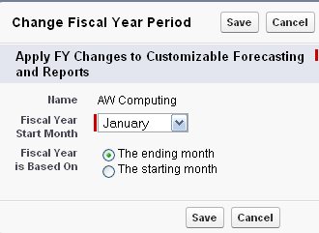
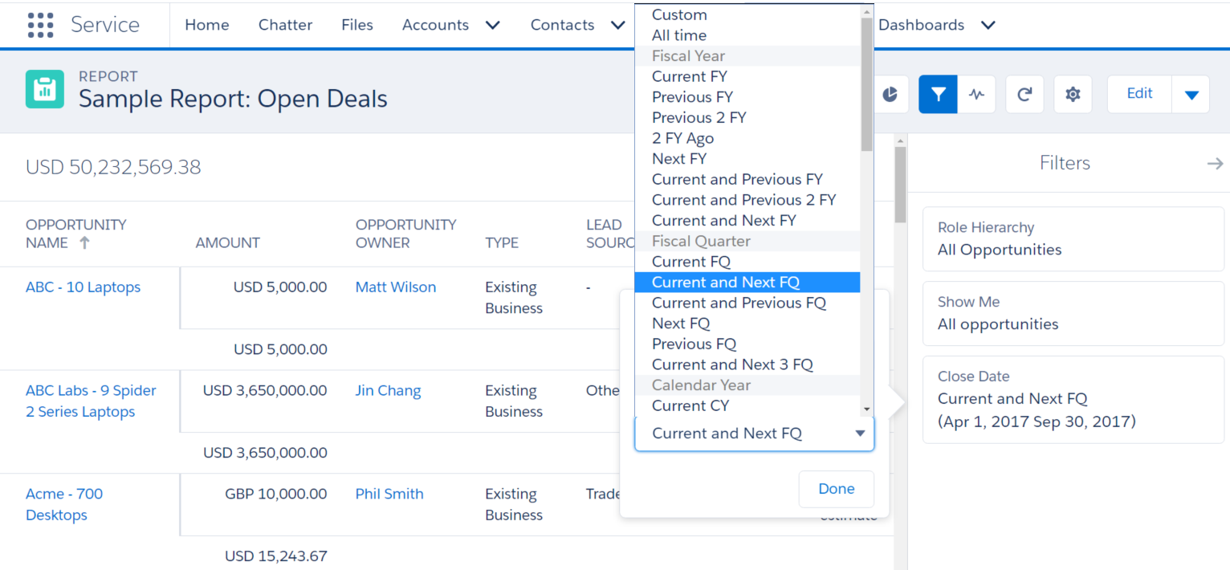
Configurer l'année fiscale
Configurez l'année fiscale de votre organisation dans Salesforce afin de garantir que les rapports et prévisions sont générés avec les bonnes plages de dates.
L'année fiscale standard par défaut suit le calendrier grégorien.
PARCOURS D'ACCÈS :
Configuration | Paramètres de la société | Année fiscale
Notes:
Teaching Points
Extra Material
Suggestions

Slide 51
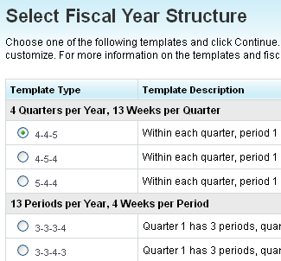
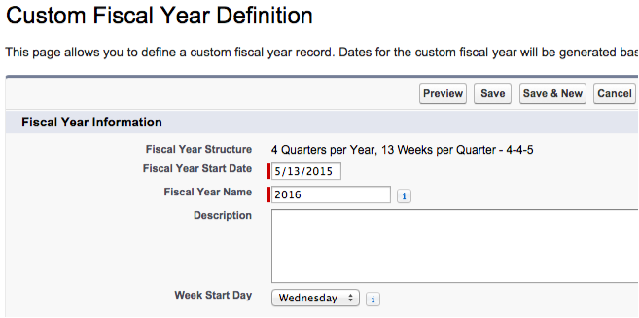
Utiliser une année fiscale personnalisée
Définissez une année fiscale personnalisée pour l'année fiscale de votre organisation si cette dernière ne suit pas le calendrier grégorien. Par exemple, si vous avez :
Une année fiscale à 13 mois.
Des trimestres à 13 semaines.
Une année fiscale qui ne commence pas le premier jour du mois.
REMARQUE :
Rechercher : définir une année fiscale personnalisée
Notes:
Teaching Points
Extra Material
Suggestions

Slide 52
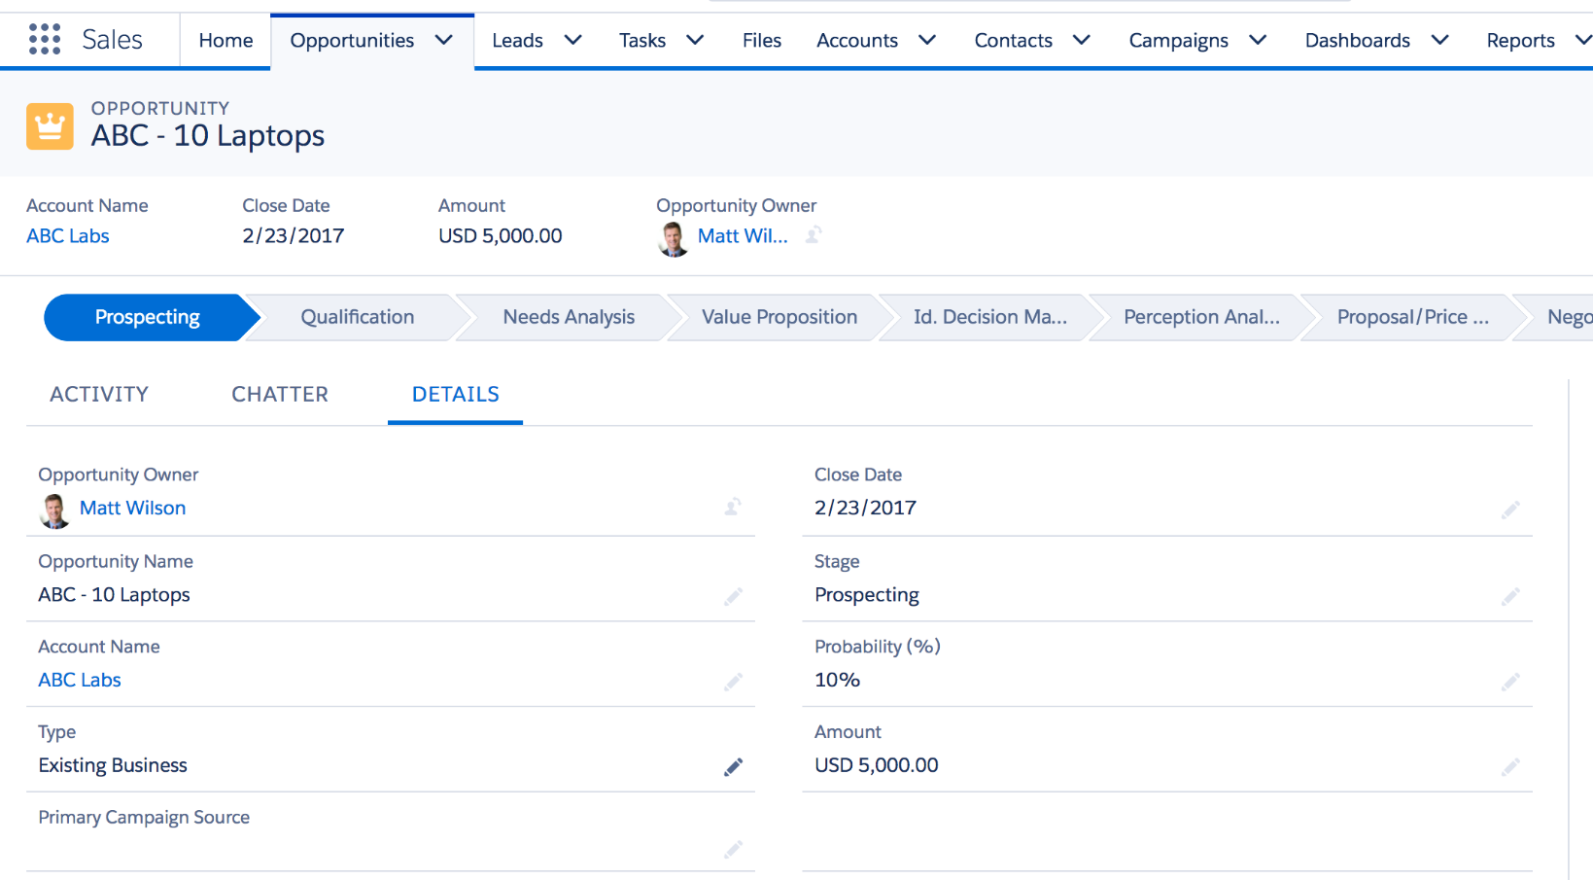

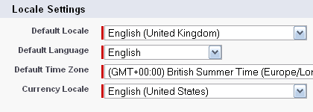
Mettre en place la devise de votre organisation
Par défaut, les organisations Salesforce sont à devise unique. Ceci signifie que :
Vous définissez la paramètre régionaux de la devise dans les paramètres de la société.
Toutes les valeurs de devise dans les enregistrements seront affichées dans la bonne devise.
Notes:
Teaching Points
Extra Material
Suggestions

Slide 53

Travailler avec des devises multiples
Activer des devises supplémentaires.
Les administrateurs définissent la devise de la société et activent de nouvelles devises.
Les nouveaux utilisateurs héritent de la devise de la société mais peuvent définir leur propre devise.
Les nouveaux enregistrements héritent de la devise personnelle d'un utilisateur, qui peut être modifiée.
Les pistes, comptes, contacts, opportunités et requêtes affichent des montants de devises dans la devise de l'enregistrement et en option de l'utilisateur.
Société
(Paramètres par défaut)
USD
Utilisateur
(Personnel)
USD
GBP
JPY
Enregistre-ment
USD
JPY
GBP
EUR
JPY
USD
Notes:
Teaching Points
The display of the converted amount in brackets on a record when the viewing user’s currency is different to that of the record (called Parenthetical Currency Conversion) can be disabled in Setup under Manage Currencies.
Extra Material
Suggestions

Slide 54
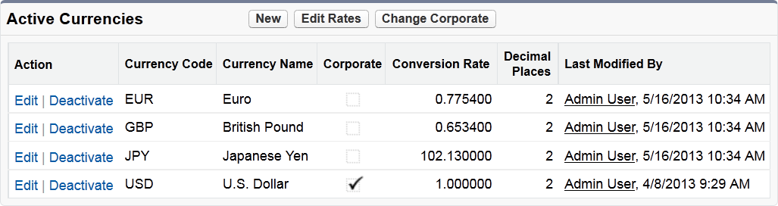
Définir des devises multiples
Les administrateurs doivent :
Définir la devise de la société et activer de nouvelles devises.
S'assurer qu'ils disposent des bonnes devises personnelles.
S'assurer que les utilisateurs utilisent la bonne devise quand ils créent des enregistrements.
PARCOURS D'ACCÈS :
Configuration | Paramètres de la société | Gestion des devises
Notes:
Teaching Points
If this option is not available, administrators have to contact support to enable multi-currency, see help link https://help.salesforce.com/articleView?id=000003638&type=1
Extra Material
Suggestions

Slide 55
REJOIGNEZ-MOI
2-2 : Vérification de l'année fiscale et paramétrage de la devise Euro
Objectifs :
Brent Bassi, Vice-président Finances, vous a demandé de vérifier que l'année fiscale a été configurée correctement. Il a également demandé que vous configuriez l’euro avec le dernier taux de change.
10 min
Tâches :
Assurez-vous que l'exercice fiscal correspond à une année standard commençant le 1er janvier.
Activez la devise euro et ajoutez le taux de change.
Testez la nouvelle devise avec une opportunité et prenez note du montant converti.
PARCOURS D'ACCÈS :
http://www.bloomberg.com/markets/currencies/cross-rates/
Notes:
Teaching Points
Extra Material
Suggestions

Slide 56



Gestion avancée des devises
Brent Bassi Il y a 12 heures
Maintenant que nous avons configuré toutes les équipes des ventes, vous devriez vérifier ce qui suit : Notre année fiscale débute en janvier et se termine en décembre. Veuillez vous assurer que ceci est correctement configuré dans Salesforce afin que nos rapports correspondent au système de facturation. Nos commerciaux internationaux doivent pouvoir être en mesure de générer des devis et des opportunités dans les devises des clients. Veuillez configurer l’euro sans oublier les taux de change.
2 commentaires · 8 vues
Utilisateur administrateur Brent, je confirme que l'année fiscale est configurée comme vous l'aviez demandé. La devise euro est désormais disponible pour nos équipes EMEA et APAC. J'aime · Il y a 2 heures Brent Bassi C'est parfait ! Pourriez-vous mettre les taux de change à jour toutes les semaines ? J'aime · Il y a 1 heure
J'aime
Commenter
Partager
Notes:
Teaching Points
Extra Material
Suggestions

Slide 57
REGARDEZ-MOI
2-3 : Mise à jour des taux de change
Objectif :
Brent Bassi, Vice-président Finances, vous a demandé de mettre les taux de change à jour toutes les semaines.
5 min
Tâches :
Mettez à jour le taux de change.
Affichez l'opportunité de l'exercice précédent et comparez les montants convertis à ceux que vous avez notés.
Notes:
Teaching Points
Extra Material
Suggestions
If you get questions regarding the automation of the exchange rate updates, you can search the AppExchange for “currency rate." You will see AppExchange apps whose sole purpose is that of updating currency rates. Since the AppExchange is introduced much later in the course, you may want to keep the intro to the AppExchange very general and brief.

Slide 58
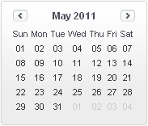
Qu'est-il arrivé à mon opportunité fermée ?
Par défaut, le multi devises ne permet qu'un taux de change par devise. Ceci signifie que quand vous mettez à jour un taux de change, vous mettez à jour la devise convertie dans tous les enregistrements qui utilisent cette devise.
Ceci peut s'avérer indésirable pour les opportunités historiques !
MAI
MAI
MAI
Opportunité fermée
TxCh 0,6859
EUR 10 000
14 579 USD !!!!
Nouvelle opportunité en euros
TxCh 0,6942
EUR 10 000
14 405 USD
Opportunité fermée
TxCh 0,6942
EUR 10 000
14 405 USD
TxCh EUR mis à jour
TxCh 0,6859
Notes:
Teaching Points
Extra Material
Suggestions

Slide 59
Qu'est-ce-que la gestion avancée des devises ?
La gestion avancée des devises vous permet de « verrouiller » efficacement le montant converti des opportunités en fonction de leur date de clôture.
Vous pouvez attribuer une date de début à tous les nouveaux taux de change.
Les opportunités utilisent le taux qui correspond à la date de clôture.
MAI
MAI
MAI
Opportunité fermée
TxCh 0,6942
EUR 10 000
14 405 USD !!!!
Nouvelle opportunité en euros
TxCh 0,6942
EUR 10 000
14 405 USD
Opportunité fermée
TxCh 0,6942
EUR 10 000
14 405 USD
TxCh EUR mis à jour
TxCh 0,6859
PARCOURS D'ACCÈS : Configuration | Paramètres de la société | Gestion des devises | Activer
Notes:
Teaching Points
Extra Material
Suggestions

Slide 60
REJOIGNEZ-MOI
2-4 : Mise à jour du taux de change en euro avec la gestion avancée des devises
Objectif :
Vous devez être en mesure de mettre les taux de change à jour toutes les semaines sans affecter les opportunités historiques.
5 min
Tâches :
Activez la gestion avancée des devises.
Mettez à jour le taux de change de l'euro en utilisant le premier jour du mois suivant comme Date de début.
Modifiez la date de clôture de l'opportunité en euros afin d'observer comment les montants convertis se modifient en fonction des taux de change respectifs.
Notes:
Teaching Points
Extra Material
Suggestions

Slide 61
Module 2 : Préparation de votre organisation pour vos utilisateurs
Création du profil d'entreprise
Configuration de l'interface utilisateur
Création des activités et des calendriers
Création des groupes Chatter
Accès mobile avec l'application mobile Salesforce
Intégration e-mail Salesforce
Notes:
Teaching Points
Extra Material
Suggestions

Slide 62


Les pages d'accueil personnalisées améliorent l'expérience client
Noah Larkin Il y a 7 heures
Notre équipe Service client a récemment participé à un sondage et est tombée sur ces demandes concernant sa page d'accueil : Grand graphique contenant toutes les requêtes par agent et par statut Graphique plus petit contenant toutes les requêtes réparties par produit Les cinq requêtes les plus récentes Publications Chatter dans lesquelles le commercial est @mentionné Les tâches du jour et les événements à venir Lien permettant de quitter le site Salesforce Trust Pouvez-vous prendre cela en charge ? #merci
1 commentaire · 15 affichages
Robin Kramer, Cara Ng et Seema Kumar aiment.
Juan Garcia Ça serait vraiment bien, merci Noah ! J'aime · Il y a 45 minutes
J'aime
Commenter
Partager
Notes:
Teaching Points
Extra Material
Suggestions

Slide 63
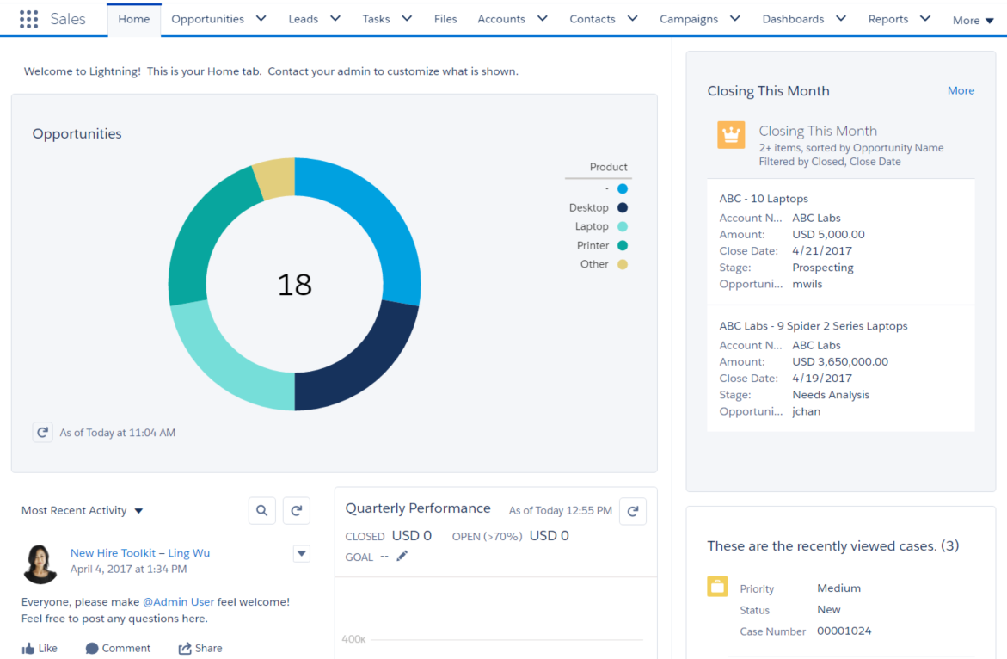

Page d'accueil
La page d'accueil est une zone de dessin polyvalente qui met à avant pour vos utilisateurs les mises à jour, détails et synthèses avec les composants Lightning.
Appliquer des composants Lightning standard ou personnalisés
Mettre à jour les propriétés des composants
Attribuable aux profils utilisateurs
Notes:
Teaching Points
Reference Slide Only – This should be shown in the application.
Extra Material
Suggestions

Slide 64
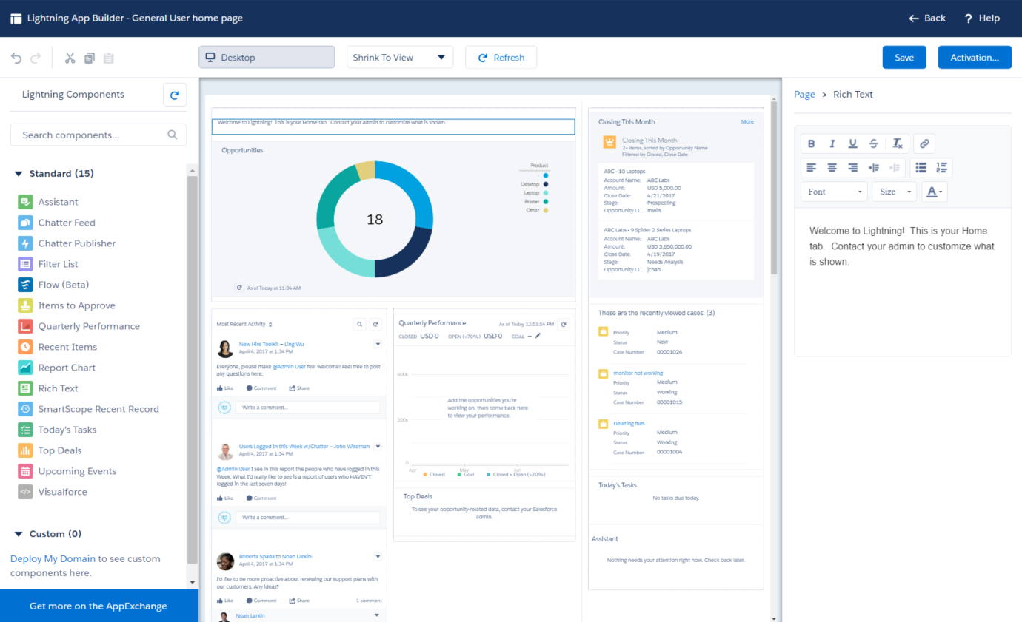



Personnaliser la page d'accueil avec le générateur d'application Lightning
N'oubliez pas d'activer quand vous avez terminé !
Appliquez les composants standard et personnalisés.
Mettez à jour les paramètres des composants.
Glissez déposez les composants.
PARCOURS D'ACCÈS : Configuration | Interface utilisateur | Générateur d'application Lightning

Slide 65
REJOIGNEZ-MOI
2-5 : Personnaliser la page d'accueil
Objectif :
Noah Larkin, Vice-président Services, a reçu des commentaires sur ce que la page d'accueil de l'équipe Service client devrait contenir. Créez une nouvelle page d'accueil à partir de ces informations.
10 min
Tâches :
Ajoutez une nouvelle page d'accueil qui répond aux exigences de l'équipe Service client.
Testez la nouvelle page d'accueil.
Notes:
Teaching Points
Extra Material
Suggestions

Slide 66


Utiliser la vue de liste pour des meilleurs résultats
Conner McCoy Il y a 4 heures
Le service marketing est actuellement en train de cibler des comptes dans le secteur de la technologie et de la fabrication. À part exécuter un rapport, comment mon équipe peut-elle avoir accès à des listes simples portant uniquement sur ces secteurs ?
1 commentaire · 4 affichages
Lorenzo Costa aime.
Samir Patel @Conner, ne pas passer d'un rapport à l'autre constamment serait un gain de temps précieux. J'aime · Il y a 12 minutes
J'aime
Commenter
Partager
Notes:
Teaching Points
The marketing team often target customers based on their industry, but they are not successful when they search for accounts by industry. For example, doing a global search for “technology” returns only accounts with “technology” in the name or description.
Extra Material
Suggestions

Slide 67
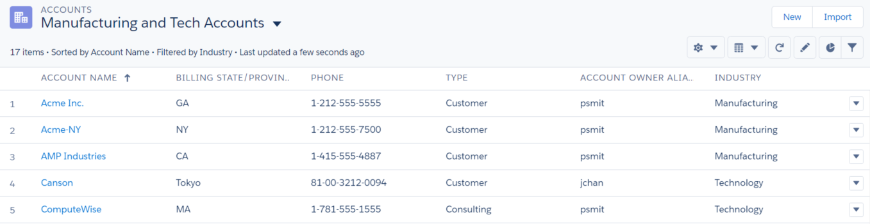
Comment les vues de liste peuvent-elles avantager vos utilisateurs ?
Créez des vues de liste pour les recherches fréquentes. Vous pouvez :
Enregistrer les vues de liste pour des utilisations futures.
Filtrer sur un champ spécifique ou des champs.
Spécifier quels groupes d'utilisateurs ont accès à la vue de liste.
Afficher sous forme de grille ou de Kanban. Sélectionner l'affichage du graphique.
Modifier les enregistrements dans la vue de liste.
Notes:
Teaching Points
A major difference between list views and global search is that list views allow for a greater degree of accuracy since you can choose which fields to filter on.
We’ve already talked about list views when setting up the UI, but remind students that:
Mass edit NOW available in Lightning!
Certain fields cannot be edited in list views, for example “life-cycle” fields such as Stage and Status.
Point out that “Create and Customize List Views” permission allows administrators to control which users can create and modify their own personal list views. All standard profiles have this permission by default but you can remove it if you need to restrict certain users to a shared set of centrally-managed list views.
Extra Material
Points to help instructors transition from ADM201 to ADX201:
You cannot drag and drop to customize the order of the headers.
There is no option to sort by a column and then jump through the alphabet.
Contact Name sorts by First Name and not by Last Name.
List view sharing does not allow to share with particular roles, groups, etc.
You can't follow from list views.
Suggestions

Slide 68
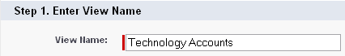
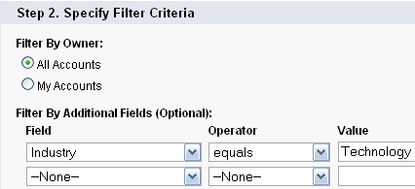
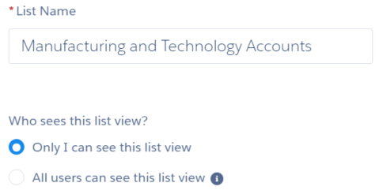
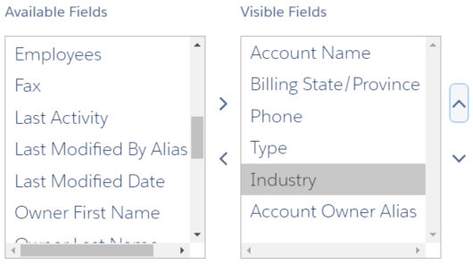
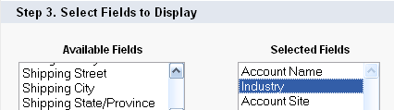
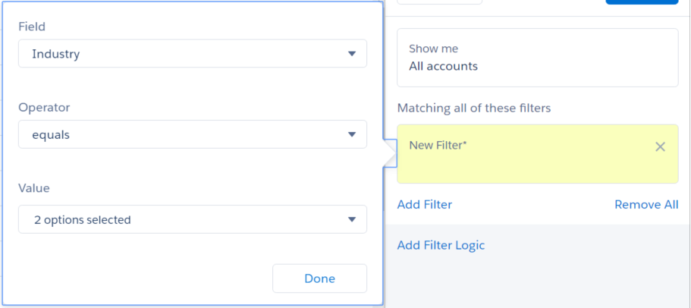
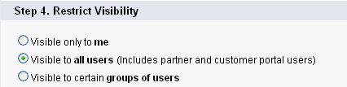
Création d'une vue de liste
1. Saisissez un nom approprié et une visibilité.
3. Sélectionnez jusqu'à 15 colonnes.
2. Spécifiez jusqu'à 10 filtres.
PARCOURS D'ACCÈS : Objet | Contrôles de vue de liste | Créer une vue
Notes:
Teaching Points
Reference Slide Only – This should be shown in the application.
Extra Material
Suggestions

Slide 69
REJOIGNEZ-MOI
2-6 : Création d'une vue de liste des comptes liés au secteur de la fabrication et des technologies
Objectif :
Le service marketing est en actuellement en train de cibler des comptes dans les secteurs de la fabrication et de la technologie. Il doit avoir un accès rapide et régulier à ces comptes.
5 min
Tâche :
Créez une vue de liste pour afficher les comptes appartenant aux secteurs de la fabrication et des technologies.
Notes:
Teaching Points
Extra Material
Suggestions

Slide 70
Module 2 : Préparation de votre organisation pour vos utilisateurs
Création du profil d'entreprise
Configuration de l'interface utilisateur
Création des activités et des calendriers
Création des groupes Chatter
Accès mobile avec l'application mobile Salesforce
Intégration e-mail Salesforce
Notes:
Teaching Points
Extra Material
Suggestions

Slide 71


Création des activités et des calendriers
Allison Wheeler Il y a 2 heures
Chaque commercial doit suivre les e-mails, réunions et tâches relatifs à ses comptes et contacts. J'aimerais aussi voir ce que mes commerciaux ont prévu dans leurs calendriers. Pourriez-vous vous assurer que nous disposons de cette capacité ?
1 commentaire · 5 affichages
Courtney Brown aime.
Courtney Brown Les rapports d'activité faciliteraient également le travail du service Opérations commerciales. Pouvons-nous mettre cela en place ? J'aime · Il y a 23 minutes
J'aime
Commenter
Partager
Notes:
Teaching Points
Extra Material
Suggestions

Slide 72





Que sont les activités ?
Marquées comme complétées par l'utilisateur une fois terminées.
À faire
Créées par l'utilisateur
Journal d'appels
Créées par l'utilisateur
Créées par le système pendant la fusion du courrier
Créées en tant que tâches complétées :
Date d'échéance = Date de création.
Tâches
Fusion du courrier
Créé par le système lors de l'envoi d'un e-mail à partir de Salesforce
ou l'ajout d'un e-mail depuis Outlook
E-mail
Automatiquement marqué comme terminé une fois la date de début atteinte.
Interactions programmées par l'utilisateur, avec une date de début et de fin qui apparaissent sur les calendriers.
Événements
DÉFINITION :
Les activités correspondent aux interactions entre votre organisation et des enregistrements tels que vos comptes, vos contacts et vos opportunités. Elles peuvent faire référence à des tâches ou à des événements.
Notes:
Teaching Points
This is intended as a high-level overview. Make the following points:
A lot of people think of tasks as just to dos or reminders. But in Salesforce a completed task is created for logged calls, mail merges, and emails.
Tasks have a Due Date, which is set to the current date when a user marks it as complete. For calls, mail merges, and emails, the Due Date is the date the task is created.
Events have a start and end date. When the start date is reached, the event becomes completed automatically.
Extra Material
Suggestions
Summarize this information in a table on the whiteboard as below. (Note: Go to Notes Page View to see table.) You can then refer back to this table when you are going through the Filtering Records by the Last Activity Field slide.

Slide 73
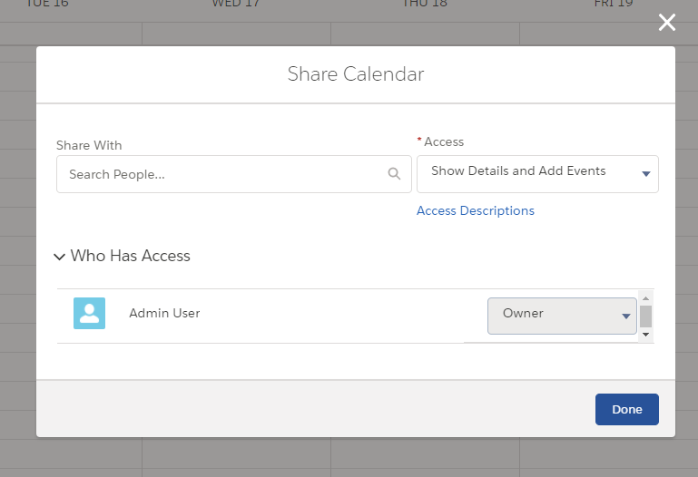
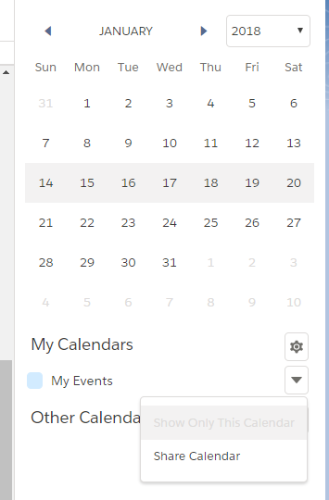
Calendriers personnels
Chaque utilisateur dispose d'un calendrier personnel. L'administrateur définit l'accès aux calendriers personnels dans Contrôles de sécurité.
Les utilisateurs individuels accordent ensuite l'accès à des utilisateurs spécifiques.
PARCOURS D'ACCÈS : Configuration | Sécurité | Paramètres de partage
Notes:
Teaching Points
**this is where we set OWD – it will be in Teaching Points in OWD as well**
Hide Details - Users can only see availability.
Hide Details and Add Events - Users can see availability and add events.
Show Details - Users can view the details of events, but they cannot add events or edit existing events.
Show Details and Add Events - Users can view the details of events and add events, but they cannot edit existing events.
Users can grant wider access to calendar data; they cannot restrict it to less than the OWD settings.
Extra Material
As of Winter 18, users can share their personal calendars in Lightning.
You can share your My Events calendar with your manager or other coworkers, but not with personal and public groups or roles.
When you share your calendar, you can control whether coworkers see event details or add events, but you cant give coworkers full access to edit your events.
You can share calendars that you created from Salesforce objects
Managers in the role hierarchy can use reports to view events owned by people below them in the role hierarchy, but not to edit them.
Only one person can own a meeting. If you reassign a meeting, it no longer appears on your calendar.
Suggestions

Slide 74
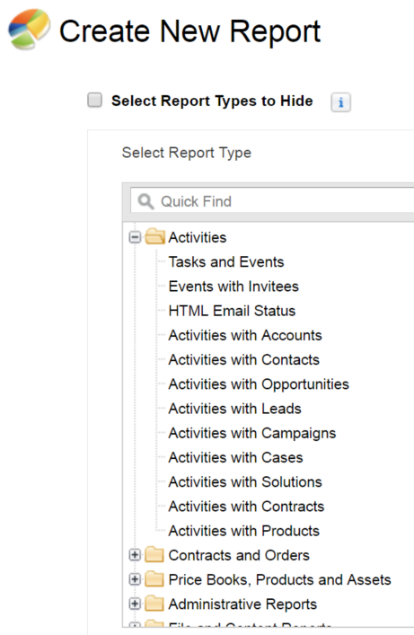
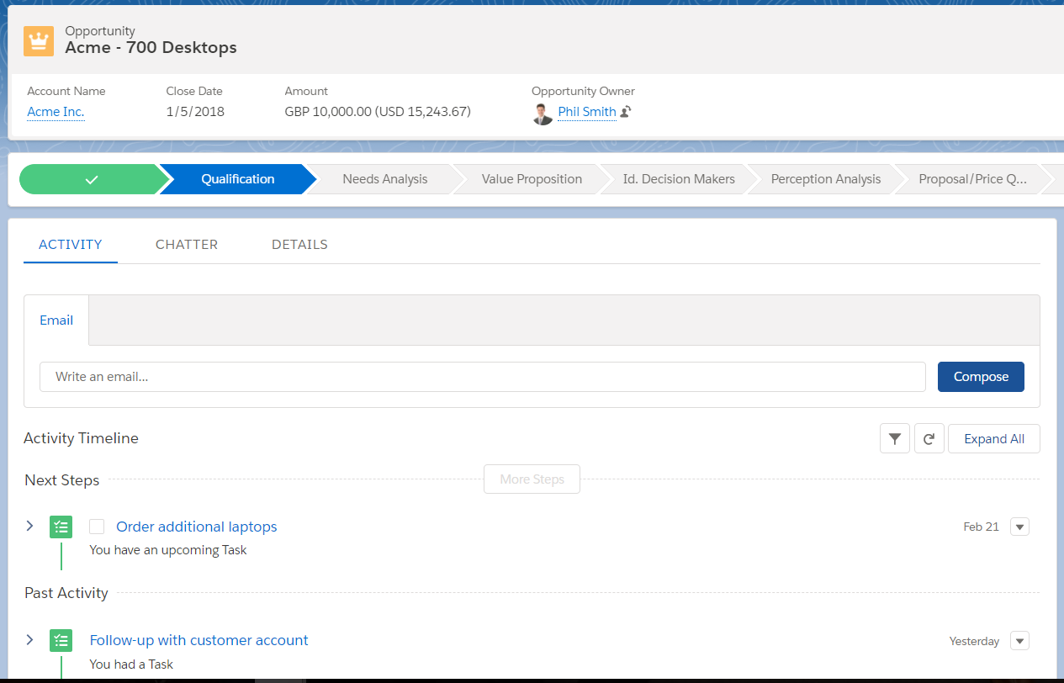

Tâches, événements et e-mails dans Salesforce
Les tâches correspondent à votre liste de tâches. Les événements font référence à ce qui apparaît dans votre calendrier. Associez des tâches et événements à des contacts, des requêtes et des opportunités afin d'obtenir une vue complète de l'ensemble des activités sur vos comptes.
Exécutez des rapports d'activités standard (ou rédigez les vôtres) afin de mesurer et surveiller les activités.
Les tâches et les événements actuels et passés sont suivis dans le Flux d'activités.
Notes:
Teaching Points
Custom and Standard Objects can have related Activities.
Activities created on Opportunities, Cases, and Contacts roll up to the Account Activities related lists for a 360-degree view of Accounts.
Tasks have to be closed/completed manually.
Events have a date and time element. They automatically close when the time of the event passes.
Events are attached to your calendar.
Note: There is no Activities tab. However, there is a Tasks tab and Calendar tab in Lightning.
Extra Material
Suggestions
Exercise
Create a task on an opportunity record and save it. Show the Open Activities related list on the Opportunity and the Account – showing that activities will roll up to the account so you can get a total account view.
Close the task on the Opportunity. Show that it moved from Open to History on both the Opportunity and the Account.
Run the standard Tasks and Appointments report to show open and completed Activities.

Slide 75
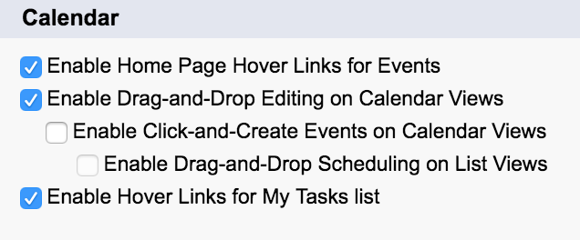
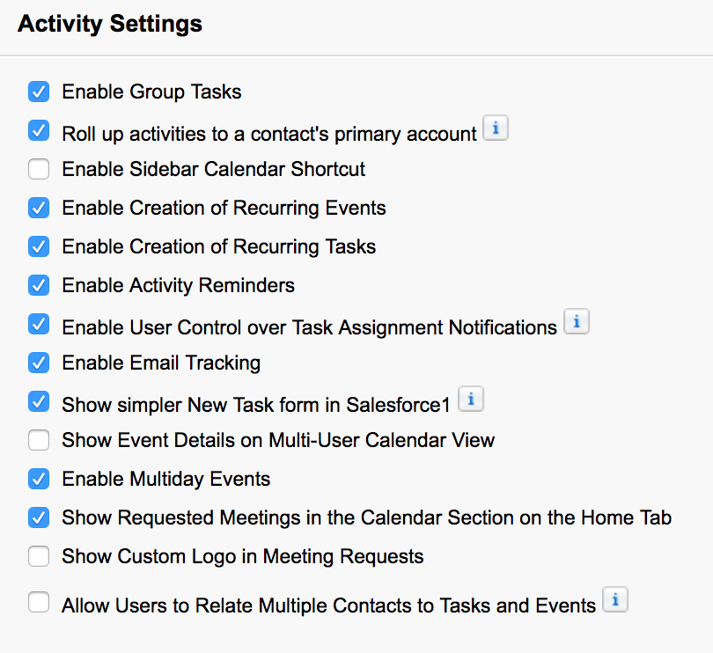
Paramètres de calendrier et d'activité
PARCOURS D'ACCÈS : Configuration | Interface utilisateur | Interface utilisateur
Les paramètres d'activité sont accessibles dans deux zones différentes du menu Configuration.
Les options d'interaction des utilisateurs pour les calendriers sont définies dans la section Calendrier, dans Interface utilisateur.
Les fonctionnalités Détail, tâches et événements du calendrier, telles que les tâches récurrentes, les tâches de groupe, etc. sont définies dans Paramètres d'activité.
PARCOURS D'ACCÈS : Configuration | Paramètres de fonctionnalité | Ventes | Paramètres d'activité
Notes:
Teaching Points
Point out the last option on Activity settings, which allows users to add up to 50 contacts to tasks and events. Warn students that if they enable this feature:
It may take from several minutes to 48 hours to complete if they have a high volume of activities.
The process cannot be interrupted.
They can continue working, and return to this page to see the status.
They will receive an email when complete.
Once enabled, to disable this feature they will have to contact the salesforce.com Support team.
Extra Material
Suggestions

Slide 76
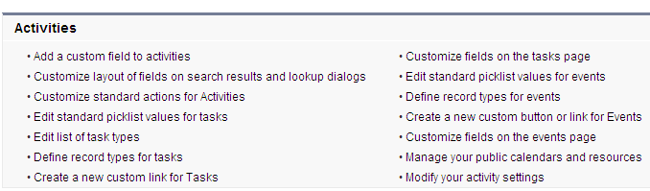
Personnalisation d'activités
Les tâches et les événements sont des activités.
Ils peuvent être personnalisés comme n'importe quel autre objet.
Des champs personnalisés peuvent être créés pour toutes les activités et intégrer des règles de workflow, des types d'enregistrements et des présentations de page.
Il n'y a pas d'onglet Activités. Il existe, toutefois, un onglet Calendrier et un onglet Tâches dans Lightning.
PARCOURS D'ACCÈS : Configuration | Objets et champs | Gestionnaire d'objet
Notes:
Teaching Points
Clarify here that tasks and events ARE activities.
Extra Material
Suggestions

Slide 77
Module 2 : Préparation de votre organisation pour vos utilisateurs
Création du profil d'entreprise
Configuration de l'interface utilisateur
Création des activités et des calendriers
Création des groupes Chatter
Accès mobile avec l'application mobile Salesforce
Intégration e-mail Salesforce
Notes:
Teaching Points
Extra Material
Suggestions

Slide 78

Amélioration de l'expérience utilisateur avec Chatter
Tous les employés occupant un poste de vice-président ainsi que le PDG viennent à peine de rentrer d'un séminaire de trois jours à l'extérieur. L'amélioration de la communication a été le sujet prioritaire.
Séminaire de trois jours à l'extérieur : améliorez la communication !
Informez la direction des problèmes aussi tôt que possible.
Partagez des connaissances et des expériences entre équipes, services et personnes externes à AW Computing.
Trouvez des solutions pour limiter le nombre de pièces jointes volumineuses et redondantes.
Notes:
Teaching Points
Make sure you are up-to-date with the latest Chatter features. New features are introduced in each new release, so make sure you’ve read the release notes.
Extra Material
Suggestions

Slide 79





Qu'est-ce que Chatter ?
REMARQUE :
Chatter permet à vos employés de collaborer avec des collègues sur des fichiers et des enregistrements. Chatter est automatiquement activé dans l'ensemble des nouvelles organisations.
Suivre
Des personnes, des enregistrements, des dossiers
J'aime
Des publications
Télécharger
Des fichiers
Associer
Des liens internes et externes
Commenter
Des publications, des enregistrements
Rédiger un commentaire...
Joindre
Des fichiers à des publications, des enregistrements
ATTENTION :
Demandez à Salesforce d'activer Chatter en fonction du profil pour votre organisation si vous souhaitez uniquement que certains groupes d'utilisateurs accèdent à Chatter.
Notes:
Teaching Points
Chatter is enabled by default.
Demonstrate some Chatter features in the org. Show Chatter in the app menu, as well as a tab in the app.
Using Chatter to communicate you can:
Comment directly on an object, file, profile, or group using Chatter.
Follow groups, records and people. Record followers receive notice when certain field values change, as well as when posts or comments are made to the record. Note that administrators determine which objects can be followed, and which fields on those objects will generate a change notification.
Like comments, posts, and files.
Download files from Groups and personal profiles.
Comment on posts.
Attach files to Chatter posts.
4. You can request Salesforce to enable profile-based rollout of Chatter in your org. This means that administrators can give access to Chatter to users based on their profile, rather than a global setting which turns Chatter on or off for all users.
Extra Material
Documentation on how to turn on Chatter if it is not already turned on in your organization:
https://help.salesforce.com/HTViewHelpDoc?id=collab_enable.htm&language=en_US
Chatter: What’s Different or Not Available in Lightning Experience:
https://help.salesforce.com/articleView?id=lex_gaps_limitations_collaboration.htm&type=0

Slide 80
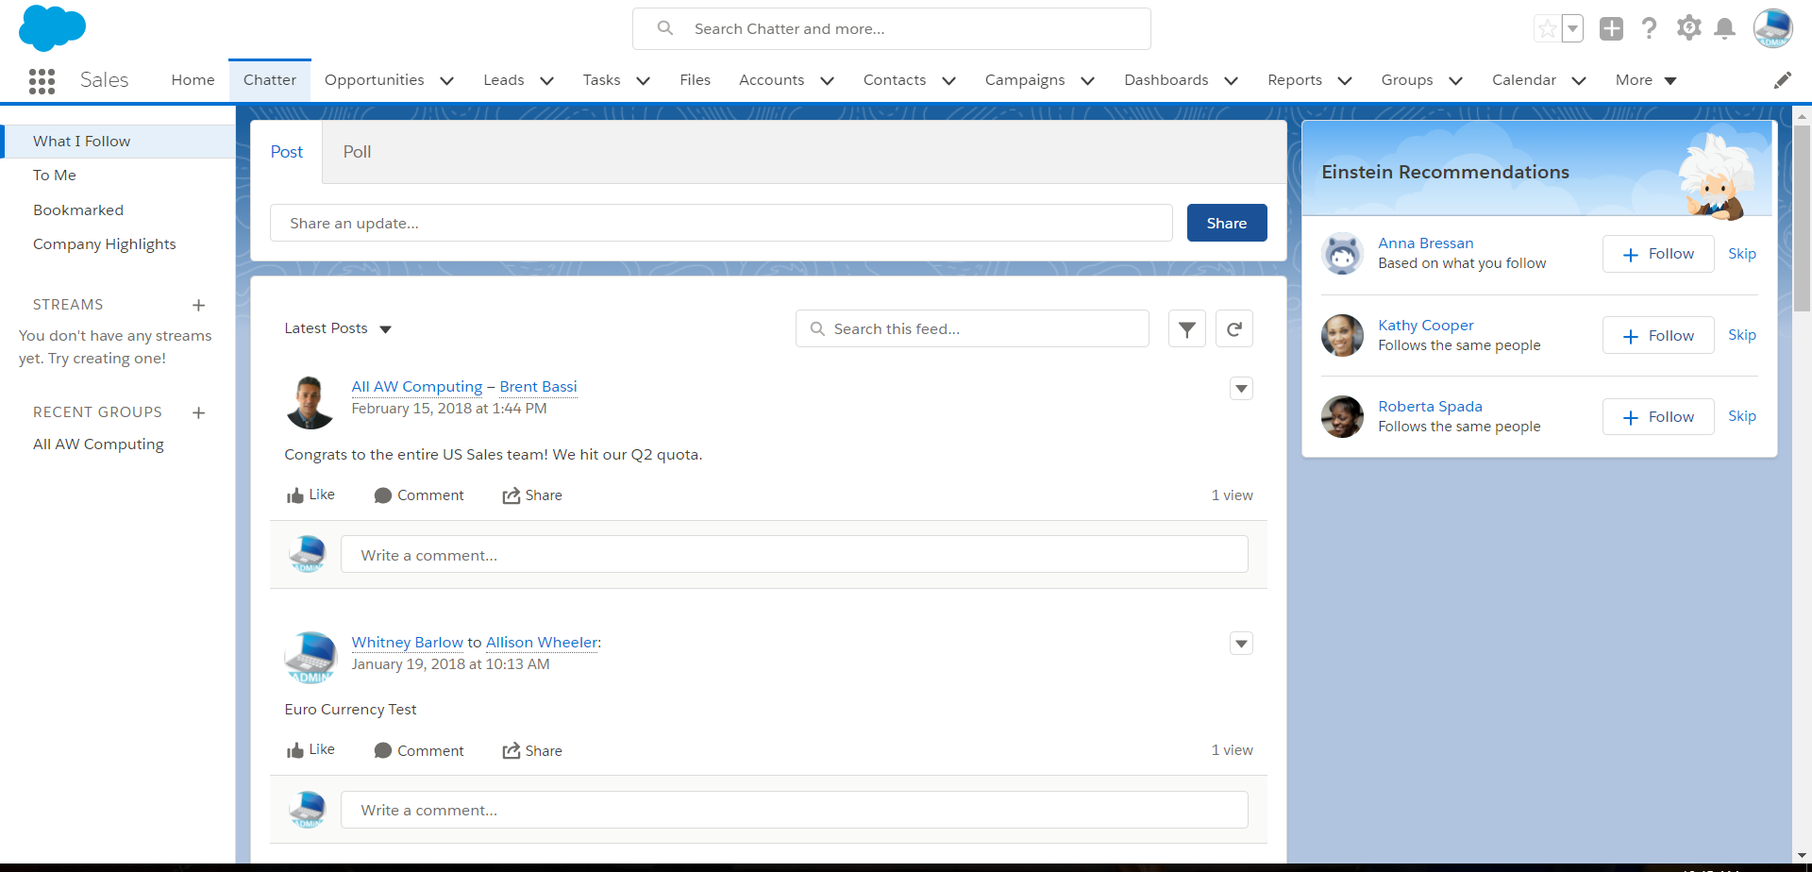



Page d'accueil de Chatter
Filtres de visualisation du fil
Catégories organisées des éléments suivis
Les recommandations apparaissent uniquement sur la page d'accueil de Chatter.
Groupes Chatter récemment consultés
Vue des publications et des réponses Chatter
PARCOURS D'ACCÈS : cliquez sur l'onglet Chatter.
Notes:
Teaching Points
Chatter Streams: Create personalized feeds with customize streams. Groups, users and records. Chatter Streams allow you to create your own personalized feeds from Groups, People, and records like opportunities or accounts. Build a Stream with your largest opportunities or highest priority cases or put them all into one Stream - it’s up to you.
Extra Material
Suggestions
View Chatter Home in Lightning

Slide 81
Administration de Chatter
REMARQUE :
Chatter est sécurisé et fonctionne en respectant tous les paramètres de sécurité et d'autorisation de votre organisation Salesforce !
En tant qu'administrateur, vous pouvez :
Accorder aux utilisateurs l'accès à Chatter en fonction de leur profil.
Activer des notifications par e-mail, permettant ainsi l'envoi d'e-mails lors de chaque publication et commentaire Chatter.
Autoriser l'archivage des groupes.
Configurer des invitations, ce qui permet aux utilisateurs d'inviter des non-utilisateurs de Salesforce et des personnes extérieures à votre entreprise à rejoindre la communauté Chatter.
Activer des objets et des champs pour suivre des fils, en alertant les suiveurs de toutes les modifications apportées aux enregistrements qu'ils suivent.
Chaque utilisateur contrôle la réception de notifications par e-mail dans la zone de ses paramètres personnels.
PARCOURS D'ACCÈS : pour activer et administrer Chatter :
Configuration | Paramètres de fonctionnalité | Chatter | Paramètres Chatter
Notes:
Teaching Points
Rich link previews are powered by Embed.ly, a third-party service. They include thumbnails, descriptions, and video players for links to videos, on services such as YouTube, Vimeo, and Mashable. The setting is enabled by default. If you disable it, users can only preview videos from the YouTube community.
Enable objects and fields for feed tracking, alerting followers to any changes made to records they follow. The following objects are automatically enabled for feed tracking: Account, Case, Chatter Group, Contact, Lead, Opportunity, User. Each has different fields that are enabled for tracking.
You can also preview linked content from:
bloomberg.com
box.com
engadget.com
en.wikipedia.org
google.com/finance
huffingtonpost.com
marketwatch.com
npr.com
scribd.com
Extra Material
Suggestions
Open up Chatter settings so you can point out these options as you go through them.

Slide 82
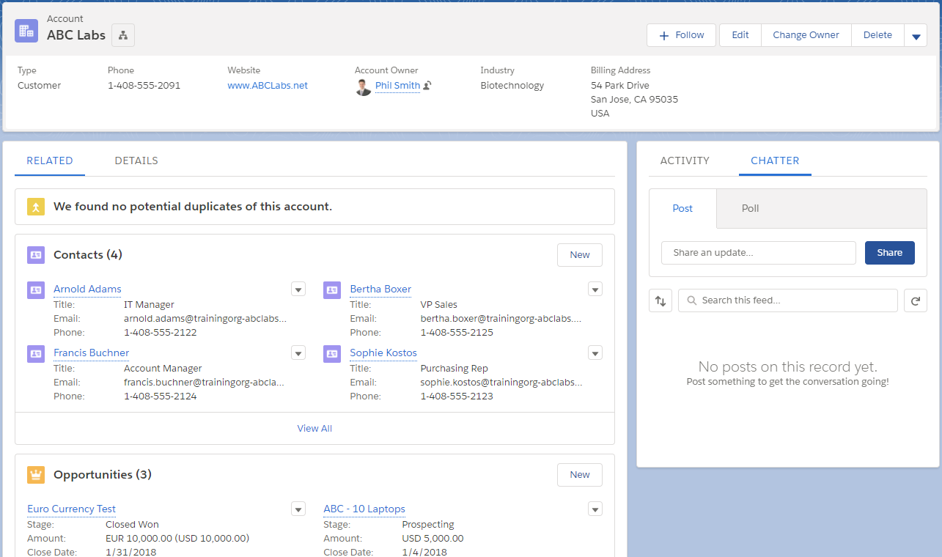

Suivi d'enregistrements dans Chatter
REMARQUE : les publications Chatter liées à des enregistrements s'affichent dans le Fil Chatter et sont visibles par toutes les personnes bénéficiant d'un accès à l'enregistrement d'objet.
Enregistrement d'objet
Rédaction d'une nouvelle publication.
Recherche de publications passées.
Commentaires sur des publications existantes.
REMARQUE : la fonctionnalité de suivi du fil doit être activée afin que les utilisateurs puissent consulter les mises à jour du Fil Chatter liées aux enregistrements qu'ils suivent.
Notes:
Teaching Points
Only objects with feed tracking enabled will have associated Chatter posts visible in the Chatter feed.
To enable feed tracking for objects: Setup | Feature Settings | Chatter | Feed Tracking
All organizations that have Chatter automatically enabled will have the following objects and fields tracked by default:
Account: Account Name, Account Owner
Case: Case Owner, Priority, Status
Chatter Group: Allow Customers, Description, Group Access, Information Body, Information Title, Name, Owner Name
Contact: Account Name, Contact Owner, Name
Lead: Lead Owner, Lead Status, Name
Opportunity: Amount, Close Date, Opportunity Name, Opportunity Owner, Stage
Topic: Description
User: About Me, Address, E-mail, Manager, Phone, Title

Slide 83
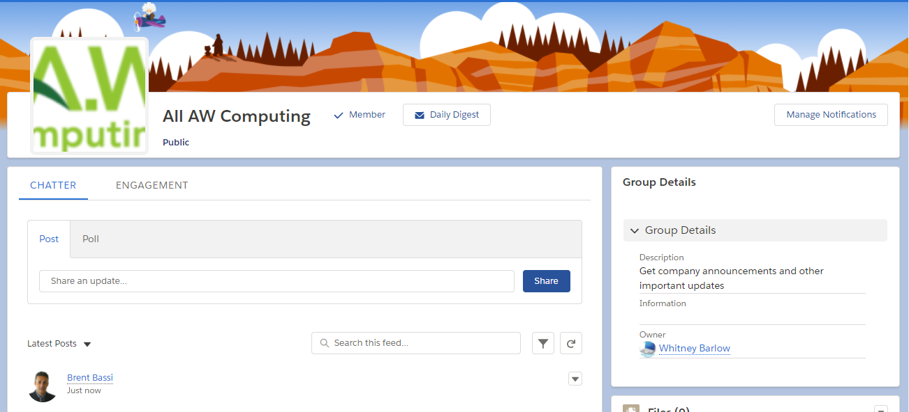

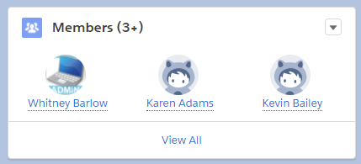
À quoi correspondent les groupes Chatter ?
Les groupes sont une fonctionnalité performante de Chatter que les utilisateurs peuvent créer. Les utilisateurs d'un groupe Chatter peuvent :
Collaborer dans un groupe privé, public ou non répertorié.
Utiliser des Annonces pour des messages importants.
Publier des mises à jour, des fichiers et des liens.
Inclure des clients dans des groupes privés.
Réduire le nombre d'e-mails du groupe.
Réduire les pièces jointes.
Informations et description du groupe.
Mesure de l'activité.
Publication de mises à jour, de fichiers, de liens, de sondages, etc.
Ajout et gestion de membres.
Notes:
Teaching Points
Users can access groups either from the sidebar on the Chatter tab, or from the Groups tab.
Every user with the “Create and Own New Chatter Groups” permission has the ability to create a group and add members. This permission is on by default in all standard profiles except Chatter External User.
Each group has 1 owner and can have several managers, who can add other members, delete posts and comments, and edit the group settings.
The Engagment tab displays the group name, number of members, date of last activity, and group owner, making it easy to target inactive groups that should be deleted.
Non-members can post to a group feed, and users can search within a group feed (click magnifying glass button at top of group feed page).
Users with the Modify All Data permission can access private groups they are not a member of.
Unlisted groups offer more privacy compared to private groups, because only members and users with the “ Manage Unlisted Groups” permission can access unlisted groups in list views, feeds, and search results. These must be enabled Setup | Customize | Chatter | Settings
Broadcast Only Groups can be created by going to the group settings for any public, private, or unlisted group and selecting Broadcast Only. By restricting the ability to post, group owners and managers can keep group discussions focused and relevant by cutting down noise from off-topic posts.
Extra Material
Instructors may want to point out that users may view group member engagement in a convenient report linked from each group. This feature is available in Salesforce Classic only. (Report link is visible in screenshot).
Anyone with permissions can view the group engagement report. Group owners, managers, and other users with permissions (for example, users with the “Modify All Data” and “Manage Unlisted Groups”) can quickly access this report by clicking Show Group Report below the group photo.
Suggestions

Slide 84
REJOIGNEZ-MOI
2-7 : Création de groupes Chatter publics et privés
Objectif :
Créez des groupes Chatter pour remplacer les listes d'e-mail de groupe. Publiez un lien vers une formation et marquez-la à l'aide d'une balise afin que les utilisateurs puissent aisément rechercher des publications concernant des formations.
10 min
Tâches :
Créez des groupes Chatter destinés à Tous les vendeurs (publics) et à Tout le personnel du service client (privés).
Publiez un lien destiné au groupe Tout le personnel du service client pour expliquer comment utiliser les @mentions.
Cliquez sur #formation dans votre publication Chatter pour consulter d'autres conversations dans la société concernant les formations.
Notes:
Teaching Points
When we create Chatter groups to replace email distribution lists, discuss with students how they might send one final email to each list, with a link to the new Chatter group.
Extra Material

Slide 85
Module 2 : Préparation de votre organisation pour vos utilisateurs
Création du profil d'entreprise
Configuration de l'interface utilisateur
Création des activités et des calendriers
Création des groupes Chatter
Accès mobile avec l'application mobile Salesforce
Intégration e-mail Salesforce
Notes:
Teaching Points
Extra Material
Suggestions

Slide 86


Accès mobile avec l'application mobile Salesforce
Ling Wu Il y a 11 heures
Nos commerciaux adorent utiliser l'application mobile Salesforce sur les tablettes de l'entreprise et sur leurs téléphones portables. Nous souhaitons vraiment que l'équipe de recrutement adopte les appareils mobiles afin de pouvoir utiliser leurs données Salesforce lorsqu'ils se trouvent dans des salons consacrés à l'emploi. Pouvez-vous mettre en place cela ?
1 commentaire · 3 affichages
Marcela Lopez aime cette publication.
Marcela Lopez Cela signifie-t-il que nous pouvons enregistrer de nouveaux candidats et mener des entretiens sans nos portables ? J'aime · Il y a 31 minutes
J'aime
Commenter
Partager

Slide 87

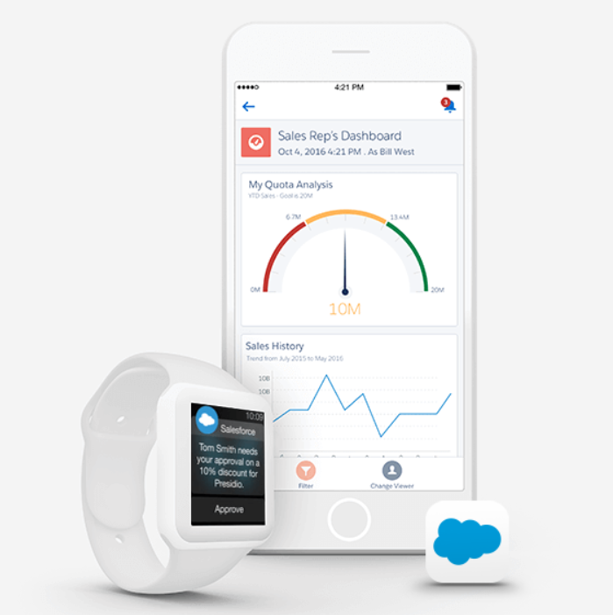


Application mobile Salesforce
REMARQUE :
Permet d'accéder à Salesforce à partir d'appareils mobiles.
L'application mobile Salesforce est accessible sur les appareils suivants :
Smartphones Android, version 4.4 ou ultérieure.
Smartphones et tablettes iOS, version 10 ou ultérieure.
L'application mobile Salesforce est accessible à l'aide d'un navigateur mobile. Consultez Aide et formation pour obtenir la liste des navigateurs pris en charge.
Notes:
Teaching Points:
Users must have the "API Enabled" permission enabled to access Salesforce mobile app.
Extra Materials:
If students would like to learn more, point them to the Getting Started: Administering Salesforce mobile app training available from Help and Training.
If enabled, it can also be accessed through a mobile web browser:
Safari on iOS smart phones and tablets.
Chrome or stock browser on Android phones.
BlackBerry Browser on BlackBerry Z10 devices with BlackBerry OS 10.2 or later.
Good Access browser on Android phones with Android 4.4 or later and iOS phones and tablets with iOS 8 or later.
Stock browser on Windows 8.1 devices.
Suggestions:

Slide 88

Administration de l'application mobile Salesforce
L'application mobile Salesforce a été activée pour toutes les organisations et est administrée à partir d'applications connectées. Ses composants sont installés automatiquement lorsque...
Un utilisateur télécharge et installe l'application et…
S'authentifie auprès de votre organisation en se connectant à l'application mobile.
PARCOURS D'ACCÈS :
Configuration | Applications | Applications connectées
Notes:
Teaching Points
Salesforce mobile app is enabled for all orgs. The Connected App components are installed automatically when one of your users installs a Salesforce downloadable app from the App Store or Google Play on their mobile device and authenticates with your organization by logging in to the mobile app.
Administrators should download and log in to the app to install components automatically in the org.
Extra Material
Suggestions

Slide 89
REJOIGNEZ-MOI
2-8 : Préparez-vous à utiliser l'application mobile Salesforce
Objectif :
Examinez les composants de l'application mobile Salesforce et assurez-vous que tous les utilisateurs d'appareils iOS peuvent s'auto-accorder l'autorisation d'utiliser l'application. Vérifiez les paramètres et répondez à quelques questions concernant les composants.
5 min
Devoirs :
Téléchargez l'application mobile Salesforce sur votre appareil Android ou iOS, et utilisez votre identifiant ADX201 et votre mot de passe pour vous connecter. Préparez-vous à parler de votre expérience demain en classe !
Tâches :
Examinez les composants de l'application mobile Salesforce.
Modifiez le code PIN requis pour accéder à l'application mobile Salesforce à l'aide d'un appareil iOS, et répondez à quelques questions sur la base des informations que vous trouverez dans l'application.
Notes:
Teaching Points
What are the two groups of Permitted Users?
All users may self authorize.
Admin approved users are pre-authorized.
Can you restrict access by IP address?
Yes. You can restrict access to Salesforce mobile app based on IP addresses.
What are the pros and cons of having users log in to the app every time?
Discuss the pros/cons of heightened security vs. user ease and adoption.
Make sure you discuss the homework assignment! Have students download Salesforce mobile app to their mobile devices after they leave class (this is so you don’t have to worry about people using different download speeds, etc., to download, and then potentially distracting them from the material during the remainder of the course). Discuss their experience with them at the beginning of the class on day 2.

Slide 90
Module 2 : Préparation de votre organisation pour vos utilisateurs
Création du profil d'entreprise
Configuration de l'interface utilisateur
Création des activités et des calendriers
Création des groupes Chatter
Accès mobile avec l'application mobile Salesforce
Intégration e-mail Salesforce
Notes:
Teaching Points
Extra Material
Suggestions

Slide 91


Intégration de Salesforce avec Outlook
Grâce à une intégration avec Outlook, vous pouvez :
Consulter des contacts, des pistes, des comptes, des opportunités et des requêtes Salesforce liés à des e-mails Outlook.
Synchroniser des contacts et des événements de calendrier.
Copier des e-mails et des pièces jointes Outlook dans Salesforce.
Rechercher des enregistrements.
Salesforce pour Outlook :
Pour des versions Exchange et Outlook plus anciennes
Nécessite l'installation du logiciel et des mises à jour manuelles de la version
Lightning pour Outlook :
100 % dans le cloud, utilise systématiquement les fonctionnalités de la dernière version (aucune installation ou mise à jour requise)
Affiche les composants Lightning personnalisés à l'aide du Générateur d'application Lightning
Compatible avec l'interface utilisateur Lightning et Classic
Notes:
Teaching Points
(Context: Lightning for Outlook and Salesforce for Outlook integrations built from the Salesforce Microsoft Partnership. )
Since our founding in 1999, Salesforce’s guiding principle for our product, our strategy, and our partnerships has always been maximizing our customers success. Microsoft and Salesforce decided it was time to break down any obstacles between their respective products and usher in a new era of efficiency and effectiveness. For more information on the partnership and other integrations, please go to: www.salesforce.com/microsoft
Suggestions
- Emphasize that Lightning for Outlook works on both Salesforce classic and Lightning experience and where possible.
- Look at using Lightning for Outlook as new features and updates are automatically available to end-users with every release without having to install any new version.
Lightning for Outlook works on:
- Email Server:
- Exchange 2016, 2013 on-premises, or Exchange Online (a part of Office 365)
- Email Application:
- Outlook for Web App (OWA)
- Microsoft Outlook 2013 or 2016 on Windows PC
- Microsoft Outlook for Mac 2016 on Mac
- Available on: Group, Professional, Enterprise, Performance, Unlimited & Developer Editions
Also note that Lightning for Gmail is also available.
Lightning for Outlook (with Office 365) does not sync Contacts and Calendar events. You need to set up Lightning Sync as well.
Extra Material
- More details for setup and system requirements can be found in Documentation.

Slide 92


Lightning pour Outlook
Notes:
Teaching Points
Let’s take a look at the Outlook 2016 that is using Lightning for Outlook. There are a few key things to notice:
The People section is populated with the Salesforce contacts of people associated with the email. Anyone not found can be quickly added into Salesforce without having to toggle between windows.
Adding new contacts is simple - click on the ‘add’ button and it will prepopulate information (First name, last name, email etc)
Jump out button (next to user photo) automatically launches Salesforce if further searches need to be done.
The Accounts section shows Account information of the people involved in this email or calendar event.
The Opportunities and Cases associated with the account can also be shown
Search for Salesforce records and files directly inside of the vertical pane
Calendar events can sync using Lightning Sync – so that they appear in the Salesforce App
Both standard and custom Lightning Components can be adjusted according to different user profiles in the Lightning App Builder. (Partner Lightning Components can be downloaded from the AppExchange.)
Extra Material
Documentation can be found at Salesforce Help: https://help.salesforce.com/articleView?id=app_for_outlook_user_overview.htm
Lightning for Outlook can be downloaded from the Microsoft Store ‘Salesforce Lightning for Outlook’

Slide 93










Salesforce Inbox
DÉFINITION : Salesforce Inbox connecte la messagerie d'un utilisateur à Salesforce afin de synchroniser automatiquement les contacts, les messages et les événements de calendrier avec des enregistrements CRM.
Développé par Salesforce
Connectez le CRM et la messagerie de manière fluide et sécurisée.
Repose sur des informations
Restez au fait de tous les contrats grâce à des notifications proactives.
Se connecte à
l'application mobile Salesforce
Disponible dès aujourd'hui
⁺15 %
d'augmentation des contrats tous les mois
⁺21 %
d'accélération des cycles de vente
⁺25 %
de productivité des commerciaux
⁺38 %
d'amélioration en termes d'adoption du CRM
Notes:
Talk Track
At its core, Salesforce Inbox brings the power of Salesforce – the World’s #1 CRM platform – to where sales reps work every day, their email inbox. Inbox is a suite of smart email applications – available on desktop & mobile – for Gmail and Outlook users on Sales Cloud and Service Cloud.
As an app built by Salesforce, Inbox has gone through in-depth security testing, because Trust is our #1 value. We realize that salespeople exchange a lot of sensitive information through email. Inbox is an enterprise-grade application that keeps this information secure.
But this isn't any old email application – Salesforce Inbox is powered by intelligence. With data science, these apps help reps leverage their customer data to sell smarter. For example, Salesforce Inbox analyzes your email and provides proactive notifications that notified reps if they've missed an email from an engaged customer, making sure nothing slips through the cracks.
And lastly, Salesforce Inbox is an app that salespeople love to use. It has an intuitive user interface that eliminates clicks from burdensome tasks, like updating pipeline data or scheduling meetings. With Inbox, reps can close more deals with less work.
Talk Track
But don’t take it from us. We asked our customers, and they agree: Inbox drives sales performance. On average, our customers report a 15% increase in the number of deals closed each month.
How does Inbox create this impact?
First, with Inbox, reps can use sales intelligence to stay on top of every deal, reducing sales cycle times by 21%.
Reps can also use Inbox to reduce the amount of time they spend on low-value administrative tasks like scheduling meetings or replying to email, increasing the amount of time they spend selling by 25%.
Lastly, with CRM in their inbox, it is easy for reps to keep pipeline data up to date, boosting CRM adoption on average by 38%.
Check out Salesforce Inbox and download a free trial today!
About the Customer Survey (if asked)
In May 2016, Salesforce sent out a customer survey to our entire customer base. Some questions received more responses than others.
If asked:
Salesforce Inbox currently supports Gmail, Microsoft Exchange 2013 and 2016, and Office 365, and Android and iOS.

Slide 94
Contrôle des connaissances
Dans quelle partie de l'outil un administrateur peut-il modifier le nom et l'adresse, les paramètres régionaux, linguistiques et de fuseau horaire par défaut de l'organisation ?
Comment un administrateur peut-il personnaliser un exercice fiscal standard ?
Quels paramètres de l'interface utilisateur doit-on activer pour permettre aux utilisateurs de modifier des enregistrements directement dans une vue de liste, sans quitter la page ?
Comment un administrateur peut-il personnaliser une recherche globale pour aider des utilisateurs à trouver rapidement des informations ?
Veuillez citer une fonctionnalité de Chatter.
Dans quelle partie de l'outil un utilisateur peut-il afficher les tâches terminées et les événements passés concernant une opportunité ?
Notes:
Teaching Points
All English classes must use the Knowledge Check Manager in place of this slide. 1. Where can an administrator change the organization name and address, default locale, default language, and default time zone? From the Company Information section, an administrator can modify the organization name and address, default locale, default language, and default time zone. An administrator can also view the unique salesforce.com organization ID, number and types of licenses available, and corporate currency. 2. How can an administrator customize a standard fiscal year? The standard fiscal year follows the Gregorian calendar. The administrator can change the start month of the fiscal year and specify whether the fiscal year is defined by the year it begins or ends. The administrator must use a custom fiscal year if their company does not follow the Gregorian calendar, such as a 13-month fiscal year or a fiscal year not starting on the first day of the month. 3. Which user interface settings must be enabled to allow users to edit records directly from a list view, without navigating away from the page? The Enable Enhanced Lists setting lets users quickly view, customize, and edit list data. The Enable Inline Editing setting lets users quickly edit field values, right on a record’s detail page. When both settings are enabled, users can edit records directly from the list, without navigating away from the page. 4. How can an administrator customize global search to help users quickly find information? An administrator can customize the search settings to set the number of results displayed per page for each object. An administrator can also customize the search layouts for an object to add filters to the search results and control what fields display. 5. What is a capability of Chatter? When an administrator enables objects and fields for feed tracking, people see Chatter feed updates for objects and changes to fields on records they follow. Users can create public or private Chatter groups for sharing information, files, and links. Customers can only be invited to private Chatter groups. People can @mention individual people or a group in a Chatter post. 6. Where can a user view the completed tasks and past events for an opportunity? Completed tasks, past events, and sent emails are tracked in the Activity History related list for a record. Tasks and events that have not yet completed are tracked in the Open Activities related list. In addition, activity reports allow users to analyze tasks and events.

Slide 95
Module 3: Création Et Gestion Des Utilisateurs

Slide 96
Module 3 : Création et gestion des utilisateurs
À la fin de ce module, vous serez en mesure :
D'expliquer l'objet des profils utilisateur.
De créer et de modifier des profils personnalisés.
De créer des utilisateurs et de leur attribuer des profils.
D'inviter des clients dans des groupes Chatter privés.
De résoudre des problèmes de connexion utilisateur.
Notes:
Teaching Points
Extra Material
Suggestions

Slide 97
Module 3 : Création et gestion des utilisateurs
Gestion des profils utilisateur
Gestion des utilisateurs
Création d'utilisateurs et d'invitations Chatter Free
Résolution des problèmes de connexion
Dans le module précédent, nous avons configuré des paramètres à l'échelle de l'organisation qui s'appliquent à tous les utilisateurs, tels que les paramètres régionaux, les devises et l'interface utilisateur par défaut.
Nous allons, à présent, configurer des groupes d'utilisateurs spécifiques et des utilisateurs individuels afin qu'ils puissent consulter et réaliser les tâches requises.
Notes:
Teaching Points
Extra Material
Suggestions

Slide 98
Vision d'ensemble
Profil de la société
Paramètres de l'interface utilisateur
Paramètres de calendrier
Chatter
Profil utilisateur
Enregistrement utilisateur
Notes:
Teaching Points
We have just finished setting up the parameters that apply to the company, and all users. We will now address certain groups of users, and their needs within the org.
Extra Material
Suggestions

Slide 99

Gestion des profils utilisateur
Ling Wu Il y a 11 heures
Mon équipe de recrutement ne peut pas accéder à l'application de recrutement que le consultant qui a réalisé notre mise en œuvre a créée pour nous. Ils ne peuvent pas afficher les objets suivants, dont ils ont besoin : -Candidat -Personne assurant les entretiens -Candidature -Poste Pouvez-vous m'aider ?
1 commentaire · 12 affichages
Daniel Garcia aime cette publication.
Daniel Garcia Ling, nous avons également besoin d'envoyer des e-mails et d'exécuter des rapports. Pouvons-nous obtenir cela également ? J'aime · Il y a 31 minutes
J'aime
Commenter
Partager
Notes:
Teaching Points
Extra Material
Suggestions

Slide 100
Qu'est-ce qu'un profil ?
DÉFINITION :
Un ensemble de paramètres et d'autorisations qui déterminent ce que les utilisateurs peuvent voir dans l'interface utilisateur et ce qu'ils peuvent faire.
Paramètres (ce que les utilisateurs voient)
Autorisations (ce que les utilisateurs font)
Applications
Autorisations de l'application (ex. convertir une piste, importer des solutions)
Onglets
Autorisation système (ex. exécuter des rapports, envoyer des e-mails en masse)
Types d'enregistrements
Objet standard (ex. créer des pistes)
Présentations de page
Champs
Objet personnalisé (ex. modifier des postes)
REMARQUE :
Rechercher : autorisations d'utilisateur
Notes:
Teaching Points
Extra Material
Suggestions

Slide 101

Dans quelle mesure un profil modifie-t-il l'expérience utilisateur ?
Onglets visibles
Ce que les utilisateurs peuvent faire avec les enregistrements d'un objet particulier
Applications visibles
Champs modifiables
Champs visibles
Type d'enregistrement/ présentation de page
Notes:
Teaching Points
When a user is working in Salesforce, pretty much everything they can see and do is determined by their profile.
Extra Material
Suggestions

Slide 102






Profils standard pour se lancer
Les profils standard ne peuvent pas être supprimés et les autorisations ne peuvent pas être modifiées.
Afficher et modifier toutes les données, et personnaliser l'application.
Afficher, modifier et supprimer des enregistrements auxquels ils peuvent accéder.
Utilisateur standard + gérer des solutions publiées.
Administrateur système
Utilisateur standard
Responsable solutions
Utilisateur de Marketing
Responsable du Contrat
Lecture seule
Utilisateur standard + importer des pistes.
Utilisateur standard + gérer des contrats.
Afficher uniquement les enregistrements auxquels ils peuvent accéder.
Notes:
Teaching Points
Standard profiles can be cloned and edited. Great to use as a starting point for custom profiles.
It is best practice to NOT assign standard profiles to users. Instead, even if no changes are to be made, the Standard Profiles should be cloned and the clones assigned to users. That way, should permissions or custom object access be needed in the future, the cloned profiles can be updated easily.
Extra Material
Suggestions

Slide 103




Profils Chatter standard
Les profils Chatter sont exclusivement réservés aux utilisateurs bénéficiant d'une licence utilisateur Chatter Free ou Chatter External et permettent aux utilisateurs de se connecter à Chatter uniquement.
Utilisateur Chatter Free
Utilisateur Chatter External
Utilisateur Chatter Moderator
Accès à l'ensemble des personnes, profils, groupes et fichiers standard Chatter.
Accès aux groupes auxquels ils ont été invités et échange avec les membres de ces groupes.
Accès aux mêmes données que les utilisateurs de Chatter Free.
Activation/désactivation d'autres utilisateurs et modérateurs de Chatter Free.
Octroi/annulation des privilèges de modérateur.
Suppression de publications et de commentaires qu'ils peuvent voir.
Notes:
Teaching Points
We will be covering Chatter users and inviting Chatter users in more detail in the Collaboration module, but provide an overview for students here as you will be encountering these profiles and licenses when you set up new profiles.
Because Chatter Free and/or or Chatter External users cannot access any object details, Chatter profiles include only a very limited number of administrative and general user permissions, and do not include any of the following settings or permissions:
Console settings
Page layouts
Field-level security
Custom app settings
Tab settings
Record type settings
Standard object permissions
Custom object permissions
The Chatter moderator profile’s main functionality was intended for Chatter.com orgs. It would be uncommon in a full CRM org to designate a Chatter Free user as a moderator. It would be more likely that the admin would add the “Moderate Chatter” profile permission to a custom profile.
Extra Material
Suggestions

Slide 104







Création de profils personnalisés
Dans la mesure où vous ne pouvez pas modifier les autorisations sur un profil standard, nous vous conseillons de créer systématiquement des profils personnalisés pour vos utilisateurs. Pour ce faire, clonez et modifiez un profil existant.
Utilisateur responsable
Utilisateur du service marketing général
Utilisateur VAR
Utilisateur du service consulting
Utilisateur commercial
Utilisateur du service client
Utilisateur comptable
Utilisateur recrutement
PARCOURS D'ACCÈS :
Configuration | Utilisateurs | Profils | Nouveau
Notes:
Teaching Points
The profiles listed on this slide are the custom profiles already in existence at AW Computing.
Consulting User: Not referenced in this course.
Executive User: Assigned to VP Level and above. CRED for all standard and custom objects
General Marketing User: Assigned to Customer Support Director and below. CRED for campaigns, contacts, contracts, documents and leads. Limited access to other standard objects. No access to custom objects.
No Access Profile: Not assigned. NO access to standard or custom objects.
Sales User: Assigned to all positions/users below Allison Wheeler (VP Global Sales). CRE on accounts, CRED on contacts, contracts, documents, ideas, opptys. Limited access to other standard objects. No access to custom objects.
Support User: Assigned to all positions/users from Customer Support Director and all her reports. CRED on Assets, cases, contacts, contracts, documents, solutions. Limited access to other standard objects. No access to custom objects.
VAR User: Not referenced in this course.
We will be creating the Accounts Receivable and Recruiting User profiles in class.
Extra Material
Custom Profiles are limited to 1500 per user license type.
Suggestions

Slide 105







À quoi correspondent les autorisations d'objet ?
Les autorisations d'objet déterminent le type d'enregistrement (objet) que les utilisateurs peuvent afficher, créer, modifier ou supprimer, mais pas les enregistrements individuels eux-mêmes. Comparez-les à des autorisations liées au véhicule sur un permis de conduire :
Une autorisation détermine les types d'enregistrements ou de véhicules.
Notes:
Teaching Points
CRED (Create, Read Edit, Delete) profile permissions determine object-level access, NOT record access or Field access.
Extra Material
Suggestions

Slide 106

Comment les paramètres d'onglet fonctionnent-t-ils ?
Les paramètres d'onglet vous permettent de définir la visibilité de référence de l'onglet pour les utilisateurs associés au profil.
Les utilisateurs peuvent accéder aux onglets définis sur Valeur par défaut désactivée via le Lanceur d'application, section Tous les éléments :
 | Visible en haut de la page.
 | Disponible dans le Lanceur d'application, section Tous les éléments.
 | Masqué, l'utilisateur ne peut pas accéder à l'onglet.
ATTENTION :
Si vous sélectionnez Ignorer les personnalisations d'onglets personnels des utilisateurs lors de la modification d'un profil, les personnalisations existantes des utilisateurs seront réinitialisées.
Notes:
Teaching Points
Hiding a tab does NOT hide the DATA!!
Ex: Maybe you can’t see the opportunity tab but you can see the related list of opportunities on an account, or see the data through a report, or through the API (possibly through Outlook).
Extra Material
Suggestions

Slide 107
REJOIGNEZ-MOI
3-1 : Création du profil utilisateur Recrutement
Objectif :
L'équipe de recrutement utilisera Salesforce dans le processus de recrutement. Quatre objets personnalisés - Candidats, Personnes assurant les entretiens, Candidatures et Postes - ont été créés. Le Vice-président des ressources humaines s'inquiète du fait que les recruteurs ne peuvent afficher aucun enregistrement lié à des recrutements et accèdent actuellement à des données qui ne leur sont pas destinées. Ils doivent pouvoir utiliser l'application mobile Salesforce sur leur téléphone d'entreprise.
10 min
Tâches :
Créez un nouveau profil utilisateur Recrutement en clonant le profil Aucun accès.
Modifiez le nouveau profil pour sélectionner les paramètres et les autorisations indiquées dans la diapositive suivante, sans modifier les autres.
Attribuez Daniel Garcia, Marcela Lopez et Javier Reyes au profil.
Notes:
Teaching Points
Be sure to point out that with custom objects, the default profile permissions are NO ACCESS – i.e. all CRED options are Unchecked. The admin must create a custom profile and specifically grant CRED as needed, for any custom objects.
Extra Material
Suggestions

Slide 108
3-1 : Création du profil utilisateur Recrutement (suite)
Applications attribuées Applications connectées attribuées | Content, Recrutement (par défaut), Salesforce Chatter Salesforce mobile app for Android
Objets et onglets | Onglet | Lire | Créer | Modifier | Supprimer
Candidats | Valeur par défaut activée | ✓ | ✓ | ✓
Personnes assurant les entretiens | Valeur par défaut activée | ✓ | ✓ | ✓ | ✓
Candidatures | Valeur par défaut activée | ✓ | ✓ | ✓
Postes | Valeur par défaut activée | ✓ | ✓ | ✓ | ✓
Autorisations de l'application | Aucune
Autorisations système | Modifier les événements, Modifier les tâches, Envoyer des messages en masse, Exécuter des rapports, Envoyer un e-mail
Notes:
Teaching Points
Extra Material
Suggestions

Slide 109
Module 3 : Création et gestion des utilisateurs
Gestion des profils utilisateur
Gestion des utilisateurs
Création d'utilisateurs et d'invitations Chatter Free
Résolution des problèmes de connexion
Notes:
Teaching Points
Extra Material
Suggestions

Slide 110

Création d'utilisateurs
Allison Wheeler Il y a 4 heures
À mesure que nous développons nos équipes à l'international, nous intégrons des nouvelles recrues dans les régions APAC, EMEA et LATAM. De toute évidence, elles auront besoin d'accéder à Salesforce. Pouvez-vous collaborer avec @Ling Wu pour obtenir leurs coordonnées et les créer dans Salesforce ?
1 commentaire · 18 affichages
Ling Wu aime cette publication.
Ling Wu Je vous @mentionnerai les détails. Je vous remercie de votre aide ! J'aime · Il y a 2 heures
J'aime
Commenter
Partager
Notes:
Teaching Points
In many companies, new users would be created in a separate personnel/ERP system and pushed over to Salesforce automatically (or at least electronically, not manually). In this scenario we are going through the manual process in order to show how users can be created directly in Salesforce.
Extra Material
Suggestions

Slide 111
Qu'est-ce qu'un utilisateur ?
DÉFINITION :
Personne disposant d'un identifiant de connexion à votre organisation Salesforce, d'une licence et d'un enregistrement d'utilisateur contenant des informations personnelles, de sécurité et régionales.
Personnel
Sécurité et accès
Localisation
Nom
Nom d'utilisateur
Fuseau horaire
Alias
Licence(s)
Localisation
E-mail
Profil
Langue
Numéro de téléphone/Adresse
Rôle
Fonction
Historique de connexion
Devise
PARCOURS D'ACCÈS : Configuration | Utilisateurs | Utilisateurs
Notes:
Teaching Points
Extra Material
Suggestions

Slide 112


Création de nouveaux utilisateurs
Vous pouvez créer des utilisateurs uniques ou multiples à l'aide des informations requises. L'option Générer un nouveau mot de passe, sélectionnée par défaut, enverra à l'utilisateur par e-mail le nom d'utilisateur et un mot de passe provisoire.
Notes:
Teaching Points
One profile per user, username = unique (remember the U's), one role per user (none specified satisfies requirement).
Alias – Point out that the Alias is a short form of the user’s name (defaults to user’s initial and first four characters of last name) used to identify the user on list pages, reports, and other pages where the entire name does not fit. It is a required field, but doesn’t have to be unique, therefore there is a danger of more than one user having the same alias. One way around this would be to use the user’s email “handle” (first part of email address before @), however, alias input is restricted to 8 characters. Possible use case: When migrating/importing users from a legacy system, the Alias field could be used for their ID from the legacy system.
Ask why you might NOT want to generate a new password + notify the user immediately? Possible reasons: You haven’t gone live yet; you’re setting up a user record for a new hire who hasn’t started yet, etc. Point out that checkbox is SELECTED by DEFAULT.
The link that new users receive in the email is valid for only one use or 24 hours, whichever comes first, where previously it was valid until they set a password. A user who follows the link without setting a password, or lets the link expire, must have an administrator reset their password before they can log in.
The new emails have a “Verify” button.
Extra Material
Suggestions

Slide 113

REJOIGNEZ-MOI
3-2 : Création d'un utilisateur APAC
Objectif :
Vous avez reçu des informations relatives à une nouvelle embauche dans le bureau de Tokyo, qui nécessite un accès à votre organisation Salesforce.
5 min
Tâche :
Créez un enregistrement d'utilisateur pour le nouvel utilisateur.
Nom : Fumiko Suzuki
E-mail : fsuzuki@aw####.com
Fonction : Commercial
Service : Ventes APAC
Responsable : An Lin
Lieu : Tokyo, Japon
Notes:
Teaching Points
Fumiko MUST be set up, since she is used in a later exercise.
Extra Material
Suggestions

Slide 114
Module 3 : Création et gestion des utilisateurs
Gestion des profils utilisateur
Gestion des utilisateurs
Création d'utilisateurs et d'invitations Chatter Free
Résolution des problèmes de connexion
Notes:
Teaching Points
Extra Material
Suggestions

Slide 115
Comment inclure plus d'utilisateurs sur Chatter ?
Allison Wheeler Il y a 23 heures
Chatter s'est avéré formidable pour mon équipe et nous aimerions que les membres de l'équipe R+D nous rejoignent sur Chatter, afin de participer à des groupes produits. Cependant, Brent m'a indiqué que les licences supplémentaires Salesforce CRM ne sont pas comprises dans le budget. Avez-vous des idées ?
1 commentaire · 13 affichages
Conner McCoy et Brent Bassi aiment.
Conner McCoy J'ai appris qu'il était désormais possible d'inviter des personnes hors AW dans Chatter - J'aimerais vraiment faire rentrer certains de nos sous-traitants marketing dans Chatter et créer un Groupe des meilleures pratiques en marketing ! J'aime · Il y a 1 heure
J'aime
Commenter
Partager
Notes:
Teaching Points
Extra Material
Suggestions

Slide 116
Licences Chatter Free et Chatter External
Fonctionnalité | Chatter External (Accès limité aux articles et personnes des groupes dans lesquels les clients sont invités) | Chatter Free
Chatter Desktop Client (Applications téléchargeables qui nécessitent l'autorisation de profil « Activé pour API ») | X | X
Utiliser l'application Salesforce | X Application téléchargeable dans laquelle les utilisateurs ne peuvent pas accéder aux vues de liste Groupes ou Personnes. | X
Flux | X | X
Partage de dossiers | X | X
Connexion de fichiers
Groupes | X | X
Notes:
Teaching Points
Extra Material
Chatter: What’s Different or Not Available in Lightning Experience:
https://help.salesforce.com/articleView?id=lex_gaps_limitations_collaboration.htm&type=0
Suggestions

Slide 117
Licences Chatter Free et Chatter External (suite)
Fonctionnalité | Chatter External | Chatter Free
Invitations à rejoindre des Groupes (Seuls les clients qui sont également responsables de groupes peuvent inviter les utilisateurs Chatter à former les groupes auxquels ils ont accès ou inviter des personnes hors Chatter.) | X | X
Profils | X | X
Thèmes et hashtags |  | X
Messages privés | X | X
Recherche globale | X Les résultats de recherches ne comprennent que les éléments auxquels les clients ont accès via les groupes. | X
Notes:
The following features are NOT available to Chatter External or Chatter Free:
Custom objects
Accounts & contacts
Calendar & events
Content library
Ideas & answers
Reports & dashboards
Tasks & Activities
Using & approving workflows

Slide 118


Créer des utilisateurs Chatter Free et Chatter External
Ces licences Chatter peuvent être attribuées de deux façons différentes :
Par l'administrateur, sur l'enregistrement utilisateur.
Créez un nouvel enregistrement utilisateur.
Dans la liste déroulante Licence, sélectionnez Chatter Free ou Chatter External.
Par le biais de Chatter Invites, qui permet aux utilisateurs Chatter actuels d'inviter des employés et des personnes en-dehors de votre entreprise à rejoindre Chatter.
L'administrateur active Coworker Invitation (Invitations collaborateurs) dans les paramètres Chatter (pour les utilisateurs Chatter Free).
L'administrateur active Customer Invitations (Invitations clients) dans les paramètres Chatter (pour les utilisateurs Chatter External).
REMARQUE : les utilisateurs Chatter actuels peuvent inviter des personnes à rejoindre la communauté Chatter.
Notes:
Teaching Points
Point out:
Customer invitations are enabled for organizations that haven’t opted out and haven’t enabled them.
Coworker invitations are automatically turned on for new Salesforce organizations and the Company Email Domains field is populated based on the first user's email address. Invitations aren't turned on if the user's domain is a free email provider such as yahoo.com or gmail.com.
The administrator can define (white-list) up to 200 email domains to which Chatter Coworker Invites can be sent.
A user has up to 30 days to accept an invitation to join Chatter.
Once they accept, a Salesforce user record is automatically created and a Chatter license is assigned.
Users can be upgraded to a more functional license (Chatter Plus, Salesforce CRM). However users with the more functional licenses cannot be downgraded to a Chatter Free license.
Extra Material
Suggestions

Slide 119

L'expérience client Chatter
Ils peuvent visualiser :
Les groupes et profils des membres des groupes auxquels ils appartiennent.
Les fichiers partagés au sein des groupes auxquels ils appartiennent.
Les clients Chatter ne peuvent être invités à rejoindre un groupe Chatter privé que par un responsable ou le propriétaire du groupe. Ils sont identifiés en tant que clients dans leurs profils et dans les groupes auxquels ils appartiennent.
Ils ne peuvent pas :
Publier sur des profils.
Afficher les enregistrements ou d'autres informations Salesforce, même dans les résultats de recherche.
Être suivis. De plus, les clients ne peuvent pas suivre des personnes ou des fichiers.
Notes:
Teaching Points
Extra Material
Suggestions

Slide 120
C'EST À VOUS
3-3 : Création d'un utilisateur Chatter Free
Objectif :
Desmond Castillo, responsable du service juridique, demande accès à Chatter afin de surveiller les types de conversations qui s'y déroulent. Donnez-lui accès à Chatter sans générer de coûts supplémentaires.
5 min
Tâches :
Créez un nouvel enregistrement d'utilisateur pour Desmond Castillo.
Attribuez la licence Chatter Free.
Accueillez le nouvel utilisateur en publiant sur son profil.
Notes:
Teaching Points
Extra Material
Suggestions
Instructors can also participate in this activity by making a Chatter Free User profile with their own email address (rather than Desmond’s) so they can show the class the Chatter Free User experience.

Slide 121
REJOIGNEZ-MOI
3-4 : Configurer Chatter Invites
Objectif :
Configurez Chatter Invites de façon à ce que les utilisateurs d'AW Computing puissent recevoir les invitations à rejoindre la communauté Chatter.
5 min
Tâches :
Accédez aux paramètres Chatter de l'ensemble de l'organisation et activez Invites.
Indiquez le domaine de messagerie d'AW Computing autorisé.
Publiez dans le groupe Toutes les ventes pour signaler que les invitations ont été activées.
Notes:
Teaching Points
Extra Material
Suggestions

Slide 122
Module 3 : Création et gestion des utilisateurs
Gestion des profils utilisateur
Gestion des utilisateurs
Création d'utilisateurs et d'invitations Chatter Free
Résolution des problèmes de connexion
Notes:
Teaching Points
Extra Material
Suggestions

Slide 123

Résolution des problèmes de connexion
Fumiko Suzuki a envoyé un e-mail pour prévenir qu'elle reçoit un message d'erreur quand elle essaye de se connecter. Elle s'est connectée dans le passé sans aucun problème.
Notes:
Teaching Points
Extra Material
Suggestions

Slide 124

Afficher l'historique de connexion d'un utilisateur
La liste relative à l'historique de connexion dans un enregistrement utilisateur affiche quand, où et comment un utilisateur tente de se connecter. Utilisez la colonne Statut pour diagnostiquer les problèmes de connexion. S'il n'existe aucune entrée ici portant sur la tentative de connexion de l'utilisateur, ce dernier utilise probablement un mauvais nom d'utilisateur.
PARCOURS D'ACCÈS :
Configuration | Utilisateurs | Utilisateurs | Nom de l'utilisateur
Notes:
Teaching Points
You can see the geographic location of the IP addresses in the user’s detail page. This feature is available in both Lightning Experience and Salesforce Classic.
Extra Material
Other examples include login type, status, application.
Suggestions

Slide 125

Résoudre un problème de mot de passe invalide
Une bonne pratique consiste à laisser les utilisateurs réinitialiser leurs mots de passe eux-mêmes en cliquant sur le lien Mot de passe oublié ? sur la page de connexion. S'ils continuent à rencontrer des problèmes, vous pouvez réinitialiser le mot de passe manuellement.
PARCOURS D'ACCÈS :
Configuration | Utilisateurs | Utilisateurs
Notes:
Teaching Points
The generated link in the email to reset a password expires after 24 hours.
Users can request to change a password up to a maximum of five requests in a 24 hour period.
Administrators can reset a password as often as needed.
The password policy setting requires a minimum 1 day password lifetime.
Extra Material
Suggestions

Slide 126


Politiques en matière de mots de passe
Un verrouillage du mot de passe se produit quand votre politique en matière de mots de passe verrouille les utilisateurs qui excèdent un certain nombre de tentatives de connexion. Ce verrouillage peut être temporaire ou nécessiter une réinitialisation de l'administrateur. Vous pouvez déverrouiller un utilisateur en cliquant sur Déverrouiller dans l'enregistrement de l'utilisateur en question.
PARCOURS D'ACCÈS :
Configuration | Sécurité | Politiques en matière de mots de passe
Notes:
Teaching Points
Point out that resetting a user’s password also unlocks the user, but with the added bonus that the user now has the chance of entering a new password - rather than getting the user to click on the link to say they have forgotten their password and being asked for their security question.
You will also have the option to obscure users’ secret answers when they answer their security questions during password resets.
The following password options are available:
Longer minimum password length (up to 50 characters).
Uppercase and lowercase password complexity option.
Minimum password lifetime option, which requires a minimum password lifetime to prevent multiple resets in short periods of time.
You can now set Password Policies and Session Timeout per profile. The Org-wide settings for Password Policies and Sessions will drive that on the Profiles, until a customization is made to those settings at the Profile level. Then the Org-wide settings will no longer apply to those Profiles that have customized Password Policies and Session settings.
Extra Material
Suggestions

Slide 127
REJOIGNEZ-MOI
3-5 : Diagnostic et résolution de problèmes de connexion
Objectif :
Fumiko Suzuki n'arrive pas à se connecter. Trouvez le problème et résolvez-le.
10 min
Tâches :
Définissez la stratégie de mot de passe sur trois tentatives maximales de connexion non valides.
Essayez de vous connecter en tant que Fumiko avec un mot de passe incorrect.
Consultez les connexions dans l'historique des connexions de Fumiko.
Essayez de vous connecter en tant que Fumiko à trois autres reprises avec un mot de passe incorrect.
Affichez les connexions dans l'historique de connexion de Fumiko et déverrouillez la connexion.
Notes:
Teaching Points
Extra Material
Suggestions

Slide 128
Gestion de Salesforce en déplacement
John Wiseman Il y a 2 heures
Nous sommes tous ravis que vous participiez à Dreamforce cette année. Mais je m'inquiète de qui va prendre en charge les besoins d'administration de base lors de votre absence.
1 commentaire · 11 affichages
Conner McCoy aime.
Utilisateur administrateur Merci de m'envoyer à Dreamforce, @John Wiseman ! Je peux prendre en charge les tâches administratives grâce à SalesforceA et mon téléphone d'entreprise, je ne passerai à côté de rien ! J'aime · Il y a 4 minutes
J'aime
Commenter
Partager

Slide 129







SalesforceA
Devoirs :
Téléchargez SalesforceA sur votre appareil Android ou iOS et utilisez votre identifiant et mot de passe ADX201 pour vous connecter. Préparez-vous à raconter votre expérience demain pendant la formation !
Les administrateurs peuvent :
Bloquer un utilisateur.
Désactiver un utilisateur.
Déverrouiller un utilisateur.
Réinitialiser un mot de passe utilisateur.
Afficher et modifier les données d'un utilisateur.
Attribuer des ensembles d'autorisations.
Afficher le statut du système.
Passer d'un compte à l'autre au sein d'organisations multiples.
... tout ça depuis leur téléphone portable !
Notes:
Teaching Points
SalesforceA is a mobile app just for Admins. SalesforceA provides administrators the ability to manage users from their mobile device.
SalesforceA is supported on Apple mobile devices, both iPhone and iPad, with iOS 8 or later and Android phones and tablets with Android 4.4 or later. SalesforceA is available as a downloadable app from both Google Play and the App Store. Click either link to download SalesforceA.
With SalesforceA administrators can now perform essential user management tasks—including freezing a user, deactivating a user, unlocking a user, resetting a user's password, viewing and editing a user's information, and assigning permission sets from their mobile device.
View System Status from SalesforceA - Access the Salesforce system status site (trust.salesforce.com) from SalesforceA.
Switch between Accounts in Multiple Organizations- Now you can easily access multiple accounts in different organizations without having to log out and log in each time you need to switch to a different account.
Instead of clicking on the publisher action button (+ sign), user task buttons are now displayed as action icons and are available from the action bar at the bottom of the page.
Extra Material
Suggestions

Slide 130
Contrôle des connaissances
Qu'est-ce-qui est déterminé par le profil utilisateur ?
Quelles tâches peuvent être effectuées par un utilisateur affecté au profil standard d'administrateur système ?
Les utilisateurs en charge du service client chez AW Computing peuvent afficher, créer et modifier les comptes. Cependant, l'équipe de gestion ne souhaite pas que les utilisateurs en charge du service client puissent supprimer des comptes au sein de l'organisation. Comment un administrateur peut-il répondre à cette exigence ?
Lors de la création d'un nouvel utilisateur, quelles informations sont capturées sur l'enregistrement utilisateur ?
Un utilisateur reçoit un message d'erreur lors de sa tentative de connexion à Salesforce. Quelle est la première étape à laquelle doit procéder un administrateur afin de résoudre le problème ?
Un administrateur reçoit un nombre élevé d'appels car les utilisateurs n'arrivent pas à se connecter à Salesforce. L'administrateur vérifie l'historique de connexion et remarque que la majorité des utilisateurs ont le statut Verrouillage du mot de passe. Quels paramètres de la Politique en matière de mots de passe l'administrateur peut-il modifier afin de réduire le nombre de verrouillages ?
Notes:
Teaching Points
All English ADX201 classes must use the Knowledge Check Manager in place of this slide. 1. What is determined by the user's profile? A profile determines what tabs and apps are visible in the user interface, which record types and page layouts users see, and which fields users can view and edit. A profile also determines what users can do with records of a particular object and what tasks (such as running a report) users can perform. 2. What tasks can be performed by a user who is assigned to the standard System Administrator profile? A user who is assigned to the standard System Administrator profile can configure and customize the application, such as creating and assigning custom profiles to users. The user can also view and modify all data in the organization including resetting user passwords. 3. Support users at AW Computing can view, create, and edit accounts. However, the management team does not want support users to delete accounts in the organization. How can an administrator meet this requirement?
The Standard User, Solution Manager, Marketing User, and Contract Manager standard profiles have the Delete permission enabled for the account object. The Read Only standard profile has the Delete permission disabled for the account object, but it also has the Create and Edit permissions disabled for the account object. Since permissions on a standard profile cannot be modified, an administrator needs to create a custom profile that has the Delete permission disabled for the account object. The system administrator needs to assign this custom profile to support users. 4. When creating a new user, what information is captured on the user record? The user record contains personal information about the user, such as name, email, and address. The user record also contains security and access information, such as username, license (Salesforce, Chatter External, Chatter Free), profile, and role. Finally, the user record contains locale information, such as time zone, locale, language, and currency. 5. A user receives an error message when attempting to log in to Salesforce. What is the first step an administrator should take to troubleshoot the problem? An administrator should view the Login History related list on the user record to determine the root cause of the login issue. 6. An administrator is receiving a high volume of calls because users cannot log in to Salesforce. The administrator checks the Login History and notices that most users have a status of Password Lockout. What Password Policy settings can an administrator change to reduce the number of lockouts? An administrator can change the "Maximum invalid login attempts" and "Lockout effective period" settings to reduce the number of lockouts. The "Maximum invalid login attempts" setting is the number of login failures allowed for a user before they become locked out. The "Lockout effective period" setting is the duration of the login lockout.

Slide 131
Module 4: Sècuritè et Accès aux Donnèes

Slide 132
Module 4 : Sécurité et accès aux données
À la fin de ce module, vous serez en mesure de :
Restreindre quand et où les utilisateurs peuvent se connecter à une organisation.
Déterminer les niveaux d'accès des utilisateurs aux objets.
Configurer un modèle d'accès aux données basé sur la hiérarchie des rôles, le partage et les équipes.
Contrôler les niveaux d'accès des utilisateurs aux champs.
Notes:
Teaching Points
Extra Material
Suggestions

Slide 133
Module 4 : Sécurité et accès aux données
Restriction des connexions
Identification de l'accès aux objets
Création de l'accès aux enregistrements
Création d'une hiérarchie des rôles
Gestion des exceptions d'accès aux enregistrements
Gestion de la sécurité au niveau du champ
Nous avons maintenant configuré l'environnement Salesforce pour nos utilisateurs, créé les profils nécessaires pour déterminer ce qu'ils peuvent voir et faire et créé des enregistrements utilisateurs pour les nouveaux utilisateurs.
Nous allons maintenant travailler sur la sécurisation de notre organisation Salesforce et sur la façon dont nous pouvons contrôler à quelles données précises nos utilisateurs ont accès au sein cette organisation.
Notes:
Teaching Points
Extra Material
Suggestions

Slide 134

Restreindre l'accès à la connexion
John Wiseman Il y a 6 heures
J'ai quelques inquiétudes en matière de sécurité. Je veux réduire les risques d'accès non autorisé aux données que nous stockons chez Salesforce. - Les utilisateurs Marketing, Comptes débiteurs et Recrutement ne devraient pouvoir se connecter que pendant les heures d'ouverture standard de l'entreprise et seulement lorsqu'ils sont connectés au réseau de l'entreprise. - Tous les autres utilisateurs doivent avoir un accès 24h/24 et 7j/7, et être en mesure de se connecter sur le réseau de l'entreprise et le VPN.
1 commentaire · 17 affichages
Allison Wheeler aime.
Noah Larkin Merci John, les membres des équipes Service client et Ventes sous la responsabilité de @Allison Wheeler ont besoin de l'accès élargi en dehors des heures ouvrées et à distance. J'aime · Il y a 2 heures
J'aime
Commenter
Partager
Notes:
Teaching Points
Extra Material
Suggestions

Slide 135
Vision d'ensemble : configurer l'accès à l'organisation
L'organisation
Objet
Enregistrement
Champ
Notes:
Teaching Points
Think of a Salesforce organization as a building with a number of rooms within rooms inside it. For example, there is a room for each object, and inside that room are a number of smaller rooms representing the records within that object. Each of these “record” rooms in turn have a number of smaller “field” rooms inside them. When setting up our security and access model we are essentially determining which users have access to these rooms. In order to access each room a user must have access to all of the rooms outside it.
For example: If sales user Phil Smith needs to view the Amount field on the ABC opportunity, he will need the following access:
Login access to the organization (login hours. IP ranges).
At least read access to the opportunity object (profile permissions).
At least read access to the ABC opportunity record (record access).
At least read access to the opportunity Amount field (field-level security).
In this module, we will look at how we can set access at each of these levels (“rooms”), and revisit this graphic at each level as we progress.
Extra Material
Suggestions

Slide 136








Comment fonctionne la connexion ?
Par défaut, Salesforce ne restreint pas les horaires de connexion ni les emplacements de connexion. Quand les utilisateurs se connectent pour la première fois, un cookie est placé dans leur navigateur.
Quand ils se connectent de nouveau, Salesforce utilise ces informations pour les authentifier :
Oui
L'utilisateur se connecte.
Non
L'utilisateur s'est-il déjà connecté via ce navigateur ?
L'utilisateur tente de se connecter via le navigateur.
L'utilisateur doit activer l'ordinateur.
Notes:
Teaching Points
Administrators can view which users are logged in from Setup | Settings | Security | Session Settings. From here they can select suspicious sessions and remove them to end them.
IP address was removed from identity confirmation. See https://help.salesforce.com/apex/HTViewSolution?id=000232553 for more info and http://salesforce.vidyard.com/watch/3W9qYn7PNrIVJ9YN4xNiGg for a video.
Extra Material
There are numerous updates made to Authentication and Identity settings including streamlined setup for SSO and two-factor verification. If students would like more information, please direct them to the release notes: http://releasenotes.docs.salesforce.com/en-us/spring16/release-notes/rn_security_auth.htm
This help link very useful because it shows users how to keep the correct cookies: https://help.salesforce.com/apex/HTViewSolution?id=000232553
Suggestions
Show students the Session Management Page. You will only see yourself there, but recommend students use this to check for suspicious activity.

Slide 137





Activer un ordinateur non reconnu
Le processus d'activation utilise un code de vérification pour confirmer l'identité de l'utilisateur et ajoute un cookie de navigation. Les codes de vérification sont envoyés selon la méthode offrant la plus haute priorité disponible pour vérifier l'identité de l'utilisateur.
L'utilisateur est invité à activer l'ordinateur.
L'utilisateur soumet le code de vérification.
L'utilisateur se connecte depuis un ordinateur non reconnu.
L'utilisateur récupère le code d'activation reçu selon la méthode offrant la plus haute priorité disponible.
L'utilisateur se connecte.
REMARQUE :
Rechercher : à propos des activations de confirmation d'identité
Notes:
Teaching Points
When a user attempts to log in from an unrecognized IP address using a browser that does not have the Salesforce cookie, they are prompted to activate their computer. This process has traditionally used email to send the user a verification code, but starting in Winter ‘16, Salesforce automatically selects the highest priority method available to verify their identity. If needed, users can choose a different method to receive their verification code.
Identity confirmation is used to verify the identities of users coming from unknown devices, and adds an extra layer of security on top of the authentication and single-sign-on features.
When a user comes from an unknown device with a new IP address, the user is challenged to provide an identity confirmation code delivered via email, SMS, or a mobile authenticator app. Once the user completes the identity confirmation challenge, the device (and client browser) is considered activated.
Extra Material
Activations documentation: https://help.salesforce.com/articleView?id=security_activation_about.htm&language=en_US&type=0
Suggestions
Take students to https://trust.salesforce.com/en/security/stay-current-security/
to show all the resources there around SMS and other security best practices.

Slide 138

Ne plus demander
Quand vos utilisateurs se connectent à Salesforce et confirment leur identité sur un appareil qui n'est pas privé, ils peuvent contribuer à la sécurité de votre organisation en prévenant Salesforce.
Quand les utilisateurs se connectent depuis un navigateur ou une application inconnus et que leur adresse IP est en-dehors de la plage d'IP de confiance, il leur est demandé de confirmer leur identité.
Sur la page de confirmation d'identité, l'option Ne plus demander l'identité de nouveau est cochée par défaut.
Demandez à vos utilisateurs de désélectionner l'option Ne plus demander de façon à ce que la vérification d'identité soit active chaque fois que quelqu'un se connecte depuis cet ordinateur ou navigateur.
Quand les utilisateurs se connectent depuis un ordinateur public ou partagé, comme un ordinateur de bibliothèque ou de cyber café, ils peuvent décocher la case.
REMARQUE :
Rechercher : confirmer son identité
Notes:
Teaching Points
Extra Material
Suggestions

Slide 139


Création d'une liste d'adresses IP de confiance pour l'ensemble de l'organisation
Vous pouvez ajouter manuellement des plages d'adresses IP de confiance pour votre organisation, ce qui permet aux utilisateurs de contourner le processus d'activation.
ATTENTION :
Les utilisateurs peuvent quand même se connecter en-dehors de ces plages en passant par le processus d'activation.
Notes:
Teaching Points
You can manually add trusted IP address ranges for your organization, from which users can always log in without having to activate their computers. This could be your office network or VPN. Note that users would still be able to log in from addresses outside these ranges through the activation process.
Click Path: Setup | Settings | Security | Network Access
Extra Material
Suggestions

Slide 140



Restreindre les horaires de connexion et les plages d'adresses IP de connexion sur les profils
Vous pouvez verrouiller l'accès de certains groupes d'utilisateurs en ajoutant des heures autorisées et des plages de connexion à leurs profils. Les utilisateurs qui se connectent en-dehors de ces heures ou plages se verront refuser la connexion.
PARCOURS D'ACCÈS :
Configuration | Administration | Utilisateurs | Profils | Nom du profil
Notes:
Teaching Points
This could be used to allow office-based users access only through the office network and during office hours, but give remote users 24/7 access through a VPN.
Extra Material
Suggestions

Slide 141




Comment fonctionnent les heures de connexion et les plages d'IP relatives au profil ?
Les restrictions de connexion de profils supplantent toutes les autres formes d'authentification. Si un utilisateur ne répond pas aux exigences de restrictions d'heures ou de plages d'IP sur son profil, il ne pourra pas se connecter, quelles que soient les listes d'adresses IP de confiance pour l'ensemble de l'organisation.
Connexion refusée
NON
NON
Oui
Oui
La connexion est-elle établie à l'intérieur des plages d'adresses IP de connexion pour le profil ?
L'utilisateur se connecte.
L'utilisateur essaye de se connecter.
La connexion est-elle établie pendant les heures de connexion ?
Notes:
Teaching Points
If you want to allow for 24 hour access you need to specify that by using blanks. Choosing 12 AM – 12 AM effectively locks the user OUT.
Password-free logins rely on Salesforce Authenticator (version 2 or later), the two-factor authentication mobile app that’s available as a free download for iOS and Android devices.
The first factor is something that the user has—a mobile device that has Salesforce Authenticator installed and connected with the user’s Salesforce account. The second factor is something that the user is, such as a fingerprint, or something that the user knows, such as a PIN.
Extra Material
Suggestions

Slide 142
REJOIGNEZ-MOI
4-1 : Limitation des heures de connexion et des plages de connexion IP
Objectif :
Les utilisateurs comptable ne devraient pouvoir se connecter que pendant les heures d'ouverture standard de l'entreprise et seulement lorsqu'ils sont connectés au réseau de l'entreprise.
5 min
Tâches :
Limitez les heures de connexion sur le profil d'utilisateur comptables de 8h à 18h, du lundi au vendredi.
Limitez la plage de connexion IP dans le profil de l'utilisateur comptable au réseau de l'entreprise.
Notes:
Teaching Points
If you are in the middle of editing and your login hour restrictions come up, you are logged out with NO warning and no "auto save.“
Extra Material
Suggestions

Slide 143

Contrôle d'intégrité
Repérez et comblez les lacunes en matière de sécurité directement depuis la page Contrôle d'intégrité. Un score de synthèse vous montre comment votre organisation se situe par rapport aux principes de bases recommandés par Salesforce.
Identifier et réparer les risques de sécurité pour :
Politiques en matière de mots de passe
Paramètres de session
Paramètres d'accès au réseau
Politiques en matière d'accès à la connexion
Paramètres de site à distance
PARCOURS D'ACCÈS :
Configuration | Paramètres | Sécurité | Contrôle d'intégrité
Notes:
Teaching Points
Administrators can now control org security more closely with Health Check.
Access Health Check by Setup | Settings | Security | Health Check or enter Health in the Quick Find box to find and click on Health Check.
The Salesforce Baseline Standard is a melded recommended value for settings in the Session Settings, Password Policies and Network Access Settings. The Health Check score is calculated by a proprietary formula that measures how well your password policies, network access configuration, and session settings meet the Salesforce Baseline standard. Settings that meet or exceed the standard raise your score, and settings at risk lower your score.
Groups are listed individually and your high- and medium-risk settings are shown with information about how they compare against the standard value for that group.
To remediate a risk, edit the setting and refresh your score to see whether it improved.
Your settings that meet the standard are listed at the bottom.
If you change settings to be less restrictive than what’s in the Salesforce Baseline standard, your health check score can decrease.
Extra Material
Fix Risks in Login Access Policies and Remote Site Settings with Health Check: This feature is available in both Lightning Experience and Salesforce Classic. See Release Notes for more information:
Suggestions
Example
Suppose that you changed your password minimum length from 8 (the default value) to 5, and changed other Password Policies settings to be less restrictive. These changes make your users’ passwords more vulnerable to guessing and other brute force attacks. As a result, your overall score decreases, and the settings are listed as risks.

Slide 144
Module 4 : Sécurité et accès aux données
Restriction des connexions
Identification de l'accès aux objets
Création de l'accès aux enregistrements
Création d'une hiérarchie des rôles
Gestion des exceptions d'accès aux enregistrements
Gestion de la sécurité au niveau du champ
Notes:
Teaching Points
Extra Material
Suggestions

Slide 145

Point n°1 à l'ordre du jour : Identification de l'accès aux objets
Vous assistez à une réunion d'examen sur la sécurité et l'accès aux données avec le PDG et l'équipe de direction. Le premier point à l'ordre du jour est de s'assurer que tous les utilisateurs disposent des autorisations d'objets appropriées pour leur rôle.
John Wiseman
PDG
Brent Bassi
Vice-président Finances
Allison Wheeler
Vice-présidente Ventes internationales
Conner McCoy
Vice-président Marketing
Noah Larkin
Vice-président Services
Ling Wu
Vice-présidente Ressources humaines
Notes:
Teaching Points
Extra Material
Suggestions

Slide 146

Point n°1 à l'ordre du jour : Identification de l'accès aux objets (suite)
Autorisation d'objet à vérifier :
Seuls les utilisateurs de niveau direction et Service client doivent être en mesure de supprimer des comptes.
Courtney Brown devrait avoir un accès temporaire à la suppression des comptes.
Notes:
Teaching Points
Object permissions have already been covered in Module 3 when we were setting up profiles, but we are revisiting them here as they form an important part of our security and access model. To avoid repetition, the examples here let us explore two different ways of setting permissions - updating profile permissions, and using permission sets to grant permissions to specific users without having to create new profiles or change existing ones.
Note: We will be adding a permission set for Courtney Brown to delete accounts.
Extra Material
Suggestions

Slide 147
Vision d'ensemble : Configurer l'accès aux objets
L'organisation (accès à la connexion, restrictions d'IP)
Objet
Enregistrement
Champ
Notes:
Teaching Points
In the previous section, we granted access to the Organization. Now we’ll look at granting access to specific objects.
Extra Material
Suggestions

Slide 148
Autorisations d'objet
N'oubliez pas, les autorisations relatives aux objets ne déterminent que les types d'enregistrements que les utilisateurs peuvent afficher, créer, modifier ou supprimer, et pas les enregistrements eux-mêmes.
Les autorisations déterminent les types d'enregistrements.
Notes:
Teaching Points
Extra Material
Suggestions

Slide 149

Utiliser les vues de liste de profils améliorées pour mettre à jour les profils en masse
Activez les vues de liste de profils améliorées pour mieux travailler avec plusieurs profils simultanément. Vous pouvez :
Créer des listes filtrées de profils.
Afficher et comparer les paramètres et autorisations pour des profils multiples.
Mettre à jour des profils multiples en masse.
PARCOURS D'ACCÈS :
Configuration | Utilisateurs | Paramètre de gestion des utilisateurs
Notes:
Teaching Points
This is the tool we will use for the first two requirements in the story.
Enhanced list views are available for profiles. Once you enable this feature, you can create lists of profiles and use them to compare profile settings as well as create, edit and delete custom list views. You can also print lists of profiles, and since you can load up to 200 profiles in a single list view, you can make mass updates across multiple profiles.
Extra Material
Suggestions

Slide 150


Utiliser les ensembles d'autorisations pour accorder des permissions supplémentaires
Utilisez les ensembles d'autorisations pour accorder des permissions supplémentaires à des utilisateurs spécifiques, en plus de leurs autorisations de profil existantes, sans avoir à modifier leurs profils existants, créez de nouveaux profils ou accordez un profil administrateur là où ce n'est pas nécessaire.
PARCOURS D'ACCÈS :
Configuration | Toute la configuration | Utilisateurs | Ensembles d'autorisations
Notes:
Teaching Points
You can create up to 1,000 permission sets per organization.
App, tab, user, object, field, service provider, Apex class, and Visualforce permissions can be granted through a permission sets.
Settings such as page layouts, IP ranges, and several others must still be enabled through the profile.
The User License picklist allows you to restrict the permission set to just users with a specific license. Select “None” if you want to assign it to users with different licenses.
You can grant access to Lightning Experience with a permission set, without the need to create a new profile.
Extra Material
If students ask about Permission set licenses, you can relate this new Winter 17 functionality. Easily Associate Permission Sets with Permission Set Licenses. In Winter 17 now when you create a permission set, you can immediately associate it with an available permission set license and then assign them both at the same time to users. When you enable the permissions within these permission sets, only permissions available through the permission set license are visible, simplifying your life.
Suggestions

Slide 151






Attribuer des ensembles d'autorisations aux utilisateurs
Les ensembles d'autorisations peuvent être attribués aux utilisateurs depuis l'ensemble d'autorisations lui-même ou par le biais de la liste des attributions d'ensembles d'autorisations sur l'enregistrement d'un utilisateur. L'accès total de l'utilisateur sera déterminé par le profil de l'utilisateur, plus tout ensemble d'autorisations attribué à l'enregistrement de l'utilisateur.
ou
Ensemble d'autorisations 1
Ensemble d'autorisations 2
Accès de l'utilisateur
Profil
+
+
=
Notes:
Teaching Points
The Manage Assignments option on a permission set lets you mass assign a permission set to multiple users at the same time. You can continue to assign permission sets to individual users through the user record, which allows you to assign multiple permission sets at the same time. You can help students decide which method to use as follows:
If you need to assign one permission set to multiple users, use Manage Assignments.
If you need to assign multiple permission sets to an individual user, do it through the user record.
Multiple permission sets can be “layered” one on top of the other. At run time, a user’s profile permissions and all their permission set permissions are added together to determine the user’s total access.
Note that you can use permission sets to grant additional permissions, but not to deny permissions. Permissions can only be revoked by removing them from a user’s profile, and from all assigned permission sets.
Extra Material
Suggestions

Slide 152


Tester et résoudre les problèmes : se connecter en tant qu'utilisateur final
Les utilisateurs peuvent accorder l'accès à la connexion via le menu Paramètres.
Les administrateurs se connectent en tant qu'utilisateurs depuis la liste Utilisateurs ou l'enregistrement d'utilisateur.
RESSOURCE :
Contactez Salesforce si vous souhaitez désactiver le paramètre « L'utilisateur peut se connecter comme n'importe quel utilisateur ».
Notes:
Teaching Points
Administrators with the “Modify All Data” permission and delegated administrators with the “View Setup and Configuration” permission can log in as any user without asking end users to grant access.
Only users themselves can grant login access to an administrator. You will need to demo this through your own Settings menu, as you will not be able to log in as another user and access the grant login access page.
Point out that administrators can also log in as any user in their organization without asking end-users to grant login access.
Note: This feature doesn’t apply to portal users who have login access granted automatically, and Chatter Free users.
Extra Material
https://help.salesforce.com/articleView?id=Enabling-Organization-Admins-Can-Login-as-Any-User&type=1
Suggestions

Slide 153
REJOIGNEZ-MOI
4-2 : Mise à jour des autorisations d'objet du compte
Objectif :
John Wiseman, PDG, veut s'assurer que les utilisateurs ont accès aux objets dont ils ont besoin pour faire leur travail, mais veut restreindre la capacité de suppression des enregistrements aux utilisateurs Direction et à l'équipe Service client.
10 min
Tâches :
Activez l'option Vues de liste de profil optimisées.
Créez une Vue de profil pour les autorisations d'objet du compte.
Mettez à jour en masse les autorisations de « Suppression » conformément au tableau de la diapositive suivante.
Connectez-vous en tant qu'Allison Wheeler et Courtney Brown pour tester les autorisations.
Notes:
Teaching Points
We create the profile view for the Account object but ALL OTHERS HAVE ALREADY BEEN CREATED.
We only need to change the perms on the Account. ALL OTHER PERMS ARE CORRECT.
Extra Material
Suggestions

Slide 154
4-2 : Mise à jour des autorisations d'objet du compte (suite)
Nom du profil | Compte : Lire | Compte : Créer | Compte : Modifier | Compte : Supprimer
Utilisateur comptable | ✓ |  | ✓
Utilisateur consultation | ✓ | ✓ | ✓
Utilisateur responsable | ✓ | ✓ | ✓ | ✓
Utilisateur du service marketing général | ✓ | ✓ | ✓
Profil d’aucun accès
Utilisateur recrutement
Utilisateur commercial | ✓ | ✓ | ✓
Utilisateur du service client | ✓ | ✓ | ✓ | ✓
Utilisateur VAR | ✓ | ✓ | ✓
Notes:
Teaching Points
Extra Material
Suggestions

Slide 155
C'EST À VOUS
4-3 : Autoriser la suppression de comptes à l'aide de l'option Ensembles d'autorisations
Objectif :
Courtney Brown du service Opérations commerciales participe au nettoyage des enregistrements et aura besoin d'une autorisation provisoire pour supprimer certains comptes.
10 min
Tâches :
Créez un ensemble d'autorisations « Supprimer des comptes » et l'attribuer à Courtney Brown.
Connectez-vous en tant que Courtney Brown pour tester l'ensemble des autorisations.
Notes:
Teaching Points
Extra Material
Suggestions

Slide 156
Module 4 : Sécurité et accès aux données
Restriction des connexions
Identification de l'accès aux objets
Création de l'accès aux enregistrements
Création d'une hiérarchie des rôles
Gestion des exceptions d'accès aux enregistrements
Gestion de la sécurité au niveau du champ
Notes:
Teaching Points
Extra Material
Suggestions

Slide 157
Point n°2 à l'ordre du jour : Création de l'accès aux enregistrements
Vous avez désormais défini le niveau d'accès approprié pour les objets dont ont besoin les utilisateurs. Le sujet passe à l'accès aux données et vous discutez des enregistrements individuels que les utilisateurs doivent être en mesure d'afficher et de modifier dans chaque objet auquel ils ont accès via leur profil.
John Wiseman
PDG
Brent Bassi
Vice-président Finances
Allison Wheeler
Vice-présidente Ventes internationales
Conner McCoy
Vice-président Marketing
Noah Larkin
Vice-président Services
Ling Wu
Vice-présidente Ressources humaines
Notes:
Teaching Points
Extra Material
Suggestions

Slide 158
Point n°2 à l'ordre du jour : Création de l'accès aux enregistrements (suite)
Exigences relatives à l'accès aux enregistrements :
Les comptes, contacts, pistes et campagnes doivent être visibles par tous les utilisateurs, mais modifiables seulement par les propriétaires.
Les opportunités et requêtes ne devraient être visualisées et modifiées que par leurs propriétaires.
Les candidats, les personnes chargées des entretiens, les candidatures et les postes ne devraient être visualisés et modifiés que par leurs propriétaires.
Notes:
Teaching Points
Extra Material
Suggestions
It’s a good idea to have these requirements visible all the times as you go through the slides in this section. To do this, you could write up a table on the board or flipchart, similar to the one below, with the records in the first column. Then get students to help you fill in the View and Edit columns, using the information on this slide. Leave the last column blank initially. As you go through the slides and learn about special ownership permissions, and OWDs, you can come back to this table and fill in the last column.

Slide 159
Vision d'ensemble : configurer l'accès aux enregistrements
L'organisation (accès à la connexion, restrictions d'IP)
Objet (CRED - Créer, Lire, Modifier, Supprimer un profil)
Enregistrement
Champ
Notes:
Teaching Points
We have established access to the organization and to specific objects. Now we’ll establish access to individual records.
Extra Material
Suggestions

Slide 160





Accès aux enregistrements
L'accès aux enregistrements détermine quels enregistrements individuels les utilisateurs peuvent visualiser et modifier dans chaque objet auquel ils ont accès via leur profil.
L'accès aux enregistrements détermine les enregistrements individuels.
Autorisations d'objet de profil.
Notes:
Teaching Points
Extra Material
Suggestions

Slide 161




L'accès par défaut est basé sur la propriété des enregistrements
Quel que soit le modèle d'accès aux données que vous choisissez, les propriétaires d'enregistrement disposent de privilèges spéciaux concernant leurs propres enregistrements.
Avec les autorisations de profil appropriées, l'utilisateur propriétaire d'un enregistrement peut :
Visualiser et modifier l'enregistrement.
Transférer l'enregistrement vers un autre propriétaire.
Supprimer l'enregistrement.
Notes:
Teaching Points
The only way you can take this away is through the profile. Another way to phrase this is that the profile always wins.
Owners can change ownership AND can share records.
Example of why you might want to restrict an owner’s permissions: you have a data entry clerk, who creates records, but should not be able to delete them.
Extra Material
Suggestions

Slide 162
Accès aux comptes associés
Les propriétaires d'enregistrement associés à un compte disposent en plus d'un accès visuel au compte associé, même quand ce dernier appartient à un autre utilisateur. Les propriétaires de requête peuvent également afficher les contacts relatifs à leurs requêtes.
Contact 1 Propriétaire : Phil Smith
Contact 2 Propriétaire : Matt Wilson
Compte : ABC Labs Propriétaire : Phil Smith
Requête 1 Propriétaire : Roberta Spada
Requête 2 Propriétaire : Tim Howe
Opportunité 1 Propriétaire : Phil Smith
Opportunité 2 Propriétaire : Matt Wilson
Notes:
Teaching Points
Users must already have at least read-only access to an account in order to add contacts, cases, or opportunities to it.
Extra Material
Suggestions

Slide 163
Déterminer votre modèle d'accès aux données
Un modèle d'accès aux données est une description détaillée de vos besoins en matière d'accès aux données et est un bon point de départ pour déterminer les types d'enregistrements auxquels les différents groupes doivent avoir accès. Il en existe trois types :
Public
Privé
Hybride
Il n'existe aucune restriction en ce qui concerne l'accès aux enregistrements. Les utilisateurs peuvent visualiser et modifier tous les enregistrements autorisés par les autorisations de leur profil. C'est le modèle par défaut dans Salesforce.
Les utilisateurs ne peuvent accéder qu'aux enregistrements qu'ils possèdent et ne peuvent pas visualiser les enregistrements appartenant à d'autres utilisateurs, notamment les rapports et les résultats de recherche.
C'est une solution intermédiaire entre un accès public et un accès privé. Les utilisateurs peuvent accéder aux enregistrements qu'ils possèdent et seulement aux enregistrements des autres utilisateurs requis pour effectuer leur travail.
Notes:
Teaching Points
Extra Material
Suggestions

Slide 164


Pourquoi utiliser un modèle privé ou hybride ?
Utilisez un modèle privé ou hybride pour :
La sécurité : les utilisateurs ne voient que les enregistrements qu'ils doivent voir. Il convient, par exemple, lorsque vous disposez de données confidentielles ou sensibles.
La visibilité : les utilisateurs ne voient que les enregistrements qu'ils ont besoin de voir. Par exemple, les vues de liste, les recherches et les rapports n'affichent que les enregistrements pertinents.
Notes:
Teaching Points
Another way to phrase this question:
If there is ONE record a user SHOULD NOT SEE, you cannot use a public model.
Extra Material
Suggestions

Slide 165




Définir les principes de bases avec des valeurs par défaut à l'échelle de l'organisation
Utilisez les valeurs par défaut à l'échelle de l'organisation pour configurer le niveau d'accès par défaut dont disposent les utilisateurs pour les enregistrements qu'ils ne possèdent pas, dans chaque objet.
Modèle public
Modèle hybride
Modèle privé
PARCOURS D'ACCÈS :
Configuration | Paramètres | Sécurité | Paramètres de partage
Notes:
Teaching Points
Org-wide defaults are all about access to records you DON'T own.
If you have ONE user who should not see ONE record you need to lock down access to the ENTIRE object via Org-wide defaults. THEN you open it back up via roles, sharing rules.
The User object is now included in the sharing model. This feature is called User Sharing and enables you to show or hide an internal or external user from another user in your organization. You can:
Set the organization-wide defaults for user records to Private or Public Read Only.
Create user sharing rules based on group membership or other criteria.
Create manual shares for user records to open access to individual users or groups.
Control the visibility of external users in customer or partner portals and communities.
User Sharing is automatically enabled in all organizations.
Extra Material
User Sharing is now enabled in our training orgs if you’d like to point it out to students.
Suggestions

Slide 166
Valeurs par défaut à l'échelle de l'organisation : niveaux d'accès
Les niveaux d'accès déterminent ce qu'un utilisateur peut faire avec les enregistrements qu'il ne possède pas :
Rechercher/rendre compte uniquement sur les enregistrements possédés.
Rechercher/rendre compte sur n'importe quel enregistrement. Tous les enregistrements connexes.
Modifier les détails d'un enregistrement.
Modifier le propriétaire d'un enregistrement.
Privé
Accès public en lecture seule
Accès public en lecture/ écriture
Accès public en lecture/écriture/ transfert (pistes et requêtes)
Notes:
Teaching Points
**Note that Calendar OWD settings are different.
Hide Details - Users can only see availability.
Hide Details and Add Events - Users can see availability and add events.
Show Details - Users can view the details of events, but they cannot add events or edit existing events.
Show Details and Add Events - Users can view the details of events and add events, but they cannot edit existing events.
Extra Material
Suggestions
Extra Material
Suggestions

Slide 167
Déterminer comment configurer une valeur par défaut à l'échelle de l'organisation pour un objet
Déterminer comment configurer une valeur par défaut à l'échelle de l'organisation pour un objet
Posez- vous ces questions pour déterminer les niveaux d'accès.
Qui est l'utilisateur qui possède l'accès le plus restreint pour cet objet ?
1
2
Existe-t-il un enregistrement que cet utilisateur ne doit jamais être autorisé à voir ?
OUI
Valeur par défaut à l'échelle de l'organisation = PRIVÉ
NON
Valeur par défaut à l'échelle de l'organisation = ACCÈS PUBLIC EN LECTURE SEULE
3
Existe-t-il un enregistrement que cet utilisateur ne doit jamais être autorisé à modifier ?
OUI
NON
Valeur par défaut à l'échelle de l'organisation = ACCÈS PUBLIC EN LECTURE/ÉCRITURE
Notes:
Teaching Points
Extra Material
Suggestions

Slide 168
REJOIGNEZ-MOI
4-4 : Paramétrage des valeurs par défaut de l'organisation
Objectifs :
En raison des besoins en matière d'accès aux données d'AW Computing, vous avez décidé d'utiliser un modèle d'accès aux données hybride. Vous devez modifier les valeurs par défaut à l'échelle de l'organisation afin de déterminer l'accès approprié aux enregistrements.
10 min
Tâches :
Définissez le paramètre d'accès interne par défaut des options Piste, Compte, Contact et Campagne sur Accès public en lecture seule.
Définissez l'accès interne par défaut aux opportunités et aux requêtes sur Privé.
Définissez l'accès interne par défaut aux candidats, aux personnes chargées des entretiens et aux postes sur Privé.
Notes:
Teaching Points
The Job Application object does not appear, since it is in a master-detail relationship with both the Applicant and Position objects.
Extra Material
Suggestions
If you had used the table suggested in the previous Story slide, you will already know what access levels to set when you get to this slide.

Slide 169
Module 4 : Sécurité et accès aux données
Restriction des connexions
Identification de l'accès aux objets
Création de l'accès aux enregistrements
Création d'une hiérarchie des rôles
Gestion des exceptions d'accès aux enregistrements
Gestion de la sécurité au niveau du champ
Notes:
Teaching Points
Extra Material
Suggestions

Slide 170
Point n°3 à l'ordre du jour : Création d'une hiérarchie des rôles
Vous avez établi un niveau d'accès de base de façon à ce que les utilisateurs puissent avoir le niveau d'accès approprié aux enregistrements dont ils ont besoin. Cependant, la discussion est maintenant axée sur comment ceci va impacter les directeurs et vice-présidents qui n'auront plus l'accès dont ils ont besoin.
John Wiseman
PDG
Brent Bassi
Vice-président Finances
Allison Wheeler
Vice-présidente Ventes internationales
Conner McCoy
Vice-président Marketing
Noah Larkin
Vice-président Services
Ling Wu
Vice-présidente Ressources humaines
Notes:
Teaching Points
Extra Material
Suggestions

Slide 171
Point n°3 à l'ordre du jour : Création d'une hiérarchie des rôles
Accès supplémentaire aux enregistrements requis :
Le PDG n'a pas une vision d'ensemble de toutes les données de l'organisation.
Le Vice-président Ventes mondiales et les directeurs commerciaux ne peuvent pas visualiser ou rendre compte sur les opportunités de leurs commerciaux.
Les services Opérations commerciales et les ingénieurs commerciaux n'ont pas accès aux opportunités de l'organisation.
Le Vice-président Services ne peut pas visualiser ni rendre compte sur les requêtes de ses agents.
Les autres Vice-présidents et Directeurs n'ont qu'un accès en lecture seule aux enregistrements de leurs collaborateurs.
Notes:
Teaching Points
The organization-wide defaults that we have just set have satisfied our initial requirements. However, because they are “organization-wide” they affect all users, which often leads to the situation where you fix one problem, but in doing so you create another, as we can see here. So now we are going to look at how we can “fine tune” record access.
Extra Material
Suggestions
If you still have the table from the previous section on the board/flipchart, you can refer back to it here and talk about it alongside the organization chart slide from the first module, to show how we’ve effectively “locked out” VPs, directors, and managers from our company data.

Slide 172
Hiérarchie des rôles : qui a besoin de visibilité ?
Assistant(e) de direction
CEO
VP Finances
VP Ventes internatio-nales
Directeur Opérations commerciales
Opérations commerciales
VP Marketing
Vice-président Services
VP Ressources humaines
Directeur financier
Directeur Ventes US
Directeur Ventes EMEA
Directeur Ventes APAC
Directeur Marketing
Directeur Service client
Directeur Ressources humaines
Comptabilité
Commerciaux États-Unis
Commerciaux EMEA
Commerciaux APAC
Ingénieurs commerciaux
Distributeurs
Agent du service client
Recruteurs
Notes:
Teaching Points
The Role Hierarchy does not necessarily follow the HR Org chart. In this example, even though the Executive assistant would report up to the CEO, he/she needs the same visibility to records that the CEO does.
Even though Sales Operations personnel would report up to the Director of Sales Ops, who would then report up to the VP of Global Sales, for visibility to Salesforce data, these rolls all need the same visibility, so should occupy the same place in the role hierarchy.
In this section we will be moving the Dr. of Sales ops and all the Sales Ops personnel into the VP of Global Sales role, and renaming it.
We will be creating roles for the APAC region, for Sales Engineers, and the Customer Support team.
Extra Material
Suggestions

Slide 173








Qu'est-ce que la hiérarchie des rôles ?
Dans un modèle privé ou hybride, la hiérarchie des rôles vous permet d'ouvrir l'accès aux enregistrements pour les responsables, chefs d'équipes et membres de l'équipe Opérations qui ne disposent pas par défaut d'un accès à l'échelle de l'organisation.
PDG
Les utilisateurs appartenant à des fonctions plus élevées héritent des privilèges spéciaux de propriété pour tous les enregistrements appartenant aux utilisateurs des fonctions subalternes.
Vice-président des ventes internationales
Directeur Ventes États-Unis
Directeur Ventes EMEA
Directeur Ventes APAC
Commercial États-Unis
Commercial EMEA
Commercial APAC
Notes:
Teaching Points
The manager we defined on the new user records is an ORG CHART manager and DIFFERENT from the manager ROLE we are defining here.
Visibility rolls UP the hierarchy, not ACROSS it. (Sharing rules allow us to provide visibility across the organization.)
Extra Material
Suggestions

Slide 174



Définir l'accès aux enregistrements associés via les rôles
Lorsque vous créez des rôles, vous pouvez définir le niveau d'accès des propriétaires, dans chaque rôle, aux enregistrements associés à leurs comptes mais appartenant à d'autres utilisateurs. Par exemple, vous pouvez décider que les propriétaires de comptes ne doivent avoir qu'un accès visuel aux requêtes associées.
Notes:
Teaching Points
Extra Material
Suggestions

Slide 175
Testez vos connaissances : Question 1
Scénario :
Valeurs par défaut à l'échelle de l'organisation = Privé
Autorisations d'objets standard activées
Question 1 :
Le Directeur Ventes États-Unis peut-il visualiser les donnés appartenant au Directeur Ventes EMEA ?
PDG
Vice-président des ventes internationales
Directeur Ventes États-Unis
Directeur Ventes EMEA
Directeur Ventes APAC
Commercial États-Unis
Commercial EMEA
Commercial APAC
Notes:
Teaching Points
Extra Material
Suggestions

Slide 176
Testez vos connaissances : Question 2
Scénario :
Valeurs par défaut à l'échelle de l'organisation = Privé
Autorisations d'objets standard activées
Question 2 :
Le Directeur Ventes EMEA peut-il modifier et supprimer l'un des comptes appartenant à l'agent commercial EMEA ?
PDG
Vice-président des ventes internationales
Directeur Ventes États-Unis
Directeur Ventes EMEA
Directeur Ventes APAC
Commercial États-Unis
Commercial EMEA
Commercial APAC
Notes:
Teaching Points
Extra Material
Suggestions

Slide 177
Testez vos connaissances : Question 3
Scénario :
Valeurs par défaut à l'échelle de l'organisation = Privé
Autorisations d'objets standard activées
Question 3 :
Le PDG peut-il visualise et modifier les données appartenant à un agent commercial APAC ?
PDG
Vice-président des ventes internationales
Directeur Ventes États-Unis
Directeur Ventes EMEA
Directeur Ventes APAC
Commercial États-Unis
Commercial EMEA
Commercial APAC
Notes:
Teaching Points
Extra Material
Suggestions

Slide 178
REJOIGNEZ-MOI
4-5 : Création d'une hiérarchie des rôles
Objectifs :
Suite à un examen d'accès aux données, il a été décidé que :
À des fins de rapports et de suivi, le Vice-président des ventes internationales et le service Opérations commerciales demandent un accès visuel et de modification à tous les enregistrements dans l'organisation Ventes.
Les Directeurs Ventes demandent l'accès aux enregistrements de leurs équipes.
Les commerciaux disposent d'un accès visuel seulement aux requêtes qui ne sont pas associées à leurs comptes.
10 min
Tâches :
Développez la hiérarchie des rôles afin qu'elle comprenne les rôles non grisés dans le schéma de la diapositive suivante.
Renommez le rôle du Vice-président des ventes internationales afin qu'il comprenne les opérations commerciales.
Notes:
Teaching Points
The Sales Ops team (the director and the sales ops) provide support to all accounts worldwide. They need to the same visibility to records as the VP of Global Sales, so we are moving the sales operations personnel up to the VP of Global Sales Role and then renaming it. Note: Janet Young is an INACTIVE user.
When you create the first role in the exercise, explain the Role Name as displayed on reports field without going into too much detail. May sure you cover these key points:
The role labels are displayed at the top of opportunity reports as links, allowing viewers to click and drill down into the data visible to the users in different roles. The Role Name as displayed on reports field allows you to provide a different name to be used for the role in these links. For example you could choose to display the VP of Global Sales role as “Global Sales”.
The Role Name as displayed on reports value is also used to populate the Owner Role field on reports. This can be confusing as you would expect this value to come from the user record. If Role Name as displayed on reports is left empty, the Owner Role field for users in the role will also be empty on reports. You have been warned!
Extra Material
Suggestions
Make this more of a deduction exercise, where students work out what roles are needed.

Slide 179
4-5 : Création d'une hiérarchie des rôles (suite)
CEO
Vice-président des ventes internationales
Directeur Ventes États-Unis
Directeur Ventes EMEA
Directeur Ventes APAC
Commercial États-Unis
Commercial EMEA
Commercial APAC
Notes:
Teaching Points
The VP Global Sales/Sales Ops role will include the following users:
VP of Global Sales – Allison Wheeler
The Director of Sales Operations and all Sales Ops personnel – Yuko Ishikawa, Courtney Brown, and Tony Jenkins
Extra Material
Suggestions

Slide 180
REJOIGNEZ-MOI
4-6 : Attribuer des rôles aux utilisateurs
Objectifs :
Maintenant que les rôles commerciaux ont été créés, les utilisateurs peuvent être affectés à leurs rôles. Une fois que les utilisateurs Opérations commerciales ont été réaffectés, les rôles Opérations commerciales peuvent être supprimés.
10 min
Tâches :
Attribuez aux utilisateurs leurs rôles conformément au tableau ci-dessous.
Supprimez les rôles Opérations commerciales et Directeur des opérations commerciales.
Attribuez-vous (en tant qu'administrateur) le rôle de PDG à des fins de rapports.
Rôle | Utilisateur
Directeur Ventes APAC | An Lin
Commercial APAC | Fumiko Suzuki, Jin Chang
Vice-président des ventes internationales | Yuko Ishikawa, Courtney Brown, Tony Jenkins, Alan Wong
Notes:
Teaching Points
Why are we doing task 3? When a user runs an opportunity report, their role and their subordinate roles appear as links at the top of the report. The user can click these links to drill down into different levels of the role hierarchy and display opportunities owned by users at those levels. It’s a good idea to put Admin in the top role, so that when you are building reports you’ll be able to test them by drilling down into different levels of the role hierarchy. If Admin is not in a role, these links will not appear at the top of opportunity reports.
Extra Material
Suggestions

Slide 181
C'EST À VOUS
4-7 : Création d'une hiérarchie des rôles
Objectif :
Le Vice-président Services et l'équipe Service client demandent accès à tous les enregistrements sur lesquels travaillent leurs équipes.
10 min
PDG
Tâches :
Développez la hiérarchie des rôles afin qu'elle comprenne les rôles non grisés dans le schéma situé à droite.
Attribuez aux utilisateurs leurs rôles conformément au tableau :
Vice-président des ventes internatio-nales
Vice-président Services
Rôle | Utilisateur
Vice-président Services | Noah Larkin
Directeur du service client | Roberta Spada
Agent du service client | Tim Howe, Robin Kramer, Cara Ng
Ingénieur commercial | Amy Daniels, Kevin Bailey
Ingénieur commercial
Directeur du service client
Agent service client
Notes:
Teaching Points
There will be some unassigned users. Ask your students if it is a problem to have unassigned users if you have a role hierarchy?
The answer is, Probably. Their records become "invisible" to users in the role hierarchy depending on OWD.
Janet Young will also show up as an unassigned user. She is inactive.
Extra Material
Suggestions

Slide 182
Module 4 : Sécurité et accès aux données
Restriction des connexions
Identification de l'accès aux objets
Création de l'accès aux enregistrements
Création d'une hiérarchie des rôles
Gestion des exceptions d'accès aux enregistrements
Gestion de la sécurité au niveau du champ
Notes:
Teaching Points
Extra Material
Suggestions

Slide 183
Point n°4 à l'ordre du jour : Exceptions relatives à l'accès aux données
Les responsables et membres de l'équipe Opérations disposeront désormais du niveau d'accès requis en ce qui concerne les enregistrements qu'ils ne possèdent pas. Cependant, il existe certaines exceptions pour le modèle que vous devez traiter.
John Wiseman
PDG
Brent Bassi
Vice-président Finances
Allison Wheeler
Vice-présidente Ventes internationales
Conner McCoy
Vice-président Marketing
Noah Larkin
Vice-président Services
Ling Wu
Vice-présidente Ressources humaines
Notes:
Teaching Points
Extra Material
Suggestions

Slide 184
Point n°4 à l'ordre du jour : Exceptions relatives à l'accès aux données
Exceptions relatives à l'accès aux données :
Le Directeur Marketing demande un accès en lecture seule pour tous les comptes et opportunités connexes à des fins d'analyse des campagnes.
Pour collaborer, les agents commerciaux ont besoin d'accéder aux opportunités les uns des autres en lecture seule.
Les utilisateurs comptables ont besoin d'un accès en lecture/écriture à toutes les opportunités remportées.
Pour des raisons de confidentialité, les enregistrements relatifs aux candidats, aux personnes chargées des entretiens et aux postes ont été rendus privés. Cependant, les membres de l'équipe de recrutement doivent collaborer sur les enregistrements les uns des autres, et les Vice-présidents doivent avoir un accès en lecture seule à tous les postes à pourvoir.
Notes:
Teaching Points
Extra Material
Suggestions

Slide 185
Exceptions relatives à votre modèle d'accès aux données
Dans un modèle privé ou hybride, la hiérarchie des rôles peut ne pas être suffisamment flexible pour accorder à tous les utilisateurs l'accès aux enregistrements dont ils ont besoin. Vous pouvez utiliser une combinaison de différentes fonctions de partage pour créer des exceptions à votre modèle.
Règles de partage
Équipes
Partage manuel
Notes:
Teaching Points
Extra Material
Suggestions

Slide 186
Règles de partage
Créez des règles de partage afin d'accorder un accès supplémentaire aux enregistrements à des groupes d'utilisateurs objet par objet. Les règles de partage sont :
Des exceptions relatives aux valeurs par défaut à l'échelle de l'organisation.
Non pertinentes pour les modèles d'accès aux données publiques.
Composées de six étapes de configuration.
La propriété de certains utilisateurs
Conformes à certains critères
Quels enregistrements partager ?
Groupes publics
Rôles
Rôles et subordonnés
Avec quels utilisateurs ?
Lecture seule
Lecture/Écriture
Quel niveau d'accès ?
PARCOURS D'ACCÈS :
Configuration | Paramètres | Sécurité | Paramètres de partage
Notes:
Teaching Points
Extra Material
Suggestions

Slide 187

Règles de partage basées sur les critères
Utilisez les règles de partage basées sur les critères pour déterminer quels enregistrements vous devez partager en fonction des valeurs de champs plutôt que la propriété. Par exemple, partager les comptes d'une certaine région ou les opportunités relatives à un produit en particulier.
Vous pouvez utiliser les règles de partage basées sur les critères avec :
Les comptes, opportunités, requêtes, contacts, pistes, campagnes et objets personnalisés.
La plupart des types de champs.
ATTENTION :
Les champs Texte et Zone de texte sont sensibles à la case en ce qui concerne les règles de partage.
Notes:
Teaching Points
Extra Material
Suggestions
For limits and field type exceptions, search Help & Training for “Criteria-Based Sharing Rules Overview.”

Slide 188





Utiliser les groupes publics
Un groupe public est un regroupement d'utilisateurs défini par l'administrateur que vous pouvez utiliser pour simplifier la création des règles de partage impliquant plusieurs utilisateurs.
Un groupe public peut comprendre une combinaison de :
Groupes publics
Utilisateurs individuels
Rôles
Rôles et subordonnés
Autres groupes publics
Commercial US
Commercial EMEA
Commercial APAC
Vice-président Marketing
Directeur Marketing
Distributeurs
Notes:
Teaching Points
Extra Material
Suggestions

Slide 189

Groupes de responsables
DÉFINITION :
Les groupes de responsables permettent aux utilisateurs de partager des enregistrements à tous les niveaux de leur chaîne de responsabilités.
Les utilisateurs peuvent partager les enregistrements grâce au(x) :
Partage manuel.
Règles de partage.
Les administrateurs doivent activer l'option Groupes de responsables dans les organisations.
Notes:
Teaching Notes:
Salesforce introduces Manager Groups, which allow users to share records up or down their management chain, instead of all managers in the same role.
End users can share records to manager groups through manual sharing, sharing rules, and Apex managed sharing.
For the end users to use this feature, administrators must enable Manager Groups by navigating to Setup | Settings | Security | Sharing Settings | Edit.
Manager Groups:
Cannot be added to other groups.
Do not include portal users.
Contain only Standard and Chatter Only users.

Slide 190
REGARDEZ-MOI
4-8 : Création des règles de partage des opportunités
Objectifs :
À ce jour, les opportunités ne sont visibles qu'aux propriétaires et utilisateurs à des niveaux plus élevés dans la hiérarchie des rôles. Créer des règles de partage pour d'autres utilisateurs qui ont également besoin d'accéder aux opportunités.
10 min
Tâches :
Créez une règle de partage permettant d'accorder au Directeur marketing un accès en lecture seule à toutes les opportunités.
Créez un groupe public pour tous les commerciaux.
Créez une règle de partage permettant d'accorder aux agents commerciaux un accès en lecture seule aux opportunités des autres.
Créez une règle de partage permettant d'accorder aux utilisateurs comptables un accès en lecture/écriture à toutes les opportunités gagnées.
Notes:
Teaching Points
Extra Material
Suggestions

Slide 191
C'EST À VOUS
4-9 : Création des règles de partage pour les utilisateurs Recrutement
Objectifs :
Pour des raisons de confidentialité, les enregistrements relatifs aux candidats, aux personnes chargées des entretiens et aux postes ont été rendus privés. Cependant, les membres de l'équipe de recrutement doivent collaborer sur les enregistrements les uns des autres, et les Vice-présidents doivent avoir un accès en lecture seule à tous les postes à pourvoir.
10 min
Tâches :
Créez une règle de partage permettant d'accorder aux agents de recrutement un accès en lecture seule aux enregistrements de candidats de tous.
Créez une règle de partage permettant d'accorder aux agents de recrutement un accès en lecture seule aux enregistrements de recrutement de tous.
Créez une règle de partage permettant d'accorder aux agents de recrutement un accès en lecture/écriture aux enregistrements de postes des autres.
Créez un groupe public pour tous les VP.
Créez une règle de partage permettant d'accorder à tous les Vice-présidents un accès à tous les postes à pourvoir.
Notes:
Teaching Points
As you will see in the exercise guide, for Step 4 we are including all VP roles except for the VP of Global Sales/Sales Ops, since that role includes users who are not VPs. We will add Allison Wheeler separately.
Review question for class: Why are we adding Allison Wheeler separately?
Answer: Because her role includes Sales Ops, who should not have access to the applicant records.
Extra Material
Suggestions
Make this more of a deduction exercise, where students work out what rules are needed.

Slide 192
Exceptions supplémentaires relatives à l'accès aux données
Exceptions supplémentaires relatives à l'accès aux données :
La vente est une activité collaborative chez AW Computing. En plus des agents commerciaux, les agents du service client sont également impliqués dans les comptes clients et par conséquent doivent avoir accès aux opportunités, requêtes et contacts correspondants.
Notes:
Teaching Points
Extra Material
Suggestions

Slide 193
Équipes Compte
Autoriser les équipes Compte à permettre aux utilisateurs d'accorder des accès supplémentaires à leurs comptes et enregistrements connexes. Les propriétaires de comptes, leurs responsables dans la hiérarchie des rôles et les administrateurs peuvent :
Ajouter et supprimer manuellement des membres d'équipes et assigner des rôles d'équipe.
Accorder à chaque membre d'équipe un accès en lecture seule ou en lecture-écriture au compte et ses contacts, opportunités et requêtes connexes.
Créer une équipe personnelle par défaut, qui peut être ajoutée automatiquement.
Phil Smith Propriétaire de compte
Tim Howe, Agent du service client
Amy Daniels, Ingénieur commercial
Notes:
Teaching Points
Account team members have visibility to ALL records owned by the Account team leader, whereas with Opportunity teams, those users only have access to specific records (opportunities).
This is actually an end user configurable setting, as opposed to what we've seen earlier which is all admin-only configuration. However, you may be asked to set up Account or Sales Teams en masse.
Extra Material
Suggestions

Slide 194
Équipes Opportunités
Autoriser les équipes Opportunités à permettre aux utilisateurs d'accorder des accès supplémentaires à leurs opportunités. Les propriétaires d'opportunités, leurs responsables dans la hiérarchie des rôles et les administrateurs peuvent :
Ajouter et supprimer manuellement des membres d'équipe dans une équipe commerciale d'opportunités et assigner des rôles d'équipe.
Accorder un accès en lecture seule ou en lecture-écriture à l'opportunité à chaque membre.
Créer une équipe commerciale personnelle par défaut, qui peut être ajoutée automatiquement.
Phil Smith, Propriétaire d'opportunité
Kevin Bailey, ingénieur commercial
Notes:
Teaching Points
Opportunity teams have an object which means you can customize opportunity team members to capture more information than just their role and level of access using:
Custom fields
Validation rules
Page layouts (There are two types of page layout available: One for the team member detail page that you get to when you click a members name in the team related list; and one for the multi-line page you see when you manually add members through the team related list).
It is not necessary to go into too much detail here as we haven’t yet covered customization, but spend at least a minute or two going through the customizations, reminding students that we will be covering customization in the next module.
Point out that administrators can also create workflow rules for opportunity teams.
Extra Material
Suggestions

Slide 195
Créer des équipes du compte et les équipes d'opportunités
ATTENTION :
La même liste de rôles d'équipe est utilisée à la fois pour les équipes du compte et les équipes d'opportunités.
Les équipes du compte et les équipes d'opportunités doivent être activées avant de pouvoir les utiliser. Le processus de création est similaire pour les deux équipes.
Activer les équipes
Mettre à jour les rôles d'équipes
Créer des équipes par défaut
Activer
Sélectionner la/les présentation(s) de page pour la liste d'équipe pertinente
Ajouter
Supprimer
Renommer
Remettre en ordre
Créé par l'administrateur ou l'utilisateur
Peut ajouter automatiquement des nouveaux enregistrements
Peut mettre à jour les enregistrements existants
PARCOURS D'ACCÈS :
Configuration | Paramètres de fonctionnalité | Vente | Équipes du compte
Configuration | Paramètres de fonctionnalité | Vente | Paramètres de l'équipe d'opportunités
Notes:
Teaching Points
The roles available under the teams are NOT related to the roles in the role hierarchy. For example, Amy Daniels is a sales engineer but she acts as an Architect on all telecom deals.
Point out that administrators can optionally create custom fields, page layouts, validation rules, and, workflow rules when enabling opportunity teams.
Extra Material
Case Teams are not yet available in Lightning.
Suggestions

Slide 196
REJOIGNEZ-MOI
4-10 : Création des équipes de compte
Objectifs :
Les agents commerciaux, ingénieurs commerciaux, agents du service client et les agents de consultation collaborent sur les comptes clients et requièrent un accès aux opportunités et requêtes relatives aux comptes sur lesquels ils travaillent.
5 min
Tâches :
Activez des équipes de compte.
Attribuez des nouveaux rôles à des membres d'équipe :
Ingénieur pré-ventes
Représentant du service client dédié
Connectez-vous en tant que Phil Smith et créez un compte d'équipe par défaut afin d'accorder un accès en lecture seule à :
Tim Howe, Agent dédié du service client
Amy Daniels, Ingénieur pré-ventes
Ajoutez l'équipe par défaut à l'un des comptes de Phil.
Notes:
Teaching Points
Extra Material
Suggestions

Slide 197


Partage manuel
Le partage manuel permet aux utilisateurs d'accorder un accès unique à leurs enregistrements individuels aux utilisateurs, rôles et groupes publics. Le partage manuel est disponible :
Aux propriétaires d'enregistrements, leurs responsables dans la hiérarchie des rôles et administrateurs.
Pour les objets définis avec un statut Accès public en lecture seule ou Privé dans les valeurs par défaut à l'échelle de l'organisation.
Doivent passer sur Salesforce Classic afin de partager manuellement les enregistrements.
REMARQUE :
Vous pouvez installer le composant Lightning Sharing à partir d'AppExchange afin d'activer le partage manuel dans Lightning : https://appexchange.salesforce.com/listingDetail?listingId=a0N3A00000EFp0ZUAT
Notes:
Teaching Points
Remind students that sharing rules are available for User records, since all orgs have User Sharing automatically enabled.
Currently (Spring 17), Sharing button can only be accessed from Classic unless you download the Lightning Sharing component from the App Exchange.
Extra Material
Suggestions

Slide 198
Valeurs par défaut à l'échelle de l'organisation par rapport à la hiérarchie des rôles par rapport au partage
Si les Valeurs par défaut à l'échelle de l'organisation restreignent les objets à Privé ou Public ou Lecture seule :
Ouvrir l'accès
(accès latéral)
Ouvrir l'accès
(flexible)
Définissez le niveau d'accès de base :
Accès restreint
Accès public en lecture/écriture
Accès public en lecture seule
Privé
Ouvrir l'accès
(accès vertical)
Partage d'équipe et manuel
Règles
de partage
Hiérarchie
des rôles
OWD
Qui peut définir une valeur par défaut à l'échelle de l'organisation, la hiérarchie des rôles et le partage ?
Propriétaire, tout supérieur hiérarchique du propriétaire
Administrateur
Notes:
Teaching Points
Extra Material
There is a very useful PDF article called “Using data access design patterns” (search on google) that gives a good summary of everything discussed in this module, from profile object permission through to sharing and teams. Recommend that students download it and use it when configuring their own data access.
Suggestions
Who Sees What? Video: https://youtu.be/jDYfTfaqclk

Slide 199
Module 4 : Sécurité et accès aux données
Restriction des connexions
Identification de l'accès aux objets
Création de l'accès aux enregistrements
Création d'une hiérarchie des rôles
Gestion des exceptions d'accès aux enregistrements
Gestion de la sécurité au niveau du champ
Notes:
Teaching Points
Extra Material
Suggestions

Slide 200
Point n°4 à l'ordre du jour : Exceptions relatives à l'accès aux données
Maintenant qu'il existe plusieurs groupes d'utilisateurs ayant accès aux opportunités, Brent Bassi est inquiet à l'idée que certaines informations financières sensibles puissent être visibles à des utilisateurs non autorisés.
Les informations relatives aux bons de commande et aux cartes de crédit ne doivent être visibles et modifiables que par les utilisateurs comptables et commerciaux.
Les informations relatives aux commandes ne doivent être visibles que par les utilisateurs comptables et commerciaux, et modifiables seulement par les utilisateurs comptables.
John Wiseman
PDG
Brent Bassi
Vice-président Finances
Allison Wheeler
Vice-présidente Ventes internationales
Conner McCoy
Vice-président Marketing
Noah Larkin
Vice-président Services
Ling Wu
Vice-présidente Ressources humaines
Notes:
Teaching Points
Extra Material
Suggestions

Slide 201
Vision d'ensemble : configurer l'accès aux champs
L'organisation (accès à la connexion, restrictions d'IP)
Objet (CRED - Créer, Lire, Modifier, Supprimer un profil)
Enregistrement (hiérarchie des rôles, partage)
Champ
Notes:
Teaching Points
Extra Material
Suggestions

Slide 202
Qu'est-ce que la sécurité au niveau du champ ?
La sécurité au niveau du champ vous permet de sélectionner quels champs les utilisateurs peuvent visualiser et modifier en fonction de leur profil et des ensembles d'autorisations qui leurs sont attribués. Vous pouvez vous assurer que les utilisateurs n'ont accès qu'aux champs dont ils ont besoin dans leur fonction professionnelle :
Dans le détail de l'enregistrement et les pages de modification.
Dans les listes associés.
Dans les résultats de recherche et les rapports.
Dans les vues de liste.
Dans les interfaces de programmation.
REMARQUE :
N'oubliez pas : les paramètres de sécurité les plus restrictifs prévalent tout le temps. Par exemple, les utilisateurs avec un accès de modification à un champ ne seront pas en mesure de le modifier s'ils n'ont pas également un accès de modification à l'objet.
Notes:
Teaching Points
Field-level security (FLS) cannot be used to make a field required. This is done from the Page Layout.
Field access settings can be defined using both field-level security and page layouts. However, the most restrictive field access setting of the two will always apply. For example, if a field is required on the page layout, but read-only in the field-level security settings, the field will be read-only.
Hiding a field from a user using FLS also hides that field from list views, search results, and reports.
Extra Material
Suggestions

Slide 203


Visualiser et configurer la sécurité au niveau du champ
Accédez à vos paramètres de sécurité au niveau du champ par le biais du champ ou du profil. Afin de visualiser l'accès pour tous les champs et les profils, utilisez la fonctionnalité d'accessibilité au champ.
Définissez la sécurité d'un champ pour des profils multiples.
Définissez l'accès d'un profil à des champs multiples.
PARCOURS D'ACCÈS :
Configuration | Paramètres | Sécurité | Accessibilité du champ
Notes:
Teaching Points
If you just have a few fields that need security, apply FLS field by field. If you have several profiles that need FLS than apply it through the profile settings.
Point out that the second screenshot shows FLS when the enhanced profile UI is enabled. Point out how the options (Read and Edit) are different to those when setting FLS through the field.
Point out that FLS applies to System Administrators as well. Without FLS access on, the System Administrator will not have access to the field.
Extra Material
Suggestions

Slide 204
REJOIGNEZ-MOI
4-11 : Définition de la sécurité au niveau du champ - Opportunité
Objectifs :
Brent Bassi, Vice-président finances, veut s'assurer que les informations financières sur les opportunités ne sont accessibles qu'aux utilisateurs autorisés.
10 min
Tâches :
Définissez la sécurité au niveau du champ des champs suivants afin de les rendre visibles et modifiables aux utilisateurs comptables et commerciaux :
N° de bon de commande
N° de la carte de crédit
Mois d'expiration
Année d'expiration
Définissez la sécurité au niveau du champ dans le champ N° de bon de commande de façon à ce que dernier soit modifiable par les utilisateurs comptables et en lecture seule pour les utilisateurs commerciaux.
Notes:
Teaching Points
Extra Material
Suggestions

Slide 205
Vision d'ensemble : configurer l'accès à tous les niveaux
L'organisation (accès à la connexion, restrictions d'IP)
Objet (CRED - Créer, Lire, Modifier, Supprimer un profil)
Enregistrement (Hiérarchie des rôles, Partage)
Champ (sécurité au niveau du champ)
Notes:
Teaching Points
Extra Material
Suggestions

Slide 206
Contrôle des connaissances
Quel élément Salesforce authentifie-t-il avant de permettre à un utilisateur de se connecter via l'interface utilisateur ?
Quelle fonctionnalité définit le niveau d'accès par défaut dont disposent les utilisateurs quant aux enregistrements qu'ils ne possèdent pas, dans chaque objet ?
Chez AW Computing, la valeur par défaut à l'échelle de l'organisation pour les requêtes est définie sur Privé. L'équipe de gestion souhaite que des spécialistes produits travaillent sur des requêtes qui ont été remontées. Seulement, ces spécialistes produits doivent pouvoir visualiser et mettre à jour toutes les requêtes ayant été remontées. Comment un administrateur peut-il répondre à cette exigence ?
Que contrôle la sécurité au niveau du champ ?
Chez AW Computing, les responsables produits n'ont pas accès aux opportunités. Comment un administrateur système peut-il leur accorder l'accès aux opportunités si les responsables produits apportent leur assistance pour un contrat commercial particulier ?
Comment l'administrateur système peut-il accorder à l'assistante de direction la capacité de visualiser, modifier et transférer la propriété de tous les enregistrements sans l'autoriser à supprimer les enregistrements ?
Notes:
Teaching Points
All English ADX201 classes must use the Knowledge Check Manager in place of this slide. 1. What does Salesforce authenticate before allowing a user to log in through the user interface? When a user tries to log in through the user interface, Salesforce authenticates whether the user's profile has login hour restrictions or login IP range restrictions. Users outside these hours or IP ranges will have their login denied. Salesforce also authenticates whether the organization has trusted IP addresses. Users within these IP ranges will bypass the activation process. 2. What feature sets the default level of access users have to records they do not own, in each object? Organization-wide defaults set the default level of access users have to records they do not own, in each object. The role hierarchy, sharing rules, teams, and manual sharing are used to open up access to records. In order to access a record, users must also have the appropriate object permission on their profile or a permission set.
3. At AW Computing the organization-wide default for cases is set to Private. The management team wants several product specialists to assist with all cases that have been escalated. Only these product specialists need the ability to view and update all escalated cases. How can an administrator meet this requirement? An administrator can create a criteria-based sharing rule for cases that gives read/write access to a public group. The criteria would be set to only share records where Escalated equals True. The records would be shared with a public group that contains the product specialists.
4. What does field-level security control? Field-level security lets you restrict what fields users can view and edit based on their profile. Field-level security restricts access to a field on record detail and edit pages, related lists, search results, reports, and list views.
5. In AW Computing, product managers do not have access to opportunities. How can a system administrator grant them access to opportunities if the product managers are assisting with a specific deal?
An administrator can add the product managers to the opportunity teams for specific opportunities. This will give the product managers access to just the opportunities that require their assistance.
6. How can the system administrator give the executive assistant the ability to view, edit, and transfer ownership of all records, but not allow her to delete the records?
To restrict the assistant from deleting records the executive assistant can access, the administrator can create a custom profile and assign it to the assistant. The custom profile will have the Delete object permission disabled for all objects. Moreover, she must be assigned the highest role in the role hierarchy.
Extra Material
Suggestions

Slide 207
Module 5: Personnalisation des Objets

Slide 208
Module 5 : Personnalisations des objets
À la fin de ce module, vous serez en mesure de :
Lister les caractéristiques des champs standard.
Créer de nouveaux champs personnalisés afin de répondre aux besoins commerciaux.
Faciliter la saisie de données exactes avec les formules, listes de sélection et loupes.
Garantir que les utilisateurs ont accès aux bons champs dans les présentations de page.
Gérer des scénarios commerciaux multiples avec des types d'enregistrements et des processus métier.
Maintenir la qualité des donnés grâce au suivi de l'historique et à la validation des données.

Slide 209
Module 5 : Personnalisations des objets
Administration des champs standard
Création de nouveaux champs personnalisés
Création de champs de sélection : Listes déroulantes et recherches
Création de champs formule
Travail avec des présentations de page
Travail avec des types d'enregistrements et des processus métier
Gestion de la qualité des données
Notre environnement Salesforce a été configuré et nos utilisateurs ont été créés, se sont vus attribuer des profils et accorder l'accès aux enregistrements et champs dont ils ont besoin dans leur fonction.
Nous allons maintenant passer en revue la personnalisation de Salesforce afin de garantir que les utilisateurs disposent de tous les champs nécessaires pour capturer les informations dont ils ont besoin.

Slide 210


Administration des champs standard
Yuko Ishikawa Il y a 5 heures
Mon équipe Opérations commerciales utilise le champ Évaluation du compte mais ils sont inquiets à l'idée que les propriétaires de comptes ne capturent pas ces informations correctement car ils ne comprennent pas à quoi elles servent. Je me pose donc les questions suivantes : - Pouvons-nous modifier le nom du champ et l'appeler Évaluation du prospect ? - Pouvons-nous orienter quant à son utilisation ? - Pouvons-nous ajouter une valeur supplémentaire : inconnue ? - Pouvons-nous limiter la modification uniquement aux agents commerciaux et aux opérations commerciales ?
1 commentaire · 7 affichages
Allison Wheeler aime.
Allison Wheeler Merci pour votre réflexion proactive Yuko. J'aime · Il y a 31 minutes
J'aime
Commenter
Partager
Notes:
Teaching Points
Extra Material
Suggestions

Slide 211

Que sont les champs standard ?
Tous les objets disposent d'un ensemble de champs prédéfinis destinés à capturer les informations commerciales les plus communes. Vous ne pouvez pas les effacer, mais vous pouvez utiliser la sécurité au niveau du champ pour les masquer ou les supprimer des présentations de page s'ils ne sont pas nécessaires.
Bien qu'ils soient prédéfinis, vous pouvez personnaliser différents aspects des champs standard :
Modifier l'étiquette du champ Ajouter un texte explicatif Ajouter ou modifier les valeurs dans les listes de sélection | Ajouter ou modifier les filtres de loupe Configurer le suivi de l'historique du champ Changer le format des champs à numérotation auto
PARCOURS D'ACCÈS :
Configuration | Gestionnaire d'objet | Nom de l'objet | Champs et relations
Notes:
Teaching Points
Extra Material
Suggestions

Slide 212



Changer les étiquettes des champs standard
Changez les étiquettes des champs standard pour :
Adapter Salesforce aux besoins commerciaux spécifiques de votre organisation.
Rendre la raison du champ plus facile à comprendre pour les utilisateurs.
PARCOURS D'ACCÈS :
Configuration | Interface utilisateur | Renommer les onglets et les étiquettes
Notes:
Teaching Points
Reference Slide Only – This should be shown in the application.
Extra Material
Suggestions

Slide 213


Ajouter un texte explicatif dans un champ standard
L'aide au niveau des champs vous permet de fournir à vos utilisateurs des informations relatives à la raison et la fonction d'un champ. Le texte sera disponible sur toutes les pages de détails ou de modification où apparaissent les champs.
Les utilisateurs visualisent le texte quand ils passent leur souris sur une icône d'information.
PARCOURS D'ACCÈS : Configuration | Objets et champs | Gestionnaire d'objet| Nom de l'objet | Champs | Nom du champ | Modifier
Notes:
Teaching Points
Reference Slide Only – This should be shown in the application.
Extra Material
Suggestions

Slide 214


Modifier les valeurs dans les champs de listes de sélection standard
Les champs de listes de sélection contiennent des valeurs prédéfinies auxquelles vous pouvez ajouter ou enlever et que vous pouvez remettre en ordre.
PARCOURS D'ACCÈS : Configuration | Objets et champs | Gestionnaire d'objet| Nom de l'objet | Champs | Nom du champ
Notes:
Teaching Points
Reference Slide Only – This should be shown in the application.
Extra Material
Suggestions

Slide 215
REJOIGNEZ-MOI
5-1 : Administration des champs standard
Objectif :
Le service Opérations commerciales aimerait modifier le champ standard Évaluation du compte afin d'aider les utilisateurs à comprendre comment ils doivent utilisateur le champ et encourage la qualité des données.
10 min
Tâches :
Changez l'étiquette du champ Évaluation du compte en Évaluation du prospect.
Ajoutez le texte d'aide dans le champ.
Ajoutez une nouvelle valeur, Inconnue, dans le champ.
Modifiez la sécurité au niveau du champ afin de les rendre modifiables pour les utilisateurs Ventes uniquement.
Consultez un enregistrement de compte pour voir les changements apportés à ce champ.
Notes:
Teaching Points
Extra Material
Suggestions

Slide 216
Module 5 : Personnalisations des objets
Administration des champs standard
Création de nouveaux champs personnalisés
Création de champs de sélection : Listes déroulantes et recherches
Création de champs formule
Travail avec des présentations de page
Travail avec des types d'enregistrements et des processus métier
Gestion de la qualité des données
Notes:
Teaching Points
Extra Material
Suggestions

Slide 217

Créer des champs personnalisés
Noah Larkin Il y a 7 heures
Mes équipes Service client doivent être en mesure de savoir quels clients disposent d'un plan d'assistance et quand il arrive à expiration. Serait-il possible pour nous de créer des nouveaux champs sur l'objet du compte afin que les propriétaires de comptes puissent capturer ces informations quand les clients souscrivent à un plan d'assistance ?
1 commentaire · 15 affichages
Cara Ng et Seema Kumar aiment.
Robin Kramer Étudier les prestations d'assistance semble long quand vous êtes au téléphone avec un client frustré. Merci Noah. J'aime · Il y a 45 minutes
J'aime
Commenter
Partager
Notes:
Teaching Points
Extra Material
Suggestions

Slide 218

Que sont les champs personnalisés ?
Les champs personnalisés sont les nouveaux champs que vous créez sur un objet standard ou personnalisé afin de capturer les informations supplémentaires requises pour votre activité.
Parce que les champs personnalisés ne sont pas intégrés, vous pouvez :
Les personnaliser encore plus ultérieurement.
Les supprimer.
REMARQUE :
Rechercher : créer des champs personnalisés
Notes:
Teaching Points
Extra Material
Suggestions

Slide 219



Perte des données lors de la modification et la suppression de champs personnalisés
Dans la plupart des situations, modifier le type de donnés entraîne la perte des données du champ. Les vues de listes basées sur le champ seront supprimées et les règles d'attribution et d'escalade peuvent être affectées. Pour cette raison, vous ne devez modifier que les champs sans données ou songer à utiliser des nouveaux champs.
Supprimer un champ entraîne également la perte des données. Par précaution, Salesforce stocke les champs supprimés et leurs donnés pour une durée maximale de 15 jours pendant lesquels vous pouvez annuler ou confirmer leur suppression.
REMARQUE :
vous devez passer sur Salesforce Classic afin d'accéder à la liste des champs supprimés pour un objet (Configuration | Personnaliser | Nom de l'objet | Champs).
Notes:
Teaching Points
After you have deleted this field, it appears in the deleted fields list where you can either undelete it to restore the field and all data stored in it, or erase it to permanently delete it and all its data. Note that when you undelete a field, some properties on the field will be lost or changed."
Extra Material
Suggestions

Slide 220
Créer un nouveau champ personnalisé en quatre étapes simples
Créez des champs personnalisés à l'aide de l'assistant Nouveau champ personnalisé à quatre étapes. Les informations que vous devez fournir à chaque étape seront différentes en fonction du type de champ que vous créez. Les champs de formule, de récapitulatif de cumul et de loupe disposent d'étapes supplémentaires.
Sélectionner le type de données
Saisir les détails
Configurer la sécurité au niveau du champ
Ajouter à la présentation de page
Devise
Date
Case à cocher
Liste déroulante
Texte, etc.
Étiquette
Longueur
Valeurs des listes de sélection
Description
Texte explicatif
Visibilité par profil
Capacité de modification par profil
Sur quelle(s) présentation(s) de page le champ apparaitra-t-il ?
PARCOURS D'ACCÈS :
Configuration | Gestionnaire d'objet | Nom de l'objet | Champs et relations| Nouveau
Notes:
Teaching Points
Extra Material
Suggestions

Slide 221
REJOIGNEZ-MOI
5-2 : Création de champs personnalisés
Objectif :
Noah Larkin, Vice-président des services, aimerait être en mesure de suivre quels clients disposent d'un plan d'assistance et la date d'expiration dudit plan d'assistance.
10 min
Tâches :
Créez un champ avec case à cocher personnalisé Dispose d'un plan d'assistance, modifiable uniquement par les utilisateurs Commerciaux et Service client.
Créez un champ avec case à cocher personnalisé Date d'expiration du plan d'assistance, modifiable uniquement par les utilisateurs Commerciaux et Service client.
Modifiez un enregistrement de compte pour tester les nouveaux champs.
Notes:
Teaching Points
Capturing information, even something as simple as a checkbox, means that you can report on it, sort, and filter by its value.
Extra Material
Suggestions

Slide 222
Module 5 : Personnalisations des objets
Administration des champs standard
Création de nouveaux champs personnalisés
Création de champs de sélection : Listes déroulantes et recherches
Création de champs formule
Travail avec des présentations de page
Travail avec des types d'enregistrements et des processus métier
Gestion de la qualité des données
Notes:
Teaching Points
Extra Material
Suggestions

Slide 223

Témoignage : travailler avec les listes de sélection
Yuko Ishikawa Il y a 5 heures
Mon équipe Opérations commerciales a classé les comptes clients par région (US, EMEA, LATAM, APAC, Canada) et ensuite par zone à l'intérieur de chaque région. Serait-il possible de disposer des nouveau champs afin de capturer ces informations dans chaque compte ? APAC : Asie orientale, Océanie, Asie du sud-est EMEA : Afrique, Europe, Moyen-Orient, Royaume-Uni + Irlande LATAM : Caraïbes, Amérique centrale, Amérique du sud US : Centre des États-Unis, Nord-est des États-Unis
1 commentaire · 7 affichages
John Wiseman aime cette publication.
Allison Wheeler À des fins de rapports, il serait utile de savoir pourquoi les opportunités ont été remportées ou perdues. Serait-il possible de créer un nouveau champ d'opportunités afin de permettre aux agents commerciaux d'enregistrer ceci ? Les raisons possibles pourraient être : Perdue : concurrent Perdue : prix Perdue : fonctionnalités produits Perdue : projet abandonné J'aime · Il y a 31 minutes
J'aime
Commenter
Partager
Notes:
Teaching Points
Extra Material
Suggestions

Slide 224


Que sont les listes de sélection ?
Les listes de sélection sont des champs qui permettent aux utilisateurs de sélectionner soit une valeur simple soit des valeurs multiples à partir d'une liste prédéfinie pendant la saisie des données. Vous pouvez les utiliser pour :
Accélérer la saisie des données.
Maintenir la qualité des donnés en n'autorisant que les valeurs permises.
Faciliter la recherche, la création de rapports et le filtrage.
Liste déroulante
Liste de sélection (sélection multiple)
Notes:
Teaching Points
Extra Material
Suggestions
Note: What happens if you want to remove and/or change options on a picklist?
To do if picklist options are removed: update existing records, archive old records, etc.
To do if picklist options are changed: use the Replace option on the picklist.

Slide 225

Listes de sélection globales
Les valeurs des listes de sélection vous permettent de partager les valeurs des listes de sélection à travers les champs d'objets et de listes de sélection personnalisées.
Les valeurs des listes de sélection sont restreintes aux objets. Elles ne peuvent être modifiées qu'à partir des paramètres globaux.
PARCOURS D'ACCÈS :
Configuration | Outils de la plate-forme | Objets et champs | Ensembles de valeurs de liste de sélection | Nouveau
Notes:
Teaching Points
Global picklist values are strictly enforced, even through the API.
Global Picklists cannot be used in dashboard filters? This is an important consideration when deciding which option to use.

Slide 226


Listes de sélection dépendantes
Vous pouvez relier deux listes de sélection afin de créer une relation de contrôle dépendante. Les utilisateurs sélectionnent une valeur dans la liste de sélection qui filtre les valeurs disponibles dans une seconde liste de sélection dépendante.
Liste de sélection dépendante
Liste de sélection de contrôle
Notes:
Teaching Points
Even though our exercise does not use any values more than once, it is important to note that the values do not need to be mutually exclusive. For example, you might have a Controlling picklist, “Operating System,” and a Dependent picklist, “Browser.” Some browser values may appear in more than one Operating System set of allowable values.
Extra Material
Suggestions

Slide 227
Listes de sélection dépendantes : à savoir
Les listes de sélection dépendantes vous permettent de créer des dépendances à plusieurs niveaux.
Les types de champs pris en charge sont comme suit :
Type de champ | De contrôle | Dépendant
Liste de sélection standard | Oui | Non
Liste de sélection personnalisée | Oui | Oui
Liste de sélection multiple personnalisée | Non | Oui
Case à cocher standard | Oui | Non
Case à cocher personnalisée | Oui | Non
REMARQUE :
Rechercher : réflexions relatives à la liste de sélection dépendante
Notes:
Teaching Points
Extra Material
Suggestions
Help: Dependent Picklist Considerations

Slide 228
REJOIGNEZ-MOI
5-3 : Création des listes déroulantes
Objectif :
Le service Opérations commerciales divise le territoire de ventes d'AW Computing en régions et zones. Ils aimeraient être en mesure d'identifier chaque enregistrement de compte en fonction de sa région et de sa zone.
10 min
Tâches :
Copiez les valeurs Région et Zone requises à partir de la publication Chatter de Yuko Ishikawa.
Créez un ensemble de valeurs de liste déroulante globale intitulé Région.
Créez un champ de liste de sélection appelé Région relatif à la piste et aux objets de comptes à l'aide des valeurs globales
Créez un champ de liste de sélection appelé Zone sur l'objet du compte.
Créez une dépendance entre ces deux listes de sélection de façon à ce que quand une région est sélectionnée, seules les zones respectives soient disponibles dans le champ Zone.
Modifiez le compte ABC Labs afin de tester les nouveaux champs.
Notes:
Teaching Points
Extra Material
Suggestions

Slide 229
C'EST À VOUS
5-4 : Création d'une liste déroulante du motif de clôture
Objectif :
Allison Wheeler, Vice-présidente des ventes internationales, aimerait comprendre pourquoi les opportunités sont remportées ou perdues. Elle veut s'assurer que les utilisateurs ne peuvent que sélectionner les raisons appropriées et seulement quand l'opportunité est clôturée avec un statut Fermée Gagnee ou Fermée Perdue
10 min
Tâches :
Copiez les valeurs du Motif de clôture requises à partir de la publication Chatter d'Allison Wheeler.
Créez un champ de liste de sélection multiple appelé Motif de clôture, modifiable uniquement par les utilisateurs Ventes.
Créez une dépendance entre le champ Étape et le nouveau champ Motif de clôture. (Remarque : les valeurs d'étape ne disposent pas toutes d'un motif de clôture.)
Modifiez l'opportunité ABC - 10 Laptops afin de tester le nouveau champ.
Notes:
Teaching Points
Point out to students that in Task 2 they are creating a multi-select picklist, NOT a standard picklist. It must be a multi-select picklist for 5-17 Your Turn to work correctly.
Extra Material
Suggestions

Slide 230
Travailler avec les loupes
Noah Larkin Il y a 7 heures
J'ai deux requêtes : 1. Les agents du service client absents du bureau désignent un agent du service client de remplacement pour prendre en charge leurs requêtes. Nous aimerions pouvoir inscrire le nom de l'agent de remplacement dans les requêtes. 2. Les nouvelles requêtes devraient toujours être associées à un enregistrement de compte et à un enregistrement de contact. Cependant, les agents du service client sélectionnent parfois par erreur un contact d'un compte sans rapport. Existe-t-il un moyen d'empêcher cela ?
1 commentaire · 9 affichages
Ling Wu aime.
Conner McCoy Sans doute sans rapport, mais nous avons lancé un programme de recommandation des employés grâce auquel les employés peuvent recommander des pistes au service Marketing. Le service Marketing aimerait être en mesure de capturer ces informations dans l'enregistrement de la piste. J'aime · Il y a 1 heure
J'aime
Commenter
Partager
Notes:
Teaching Points
Extra Material
Suggestions

Slide 231

Que sont les loupes ?
Les loupes sont des champs qui permettent aux utilisateurs de sélectionner un enregistrement depuis un autre objet, y compris l'objet Utilisateur, pendant la saisie des données. De cette façon, il devient possible de relier deux enregistrements l'un à l'autre afin de créer une relation parent-enfant.
L'utilisateur clique à l'intérieur de la fenêtre de recherche afin de procéder à une sélection depuis une liste d'enregistrements sur l'objet cible.
Notes:
Teaching Points
Point out that administrators can enable enhanced lookups for lookup fields that look up to the Account, Contact, Opportunity, User, and custom objects (Setup | Customize | Search | Search Settings). This gives users additional features in the lookup dialog, such as the ability to filter, sort, and page through results, as well as customize columns.
You can customize what filters and columns are available through Setup | Platform Tools | Objects and Fields | Object Manager | Name of Object | Search Layouts.
All Fields option in enhanced lookup dialogs that allows users to search all searchable fields, rather than just Name fields.
Extra Material
Enhanced Lookups are not available in Lightning
Suggestions

Slide 232

Filtres de loupe
Utilisez un filtre de loupe pour limiter le nombre d'enregistrements disponibles dans la loupe.
Un filtre de loupe peut référencer :
Les autres champs dans le même enregistrement (source).
Les champs dans les enregistrements de l'objet de la loupe (cible).
Les champs dans l'enregistrement, le profil et le rôle de l'utilisateur.
Les champs des enregistrements directement liés à l'objet cible.
Notes:
Teaching Points
In Lightning Experience, a lookup filter doesn’t work if a field referenced in the filtered lookup isn't added to the page layout." with link to https://help.salesforce.com/articleView?id=fields_lookup_filters_notes.htm&type=5 ?
You can make the filter Required or Optional.
Required: Only values that match the lookup filter criteria appear in the lookup dialog, and users will see an error message if they manually enter an invalid value. You can edit the default error message here.
Optional: Only values that match the lookup filter criteria appear in the lookup dialog. However, users will be able to override this by clicking the Show all results link in the lookup dialog and selecting a value that does not match the filter criteria. An error message will not be displayed.
Lookup Filters are also available for master-detail and hierarchical relationship fields.
Limits:
Limit of 5 required lookups per object
Unlimited number of optional filters per object
Available on lookups to Accounts, Assets, Contacts, Entitlements, Quotes, Service Contracts, Users, and Custom Objects, and Campaigns, Cases, Contracts, Ideas, Leads, Opportunities, Products, and Social Personas
Extra Material
Suggestions

Slide 233

Loupes dépendantes
Utilisez un filtre de loupe qui référence un autre champ dans le même objet afin de créer une loupe dépendante. Par exemple, ajoutez un filtre de loupe au champ Contact de la requête (dépendant) de façon à ce que ce dernier n'affiche que les contacts liés au compte sélectionné dans le champ Nom du compte de la requête (contrôlant) :
Quand les utilisateurs modifient la valeur dans le champ de contrôle, un message d'erreur apparaît si la valeur de loupe dépendante ne correspond plus aux critères du filtre.
Notes:
Teaching Points
Extra Material
Suggestions
You can whiteboard the following tables to show how dependent lookups work. In this example, Case Number C-101 would be saved (since contact ID and Account ID match) whereas Case Number C-102 would not be saved (Contact ID 234 matches Account 333, not Account 222).

Slide 234
REJOIGNEZ-MOI
5-5 : Création de champs et filtres de recherche
Objectifs :
Noah Larkin, Vice-président des services, aimerait que les agents puissent être en mesure d'enregistrer le nom de l'agent de remplacement dans leurs requêtes quand ils sont absents du bureau. Il aimerait également s'assurer que les nouvelles requêtes ne puissent être associées qu'aux contacts du même compte.
15 min
Tâches :
Créez un nouveau champ Agent de remplacement qui est lié à l'objet Utilisateur et qui ne peut être modifié que par les utilisateurs Service client.
Ajoutez un filtre sur la loupe afin de garantir que seuls les utilisateurs assignés au profil Utilisateur Service client puissent être sélectionnés.
Ajoutez un filtre au champ Nom du contact de la requête de façon à ce que les utilisateurs ne puissent sélectionner que les contacts liés au compte sélectionné dans le champ Nom du compte pour la requête.
Créez un nouveau compte pour tester les loupes. Testez les utilisateurs hors Service client et les utilisateurs Service client.
Notes:
Teaching Points
When you are testing the Backup Agent field in Task 4, point out that the error message will only appear when you manually enter Allison Wheeler and then save, which is what the instructions tell you to do. You could also demonstrate that if you use the lookup to search for Allison Wheeler, you will get no results and no error message.
Extra Material
Suggestions

Slide 235
C'EST À VOUS
5-6 : Création de recherches
Objectif :
Conner McCoy, Vice-président du marketing, a lancé un programme de recommandation des employés grâce auquel les employés peuvent recommander des pistes au service Marketing. Il aimerait être en mesure de capturer ces informations dans l'enregistrement de la piste.
10 min
Tâches :
Créez un nouveau champ Recommandation des employés lié à l'objet Utilisateur.
Ajoutez un filtre à la recherche pour garantir que tous les utilisateurs, hormis ceux disposant du profil Utilisateur VAR, peuvent être sélectionnés.
Testez la loupe sur l'enregistrement de la piste de Jon Airaudi en entrant un utilisateur VAR (Value Added Reseller), Maria Bolzani, dans le champ Recommandation des employés.
Notes:
Teaching Points
Users in the VAR role can't refer leads. They're external and therefore not eligible for the referral scheme bonus.
Extra Material
Suggestions

Slide 236
Module 5 : Personnalisations des objets
Administration des champs standard
Création de nouveaux champs personnalisés
Création de champs de sélection : Listes déroulantes et recherches
Création de champs formule
Travail avec des présentations de page
Travail avec des types d'enregistrements et des processus métier
Gestion de la qualité des données
Notes:
Teaching Points
Extra Material
Suggestions

Slide 237

Créer des champs formule personnalisés
Allison Wheeler Il y a 2 heures
J'ai des requêtes portant sur des informations supplémentaires relatives aux opportunités : 1. Les agents commerciaux reçoivent une commission représentant 10 % de leurs opportunités gagnées. Serait-il possible de l'afficher pour les utilisateurs Commerciaux et de Direction ? 2. J'aimerais que la région et la zone du compte s’affichent sur l'opportunité et qu’ils soient visibles pour tous. 3. Quand une réduction a été appliquée à une opportunité, serait-il possible d’afficher le montant de cette réduction ? Ceci améliorerait significativement l’exactitude du canal. @Yuko Ishikawa
1 commentaire · 3 affichages
Brent Bassi aime.
Yuko Ishikawa Les informations de région et de zone sont particulièrement importantes pour les équipes commerciales internationales. Merci de penser à nous ! J’aime · Il y a 31 minutes
J'aime
Commenter
Partager
Notes:
Teaching Points
Extra Material
Suggestions

Slide 238


Que sont les champs formule personnalisés ?
Les champs formule personnalisés vous permettent de définir des calculs qui référencent d'autres champs afin d'afficher de nouvelles valeurs numériques, de texte, de date ou de cases à cocher, propres à vos besoins commerciaux. Les champs formule :
Sont en lecture seule
Peuvent référencer les champs sur le même objet ou un objet parent ou de loupe.
Ne peuvent pas référencer les champs encryptés, descriptifs ou personnalisés à texte long.
Ne sont pas consultables ni disponibles pour la conversion des pistes ni le service d'exportation hebdomadaire.
REMARQUE :
Rechercher : conseils sur l'élaboration des formules
Notes:
Teaching Points
There is a “Checkbox” return type. If the formula returns “true” the field will display as a checked checkbox; if “false” as an unchecked checkbox.
Extra Material
Suggestions

Slide 239



Définir une formule
Vous pouvez définir une formule grâce à une étape supplémentaire dans l'assistant de champ personnalisé.
Utilisez l'onglet Formule simple pour les calculs de base qui comprennent des champs numériques à partir du même objet.
Utilisez l'onglet Formule avancée pour les calculs plus complexes qui comprennent des fonctions, des champs non-numériques ou des champs dérivés d'objets parents.
Notes:
Teaching Points
Reference Slide Only – This should be shown in the application. Be sure to point out the "examples" of formulas link in the formula editor.
Extra Material
Recommend the following in Help:
Formulas Quick Reference Guide
Useful Formula Fields
Suggestions
Trailhead:
https://trailhead.salesforce.com/en/modules/point_click_business_logic/units/formula_fields

Slide 240



Formules inter objets
Une formule inter objets référence les champs dérivés d'objets parents. Utilisez le navigateur Insérer un champ dans l'onglet Formule avancée afin d'accéder aux champs jusqu'à 10 niveaux parents.
REMARQUE :
Utilisez des formules inter objets pour éviter la duplication des données.
Notes:
Teaching Points
Reference Slide Only – This should be shown in the application.
You can access owner fields from parent objects in cross-object formulas. For example, you could create an opportunity formula field that references the Email field of the owner of the related account.
Extra Material
Suggestions

Slide 241
REJOIGNEZ-MOI
5-7 : Création de champs formule personnalisés
Objectifs :
Allison Wheeler, Vice-présidente des ventes internationales, aimerait afficher les commissions relatives aux opportunités remportées. Elle aimerait également que le service Opérations commerciales soit en mesure de visualiser les informations de région et la zone du compte au niveau opportunité.
15 min
Tâches :
Créez un champ formule personnalisé sur l'objet opportunité qui calcule les 10 %.
Modifiez la formule de façon à ce que la commission ne soit calculée que quand une opportunité est clôturée avec le statut Fermée Gagnée.
Créez un champ formule personnalisé sur l'objet opportunité qui affiche les informations de région et de zone depuis l'enregistrement de compte.
Notes:
Teaching Points
NOTE: If you don’t see a field that you’ve just created on a record, try refreshing the page.
Extra Material
Suggestions

Slide 242
REJOIGNEZ-MOI
5-8 : Création d'un champ formule personnalisé
Objectif :
Les agents commerciaux chez AW Computing appliquent parfois des remises sur les opportunités. Allison Wheeler, Vice-présidente des ventes internationales, aimerait visualiser le montant de la réduction pour chaque opportunité afin d'améliorer l'exactitude du canal.
10 min
Tâches :
Créez un champ formule appelé Montant après réduction afin de calculer le montant après que la réduction ait été appliquée. Un champ de pourcentage personnalisé appelé Pourcentage de la remise a déjà été créé.
Testez le nouveau champ sur une opportunité.
Notes:
Teaching Points
Extra Material
Suggestions

Slide 243
Module 5 : Personnalisations des objets
Administration des champs standard
Création de nouveaux champs personnalisés
Création de champs de sélection : Listes déroulantes et recherches
Création de champs formule
Travail avec des présentations de page
Travail avec des types d'enregistrements et des processus métier
Gestion de la qualité des données
Notes:
Teaching Points
Extra Material
Suggestions

Slide 244

Présentations de page
Allison Wheeler Il y a 2 heures
Je suis inquiet à l'idée que les nouveaux champs du compte apparaissent ensemble dans la section supérieure des pages Détail de l'enregistrement du compte. Serait-il possible de les organiser dans des sections différentes afin de faciliter la recherche d'informations ?
1 commentaire · 12 affichages
Ling Wu aime cette publication.
Noah Larkin Notre équipe Consultation utilise des comptes pour enregistrer les détails des partenaires de consultation. Cependant, certains champs ne sont pas applicables aux comptes partenaires. J'aime · Il y a 25 minutes
J'aime
Commenter
Partager
Notes:
Teaching Points
Reference Slide Only – This should be shown in the application.
Extra Material
Suggestions

Slide 245


Qu'est qu'une présentation de page ?
Une présentation de page contrôle les champs, les sections, les listes associés et les boutons qui apparaissent lorsque les utilisateurs consultent ou modifient un enregistrement. Vous pouvez modifier la présentation de page par défaut d'un objet ou en créer un nouveau.
Champs : ajouter, supprimer et déplacer ; donner un statut Lecture seule ou requis.
Listes connexes : ajouter, supprimer et déplacer, modifier les colonnes et trier les enregistrements.
Sections : créer et déplacer.
Notes:
Teaching Points
Reference Slide Only – This should be shown in the application.
Extra Material
Suggestions

Slide 246



Éditeur de la présentation de page
Faites glisser les éléments d'un endroit à l'autre ou ajoutez ou supprimez.
Passez votre curseur au-dessus des éléments, puis cliquez pour faire glisser ce que vous voyez
Effectuez un double clic ou cliquez pour modifier les propriétés.
PARCOURS D'ACCÈS :
Configuration | Gestionnaire d'objet | Nom de l'objet | Présentations de page
Notes:
Teaching Points
Reference Slide Only – This should be shown in the application. Have students watch the Page Layout editor video.
When you create a new account, contact, lead, opportunity, or custom object page layout, and these objects have feed tracking enabled, you will have an option to create a feed-based page layout. A feed-based layout allows users to see the Chatter feed for a record and its detail view on two separate tabs, rather than both on the same page. We will not use this option in the exercises.
Point out the Report Charts option in the palette area. This allows you embed up to two report charts in a page layout. You can change the properties of the chart on the page layout so that it is filtered for each record. For example, you could add a pipeline report to the account page layout to show only opportunities for the account being viewed.
Extra Material
Suggestions

Slide 247
Actions rapides
Allison Wheeler Il y a 2 heures
En plus d'envoyer des e-mails directement à un contact depuis les pages d'enregistrements, les agents commerciaux doivent également être en mesure d'enregistrer les appels et de créer de nouvelles tâches directement depuis l'enregistrement du contact. Pouvez-vous ajouter cette fonctionnalité à la présentation de page du contact ?
1 commentaire · 12 affichages
Ling Wu aime cette publication.
J'aime
Commenter
Partager
Notes:
Teaching Points
Reference Slide Only – This should be shown in the application.
Extra Material
Suggestions

Slide 248


Présentation de page : Actions rapides
Les actions rapides apparaissent dans l'onglet Activité de la page de l'enregistrement.
Faites glisser les éléments ici afin de les ajouter à la section Actions rapides
E-mail, Enregistrer un appel et Nouvelle tâche ajoutés.
PARCOURS D'ACCÈS :
Configuration | Outils de la plate-forme | Objets et champs | Gestionnaire d'objet | Nom de l'objet | Présentations de page
Notes:
Teaching Points
Reference Slide Only – This should be shown in the application.
This only works for objects that have no record types defined. Thus, this cannot be demoed for Account.
Extra Material
Suggestions

Slide 249





Assigner une présentation de page à un profil
Pour s'assurer que les utilisateurs visualisent les bonnes présentations de page, assignez les présentations de page aux profils utilisateurs.
Utilisateur commercial
Utilisateur du service consulting
Notes:
Teaching Points
One page layout, per object, per profile. (Record types allow us to bypass this limitation; this is covered later in this module.)
Extra Material
Suggestions

Slide 250
REJOIGNEZ-MOI
5-9 : Créer une présentation de page de compte client
Objectif :
Allison Wheeler, Vice-présidente des ventes internationales, aimerait une nouvelle présentation de page pour les comptes clients afin de mieux organiser l'affichage des champs et des listes connexes.
10 min
Tâches :
Modifiez la présentation de page du compte par défaut pour afficher la région de vente et le plan d'assistance dans des sections distinctes.
Paramétrez le champ Évaluation pour qu'il soit obligatoire.
Ajoutez les colonnes Téléphone mobile et Ne pas appeler à la liste associée aux Contacts.
Déplacez la liste des Opportunités vers le haut.
Prévisualisez la présentation de page et la sauvegarder en tant que Présentation de page de compte client.
Assignez la présentation de page aux profils et testez-la.
Notes:
Teaching Points
Cover the symbols in the editor:
-Dependent fields
-Non-removable fields (blue circle)
-Required (red asterisk)
-X = delete
-Wrench icon
When you do task 6, the Do Not Call column does not appear in the Contacts related list because it is not visible to any profile through field-level security. Troubleshoot this with students, then go and make it visible through FLS and test again.
Extra Material
Suggestions

Slide 251
C'EST À VOUS
5-10 : Création d'une présentation de page d'un compte partenaire
Objectif :
Noah Larkin, Vice-président des services, aimerait une nouvelle présentation de page pour les utilisateurs consultation quand ils travaillent avec les comptes partenaires. Il aimerait que toutes les informations relatives aux ventes soient supprimées.
10 min
Tâches :
Créez une nouvelle présentation de page de compte appelée Présentation de page de compte partenaire en clonant la présentation de page de compte par défaut.
Supprimez les champs Évaluation, Région, Zone, Dispose d'un plan d'assistance, Date d'expiration du plan d'assistance et Niveau d'assistance.
Ajoutez la colonne Téléphone mobile à la Liste des contacts.
Supprimez les opportunités de la liste connexe.
Prévisualisez la présentation et enregistrez-la.
Attribuez la présentation au profil de l'Utilisateur du service de consulting.
Notes:
Teaching Points
Extra Material
Suggestions
If you are asked about the Feed-Based Layout option, explain that it includes separate tabs for the Chatter feed and detail view of a record, and lets you customize both views. We will not be making a feed-based layout, and will leave the checkbox blank.
Optional demo opportunity for instructors: log in as Rebecca Sanders, who has the Consulting User Profile. Look for the Do Not Call field on an account page. Ask students why they can’t see the field.

Slide 252
Module 5 : Personnalisations des objets
Administration des champs standard
Création de nouveaux champs personnalisés
Création de champs de sélection : Listes déroulantes et recherches
Création de champs formule
Travail avec des présentations de page
Travail avec des types d'enregistrements et des processus métier
Gestion de la qualité des données
Notes:
Teaching Points
Extra Material
Suggestions

Slide 253

Présentations de page et types d'enregistrements
Noah Larkin Il y a 7 heures
Notre équipe Consultation est très heureuse de la nouvelle présentation de page du compte partenaire, mais ses membres ont quelques problèmes : - Quand ils visualisent les comptes clients, ils voient encore la présentation de page des comptes partenaires. - L'équipe Consultation utilise des partenaires à des fins de consultation et de formation. Lorsqu'ils créent des nouveaux comptes partenaires, les utilisateurs doivent faire défiler une longue liste de valeurs dans le champ Industrie, simplement pour sélectionner Consultation ou Formation.
1 commentaire · 12 affichages
Conner McCoy aime.
Allison Wheeler En plus de vendre directement aux entreprises, les utilisateurs Ventes doivent parfois vendre aux particuliers. Serait-il possible d'avoir deux types différents d'enregistrements d'opportunités afin de refléter ces différents types de ventes ? J'aime · Il y a 45 minutes
J'aime
Commenter
Partager
Notes:
Teaching Points
Extra Material
Suggestions

Slide 254


Qu'est-ce qu'un type d'enregistrement ?
Les types d'enregistrements vous permettent d'offrir aux utilisateurs différentes valeurs de présentations de page et de listes de sélection pour différents scénarios commerciaux, en fonction de leurs profils. Chaque objet dispose d'un type d'enregistrement principal par défaut, mais vous pouvez en créer des nouveaux.
Utilisateur commercial
Utilisateur du service consulting
Type d'enregistrement client
Type d'enregistrement partenaire
Notes:
Teaching Points
Record types can also be assigned to users through permission sets. This allows you to assign record types to individual users, rather than simply all users in a particular profile.
Extra Material
Suggestions

Slide 255
Créer un type d'enregistrement
Vous pouvez créer un nouveau type d'enregistrement en quelques pas. Commencez par créer les présentations de page que les utilisateurs visualiseront quand ils travailleront avec un type d'enregistrement en particulier et vérifiez que les listes de sélection disposent de toutes les valeurs requises.
Préparation
Créer un type d'enregistrement : étape 1
Créer un type d'enregistrement : Étape 2
modifier les listes de sélection
Créez des présentations de page
Assurez-vous que les valeurs des listes de sélection sont complètes
Nom
Description
Activez pour les profils
Sélectionnez la présentation de page pour chaque profil
Sélectionnez les valeurs des listes de sélection
PARCOURS D'ACCÈS :
Configuration | Outils de la plate-forme | Objets et champs | Gestionnaire d'objet | Nom de l'objet | Types d'enregistrements
Notes:
Teaching Points
Extra Material
Suggestions

Slide 256
REJOIGNEZ-MOI
5-11 : Création d'un type d'enregistrement Compte client
Objectif :
Les utilisateurs Consultation doivent encore être en mesure de visualiser les bonnes présentations de page quand ils travaillent avec les comptes clients. Vous devez créer un type d'enregistrement de compte client pour que les utilisateurs Consultation puissent voir les comptes clients et pour que les utilisateurs Commerciaux puissent les créer.
10 min
Tâches :
Créez un nouveau type d'enregistrement de compte client appelé Compte client.
Assignez le type d'enregistrement aux profils utilisateur Consultation, utilisateur Direction, utilisateur Commercial et Administrateur système.
Appliquez la présentation de page du compte client à tous les profils dans le type d'enregistrement.
Modifiez les valeurs de la liste de sélection Industrie afin de supprimer Consultation et Formation
Modifiez les valeurs de la liste de sélection Type afin d'assurer que seuls Client et Prospect sont disponibles.
Connectez-vous en tant que Phil Smith et créez un nouveau compte afin de tester le type d'enregistrement.
Notes:
Teaching Points
Extra Material
Suggestions

Slide 257
C'EST À VOUS
5-12 : Création d'un type d'enregistrement Compte partenaire
Objectif :
Noah Larkin, Vice-président des services, aimerait que les utilisateurs Consultation soient en mesure de visualiser les valeurs appropriées de présentation de page et de liste de sélection dès qu'ils créent, visualisent ou modifient des comptes partenaires.
10 min
Tâches :
Créez un nouveau type d'enregistrement de compte client appelé Compte partenaire.
Assignez le type d'enregistrement aux profils utilisateur Direction, utilisateur Consultation et Administrateur système.
Appliquez la présentation Compte partenaire à tous les profils du type d'enregistrement.
Modifiez les valeurs de la liste déroulante Secteur d'activité pour n'inclure que Consulting et Formation.
Modifiez les valeurs de la liste déroulante Type pour inclure uniquement Analyste, Intégrateur, Partenaire et Autre.
Connectez-vous en tant que Rebecca Sanders et créez un nouveau compte afin de tester le type d'enregistrement.
Notes:
Teaching Points
Extra Material
Suggestions

Slide 258
Types d'enregistrements : questions fréquemment posées
Question | Réponse
Quel type d'enregistrement est utilisé pour les enregistrements créés via Web vers requête ou Web vers piste? | Les requêtes utilisent le type d'enregistrement par défaut du propriétaire de la requête par défaut. Les pistes utilisent le type d'enregistrement par défaut du propriétaire de la piste par défaut.
Que se passe-t-il quand un administrateur ajoute des nouvelles valeurs à une liste de sélection pour un objet avec des types d'enregistrements multiples ? | L'administrateur est invité à sélectionner le(s) type(s) d'enregistrement(s) qui doit/doivent inclure la nouvelle valeur.
Comment un utilisateur peut-il identifier le type d'enregistrement d'un enregistrement ? | Les administrateurs peuvent ajouter le type d'enregistrement aux présentations de page des champs.
Les utilisateurs doivent-ils toujours sélectionner un type d'enregistrement lorsqu'ils créent des nouveaux enregistrements ? | Non. Les utilisateurs peuvent choisir de toujours utiliser un type d'enregistrement d'objet par défaut, tel que défini sur leur profil.
PARCOURS D'ACCÈS :
Nom | Paramètres | Display & Layout (Affichage et présentation de page) | Set Default Record Types (Définir les types d'enregistrements par défaut)
Notes:
Teaching Points
Extra Material
Suggestions

Slide 259



Types d'enregistrements avec processus métier
Les opportunités, requêtes, solutions et pistes ont toutes un champ spécial de liste de sélection, ou un processus métier, qui vous laisse suivre ces enregistrements tout au long de leur cycle de vie. Vous pouvez créer des nouvelles versions à utiliser dans les types d'enregistrements afin de refléter les différents scénarios commerciaux.
Processus de vente
Processus de support
Processus de piste
ATTENTION :
Vous devez créer au minimum un processus métier avant de pouvoir créer un type d'enregistrement pour ces objets.
Notes:
Teaching Points
Extra Material
-For more information on forecasting categories, please search “Forecast Categories” on Help & Training.
-Solutions are available in Classic only.
Suggestions
A business process describes the set of status values, or milestones, that a record goes through from the point in time it is “new” until it is “done.” The definition of 'done' varies with the type of record.

Slide 260

Créer un processus métier
Vous devez définir vos processus métier requis avant de créer des types d'enregistrements pour les opportunités, requêtes, solutions ou pistes. Vous pouvez sélectionner un processus quand vous créez le type d'enregistrement.
Mettre à jour la liste de sélection principale
Créer un processus métier
Créer un type d'enregistrement
S'assurer que l'élément principal dispose de toutes les valeurs requises
Nom
Description
Sélectionner les valeurs à partir de l'élément principal
Sélectionner les processus métier
PARCOURS D'ACCÈS :
Configuration | Outils de la plate-forme | Paramètres de fonctionnalité | Catégorie de processus | Type de processus
Notes:
Teaching Points
Extra Material
Suggestions

Slide 261
REJOIGNEZ-MOI
5-13 : Création d'un processus métier B2C et d'un type d'enregistrement
Objectif :
Allison Wheeler, Vice-présidente des ventes internationales, aimerait que ses équipes commerciales aient accès à des types d'enregistrements d'opportunités séparés pour les ventes business-to-consumer (B2C) et business-to-business (B2B), chacun avec son propre processus métier, présentation de page et valeurs de liste de sélection. Les présentations de page B2C et B2B ont déjà été créées.
15 min
Tâches :
Ajoutez Premier contact et Devis proposé à la liste déroulante principale Étape d'opportunité.
Créez un nouveau processus de vente B2C avec les valeurs : Premier contact, Devis proposé, Fermée Gagnée, Fermée Perdue.
Créez un nouveau type d'enregistrement B2C avec le processus de vente et la présentation de page B2C, et affectez-le aux profils Utilisateur responsable, Utilisateur commercial et Administrateur système.
Modifiez la liste de sélection source de la piste afin de supprimer le partenaire, les relations publiques et les valeurs séminaire-partenaire.
Connectez-vous en tant que Phil Smith et créez une nouvelle opportunité afin de tester le type d'enregistrement.
Notes:
Teaching Points
Extra Material
Suggestions

Slide 262
REJOIGNEZ-MOI
5-14 : Création d'un processus métier B2B et d'un type d'enregistrement
Objectif :
Allison Wheeler, Vice-présidente des ventes internationales, aimerait que ses équipes commerciales aient accès à des types d'enregistrements d'opportunités séparés pour les ventes business-to-consumer (B2C) et business-to-business (B2B), chacun avec son propre processus métier, présentation de page et valeurs de liste de sélection. Les présentations de page B2C et B2B ont déjà été créées.
15 min
Tâches :
Créez un nouveau processus de vente B2B avec toutes les valeurs sauf Premier contact et Devis proposé.
Créez un nouveau type d'enregistrement B2B avec le processus de vente et la présentation de page B2B, et affectez-le aux profils Utilisateur responsable, Utilisateur commercial et Administrateur système.
Activez et modifiez le chemin de vente.
Personnalisez l'étape Qualification.
Connectez-vous en tant que Phil Smith et créez une nouvelle opportunité pour tester le type d'enregistrement.
Notes:
Teaching Points
Extra Material
Suggestions

Slide 263
Module 5 : Personnalisations des objets
Administration des champs standard
Création de nouveaux champs personnalisés
Création de champs de sélection : Listes déroulantes et recherches
Création de champs formule
Travail avec des présentations de page
Travail avec des types d'enregistrements et des processus métier
Gestion de la qualité des données
Notes:
Teaching Points
Extra Material
Suggestions

Slide 264

Gestion de la qualité des données
Noah Larkin Il y a 2 heures
Je suis inquiet à l'idée que les utilisateurs ne saisissent pas une date d'expiration quand ils marquent un compte comme disposant d'un plan d'assistance.
1 commentaire · 7 affichages
Allison Wheeler aime.
Allison Wheeler J'ai un problème similaire. Comment pouvons-nous nous assurer que les agents commerciaux saisissent systématiquement un motif de clôture quand une opportunité est perdue ? J'aime · Il y a 12 minutes
J'aime
Commenter
Partager
Notes:
Teaching Points
Extra Material
Suggestions

Slide 265


Utiliser le suivi de l'historique afin de maintenir la qualité des donnés
Activer le suivi de l'historique sur un objet afin de suivre les modifications des champs standard et personnalisés (jusqu'à 20). Les modifications peuvent être visualisées sur la liste associé à l'historique d'un enregistrement ou via les rapports d'historique.
Pour chaque champ, les journaux de suivi :
Date et heure de la modification.
Utilisateur effectuant la modification.
Valeurs anciennes et nouvelles (non comprises dans les listes de sélections multiples et les champs textuels de grande taille).
Notes:
Teaching Points
You can SET history tracking in LEX:
All Setup | Objects and Fields | Object Manager | Name of Object | Fields & Relationships | Set History Tracking
(Also make sure the object has set history tracking enabled.)
You can also see this related list in LEX.
History Tracking can be performed on all custom objects and the following standard objects:
Accounts
Contacts
leads
Cases
Solutions
Contracts
Opportunities
Important: Field history data does not count against your storage limit, but field history data that is 18 months or older is deleted for organizations created after 12:00 A.M. on June 2, 2011. This can be disabled by contacting salesforce.com support.
For more information see online Help + Training topic “Tracking Field History”.
Extra Material
Suggestions

Slide 266
REJOIGNEZ-MOI
5-15 : Activation du suivi de l'historique des champs du compte
Objectif :
Noah Larkin, Vice-président Service client, aimerait savoir quels comptes sont marqués comme disposant d'un plan d'assistance par semaine afin qu'il puisse savoir quels comptes ne disposent pas d'une date d'expiration du plan d'assistance.
15 min
Tâches :
Activez le suivi de l'historique des champs sur les comptes, et configurez-le de façon à ce qu'il suive les champs Dispose d'un plan d'assistance et Date d'expiration du plan d'assistance.
Ajoutez la liste associée Historique de compte à la présentation de page du Compte client.
À des fins de test, marquez deux comptes comme ayant des plans d'assistance, mais n'inscrivez une date d'expiration que pour l'un d'entre eux.
Notes:
Teaching Points
In this exercise, you will add the Account History related list to the Customer Account page layout. Before you start get students to go to Setup | Platform Tools | Objects and Fields | Object Manager | Accounts | Page Layouts | Page Layout Assignment to check that they have the Customer Account page layout assigned as the Master to the Sys Admin profile, and to change it if it’s not. They will not be able to complete Task 2 if they have the wrong page layout assigned to their profiles.
The reason they might have the wrong layout is that in 5-10 Your Turn: Create a Partner Account Page Layout, they were instructed to assign the Partner Account layout to their profile to test it, but then to change it back again to the Customer Account layout. If they did not complete this last step, they will have the wrong layout assigned.
Extra Material
Suggestions

Slide 267
Utiliser la validation des données afin de maintenir la qualité des donnés
La validation des données vous permet de garantir l'intégrité des données avant qu'elles ne soient sauvegardées, en empêchant les utilisateurs de sauvegarder les valeurs de champs invalides. Il existe deux types :
La validation des données du système implique de configurer des propriétés simples de champs afin de garantir une saisie de données valides :
Type de données de champ
Champ requis
Champ unique
Les règles de validation personnalisées vous permettent d'appliquer des conditions plus complexes, comprenant un ou plusieurs champs, propres à votre processus métier.
REMARQUE :
Les règles de workflow personnalisées ne sont exécutées qu'à condition qu'il n'y ait aucune erreur issue des validations système.
Notes:
Teaching Points
It is possible to get 2 sets of error messages: the first when system validation is triggered and the second when custom validation rules are triggered.
Extra Material
Suggestions

Slide 268
Validation des données du système : champs requis et uniques
Certains champs personnalisés peuvent être marqués comme étant requis et/ ou uniques au niveau du système afin de forcer les utilisateurs à toujours saisir une valeur, ou de bloquer les enregistrements contenant des valeurs dupliquées.
Obligatoire
Uniques
Requis de façon universelle au moment de la sauvegarde
Arrête les valeurs dupliquées au moment de la sauvegarde
Ajoutés à toutes les présentations de page
Les duplicatas existants entraînent des erreurs
Ne peuvent pas être rendues visibles
Champs E-mail, Numéro et Texte uniquement
Modifiables sur tous les profils (sécurité au niveau du champ)
Pas pour les cases à cocher ni les zones de texte (long)
Les champs textuels peuvent être
traités comme étant sensibles à la case
REMARQUE :
Rechercher : champs requis, champs uniques
Notes:
Teaching Points
Extra Material
Suggestions

Slide 269




Validation des données : règles de validation
Une règle de validation vous permet de spécifier vos propres critères commerciaux afin d'empêcher les utilisateurs de sauvegarder des données invalides dans un ou plusieurs champs.
Exemple : les remises sur les opportunités ne doivent pas excéder 20 %.
Si la proposition est véridique, la sauvegarde est arrêtée et un message personnalisé est affiché.
L'utilisateur saisit la ou les valeurs invalides et tente une sauvegarde.
La règle de validation utilise une proposition booléenne pour évaluer les données.
PARCOURS D'ACCÈS :
Configuration | Gestionnaire d'objet | Nom de l'objet | Règles de validation
Notes:
Teaching Points
Extra Material
Suggestions

Slide 270


Quelques exemples de validation des données
À mesure que les opportunités avancent vers les étapes ultérieures du processus de vente, il est important de collecter des informations complémentaires. Les règles de validation peuvent être utilisées pour créer des champs requis à titre conditionnel basés sur l'étape Opportunité. | Quand les agents commerciaux antidatent la date de clôture des opportunités avant la période actuelle, ceci peut entraîner des imprécisions dans les rapports de gestion. Les règles de validation peuvent être utilisées pour empêcher les agents commerciaux de saisir des dates de clôture avant la période actuelle. | Le Vice-président des finances doit pouvoir s'assurer que les agents commerciaux saisissent un numéro de carte bancaire à 16 chiffres. Les règles de validation peuvent être utilisées pour appliquer cette politique. | Le Vice-président des services doit pouvoir appliquer sa politique qui prévoit que les consultants ne peuvent pas comptabiliser plus de 60 heures par semaine sur les relevés d'heures. Une règle de validation peut être utilisée pour s'assurer que le nombre total d'heures enregistrées ne dépasse pas 60.
REMARQUE :
Règles de validation utiles (dans les Tip Sheets (fiches conseils) et les guides de l'utilisateur)
Notes:
Teaching Points
You could write up some of these error conditions in their Boolean form, to give real-world examples, but also to reassure students that validation rules are very often quite simple. For example, the Boolean form for the CC number example is the following: NOT( REGEX ( Credit_Card_No__c , "(d{16})?"))
Extra Material
Suggestions
The Boolean form for the example seen earlier is the following:
ISPICKVAL(StageName, “Closed Lost")&& ISPICKVAL(Close_Reason__c "")
Closedate < TODAY()
NOT( REGEX ( Credit_Card_No__c , "(d{16})?"))

Slide 271
Méthodologie de conception de règle de validation
Suivez un processus cohérent pour garantir que vous disposez de règles bien conçues.
1. Décrivez vos besoins commerciaux en termes descriptifs.
L'utilisateur doit saisir une date d'expiration du plan d'assistance quand l'option Dispose d'un plan d'assistance est sélectionnée.
2. Décomposez la description en une ou deux propositions simples qui décrivent les conditions d'erreur.
L'utilisateur ne doit pas être en mesure d'enregistrer le compte si :
l'option Dispose d'un plan d'assistance est sélectionnée.
La date d'expiration du plan d'assistance est vide.
3. Exprimez la condition d'erreur en tant que proposition booléenne à l'aide du langage de formule.
Dispose_d_un_plan_d_assistance__c =True && ISBLANK( Date_d_expiration_du_plan_d_assistance__c )
4. Composez un message d'erreur qui correspond à cette condition d'erreur.
La date d'expiration doit être saisie quand un compte dispose d'un plan d'assistance.
Notes:
Teaching Points
Because data validation is based on “IS TRUE” you’re going to try to find the things you DON’T want.
Follow the Data Validation Design Methodology when building Rules.
A poorly designed Data Validation Rule can stop users from saving valid data.
When creating a validation rule consider all settings in your organization that can make a data validation rule fail such as assignment rules, field level security or fields being hidden on a page layout.
Be careful not to create two conflicting validation rules on the same field as users will not be able to save data.
Note: Step 3. The expressions: Has_Support_Plan __c = True
Has_Support_Plan __c are the same and return the same results.
Extra Material
Suggestions

Slide 272
REJOIGNEZ-MOI
5-16 : Création d'une règle de validation de compte
Objectif :
Noah Larkin, Vice-président des services, aimerait s'assurer que tous les utilisateurs saisissent la date d'expiration du plan d'assistance dès lors que la case Dispose d'un plan d'assistance est sélectionnée pour un compte.
10 min
Tâches :
Créez une règle de validation de compte afin de forcer les utilisateurs à saisir une date d'expiration du plan d'assistance quand l'option Dispose d'un plan d'assistance est sélectionnée.
Testez la nouvelle règle sur un enregistrement de compte existant.
Notes:
Teaching Points
Point out that when a validation rule involves a date field and you choose to display the error message next to the date field, the error message may be obscured by the date picker that pops up next to the date field. In this exercise, you will display the error message next to the Support Plan Expiration Date field, so you can demonstrate this issue.
Extra Material
Suggestions

Slide 273
C'EST À VOUS
5-17 : Création d'une règle de validation d'opportunité
Objectif :
Allison Wheeler, Vice-présidente des ventes internationales, aimerait s'assurer que les agents commerciaux saisissent un motif de clôture dès qu'une opportunité est perdue.
10 min
Tâches :
Créez une règle de validaiton d'opportunité afin de forcer les utilisateurs à saisir un motif de clôture quand une opportunité est au stade Clôturée avec un statut Fermée Perdue. Utilisez les étapes de la diapositive suivante pour vous aider à concevoir votre règle.
Testez la nouvelle règle sur un enregistrement d'opportunité existant.
Notes:
Teaching Points
Point out that the previous exercise and this one use ISBLANK to check for a value in a date field and here in a multi-select picklist. However, ISBLANK does not work with single select picklists!
Use the following example for conditionally required picklists: ISPICKVAL(StageName, “Prospecting") && ISPICKVAL(Type, "")
Be sure to point out there are no spaces in between the "" or it will be seen as a value.
Extra Material
Suggestions

Slide 274
5-17 : Création d'une règle de validation d'opportunité (suite)
Utilisez ces étapes pour concevoir votre règle de validation :
1. Décrivez vos besoins commerciaux en termes descriptifs.
2. Décomposez la description en une ou deux propositions simples qui décrivent les conditions d'erreur.
3. Exprimez la condition d'erreur en tant que proposition booléenne à l'aide du langage de formule.
4. Composez un message d'erreur qui correspond à cette condition d'erreur.
Notes:
Teaching Points
Extra Material
Suggestions

Slide 275
Contrôle des connaissances
Les agents du service client chez AW Computing doivent pouvoir suivre les types et séries des produits lors de la création des requêtes. De quelle façon un administrateur peut-il s'assurer que le type de produit sélectionné détermine les valeurs disponibles pour les séries ?
AW Computing remplit automatiquement le champ Industrie pour chaque enregistrement de compte. L'équipe commerciale souhaite que les informations relatives à l'industrie soient affichées sur les enregistrements d'opportunités relatifs et mises à jour quand la valeur est mise à jour dans l'enregistrement de compte. Comment un administrateur peut-il répondre à cette exigence ?
Que se passe-t-il automatiquement dans un champ personnalisé est supprimé ?
Notes:
Teaching Points
All English ADX201 classes must use the Knowledge Check Manager in place of this slide. 1. Support agents at AW Computing need to track the product type and series when creating cases. How can an administrator ensure that the product type selected determines the values available for the series? An administrator can create two picklists and then link the picklists together to create a controlling-dependent relationship. The product type field will be the controlling picklist and the series field will be the dependent picklist. 2. AW Computing populates the Industry field on each account record. The sales team wants the industry information displayed on related opportunity records and updated when the value is updated on the account record. How can an administrator meet this requirement? The administrator can create a cross-object formula field on the opportunity that references the Industry field from the parent account. When the Industry field is updated on the account, the formula field will automatically display the new value on the opportunity. 3. What automatically occurs when a custom field is deleted? When a custom field is deleted, the field is removed from associated page layouts and all field data is deleted. Deleted fields and their data are stored for a maximum of 15 days, during which they can be undeleted or permanently erased.
Extra Material
Suggestions

Slide 276
Contrôle des connaissances (suite)
Un administrateur chez AW Computing a créé des champs personnalisés sur l'objet opportunité pour le Pourcentage de remise et le Montant après remise. L'équipe commerciale souhaite que ces champs soient regroupés dans l'enregistrement de compte. Comment un administrateur peut-il répondre à cette exigence ?
L'équipe Service client chez AW Computing souhaite disposer de deux différents processus métier par requête : un pour suivre les requêtes relatives aux fonctionnalités et l'autre pour suivre les problèmes d'assistance des clients. Chaque processus doit disposer d'un différent ensemble de statuts de requêtes. Comment un administrateur peut-il répondre à cette exigence ?
Un administrateur a créé une règle de validation afin de s'assurer que les utilisateurs ne modifient pas la date de clôture d'une opportunité à une journée passée. Que se passe-t-il quand un utilisateur essaye de sauvegarder une opportunité qui dont la date de clôture est du mois dernier ?
Notes:
4. An administrator at AW Computing created custom fields on the Opportunity object for Discount Percentage and Amount after Discount. The sales team wants these fields to be grouped together on the opportunity record. How can an administrator meet this requirement? The page layout controls the fields, sections, related lists, and buttons that appear when users view or edit a record. An administrator can create a new section on the opportunity page layout and add the custom fields to the section. 5. The support team at AW Computing wants two different business processes for cases: one for tracking feature requests and one for tracking customer support issues. Each process needs to have a different set of case statuses. How can an administrator meet this requirement? An administrator can create one record type and support process for feature requests. The support process would only have the case statuses specific to feature requests. The administrator can create another record type and support process for customer support issues. The support process would only have the case statuses specific to customer support issues. 6. An administrator created a validation rule to ensure that users do not change the Close Date of an opportunity to a day in the past. What happens when a users tries to save an opportunity that has a Close Date from last month? A validation rule allows you to specify your own business-specific criteria to prevent users from saving invalid data in one or more fields. If a user enters an invalid Close Date, the error message defined in the validation rule displays on the record and the record will not save.

Slide 277
Module 6: Gestion des Données

Slide 278
Module 6 : Gestion des données
À la fin de ce module, vous serez en mesure :
D'importer des enregistrements à l'aide de l'assistant d'importation.
D'expliquer le but et l'importance de l'ID d'enregistrement Salesforce.
D'exporter les ID d'enregistrements Salesforce à l'aide du Data Loader.
De mettre à jour à jour les enregistrements existants à l'aide du Data Loader.
D'effectuer des transferts d'enregistrements en masse d'un utilisateur à l'autre.
De désactiver un utilisateur.
De demander et de télécharger un rapport hebdomadaire.
D'effectuer une suppression en masse des enregistrements.
Notes:
Teaching Points
Extra Material
Suggestions

Slide 279
Module 6: Managing Data
Salesforce Einstein
Assistants d'importation
Data Loader
Transfert de masse
Sauvegarde de données
Suppression de masse et corbeille
Dans le dernier module, nous avons créé plusieurs champs personnalisés afin de capturer des informations pour les équipes Ventes, Marketing et Service. Nous allons continuer à aider ces équipes à gérer leurs informations en important, mettant à jour, transférant et en sauvegardant les données dans Salesforce.

Slide 280

Découvrez Einstein
Salesforce Einstein
Intelligence artificielle pour CRM
Notes:
And this is precisely why we launched Salesforce Einstein. To help every business user in every role, function, and industry take advantage of AI capabilities right where they work, right inside of Salesforce.
With Einstein, we’re taking the world’s #1 CRM and making it the world’s smartest CRM. It all starts with the customer data. Your data. The data you’ve been putting into Salesforce since the first time you logged in. Einstein learns from and trains on your specific data and business processes – your leads, contacts, opportunities, email data, calendar data, etc. Then, Einstein builds a unique predictive model just for your org. Your model is specific to your data and your workflows, so you see tailored predictions and recommendations just for you. Lastly, because Einstein is built on the Salesforce Platform, all Einstein insights are served up inside of Salesforce – in the Sales Console, Service Console, Marketing Cloud, etc. Everyone gets predictions embedded right where they work.

Slide 281




Salesforce continue de gagner en intelligence avec Einstein
Guider le Marketing
Conseiller les détaillants
Einstein Engagement Scoring
Einstein Segmentation
Einstein Vision for Social
Einstein Product Recommendations
Einstein Search Dictionaries
Einstein Predictive Sort
Assister aux agents de service
Habiliter les admin et les dev
Einstein Bots
Einstein Agent
Einstein Vision for Field Service
Einstein Prediction Builder
Einstein Vision & Language
Einstein Discovery
Former les représentants des ventes
Aider les membres de la communauté
Einstein Lead & Opportunity Scoring
Einstein Account & Opportunity Insights
Einstein Activity Capture & Automated Contacts
Einstein Forecasting (beta)
Salesforce Inbox
Sales Analytics
Einstein Answers
Community Sentiment
Einstein Recommendations
Austin Buchan CEO, College Forward
Notes:
And with every release, each of our clouds gets smarter with Einstein. Here are some of our amazing new GA and pilot features across all of our clouds.
In Sales Cloud Einstein, we have eight generally available (GA) features related to Sales Cloud in Spring ‘18, plus one in beta.
Why are we investing so much AI innovation on the Sales role?

Slide 282

Les représentants des ventes se noient dans les données et le courrier électronique
Notes:
Because sales reps, like this poor chap, are drowning in data and email. And you can probably relate.
You know what you need to get done. [CLICK]
You are asking yourself questions like this multiple times everyday. Where do I stand, who should I call, do I have enough pipe?
But it’s not just answering these questions that makes a sales rep’s job exceptionally challenging.
[CLICK] It’s answering these kinds of questions in a world of swirling information overload, coming from everything from external news sources to dozens and dozens of stakeholders, whether they be prospects, customers, or internal stakeholders.
And all this together means one thing: the sales rep is overloaded with data.
But yet, to be successful, they need to be GREAT at making sense out of the chaos.
The unfortunate truth is...it’s not humanly possible to keep up.

Slide 283

Vends plus intelligemment avec Sales Cloud Einstein
Notes:
And that’s exactly what we’re providing.
Now, sales organizations can sell smarter with Sales Cloud Einstein, our intelligence solution designed to make every selling moment count, on the world’s #1 sales platform.
And since Spring‘18 is our 4th release, we have customers that are live and successful, achieving quantifiable benefits, like increases in win rates as much as 30%!
They’ve been able to do this because Sales Cloud Einstein helps them in three important ways.
It helps them boost win rates using AI. Einstein is like a personal data scientist helping each sales rep, prioritizing leads and opportunities, making every selling moment count.
Sales Cloud Einstein includes simple, intuitive, and rich analytics to help salespeople discover pipeline trends and take action. And in fact, it’s much more than that. As the #1 sales platform with hundreds of thousands of customers, we’ve learned a thing or two about the types of reports that sales teams need to be successful. With Sales Cloud Einstein, we provide prepackaged best practices in the form of more than 20 dashboards and 40 KPIs that reflect what we’ve learned.
Lastly, Sales Cloud Einstein helps salespeople maximize time spent selling. It automates data capture, like email, meetings, and contacts, and eliminates hours of manual data entry that sales reps loathe. It also puts the power of Salesforce into email, and on their mobile devices. Never before has it been so easy to engage intelligently and respond quickly to customers.

Slide 284

Einstein Lead Scoring
Notes:
So let’s dig into Einstein Lead Scoring a bit more. The first thing that’s really important is that Einstein Lead Scoring makes the predictive lead score a standard field in Sales Cloud. This is important because all kinds of great things are possible, like:
Prioritized Lead Lists: Sales reps can easily prioritize their lead lists by predictive lead score so they can surface the best leads quickly.
Smart Workflows: It’s easy to assign tasks based on predictive lead score, which means that all leads receive an appropriate follow-up action.
Lead Score Dashboards & Reports: Measure performance by predictive lead score to understand metrics like quantity of high vs. low score leads, and lead disposition by lead score. And more.
Customers are reporting that their highest scored leads are outperforming their average lead conversion rate by 4x, and some customers have even reported the difference to be as high as 15x!

Slide 285













Comment ça marche
Comment fonctionne Einstein Lead Scoring
Construire le modèle mensuellement
Livrer des évaluations prédictives
6 mois de données de pistes
Champs standards & personnalisés
J.D. Harrison
Waller Corporation
Évaluer les pistes chaque heure
Équation de évaluation probabilité de conversion = f {champs de piste}

Slide 286

Obtenez votre rapport de préparation Einstein personnalisé
Vérifiez l'éligibilité de votre organisation Salesforce
1
ACCÉDER À L'ÉVALUATEUR einsteinreadiness.salesforce.com or Setup
CLIQUEZ SUR LE BOUTON "Evaluez votre disponibilité Einstein Sales Cloud"
ATTENDS QUELQUES MINUTES Le rapport sera envoyé à l'adresse email de votre administrateur
2
3
Remarque: Pour exécuter l'évaluateur de disponibilité de Sales Cloud Einstein, vous devez être un administrateur Salesforce ou disposer de l'autorisation Personnaliser l'application.
Notes:
If you are intrigued by any of Sales Cloud Einstein, I’d like to invite you to run an automated tool called the Sales Cloud Einstein Readiness Assessor.
It will check your Salesforce org’s readiness for Sales Cloud Einstein. All you need to do is
Go to the Assessor
Click the button
Wait a few minutes
...and a report will be sent to your Admin.
From there, you’ll have a better idea on next steps, and we can have a good discussion about how Salesforce can best help you get where you want to go.

Slide 287
Module 6: Managing Data
Salesforce Einstein
Assistants d'importation
Data Loader
Transfert de masse
Sauvegarde de données
Suppression de masse et corbeille

Slide 288



Importer les pistes
Conner McCoy Il y a 2 heures
Pourriez-vous s'il vous plaît importer cette liste de pistes issue de nos 2 derniers salons en Amérique du nord ?
1 commentaire · 8 affichages
Allison Wheeler aime.
John Wiseman C'est formidable de voir ces salons porter leurs fruits ! J'aime · Il y a 31 minutes
J'aime
Commenter
Partager
Notes:
Teaching Points
Click on the file icon to view it; then you can download it.
Extra Material
Suggestions

Slide 289



Importer des donnés : assistant d'importation de données
L'assistant d'importation de données propose une interface unifiée grâce à laquelle vous pouvez importer des données pour des comptes, contacts, pistes, solutions, membres de campagnes et objets personnalisés.
Utilisez le même assistant pour tous les objets disponibles.
Choisissez quoi faire avec les données importées.
Glissez déposez les fichiers d'importation.
PARCOURS D'ACCÈS :
Configuration | Administration | Données | Assistant d'aide à l'import de données
Notes:
Teaching Points
The Data Import Wizard is enabled in all organizations.
Users with the “Import Personal Contacts,” “Import Leads,” or “Import Solutions” permissions will also be able to access the Data Import Wizard in Settings.
There is a new user Profile permission to import custom objects entitled “Import Custom Objects.”
The individual person account import wizard remains accessible only from the Legacy Data Import Tools page until it's officially retired. From Setup, click Data Management | Data Import Wizard. On the Data Import Wizard Home page, click Legacy Data Import Tools.
Campaign Member Status has been added as a data update option. Importing contacts and person accounts as campaign members is also available.
The Data Import Wizard is also available from the Tools list on the following object homepages (available in both Classic and Lightning Experience):
Contacts
Leads
Custom Objects
Person Accounts
Knowledge Articles
The Data Import Wizard is supported in these browsers:
Google Chrome™ version 29 and later
Mozilla® Firefox® version 23 and later
Microsoft® Internet Explorer® version 9 and later
Apple® Safari® version 5 and later
Extra Material
Accounts, Contacts and Leads have the option to add these records to campaigns when a user adds or updates a record.
Suggestions

Slide 290


À quoi ressemble un fichier d'importation ?
Chaque ligne dans le fichier d'importation CSV correspond à un enregistrement et chaque colonne correspond à un champ.
Notes:
Teaching Points
This is the same image used to describe an object in Salesforce in module 1.
If columns in the import file do not exist as fields in Salesforce, they need to be created prior to import.
Extra Material
Suggestions
Use a list view to illustrate what a data file could/should look like.

Slide 291
Préparation du fichier d'importation
Une façon de s'assurer que les données dans Salesforce sont propres et exactes est de vérifier ces données en amont. Assurez-vous que les données importées dans Salesforce sont propres en :
Vous assurant que les données répondent aux exigences en matière de validation des données système et personnalisées.
Résolvant tout enregistrement dupliqué.
Supprimant les espaces blancs et vides.
Exécutant un correcteur d'orthographe.
Renommant les en-têtes de colonnes afin qu'elles correspondent aux noms des champs dans Salesforce.
Appliquant des normes uniformes en termes de formats des données. (Exemple : USA à la place de US ou États-Unis)
REMARQUE :
Étudiez les mots clés Importing Overview (Importer la vue d'ensemble) dans Aide et formation.
Notes:
Teaching Points
Extra Material
Suggestions

Slide 292
Autres considérations relatives au fichier d'importation
Pensez à ce qui suit lors de la préparation de votre fichier d'importation.
Nouveaux enregistrements | Valeurs d'importation
Champs universellement requis : les champs requis non répertoriés génèreront une erreur, vous empêchant de continuer. | Validation des données : si les valeurs d'importation ne répondent pas aux critères de validation des données, l'importation sera un échec sur cet enregistrement.
Champ propriétaire : si le champ est laissé vide, l'utilisateur qui effectue l'importation devient le propriétaire par défaut. | Valeurs des listes de sélection : assurez-vous que toutes les valeurs dans le champ de la liste de sélection existent dans Salesforce. Sinon, les nouvelles valeurs seront importées seulement pour les enregistrements du fichier d'importation, et la valeur ne sera pas disponible pour les autres enregistrements. Assurez-vous que les valeurs existent dans Salesforce. Sinon, l'importation sera un échec pour cet enregistrement.
Champ Devise : un champ de devise non répertorié génèrera une erreur, vous empêchant de continuer.
Notes:
Teaching Points
“(New Records)” indicates that the behavior described only applies when new records are created during an import, not when existing records are being updated only.
Extra Material
Suggestions

Slide 293
Champs correspondants et duplicatas
Objet | Type de correspondance
Contact de piste | ID Salesforce.com Nom E-mail ID externe
Compte | ID Salesforce.com Nom et site ID externe
Solutions | Nom de la solution ID Salesforce.com ID externe
Membres de la campagne | ID Salesforce.com
Objets personnalisés | Nom de l'enregistrement ID Salesforce.com ID externe
Le type de correspondance que vous sélectionnez pour une importation est utilisé pour identifier les duplicatas lorsque vous ajoutez de nouveaux enregistrements ou pour faire correspondre les enregistrements quand vous mettez à jour les enregistrements existants. Différents types de correspondances sont disponibles pour chaque objet.
Notes:
Teaching Points
Point out that the Salesforce.com ID can be used to match any object, but don’t go into detail. The Salesforce record ID will be covered in detail in the next topic.
Campaign Members does not have options for import – update only.
Extra Material
Suggestions

Slide 294
REJOIGNEZ-MOI
6-1 : Préparation du fichier d'importation
Objectif :
Étant donné que le fichier d'importation a été préparé par les agents commerciaux pendant les salons, il est probable qu'il contienne certaines inexactitudes. Vous devrez vérifier l'exactitude des données. Une fois propres, vous devez enregistrer le fichier en format CSV.
10 min
Tâches :
Téléchargez et enregistrez le fichier d'importation des pistes de Conner McCoy.
Ouvrez le fichier dans Excel.
Vérifiez l'exactitude des lignes et des colonnes.
Enregistrez le fichier au format CSV.
Notes:
Teaching Points
Extra Material
Suggestions

Slide 295
REJOIGNEZ-MOI
6-2 : Importation des pistes à l'aide de l'assistant d'importation de données
Objectif :
Importer le fichier brouillon des pistes générées pendant les salons pour l'équipe Marketing.
10 min
Tâches :
Lancez l'assistant d'importation de données.
Sélectionnez les données à importer.
Modifiez le mappage des champs.
Démarrez l'importation.
Vérifiez la présence de nouvelles pistes dans l'onglet Pistes.
Notes:
Teaching Points
Extra Material
Suggestions
If students can’t see the Map button in the pop-up screen, have them zoom out of their browser, and they should be able to see it (CTRL - ).

Slide 296
Module 6: Managing Data
Salesforce Einstein
Assistants d'importation
Data Loader
Transfert de masse
Sauvegarde de données
Suppression de masse et corbeille

Slide 297


Mettre à jour les données d'un compte
Yuko Ishikawa Il y a 5 heures
Wow ! Merci de m'avoir ajouté aux listes de sélection Région/Zone - c'est formidable !! J'ai fait remplir par mon équipe la région et la zone appropriées dans tous les comptes de l'industrie Technologie, étant donné que ceci est une priorité verticale actuellement. Pouvez-vous saisir ceci dans Salesforce ?
1 commentaire · 7 affichages
Allison Wheeler aime.
Allison Wheeler Ceci vous aidera à vous concentrer sur cette verticale. Merci Yuko ! J'aime · Il y a 31 minutes
J'aime
Commenter
Partager
Notes:
Teaching Points
Extra Material
Suggestions

Slide 298


Faire correspondre de nouvelles informations à des enregistrements existants
Lorsque vous mettez à jour des enregistrements existants, assurez-vous que les nouvelles données sont mises en correspondance avec le bon enregistrement en utilisant l'ID d'enregistrement Salesforce. Cet ID est un identifiant unique qui est généré par Salesforce lors de la création d'un nouvel enregistrement. L'ID d'enregistrement Salesforce peut être obtenu à partir :
De l'URL de l'enregistrement :
Des rapports :
D'un fichier d'exportation du Data Loader :
Notes:
Teaching Point
You can use a text formula with the expression "CASESAFEID (Id)" to get the 18 digit ID and a recommendation to use the 18 digit ID for all integrations and data manipulations.
Extra Material
Suggestions

Slide 299

Qu'est-ce que le Data Loader ?
Le Data Loader Salesforce est une application destinée à l'importation et l'exportation en masse des données. Plus robuste que les assistants d'importation, vous pouvez l'utiliser pour :
Insérer, mettre à jour, supprimer, exporter ou effectuer un upsert des enregistrements CRM de Salesforce à la fois pour les objets standard et personnalisés.
Obtenir les ID des enregistrements Salesforce.
Il est désormais complètement pris en charge par Windows et Mac OS X.
Notes:
Teaching Point
Extra Material
Suggestions

Slide 300
À propos du Data Loader
Le Data Loader et une application client : elle accède aux données Salesforce depuis l'extérieur de Salesforce.
En raison du fait que c'est une application client, vous devez vous connecter au Data Loader avec votre nom d'utilisateur et votre mot de passe.
Si vous vous connectez depuis une adresse IP qui ne se trouve pas dans la liste des emplacements de confiance de votre org, un jeton d'identification sera requis.
Le Data Loader utilise l'API Salesforce. Ceci est un ensemble de règles qui permet aux programmes extérieurs de communiquer avec les données Salesforce.
Notes:
Teaching Points
Even though we don’t go into a lot of detail here, it might be worth saying a few words about the security token, and how they can reset it.
For access via the API or a client, users MIGHT HAVE TO add their security token (or time-based token if Two-Factor Authentication on API Logins is set on the user’s profile and the user has added a time-based token to his or her account) to the end of their password in order to log in.
A security token is an automatically-generated key from Salesforce. For example, if a user’s password is mypassword, and the security token is XXXXX, then the user must enter mypasswordXXXXX to log in.
Users can obtain their security token by changing their password or resetting their security token via the Salesforce user interface. When a user changes their password or resets their security token, Salesforce sends a new security token to the email address on the user’s Salesforce record. The security token is valid until a user resets their security token, changes their password, or has their password reset.
More information on security tokens can be found in Help & Training.
Extra Material
Suggestions

Slide 301
Comparaison du Data Loader et des assistants d'importation
Si vous souhaitez . . . | Assistants d'importation | Data Loader
Importer moins de 50 000 enregistrements. | ✓ | ✓
Empêcher les doublons lorsque vous importez de nouveaux enregistrements. | ✓
Choisir si déclencher ou non les règles de workflow. | ✓
Charger jusqu'à 5 000 000 enregistrements. |  | ✓
Charger des objets comme des produits ou des opportunités. |  | ✓
Planifier des importations. |  | ✓
Enregistrer des mappages pour les utiliser ultérieurement. |  | ✓
Exporter ou supprimer des données. |  | ✓
Notes:
Teaching Points
“Import Wizards” here refers to the separate wizards and the Data Import Wizard, as they share similar characteristics. Make the following points:
Preventing duplicates – Because the wizards allow you to select a matching type when importing new records, you can avoid duplicates. The data loader does not allow you to select a matching type.
Triggering workflow rules – In additions to being able to choose whether to trigger workflow rules, the wizards give you additional options not available in the data loader, such as selecting a source, assignment rule, and record type for leads.
Schedule imports – You can schedule regular data loads such as nightly feeds.
Export or delete data – You can export data for backup.
The data loader supports importing from and exporting data to Comma Separated Value (CSV).
Extra Material
Suggestions

Slide 302
REJOIGNEZ-MOI
6-3 : Exportation à l'aide de Data Loader
Objectif :
Utilisez le Data Loader pour exporter l'ID de l'enregistrement du compte de façon à réussir à faire correspondre les nouvelles informations aux enregistrements Salesforce existants.
10 min
Tâches :
Téléchargez et installez le Data Loader (si requis).
Connectez Data Loader à la bonne organisation.
Modifiez l'emplacement de sauvegarde et le nom du fichier par défaut pour le fichier d'exportation.
Créez une requête SOQL afin d'extraire le champ ID et le nom du compte quand Industrie égale Technologie.
Exportez les enregistrements extraits dans un fichier CSV et visualisez-le dans Excel.
Faites un tri A-Z dans la colonne Nom du compte et enregistrez le fichier.
Notes:
Teaching Points
In real life you would probably never do this. You would do an export with the correct Salesforce IDs and column headers and provide that to Yuko for her team to fill in, so you don’t have to do this matching process. However, there was no convenient way to simulate this in the classroom and we wanted to keep this exercise very easy and clear.
There are now two options when a user chooses an action in the Data Loader - Default or Standard.
The Default setting allows login to Production OR Sandbox and requires oAuth, Standard is without. If a student has implemented oAuth for their org, Data Loader now supports it too.
Extra Material
Suggestions

Slide 303
REJOIGNEZ-MOI
6-4 : Faire correspondre les ID d'enregistrement aux comptes
Objectif :
Faire correspondre les ID d'enregistrements Salesforce à partir du fichier d'exportation aux données de région et de zone que vous avez reçues de la part de Yuko.
5 min
Tâches :
Ouvrez Mod 6 Yukos File for Region and Zone for Technology Industry.xlsx.
Copiez et collez la colonne ID à partir de votre fichier d'exportation vers le fichier de Yuko.
Enregistrez le fichier de Yuko en format CSV avec un nom raccourci : Yukos File
Fermer les deux fichiers.
Notes:
Teaching Points
Extra Material
Suggestions

Slide 304
REJOIGNEZ-MOI
6-5 : Mise à jour à l'aide de Data Loader
Objectif :
Mettre à jour les données de région et de zone, en faisant correspondre les enregistrements à l'aide des ID d'enregistrements obtenus du Data Loader.
5 min
Tâches :
Procédez à une mise à jour du Data Loader à l'aide du fichier de Yuko.
Enregistrez les fichiers de réussites et d'erreurs sur votre bureau.
Passez en revue les fichiers de réussites et d'erreurs.
Créez une vue de liste pour vérifier l'importation.
Notes:
Teaching Points
Data loader is a "brute force" tool. If you ask it to update 65,000 records it WILL do so, without giving you warnings, or guiding you in anyway. It assumes you know what you are doing.
Extra Material
Suggestions

Slide 305
Importation des données : meilleures pratiques
Créez tous les champs nécessaires avant l'importation.
Effacer les données avant l'importation.
Exporter tous les champs d'identifiants de l'enregistrement nécessaires.
Préparer et télécharger un lot d'essai.
Ne pas faire de mise à jour des données existantes pendant les heures de travail habituelles, afin de réduire le risque que des utilisateurs soient en train de modifier des enregistrements pendant que vous les téléchargez.
Désactiver les règles de workflow avant de commencer une importation, une mise à jour ou une opération d'insertion / mise à jour.
Notes:
Teaching Points
Extra Material
Suggestions

Slide 306
Module 6: Managing Data
Salesforce Einstein
Assistants d'importation
Data Loader
Transfert de masse
Sauvegarde de données
Suppression de masse et corbeille

Slide 307


Transférer en masse les propriétaires des enregistrements
Allison Wheeler Il y a 2 heures
À partir d'aujourd'hui, Phil Smith ne fait plus partie de la société et Matt Wilson reprend tous ses comptes, contacts et opportunités ouvertes en Californie. @Ling Wu
1 commentaire · 15 affichages
Matt Wilson aime cette publication.
Ling Wu Une fois que cela aura été fait, veuillez désactiver Phil de Salesforce, conformément au protocole RH. Merci. J'aime · Il y a 15 minutes
J'aime
Commenter
Partager
Notes:
Teaching Points
Extra Material
Suggestions

Slide 308

Transférer en masse les enregistrements
L'outil de transfert en masse d'enregistrement est utilisé pour transférer des comptes multiples, des pistes, des contrats de service et des objets personnalisés d'un utilisateur à un autre.
Selon l'objet, vous pouvez avoir des options pour transférer des enregistrements liés, également.
Notes:
Teaching Points
When you change record ownership, some associated items that are owned by the current record owner are also transferred to the new owner.
Accounts: Contacts (on business accounts only), attachments, notes, open activities, open opportunities owned by the current account owner, and optionally, closed opportunities and open opportunities owned by other users.
Leads: Open activities. When transferring leads to a queue, open activities are not transferred.
Extra Material
Service contracts are part of entitlement management. They must be enabled through entitlement management which is why we don't see them in our classroom org. More information on service contracts and entitlement management can be found in ADM-261.
Suggestions

Slide 309

Désactiver un utilisateur
Les enregistrements des utilisateurs ne peuvent pas être supprimés de Salesforce, mais les utilisateurs peuvent les désactiver.
Désactivation :
Conserve l'intégrité des données de l'historique.
Empêche cet utilisateur d'accéder à Salesforce.
Libère une licence utilisateur.
REMARQUE : vous pouvez empêcher temporairement un utilisateur de se connecter, en utilisant le bouton Suspendre sur la fiche de l'utilisateur. Ceci ne libère pas une licence.
Notes:
Teaching Points
The Freeze button is useful if you are prevented from deactivating a user that is used by the system – the default lead owner for example. You can freeze the user temporarily, change the default lead owner, and then deactivate the user. You’ll see the button on the User record before you click Edit.
An Is Frozen field is available for filters and columns in User list views, allowing you to create a list view of frozen users, for example.
Extra Material
Suggestions

Slide 310
REJOIGNEZ-MOI
6-6 : Désactiver un utilisateur et transférer en masse les enregistrements
Objectif :
Désactiver Phil Smith comme utilisateur Salesforce, transférer ses comptes californiens et opportunités ouvertes à Matt Wilson.
10 min
Tâches :
Désactivez l'enregistrement d'utilisateur de Phil Smith.
Accédez aux comptes de transfert en masse.
Transférez les comptes de Phil Smith en Californie vers Matt Wilson.
Notes:
Teaching Points
Extra Material
Suggestions

Slide 311
Module 6: Managing Data
Salesforce Einstein
Assistants d'importation
Data Loader
Transfert de masse
Sauvegarde de données
Suppression de masse et corbeille

Slide 312

Sauvegarde de données
Brent Bassi Il y a 7 heures
Y a-t-il un moyen de sauvegarder nos données régulièrement ? Pour des raisons de conformité, nous devons le faire au moins plusieurs fois par mois.
1 commentaire · 9 affichages
Noah Larkin aime cette publication.
John Wiseman Bien trouvé, Brent. Oui, nous avons vraiment besoin d'une sauvegarde régulière. Plus le processus sera automatisé, meilleur ce sera. Cela nous évitera de jongler pendant les vacances et personne n'aura besoin de travailler le week-end. J'aime · Il y a 2 heures
J'aime
Commenter
Partager
Notes:
Teaching Points
Extra Material
Suggestions

Slide 313
Options de sauvegarde
La sauvegarde des données est une tâche régulière du travail de l'administrateur. Les données doivent être sauvegardées de manière régulière, et avant toute opération importante d'importation ou d'exportation. Il y a plusieurs façons de sauvegarder des données dans Salesforce :
Rapport :
Exporter des données spécifiques vers Excel.
Le processus est manuel.
Data Loader (téléchargement des données) :
Exporter des données spécifiques vers CSV, Excel, ou toute autre base de données.
Le processus peut être manuel ou automatisé.
Service d'export des données hebdomadaire / mensuel :
Obtenir un ensemble complet de données Salesforce à archiver.
Le processus est automatisé.
Notes:
Teaching Points
Extra Material
Suggestions

Slide 314

Service d'export des données
Le service d'export des données est un moyen automatisé de recevoir un fichier zip des CSV de toutes vos données Salesforce. Le service d'export des données :
Est disponible dans l'application.
Peut être programmé.
Vous envoie un e-mail quand les fichiers zip sont prêts.
ATTENTION :
Les fichiers zip sont supprimés après 48 heures, que vous les ayez téléchargés ou non.
Notes:
Teaching Points
Extra Material
Weekly export available in: Enterprise, Performance, and Unlimited Editions
Monthly export available in: All editions
Search for “Exporting Backup Data” in Help + Training
Suggestions

Slide 315
REGARDEZ-MOI
6-7 : Planification d'une sauvegarde hebdomadaire
Objectif :
Programmer un export des données hebdomadaire pour sauvegarder toutes les données d'AW Computing comme bonne pratique générale et répondre aux conditions de conformité.
5 min
Tâches :
Accédez à l'export des données.
Définissez les paramètres d'exportation.
Planifiez une exportation tous les dimanches pour le mois à venir.
Notes:
Teaching Points
Discourage any students who might want to follow along with you during this exercise, as they will continue to receive notifications after the course. Since you can not delete the schedule once it's saved, you might want to cancel out of the weekly backup instead of saving it.
Extra Material
Suggestions

Slide 316
Module 6: Managing Data
Salesforce Einstein
Assistants d'importation
Data Loader
Transfert de masse
Sauvegarde de données
Suppression de masse et corbeille

Slide 317


Oups : mauvaises pistes dans le fichier d'importation
Attendez ! Je viens de découvrir que certaines pistes ne sont pas bonnes ! Pouvez-vous les supprimer ? Il s'agit des pistes où le nom de la compagnie AW Computing apparaît.
Notes:
Teaching Point
Extra Material
Suggestions

Slide 318
Suppression des enregistrements en masse
L'outil Supprimer en masse des enregistrements vous permet de supprimer des enregistrements d'objet standard remplissant des critères spécifiques.
Une liste de tous les enregistrements à supprimer apparaît, afin de valider chaque suppression.
L'outil vous alerte de tous les enregistrements d'enfant sur le point d'être supprimés.
Les bonnes pratiques recommandent de demander ou de réaliser une sauvegarde avant d'utiliser la suppression en masse.
Les enregistrements supprimés sont stockés dans la corbeille pour une durée 15 jours supplémentaires, à moins que vous ne choisissiez Supprimer définitivement.
PARCOURS D'ACCÈS :
Configuration | Administration | Données | Supprimer en masse des enregistrements
Notes:
Teaching Points
Mass Delete Records will delete accounts, leads, activities, contacts, cases, solutions and products.
When deleting objects, related objects are deleted as well. Review the relationship between accounts, contacts, opportunities, activities, and notes.
Best practice: Discuss with students that when deleting imported records in a scenario like this it is important to make use of the filter to ensure the correct records are deleted. For example: 1. Filter on the created date and time.
2. Create a hidden custom “batch number” field on the object you import into and populate this field in your import file. You can then also filter on this batch number if you need to delete the imported records.
Extra Material
Suggestions
Use the data model cards to review the parent child relationship, and discuss what related objects are deleted.

Slide 319

Corbeille
Les enregistrements supprimés sont stockés dans la corbeille pour 15 jours maximum.
Les enregistrements peuvent être restaurés en cliquant sur Annuler la suppression.
« Ma Corbeille » est accessible à tous les utilisateurs.
« Toutes les corbeilles » est accessible uniquement aux utilisateurs ayant l'autorisation de « Modifier toutes les données ».
La Corbeille est accessible uniquement avec Salesforce Classic.
Notes:
Teaching Points
Extra Material
Your recycle bin record limit is 25 times the Megabytes (MBs) in your storage. For example, if your organization has 1 GB of storage then your limit is 25 times 1000 MB or 25,000 records. If your organization reaches its Recycle Bin limit, Salesforce automatically removes the oldest records if they have been in the Recycle Bin for at least two hours.
Suggestions

Slide 320
REJOIGNEZ-MOI
6-8 : Suppression des enregistrements en masse
Objectif :
Identifier les pistes d'entraînements que les commerciaux ont créées lors de la préparation pour le salon professionnel. Supprimer ces pistes non valides afin que les données dans Salesforce soient à jour.
5 min
Tâches :
Cliquez sur Supprimer en masse des pistes.
Recherchez des pistes qui répondent à des critères spécifiques.
Marquez et supprimez toutes les pistes correspondantes.
Notes:
Teaching Points
Extra Material
Suggestions

Slide 321
Contrôle des connaissances
Lors de l'importation des enregistrements via l'Assistant d’importation de données, comment éviter qu'un enregistrement ne soit pas importé ?
Quels avantages y a-t-il à utiliser l'Assistant d’importation de données pour importer des données dans Salesforce ?
Pourquoi un utilisateur utiliserait Data Loader plutôt que l'Assistant d’importation de données ?
Comment un administrateur peut-il empêcher un ancien employé de se connecter à l'organisation Salesforce et de libérer une licence utilisateur ?
Quelle option fournit un moyen automatisé d'obtenir un éventail complet des données Salesforce à archiver ?
Un administrateur d'AW Computing a mal importé un ensemble d'enregistrements dans Salesforce. Quels outils peut utiliser un administrateur pour supprimer les enregistrements de Salesforce ?
Notes:
Teaching Points
All English ADX201 classes must use the Knowledge Check Manager in place of this slide. 1. When importing records using the Data Import Wizard, what conditions will cause a record to not be imported? When using the Data Import Wizard, a record will not be imported if the value of a field doesn't meet the data validation criteria or a universally required field is left blank. 2. What are the benefits of using the Data Import Wizard to import data into Salesforce? The Data Import Wizard can be used to: Import contacts, accounts, leads, solutions, and records for custom objects; Import fewer than 50,000 records; Choose whether or not to trigger workflow rules; Prevent duplicate records from entering the system. 3. Why would a user choose data loader instead of the Data Import Wizard? The data loader can be used to: Import files that contain up to 5,000,000 records; Load certain standard objects, such as products or opportunities; Schedule imports; Save field mappings for later use; Export or delete data. 4. How can an administrator prevent a former employee from logging in to the company's Salesforce organization and free up a user license? An administrator can deactivate the user record and maintain the inactive record. Deactivating a user record maintains the integrity of historic data, prevents the user from accessing Salesforce, and frees up a user license. Record ownership can be transferred to new owners using the mass transfer tool. 5. What feature provides an automated way to obtain a complete set of Salesforce data for archiving? The data export service is an automated way of receiving a zip file of CSVs of all of your Salesforce data. The data export service is available within the application and can be scheduled. The data export service emails you when the zip files are ready. In order to use data loader to obtain data for archiving, you must create batch files and schedule them to run using Windows functionality. 6. An administrator at AW Computing incorrectly imported a set of records into Salesforce. Which tools can the administrator use to remove the records from Salesforce? An administrator can delete records using data loader or mass delete records. As a best practice, an administrator should perform a back up before deleting records.

Slide 322
Module 7: Rapports et Tableaux de Bord

Slide 323
Module 7 : Rapports et tableaux de bord
À la fin de ce module, vous serez en mesure :
De décrire les différents types et formats de rapports.
De naviguer dans l'onglet Rapports pour trouver les rapports recherchés.
D'exécuter et de modifier des rapports existants.
De créer un nouveau rapport personnalisé de A à Z.
D'ajouter des filtres et D'utiliser un filtre logique dans un rapport.
D'utiliser des formules personnalisées récapitulatives dans un rapport.
D'ajouter une sélection conditionnelle dans un rapport.
De créer des graphiques pour afficher des données récapitulatives.
De programmer, d'envoyer par e-mail, d'imprimer et d'exporter un rapport
De créer un tableau de bord et ajouter des composants.
Notes:
Teaching Point
Extra Materials
Suggestions

Slide 324
Module 7 : Rapports et tableaux de bord
Exécution et modification de rapports
Création de nouveaux rapports avec le générateur de rapport
Travail avec des filtres de rapport
Synthèse avec des formules et des résumés visuels
Impression, exportation et envoi de rapports par e-mail
Création de tableaux de bord
Les choses commencent à prendre forme. Nos utilisateurs peuvent accéder aux enregistrements dont ils ont besoin, saisir et afficher les bonnes informations.
Vous allez maintenant commencer à recevoir des demandes de rapports d'analyse de ces informations, nous allons donc regarder quels rapports sont déjà accessibles dans Salesforce et les personnaliser pour remplir les conditions. Nous utiliserons également le Générateur de rapport pour créer de nouveaux rapports de A à Z.
Notes:
Teaching Point
Extra Materials
Suggestions

Slide 325


Que sont les rapports ?
DÉFINITION : les Rapports sont des listes ou des synthèses qui vous permettent de regrouper et d'analyser vos données de différentes manières.
Les rapports standard :
Sont intégrés et peuvent être utilisés comme modèles.
Sont stockés dans des dossiers standard.
Ne peuvent pas être écrasés ou supprimés.
Peuvent être personnalisés et sauvegardés comme rapports personnalisés.
Les rapports personnalisés :
Peuvent être créés à partir des rapports standard.
Peuvent être créés de A à Z en utilisant un type de rapport standard.
Doivent être sauvegardés dans un fichier personnalisé personnel ou non classé.
Peuvent être écrasés ou supprimés.
Notes:
Teaching Point
When working with reports we have choices before we start to build.
Does a Standard report exist and does it meet my requirement? (Run a standard report)
Does a Standard report exist and just needs some minor changes to meet my report requirement? (Customize a Standard Report and save as new Report)
Do I have to create a report from scratch? (Custom Report)
Extra Materials
Suggestions
These choices could be written on the board and referenced later for slide “How do we meet Allison’s Requirement”.

Slide 326

Naviguer dans l'onglet Rapports
Les rapports et les tableaux de bord ont leurs propres onglets dans Lightning. À partir de chaque onglet, vous pouvez trouver des rapports et tableaux de bord existants et en créer de nouveaux.
Notes:
Teaching Points
In Lightning, Reports and Dashboards have their own tabs.
You can create and share folders in LEX and save reports to them. Reports and Dashboards can be saved into folders created/shared either in Classic or LEX now
You can move a report from one folder to another in LEX. To move a report from one folder to another in LEX, edit report, go to report properties and change the folder and save
Extra Material:
Suggestions:
Go through all this functionality in the org, rather than on this slide, and then come back to this slide to point out to students that they have it all here for reference purposes.
The last point, iii., mentions Standard Report folders, this is a good lead in to reference the next slide (Report and Dashboard Folders).

Slide 327





Dossiers Rapports et Tableaux de bord
L'accès aux rapports et aux tableaux de bord est contrôlé via des dossiers dans l'onglet Rapports et Tableaux de bord.
Différents groupes d'utilisateurs peuvent accéder au même dossier.
Partager avec des utilisateurs, des rôles et des groupes publics.
Afficher, sauvegarder ou gérer les autorisations.
Notes:
Teaching Points:
Move Reports between Folders: Users can move dashboards and reports between folders from the Lightning Experience dashboard editor
Share Report and Dashboard Folders: Sharing permissions set on folders in Salesforce Classic are obeyed in Lightning Experience and vice versus.
Search for Report and Dashboard Folders: Users can't search for report and dashboard folders in Lightning Experience. Global search results include reports and dashboards, but not report and dashboard folders.

Slide 328


Sous-Dossiers Rapports et Tableaux de bord
Créer une hiérarchie de dossiers dans les vues de liste Rapports / Tableaux de bord optimisés
La hiérarchie des dossiers peut être vue à l'aide de ce chemin d'accès
Déplacer un rapport vers un sous-dossier.
Notes:
This is a new feature in the Lightning Report Builder (Summer 18’)

Slide 329


Exécution et modification de rapports
Allison Wheeler Il y a 6 heures
J'aimerais un rapport montrant toutes les opportunités de mon équipe pour l'exercice en cours.
1 commentaire · 2 vues
Conner McCoy aime.
An Lin Je suis curieuse de voir comment mon équipe s'en sort contre les autres géos ! J'aime · Il y a 31 minutes
J'aime
Commenter
Partager

Slide 330

Utiliser des options de rapport pour personnaliser un rapport
Cliquer sur le symbole du filtre (entonnoir) pour changer rapidement les données que vous voulez voir et les dates à appliquer.
À qui ?
Quand ?
Notes:
Teaching Point
Allison wants a report that shows all of her team's opportunities that have been won this year. We can use the Opportunity Pipeline report and make some quick amendments to meet her requirement.
Suggestions

Slide 331
Comment répondre à la demande d'Allison ?
Options de rapport | Cela va-t-il marcher ?
Chercher un rapport standard ?
Personnaliser un rapport standard ?
Créer un rapport personnalisé ?
Notes:
Teaching Point
This slide has animation.
Refer back to Slide “What are Reports” (or Board) to elicit form the students what the report options are. They should be able to come up with the three options for getting the information needed.
Browse for a Standard Report? A Closed Opportunity Standard Report exists in the Standard Opportunity Reports Folder (if you would like to browse standard folders you have to switch to Classic). However, this is only for the current FQ.
Customize a Standard Report? Modify the Closed opportunity Standard Report and save as new report. Could have the discussion if this requirement is a one off or a permanent report that Allison needs to access and refer to.
Create a Custom report from Scratch? Build a new Custom Report from Scratch.
All three options are feasible but we will look at the middle option first for this module. We will be looking at creating reports from scratch with the Report builder in the next module.
Note that standard reports are not available in Lightning Edition.
Extra Materials
Suggestions

Slide 332
REJOIGNEZ-MOI
7-1 : Exécution et modification d'un rapport
Objectif :
Allison Wheeler, VP des ventes internationales, a demandé un rapport montrant toutes les opportunités que ses équipes commerciales ont remportées cette année.
5 min
Tâches :
Créez un nouveau dossier de rapport appelé Rapports sur les ventes mondiales.
Créez un nouveau dossier de tableau de bord appelé Tableaux de bord des ventes mondiales.
Exécutez le rapport standard du pipeline Opportunité.
Modifiez le rapport pour remplir les conditions en utilisant les options de rapport.
Enregistrez le rapport sous Opportunités ouvertes cette année dans le dossier de rapports sur les ventes mondiales.
Notes:
Teaching Points
Create new report folder called Global Sales Reports. Share it with VP of Global Sales/Sales Operations (and subordinates), Allison Wheeler and John Wiseman
Extra Materials
Suggestions
Have a discussion about this before you start. Based on the previous slide, write up:
What?
Whose?
When?
Then see if they can answer the questions using the information in the request.

Slide 333
Module 7 : Rapports et tableaux de bord
Exécution et modification de rapports
Création de nouveaux rapports avec le générateur de rapport
Travail avec des filtres de rapport
Synthèse avec des formules et des résumés visuels
Impression, exportation et envoi de rapports par e-mail
Création de tableaux de bord
Notes:
Teaching Point
Extra Materials
Suggestions

Slide 334

Concevoir et créer un nouveau rapport personnalisé
Allison Wheeler Il y a 15 heures
Je voudrais avoir un rapport indiquant toutes les opportunités ouvertes.
1 commentaire · 3 affichages
Brent Bassi aime cette publication.
Brent Bassi Veuillez s'il vous plaît les trier par commercial. Allison, quelles autres informations voulez-vous voir ? Les enregistrements de qui et de quelle période? Comment voulez-vous que le rapport soit organisé, et quelles récapitulations voulez-vous voir ? J'aime · Il y a 54 minutes
J'aime
Commenter
Partager
Notes:
Teaching Points
Point out although that we could use the Opportunity Pipeline Standard Report (in Salesforce Classic) and modify it to create a new custom report. In this example we are going to build the report from scratch using the report builder.
Extra Materials

Slide 335

Générer des rapports dans Lightning Experience
Filtres de champ d'application et de durée
Champs
Colonnes
Notes:
Teaching Points
As of Summer 18’, you no longer have to use the Classic report builder in Lightning! The new, Lightning Report Builder is now generally available.
Orgs created before Summer ‘18: Choose between Lightning or Embedded Classic Builder (LEX is default)
Orgs created after Summer ‘18: Create or Edit with Lightning Report Builder only
The Enhanced Run Page (Beta) is optimized for viewing and configuring the display of reports
Joined reports can now be viewed in Lightning
Users can export their reports with the formatting and grouping information they had defined
Report subscription emails can now send the report to multiple Salesforce users based on role or membership in a public group.
Extra Material
Suggestions

Slide 336
Utilisez les options de rapport pour personnaliser un rapport standard
Les options dépendent du type de données.
Effectuez les modifications en quelques clics, puis enregistrez-les en tant que nouveau rapport.
Quoi?
Comment?
Appartenant à?
Quand?
Notes:
Teaching Point
Allison wants a report that shows all of her team’s opportunities that have been won this year. We can use Closed Opportunity report and make some quick amendments to meet her requirement.
Extra Material
Have a discussion about this before you start write up:
How?
Whose?
When?
What?
Then see if they can answer the questions using the information in the request
How? - Opportunity Owner
When? – Current FY
Whose? – All Opportunities [no change]
What? – Closed Won [no change]
Suggestions

Slide 337



Formats de rapport
Rapport tabulaire
Rapport récapitulatif
Rapport matriciel
Il y a trois types de formats de rapport dans Lightning Experience. Vous n'avez plus à choisir votre format de rapport. Le Générateur de rapports Lightning affecte automatiquement un format de rapport à un rapport, en fonction des regroupements de champs.
Notes:
Teaching Point
There are four types of report formats: Tabular, Summary, Matrix and Joined. Note: Joined reports are not available for Professional Edition customers or in Lightning Edition. We do not look at Joined reports in this class but do in the STR301 “Implementing an Analytics Strategy for the Sales Cloud.”
Extra Materials
Suggestions

Slide 338
Créer un rapport personnalisé : questions à poser
Assurez-vous d'avoir répondu à ces questions avant de créer un nouveau rapport :
1. Type de rapport
Quel objet et objet associé voulez-vous inclure dans votre rapport ?
2. Champ d'application
Les rapports de qui et de quelle période souhaitez-vous voir ?
3. Colonnes
Quelles colonnes voulez-vous voir ?
4. Format
Voulez-vous que les données soient affichées dans une liste (tabulaire), regroupées (récapitulatif), dans une grille (matriciel), ou en blocs (joint) ? Les données jointes ne sont disponibles que dans Classic.
5. Regroupement
Par quel(s) champ(s) voulez-vous les regrouper ?
6. Récapitulations
Quel(s) champ(s) numérique(s) voulez-vous afficher comme sous-totaux et totaux généraux de groupes ?
7. Filtres
Avec quels autres filtres voulez-vous limiter les données que vous voyez ?
8. Présentation / Graphiques
Voulez-vous afficher les données récapitulatives avec une présentation ou en graphiques ?
Notes:
Teaching Points
Extra Material
Suggestions

Slide 339
REJOIGNEZ-MOI
7-2 : Création d'un rapport personnalisé simple
Objectif :
Allison Wheeler, VP des ventes internationales, aimerait un rapport indiquant toutes les opportunités ouvertes, triées par commercial, avec le sous-total de la somme des opportunités pour chaque commercial.
5 min
Tâches :
Créez un nouveau rapport d'opportunité en utilisant les étapes de la diapositive suivante pour vous aider à planifier.
Définissez le champ d'application du rapport à l'aide des filtres standard.
Modifiez les colonnes si nécessaire.
Sélectionnez le format et le groupement.
Ajoutez un champ de résumé.
Enregistrez le rapport sous Opportunités par commercial. dans le dossier de rapports sur les ventes mondiales.
Notes:
Teaching Points
There is a Select Report Types to Hide checkbox on the Create New Report page. Point it out to students and make the following points:
Admins can use this option to hide report types that users won’t need, reducing clutter on this page.
You can check the box, then open a folder and click each report type that you want to hide. Hidden report types are shown with an “X”.
If you hide all the report types in a folder, the folder is hidden too.
Hidden report types don’t show up when you use the search box on the Create New Report page.
Extra Material
Suggestions

Slide 340
7-2 : Création d'un rapport personnalisé simple (suite)
Remplir les informations demandées.
1. Type de rapport
2. Champ d'application
3. Colonnes
4. Format
5. Regroupement
6. Récapitulations
7. Filtres
8. Présentation / Graphiques
Notes:
Teaching Points
Extra Material
Suggestions

Slide 341

Travailler avec des rapports récapitulatifs et matriciels
Allison Wheeler Il y a 2 heures
Le rapport est très bien conçu jusqu'à présent. J'aimerais voir également les opportunités regroupées par commercial, et par mois de clôture pour conclure avec la même information.
1 commentaire · 5 affichages
John Wiseman aime cette publication.
Brent Bassi Organisez-les peut-être en tableau ? J'aime · Il y a 23 minutes
J'aime
Commenter
Partager
Notes:
Teaching Points
Extra Materials

Slide 342


Grouper par Champ de date
Spécifier la période de regroupement.(semaine / mois / trimestre / année)
Notes:
Teaching Points
When you group a report by a date field, select Group Dates By from the group menu to specify the grouping time frame.
When grouping by a date, you can choose the granularity:
Day, Calendar Week, Calendar Month, Calendar Quarter, Calendar Year, Fiscal Quarter, Fiscal Year, Calendar Month in Year, Calendar Day in Month
Extra Material
Suggestions

Slide 343



Grouping by Date Fields Cont..
Tapez des dates pour les valeurs de filtre, choisissez des valeurs Null.
Tapez manuellement une date pour une valeur de filtre.
Incluez "Aucune sélection" comme valeur de filtre "
Notes:
Teaching Points:
You can now manually type in a date for a filter value, instead of just using the calendar picker. Date format is locale-specific
You can include “No selection” as a filter value to find records where a value has not been set for a particular field

Slide 344
REJOIGNEZ-MOI
7-3 : Création d'un rapport matriciel
Objectif :
Allison Wheeler, VP des ventes internationales, aimerait que le rapport Opportunités par commercial indique également les opportunités regroupées par date de clôture dans un tableau.
5 min
Tâches :
Modifiez le rapport Opportunités par commercial pour grouper en plus par mois civil de date de clôture.
Modifiez le format du rapport en matriciel.
Enregistrez le rapport comme nouveau rapport appelé Opportunités par commercial et mois de clôture dans le dossier de rapports sur les ventes mondiales.
Notes:
Teaching Points
Extra Material
Suggestions

Slide 345
Module 7 : Rapports et tableaux de bord
Exécution et modification de rapports
Création de nouveaux rapports avec le générateur de rapport
Travail avec des filtres de rapport
Synthèse avec des formules et des résumés visuels
Impression, exportation et envoi de rapports par e-mail
Création de tableaux de bord
Notes:
Teaching Point
Extra Materials
Suggestions

Slide 346


Utiliser des filtres et un filtre logique dans un rapport
Conner McCoy Il y a 4 heures
J'essaie d'établir une liste de cibles de nos plus grands comptes pour une campagne que nous menons dans le Nord-Est des États-Unis. J'ai besoin d'une liste de tous nos comptes dans l'État de New York, Massachusetts, Pennsylvanie ou New Jersey, pour lesquels les prospects affichent une valeur de cote « Chaud » ou dont le chiffre d'affaires annuel dépasse 8 millions.
2 commentaires · 9 vues
Samir Patel aime cette publication.
Conner McCoy J'ai aussi besoin d'effectuer une analyse de nos comptes client par secteur d'activité, alors peut-on créer un rapport avec les éléments suivants : - tous les comptes client créés dans l'année - regroupés par secteur d'activité - un sous-total du chiffre d'affaires annuel pour les clients dans chaque secteur d'activité J'aime · Il y a 50 minutes Samir Patel #merci Conner ! J'aime · Il y a 12 minutes
J'aime
Commenter
Partager

Slide 347


Filtres et logique de filtrage de rapport
Ajouter jusqu'à 20 filtres supplémentaires à un rapport directement dans le menu Filtres en utilisant le bouton Ajouter ou en déposant des champs depuis Afficher un aperçu. En outre, utiliser la logique de filtrage pour :
Lier de multiples filtres en utilisant « et, », « ou, », et « pas » pour créer des conditions complexes.
Compenser des conditions de priorité en utilisant des parenthèses et des parenthèses imbriquées.
Notes:
Teaching Points
Point out that if you delete a filter when you have filter logic, you will need to change the filter logic. An undo link appears next to deleted filters when you have logic.
You can lock filters in Lightning.
Extra Materials
Suggestions

Slide 348
7-4 : Utilisation des filtres et de la logique de filtrage dans un rapport
REJOIGNEZ-MOI
Objectif :
Conner McCoy, VP marketing, aimerait voir une liste de tous les comptes clients basés dans les états de New York, du Massachusetts, de Pennsylvanie ou du New Jersey pour lesquels les prospects affichent une valeur de cote « Chaud » ou dont le chiffre d'affaires annuel dépasse 8 millions.
5 min
Tâches :
Créez un nouveau rapport de compte.
Ajoutez les filtres et la logique de filtrage nécessaires :
Le type est Client.
La région / province de facturation est New York, le Massachusetts, la Pennsylvanie, ou le New Jersey.
La valeur de cote est Chaud ou le chiffre d'affaires annuel est supérieur à 8 millions.
Enregistrer le rapport sous Comptes cibles nord-est dans le dossier de rapports Marketing.
Notes:
Teaching Point
Extra Material
Suggestions

Slide 349
C'EST À VOUS
7-5 : Création d'un rapport personnalisé
Objectif :
Conner McCoy, VP marketing, veut réaliser une analyse par segmentation de secteurs d'activité sur les comptes clients, et a demandé un rapport indiquant tous les comptes clients regroupés par secteur d'activité. Il aimerait voir un sous-total du chiffre d'affaires annuel de tous les clients dans chaque secteur d'activité.
5 min
Tâches :
Créez un nouveau rapport montrant tous les comptes.
Regroupez les comptes par secteur d'activité, et synthétiser le champ Chiffre d'affaires annuel.
Ajoutez un filtre pour limiter le rapport aux comptes clients.
Enregistrez le rapport sous Comptes clients par secteur d'activité dans le dossier de rapports marketing.
Notes:
Teaching Point
Extra Material
Suggestions

Slide 350


Qui n'est pas connecté cette semaine ?
John Wiseman Il y a 17 heures
Je vois le rapport des personnes qui se sont connectées cette semaine. Mais ce que j'aimerais vraiment voir est un rapport des personnes ne s'étant pas connectées ces sept derniers jours ! #adoption
1 commentaire · 17 affichages
Noah Larkin aime.
Ling Wu Cela nous aiderait vraiment à savoir sur quels utilisateurs ou services nous devons axer notre stratégie de formation. J'aime · Il y a 43 minutes
J'aime
Commenter
Partager

Slide 351


Utiliser des valeurs de date relatives dans les filtres de rapport
Utilisez des valeurs de date relatives dans les filtres pour créer des plages de date dynamiques, à partir de la date de réalisation du rapport :
hier
la semaine dernière
aujourd'hui
ce mois-ci
demain
le trimestre prochain
« Quelles opportunités seront fermées dans les cinq prochains jours ? »
« Combien de requêtes avons-nous fermées ces trois derniers trimestres ? »
Notes:
Teaching Points
Relative date values are not case sensitive and depend on the users language setting.
For example in English it’s “last week” and in Spanish it’s “la semana pasada.”
There are additional values, such as last/next n weeks/months, and the “ago” option. Here’s the complete list of additions:
n FISCAL YEARS AGO
n FISCAL QUARTERS AGO
n YEARS AGO
n QUARTERS AGO
NEXT n MONTHS
LAST n MONTHS
n MONTHS AGO
LAST n WEEKS
NEXT n WEEKS
n WEEKS AGO
Extra Material
For a complete list of relative date values and their exact ranges, search Help & Training for “Relative Date Values for Filter Criteria”.
Suggestions

Slide 352


Dates relatives (suite)
Vous voulez voir toutes les opportunités que vous avez fermées cette année ?
Au lieu de filtrer par dates calendaires, telles que Date de clôture supérieure au 1er janv. 2018, filtrer votre rapport avec une date relative : Date de clôture égale à CETTE ANNÉE.
Notes:
Teaching Notes: In addition to being easy to understand, you don't have to remember to update your report filter once 2018 rolls around.

Slide 353
REJOIGNEZ-MOI
7-6 : Filtrage d'un rapport avec des valeurs de date relatives
Objectif :
John Wiseman, PDG, concentre ses efforts sur l'adoption de l'utilisateur et veut s'assurer que l'entreprise tire vraiment profit de ses licences utilisateur. Il veut un rapport hebdomadaire de tous les utilisateurs ne s'étant PAS connectés à Salesforce dans les sept derniers jours.
5 min
Tâches :
Personnalisez l'Exemple de rapport : Utilisateurs connectés, dans le dossier Tous les rapports, pour afficher les utilisateurs, par rôle, ne s'étant pas connectés au cours de ces sept derniers jours.
Enregistrez le rapport comme nouveau rapport appelé Utilisateurs inactifs dans le dossier Rapports sur l'adoption.
Notes:
Teaching Point
Extra Material
Suggestions

Slide 354
Module 7 : Rapports et tableaux de bord
Exécution et modification de rapports
Création de nouveaux rapports avec le générateur de rapport
Travail avec des filtres de rapport
Synthèse avec des formules et des résumés visuels
Impression, exportation et envoi de rapports par e-mail
Création de tableaux de bord
Notes:
Teaching Point
Extra Materials
Suggestions

Slide 355


Ajouter des formules récapitulatives personnalisées
Allison Wheeler Il y a 1 heure
Je sais maintenant ce que chacun de mes commerciaux a dans le pipeline, mais j'aimerais aussi savoir comment ils ferment : j'ai besoin de voir leurs taux de réussite. En d'autres termes, quel pourcentage d'opportunités fermées a été gagné ?
1 commentaire · 5 affichages
An Lin aime cette publication.
An Lin Pourriez-vous créer un autre rapport indiquant cela ? J'aime · Il y a 12 minutes
J'aime
Commenter
Partager
Notes:
Teaching Points
Extra Materials

Slide 356

Ajouter une formule récapitulative personnalisée à un rapport
Vous pouvez ajouter jusqu'à cinq formules récapitulatives personnalisées aux rapports récapitulatifs et matriciels pour créer des synthèses calculées de vos champs numériques, en plus des synthèses standard.
Notez que les formules récapitulatives personnalisées :
Peuvent faire référence à des champs formule, mais pas les autres formules récapitulatives.
Affichent uniquement les lignes récapitulatives, pas les lignes d'information (enregistrement).
REMARQUE :
Rechercher : création d'une formule récapitulative personnalisée
Notes:
Teaching Points
Extra Material
For more information about custom summary formulas, search Help & Training for Building Custom Summary Formulas.
Suggestions

Slide 357
REJOIGNEZ-MOI
7-7 : Ajouter une formule récapitulative personnalisée
Objectif :
Allison Wheeler, VP des ventes internationales, aimerait un rapport indiquant les taux de réussite de l'entreprise par commercial.
5 min
Tâches :
Modifiez le rapport Opportunités par commercial afin d'afficher les opportunités fermées par commercial.
Ajoutez une formule récapitulative personnalisée pour afficher le taux de réussite par commercial.
Sauvegardez le rapport comme nouveau rapport appelé Taux de réussite par commercial dans le dossier Rapport sur les ventes mondiales.
Notes:
Teaching Point
Extra Material
Suggestions

Slide 358

Utiliser des synthèses visuelles
Allison Wheeler Il y a 19 heures
J'aimerais pouvoir identifier rapidement qui ferme et qui ne ferme pas, et comparer les taux de réussite de tous les commerciaux. Pourrions-nous afficher les taux de réussite dans un graphique ?
1 commentaire · 6 affichages
Brent Bassi aime cette publication.
John Wiseman J'aime les éléments graphiques : pourrions-nous utiliser les couleurs rouge, jaune, et vert, pour mettre l'accent sur les taux de réussite faible, moyen et élevé ? J'aime · Il y a 54 minutes
J'aime
Commenter
Partager
Notes:
Teaching Points:
You can configure conditional highlighting in Lightning Experience using the Salesforce Classic report builder, but not using the Lightning Experience report builder. Though configurable, conditional highlighting doesn’t display on reports in Lightning Experience.

Slide 359

Utiliser des synthèses visuelles : graphiques
Les graphiques représentent les données de manière graphique dans les lignes ou colonnes récapitulatives d'un rapport.
Notes:
Teaching Points
Administrators can embed report charts in page layouts. Any summary or matrix reports with charts reports are available in the palette area of the page layout editor, from where they can be dragged onto the page layout. All users viewing the page layout must have access to the report’s folder, otherwise they will see an error. Administrators can select not to show charts that produce an error through the chart’s properties in the page layout editor.
Report charts on detail pages don't show in Lightning - you have to edit the page from the record detail page to get a report chart component.
Extra Material
Suggestions

Slide 360


Tableaux de bord dans Lightning
Créez de superbes tableaux à 10 colonnes avec des surbrillance conditionnelles et des photos de Chatter.
Utiliser un graphique tel que défini dans le rapport source ET ajouter un rapport à un tableau de bord directement à partir du rapport (ou de l'onglet Rapports)
Abonnez-vous à un tableau de bord et partagez avec plusieurs utilisateurs
Notes:
Teaching Points:
Other Dashboard Enhancements as of Summer 18’ include:
Use chart as defined in Source report AND
Add report to a dashboard right from the report (or reports tab)

Slide 361








Graphiques de rapport dans Lightning
Les graphiques Salesforce affichent des données de rapport récapitulatif. Vous pouvez ajuster le type de graphique sans faire de changement au rapport en lui-même.
Notes:
Teaching Points:
Pie charts are converted into donut charts and bar charts are automatically added to reports once the report is saved. When choosing a chart type it is important to consider how best to display the data. The information in the brackets reminds us how best we can display our report data that has a single grouping. Which chart you use depends on how we are analyzing the data.
Winter ’17 Chart Improvement in Lightning Experience:
Add Tables to Dashboards in Lightning Experience: From the Lightning Experience dashboard editor, you can now add table components and sort columns from the component editor. Tables in Lightning Experience dashboards show conditional highlighting and Chatter photos, but to configure conditional highlighting and Chatter photos, switch to Salesforce Classic.
Gauge Charts Display Percentages: Gauge charts added to Lightning Experience dashboards now show percentages by default. Gauge charts configured to show percentages in Salesforce Classic now also show the percentage in Lightning Experience.
Stack Bar Charts to 100%: Stacked bar charts are wonderful for comparing absolute values side by side. Stacking a bar chart to 100% enables you to compare relative values side by side. For example, instead of comparing opportunities by stage and total opportunity amount, stacking lets you compare the proportion of opportunity amounts by stage. To stack a bar chart to 100%, your report must have at least two groupings, and one of the groupings must be a number.
Plot Report Data on a Scatter Chart: Scatter charts make it easy to see how opportunity age affects opportunity amount.To plot report data on a scatter chart, your report must have at least two summarized fields.
Graph Report Data in a Cumulative Line Chart: Now you can make your line charts on reports cumulative and really highlight revenue growth over time.
View Combination Charts on Reports in Lightning Experience: Previously, combination charts added to reports in Salesforce Classic appeared as bar or donut charts in Lightning Experience. Now, combination charts that you add to your report in Salesforce Classic appear above your report in Lightning Experience.

Slide 362
C'EST À VOUS
7-8 : Création de rapports sur l'adoption personnalisés
Objectifs :
John Wiseman, PDG, aimerait voir si la plateforme Salesforce a bien été adoptée par les utilisateurs AW Computing. Il souhaite également voir combien de nouveaux rapports ont été créés, et qui se connecte et ne se connecte pas régulièrement.
10 min
Tâches :
Créez des rapports indiquant :
Le nombre d'opportunités créées ces 120 derniers jours, regroupées par mois de clôture et rôle du propriétaire.
Le nombre d'utilisateurs actifs (utilisateurs s'étant connectés au cours de ces 7 derniers jours), regroupés par nom d'utilisateur.
Notes:
Teaching Points
Extra Material
Suggestions

Slide 363
Module 7 : Rapports et tableaux de bord
Exécution et modification de rapports
Création de nouveaux rapports avec le générateur de rapport
Travail avec des filtres de rapport
Synthèse avec des formules et des résumés visuels
Impression, exportation et envoi de rapports par e-mail
Création de tableaux de bord
Notes:
Teaching Point
Extra Materials
Suggestions

Slide 364
Programmer et envoyer des rapports par e-mail
Allison Wheeler Il y a 2 heures
J'aimerais beaucoup utiliser le rapport sur les taux de réussite des commerciaux dans les réunions hebdomadaires avec mon équipe. Quelles options s'offrent à moi pour le partager avec mon équipe ?
1 commentaire · 18 affichages
Ling Wu aime cette publication.
Noah Larkin C'est une bonne idée d'utiliser les rapports dans les réunions ! #SalesforceEveryday J'aime · Il y a 14 minutes
J'aime
Commenter
Partager

Slide 365



Exporter les résultats des rapports
Exporter les informations d'un rapport vers Excel.
Crée un fichier .csv ou .xls.
Enregistrer le fichier ou l'ouvrir dans Excel.
Pas de formatage, de regroupements, ou de sous-totaux.
Manipuler sur Excel.
Notes:
Teaching Points
CSV Format and Locale Settings
When exporting reports in the .CSV format, the locale settings on your user detail page determine the field separator included in the exported file. For example:
If your locale setting is English (United States), when you export a report in .CSV format, the field separator will be a ',' (comma).
If your locale setting is French (France), the field separator will be a ';' (semicolon).
The Export Detail option adds a five-row footer to the bottom of the file, containing metadata such as the report name, the user generating the report and the date and time, and the company name. This footer can be suppressed using the Export Reports Without Footers option from Setup | Platform Tools | Feature Settings | Analytics | Reports & Dashboards | Report and Dashboard Settings.
Extra Material
Suggestions

Slide 366


Exporter les résultats des rapports
Exporter les informations d'un rapport vers Excel.
Crée un fichier .csv ou .xls.
Enregistrer le fichier ou l'ouvrir dans Excel.
Pas de formatage, de regroupements, ou de sous-totaux.
Manipuler sur Excel
Cliquer sur Export va lancer le modèle Export
Choisir l'option "Rapport formaté" conservera le formatage dans le fichier Excel téléchargeable.
Notes:
Teaching Points
Summer 18’ Improved version of “Printable View” from Classic
CSV Format and Locale Settings
When exporting reports in the .CSV format, the locale settings on your user detail page determine the field separator included in the exported file. For example:
If your locale setting is English (United States), when you export a report in .CSV format, the field separator will be a ',' (comma).
If your locale setting is French (France), the field separator will be a ';' (semicolon).
The Export Detail option adds a five-row footer to the bottom of the file, containing metadata such as the report name, the user generating the report and the date and time, and the company name. This footer can be suppressed using the Export Reports Without Footers option from Setup | Platform Tools | Feature Settings | Analytics | Reports & Dashboards | Report and Dashboard Settings.
Extra Material
Suggestions

Slide 367


Programmer et envoyer un rapport par e-mail
Programmer un rapport personnalisé à exécuter automatiquement et à envoyer aux utilisateurs qui en ont besoin, quand ils en ont besoin.
Notes:
Teaching Points
You can now schedule custom reports in Lightning! Simply click the arrow next to Edit on a report and select subscribe. Then choose when to send it and who to send it to.
Note: The Schedule Future Runs option is not available in the report builder; you must run the report before you can schedule it.
Extra Material
Suggestions

Slide 368

Programmer et envoyer un rapport par e-mail (suite)
Lorsque vous programmez un rapport :
L'utilisateur actif détermine les données de quelles personnes sont visibles dans le rapport.
L'utilisateur actif doit avoir accès au fichier dans lequel le rapport est enregistré.
Tous les destinataires d'e-mail doivent avoir accès au même dossier.
Le rapport est envoyé par e-mail dans les 30 minutes après l'heure de début choisie.
Remarque : vous devez avoir l'autorisation « Voir toutes les données » pour spécifier un utilisateur actif autre que vous-même.
Notes:
Teaching Point
Extra Material
Suggestions

Slide 369
Module 7 : Rapports et tableaux de bord
Exécution et modification de rapports
Création de nouveaux rapports avec le générateur de rapport
Travail avec des filtres de rapport
Synthèse avec des formules et des résumés visuels
Impression, exportation et envoi de rapports par e-mail
Création de tableaux de bord
Notes:
Teaching Point
Extra Materials
Suggestions

Slide 370

Création de tableaux de bord
Allison Wheeler Il y a 2 heures
J'ai quelques rapports que je dois consulter de manière régulière et partager avec mon équipe. Pourriez-vous générer un tableau de bord des ventes mondiales qui me permettrait de voir les informations clés en un coup d'œil, et qui serait également accessible à mon équipe ?
1 commentaire · 14 affichages
Ling Wu aime cette publication.
John Wiseman Je cherche quelque chose de semblable qui me permettrait de contrôler l'adoption de Salesforce des utilisateurs. Peut-être quelque chose avec des graphiques ? J'aime · Il y a 43 minutes
J'aime
Commenter
Partager

Slide 371


Afficher les informations graphiquement en utilisant les tableaux de bord
Un tableau de bord est une représentation visuelle des données de multiples rapports. Les tableaux de bord :
Affichent les données des rapports sources personnalisés.
Utilisent un utilisateur actif pour déterminer quelles données sont visibles.
Affichent les données telles qu'elles étaient avant que le tableau de bord ne soit rafraîchi.
Peuvent être programmés pour être rafraîchis et envoyés automatiquement par e-mail.
Trouver
Créer
Ouvrir
Notes:
Teacher Notes:
Dashboards are made up of components. Each component shows data on one underlying report. However, you can use the same report in multiple dashboard components on a single dashboard (e.g., use the same report in both a bar chart and pie chart). Multiple dashboard components can be shown together on a single dashboard page layout, creating a powerful visual display and a way to consume multiple reports that often have a common theme, like sales performance, customer support, etc.
Like reports, dashboards are stored in folders, which control who has access. If you have access to a folder, you can view its dashboards. However, to view the dashboard components, you need access to the underlying reports as well.
Dashboards allows for a virtually endless number of components.
Refresh must be scheduled in Classic but the refresh will be applied to the Dashboard in Lightning.

Slide 372





Du rapport source au composant d'un tableau de bord
Les composants utilisent le premier champ récapitulatif dans le rapport source. Vous pouvez modifier les composants graphiques pour changer le regroupement et le champ
utilisés.
Table
Charts
Gauge
Notes:
Teaching Points
When you initially add a component to a dashboard, the values to display are selected automatically (shown as “Auto” in the Value picklist in the component editor) as follows:
Table and chart components display the first summarized field from the top-level grouping in the source report.
Gauges and metrics typically display the first summarized field from the grand total area of the source report.
If the source report has conditional highlighting, the first highlighted summarized field is used.
You can edit the component to change the summarized field and grouping, and to create combination charts, just like you can with report charts.
Extra Material
Suggestions

Slide 373






Choisir un composant
Graphique à barres horizontales
(Comparer divers éléments)
Graphique à barres verticales (colonnes)
(Moins d'éléments ou au fil du temps)
Graphique en courbes
(Au fil du temps)
Graphiques à barres empilées
(Comparer des valeurs absolues côte à côte)
Jauge
(Montrer une valeur unique dans une plage de valeurs personnalisées)
Graphique en anneau
(Comparer les pourcentages d'un total)
Tableaux
(Montrer une sélection conditionnelle et des photos Chatter)
Graphique en entonnoir
(Processus de vente)
Métrique
(Afficher une valeur clé)
Graphique combiné
(Placer de multiples types de données sur un même graphique)
Notes:
Teaching Points
When choosing a chart type it is important to consider how best to display the data. The information in the brackets reminds us how best we can display our report data that has a single grouping. Which chart you use depends on how we are analyzing the data.
Extra Material
Suggestions

Slide 374


Composants de tableaux et de graphiques
Les tableaux et les graphiques indiquent les groupes et les champs récapitulatif à partir d'un rapport. Utiliser les options dans l'éditeur de composants pour sélectionner :
Quels groupes et champs récapitulatifs afficher dans les graphiques.
Jusqu'à quatre colonnes dans les tableaux, où le rapport source contient un graphique. Une colonne peut afficher tout champ de regroupement ou récapitulatif dans le graphique, ou le regroupement de deuxième niveau dans le rapport lui-même.
Notes:
Teaching Points
Leaderboards are supported to display in Lightning Dashboards in the table format that you are used to in Salesforce Classic. Also, funnel and scatter charts are now displayable on Lightning dashboards as well.
To display chatter photos in eligible components, select the Show Chatter Photos checkbox on the Formatting tab of the Component Editor. The limit is 20 photos.
To display more than two columns in eligible tables, click the Customize Table link on the Formatting tab of the Component Editor. Use a combination chart with a second axis if you want to display more than one summarized field in the table.
Note that you cannot sort by ascending or descending on second-level groupings in a table.
Extra Material
Suggestions

Slide 375

Jauge et métrique
Les jauges et métriques affichent les totaux généraux en bas du rapport. Utiliser les options dans l'éditeur de composants pour paramétrer :
Les points de rupture et les gammes de couleurs dans les jauges pour déterminer les seuils voulus.
La sélection conditionnelle dans les graphiques métriques pour appliquer une couleur de surlignage spécifique selon la valeur du total général.
Notes:
Teaching Points
In order to follow a single component of the dashboard, the conditions are: - Enable feed tracking for the dashboard object: Setup | Customize | Chatter | Feed Tracking
The dashboard cannot be dynamic. - The component has to be metrics or gauges. - The conditional highlighting has to be set (sometimes it does not appear if you set the breakpoints while saving the first time, so in case please change them and save again). - No dashboard filters have to be there. Please note that when you follow a dashboard, you automatically follow all eligible components
https://help.salesforce.com/articleView?id=dashboards_post_to_dashboard_feed.htm&type=5
Extra Material
Suggestions

Slide 376


Aperçus de composant d'un tableau de bord
ATTENTION :
Important : les aperçus postés sur des flux d'utilisateurs ou de groupes sont potentiellement visibles par tous les utilisateurs.
Une fois que les aperçus de tableau de bord sont activés, les utilisateurs peuvent partager les aperçus des composants d'un tableau de bord. Cela permet aux utilisateurs de poster une image statique d'un composant d'un tableau de bord sur le flux de tableau de bord, puis de mentionner des utilisateurs ou des groupes par un @.
Notes:
Teaching Points
Click Path to enable Dashboard Component Snapshots: Setup | Platform Tools | Feature Settings | Analytics | Reports & Dashboards | Report and Dashboard Settings
Extra Material
Suggestions

Slide 377


Utilisateurs actifs
DÉFINITION :
L'utilisateur actif détermine les données de quelles personnes sont visibles sur le rapport ou sur le tableau de bord. L'utilisateur actif doit avoir accès au dossier dans lequel le rapport ou le tableau de bord est enregistré.
Notes:
Teaching Notes:
When scheduling a report to run, the running user and the email recipients must have access to the folder in which the report is saved. All email recipients must have access to the same folder.

Slide 378


Générer un tableau de bord
Réajustez facilement la taille des composants pour couvrir de multiples colonnes et lignes.
Lorsque vous glissez des composants dans la grille, les autres composants se réajustent.
REMARQUE :
Les tableaux de bord enregistrés dans Lightning Experience ne peuvent pas être modifiés dans Salesforce Classic.
Notes:
Teaching Points
It is recommended that you clone a Salesforce Classic dashboard before editing it in Lightning Experience, because once you save it in Lightning, you will not be able to edit it again in Classic.
If you set the running user, dynamic dashboard, and filters in a dashboard in Salesforce Classic, they will still apply to the dashboard when viewed in Lightning Experience.
Extra Material
Suggestions

Slide 379

Modifier des tableaux de bord
Réajuster
Déplacer
Notes:
You can add, move, or resize components on the Dashboards, simply by clicking Edit.

Slide 380

Créer des composants de tableau de bord
Générez des tableaux de bord en quelques minutes en ajoutant des composants et des rapports en même temps. Glissez-les, réajustez-les, et affichez-les en même temps.
Notes:
Teaching Points
Click Path:
Dashboard tab | New Dashboard
Extra Material
Suggestions

Slide 381

Mettre à jour les composants d'un tableau de bord
Modifier les composants et les propriétés d'un tableau de bord selon les besoins via la barre d'outils située en haut du tableau de bord.
Notes:
Teaching Points
Extra Material
Suggestions

Slide 382


Conserver les filtres lorsque vous examinez un rapport à partir d'un tableau de bord
Vous pouvez filtrer un tableau de bord puis afficher l'un des rapports du composant. Le rapport s'ouvre filtré comme le tableau de bord, afin que vous puissiez continuer à analyser les données sans perdre de temps !

Slide 383
REJOIGNEZ-MOI
7-10 : Créer un tableau de bord des ventes mondiales
Objectif :
Allison Wheeler, VP des ventes internationales, aimerait un tableau de bord pour afficher les informations clés à partir de ses rapports de vente. Le tableau de bord devra aussi être accessible à son équipe.
10 min
Tâches :
Créez le tableau de bord des ventes mondiales avec Allison Wheeler comme utilisateur actif.
Ajoutez un composant de jauge Affaires fermées TCA.
Ajoutez un graphique Opportunités par commercial et des graphiques métriques.
Ajoutez un tableau des taux de réussite par commercial et des graphiques en jauge.
Enregistrez le tableau de bord et programmez un rafraîchissement journalier à 8h du matin.
Notes:
Teaching Points
Extra Material
Suggestions

Slide 384
C'EST À VOUS
7-11 : Mettre à jour le tableau de bord sur l'adoption des utilisateurs
Objectif :
John Wiseman, PDG, a demandé un tableau de bord sur l'adoption des utilisateurs pour afficher les données clés à partir de ses rapports sur l'adoption. Le tableau de bord existant doit être mis à jour pour inclure les nouveaux rapports.
10 min
Tâches :
Mettez à jour le tableau de bord sur l'adoption des utilisateurs.
Ajoutez un composant jauge pour afficher les utilisateurs actifs cette semaine.
Ajoutez un composant graphique pour montrer les nouvelles opportunités créées au cours des 120 derniers jours.
Ajoutez un tableau indiquant les rôles qui ne se sont pas connectés ces 7 derniers jours.
Notes:
Teaching Points
Extra Material
Suggestions

Slide 385








Vous voulez voir vos tableaux de bord sur vos appareils mobiles ?
Utilisez l'application mobile Salesforce !
L'application mobile Salesforce vous permet :
D'afficher et de rafraîchir vos tableaux de bord.
De commenter un flux Chatter sur un tableau de bord.
D'agrandir un composant individuel.
Aucune configuration requise. Téléchargez juste l'application !
Notes:
Salesforce is the app for smartphones and other mobile devices.
Most declarative customizations (page layouts, custom fields, record types, etc.) are supported and ported to. Salesforce mobile app. If you add or change a page layout on the web version, the mobile version is also updated. (No configuration is required unless the admin wants to turn it off.)
Salesforce mobile app available on:
Android smart phones
iOS tablets and smart phones
Download it from
iTunes
Google Play

Slide 386



Graphiques interactifs Lightning Experience dans l'application mobile Salesforce
Cliquez pour afficher plus d'informations sur ce graphique et son rapport.
Choisissez un graphique différent pour afficher les mêmes données de rapport.
Interagissez avec les graphiques lorsque vous êtes sur la page d'affichage du tableau de bord.
Filtrez le rapport en sélectionnant une zone du graphique.
Notes:
Salesforce mobile app displays the same charts that you love in the Lightning Experience and in Wave Analytics. These enhanced charts are more interactive with dynamic filters. And, with the extended flexibility to drill down into the details that matter, now you can understand your data better, anytime and anywhere.
- Seamless user experience between desktop and mobile
- More interactive charts allows you to easily explore underlying data
- Understand your data better, anytime and anywhere

Slide 387
Contrôle des connaissances
Quel format de rapport affiche une liste d'enregistrements triés dans les groupes avec les sous-totaux ?
Comment un administrateur peut-il restreindre les données dans un rapport pour afficher uniquement les comptes dont le chiffre d'affaires annuel est supérieur à 5 millions de dollars ?
Quel type de graphique un administrateur peut-il utiliser pour comparer des sommes d'opportunités par commercial, puis par étape ?
Quels types de composants de tableau de bord affichent les totaux généraux depuis le début du rapport ?
Qu'est-ce qui est déterminé par un utilisateur actif du tableau de bord ?
AW Computing utilise un modèle de partage privé pour les opportunités. Quelles opportunités un commercial verra lorsqu'il naviguera vers un rapport source d'opportunité à partir d'un composant d'un tableau de bord ?
Notes:
Teaching Points
All English ADX201 classes must use the Knowledge Check Manager in place of this slide. 1. What report format displays a list of records sorted into groups with subtotals? There are four types of report formats: Tabular - Displays a simple list of records with no groups or subtotals; Summary - Displays a list of records sorted into groups with subtotals; Matrix - Summarizes data in a grid to compare related totals; Joined - Displays multiple blocks of data in a single report. 2. How can an administrator limit the data in a report to only show accounts where the annual revenue is greater than 5 million dollars? An administrator can create a field filter to only show accounts where the Annual Revenue field is greater than 5 million dollars. 3. Which chart type can an administrator use to compare opportunity amounts by rep and then by stage? An administrator can create a stacked bar chart to compare totals and proportions, such as the opportunity amounts by rep and then by stage. 4. What types of dashboard components display the grand totals from the bottom of a report? Gauge and metric components display the grand totals from the bottom of a report. Table and chart components display data from the summary rows of a source report. 5. What is determined by the running user of the dashboard? The running user of the dashboard determines what data users see. The running user can be fixed, dynamically set to the user viewing the dashboard, or selected by authorized users viewing the dashboard. 6. AW Computing uses a private sharing model for opportunities. What opportunities will a sales rep see when he drills down to an opportunity source report from a dashboard component? The sharing model determines what records a user can view when running a report. A sales rep can only see opportunities in a report that he has access to based on the sharing model (ownership, organization-wide defaults, sharing rules, teams, and manual sharing).
Extra Material
Suggestions

Slide 388
Module 8: Automatisation

Slide 389
Module 8 : Automatisation
À la fin de ce module, vous serez en mesure :
D'automatiser l'envoi d'e-mail de la marque avec en têtes et modèles HTML.
De décrire ce qu'est une règle de workflow, et décrire les composants.
De créer un flux de règles de workflow pour automatiser des processus de travail.
De créer un processus pour automatiser un poste pour Chatter.
De paramétrer le web vers piste pour automatiser la création de pistes.
D'utiliser des règles d'assignation et des files d'attente pour tracer automatiquement les pistes et les requêtes.
De créer des règles de réponses automatiques pour automatiser les réponses à de nouvelles pistes et requêtes.
Notes:
Teaching Point
Extra Material
Suggestions

Slide 390
Module 8 : Automatisation
Les outils d'automatisation abordés dans ce module sont :
Modèles d'e-mail
Règles de validation
Générateur de processus
Automatisation des pistes
Dans les modules précédents, vous avez paramétré les bases de votre org et créé plusieurs rapports afin que les utilisateurs puissent facilement afficher et analyser les données dans Salesforce. Il est maintenant temps d'examiner les outils d'automatisation afin que vous puissiez automatiser les tâches quotidiennes, éliminer les erreurs humaines et économiser du temps.

Slide 391


Garder une image de marque cohérente
Conner McCoy Il y a 11 heures
Je veux que l'apparence de tous les e-mails envoyés aux clients soit cohérente et avec la marque correspondante (voir la capture d'écran ci-jointe). Puis-je également avoir un dossier pour tous les modèles marketing afin que chacun puisse trouver nos supports marketing ?
1 commentaire · 14 affichages
Lorenzo Costa aime cette publication.
Mimi Sato Peut-on également vérifier que tout le monde a bien accès au dossier marketing cette fois ? J'aime · Il y a 45 minutes
J'aime
Commenter
Partager
Notes:
Teaching Point
Extra Material
Suggestions

Slide 392
Modèles d'e-mail
Les modèles d'e-mail assurent que l'image de l'entreprise soit cohérente et économise le temps des utilisateurs. Plusieurs modèles d'e-mail sont disponibles dans l'application.
Les modèles d'e-mail, doivent être paramétrés pour :
Web vers piste
Web vers requête
E-mail vers requête
Règles d'attribution
Règles d'escalades
Règles de réponse automatique
Workflow
Processus
PARCOURS D'ACCÈS :
Configuration | Administration | E-mail | Modèles de message
Notes:
Teaching Point
Extra Material
Suggestions

Slide 393


Dossiers de modèles d'e-mail
Comme pour les rapports et les tableaux de bord, l'accès aux modèles d'e-mail est contrôlé par le dossier dans lequel ils sont sauvegardés.
Les administrateurs peuvent accéder aux dossiers de modèles de message via E-mail dans le menu Configuration. Les dossiers et modèles peuvent y être créés et modifiés.
PARCOURS D'ACCÈS :
Configuration | Administration | E-mail | Modèles de message
Notes:
Teaching Points
Email template folders are created in the same way as report and dashboard folders. You set an access level or Read Only or Read/Write, and make the folder public or hidden, or share it with public groups or roles.
Users with the “Manage Public Templates” permission can create, edit, and delete public email template folders from either My Templates or Email Templates.
The standard user profile does not have permission to create folders – this is important to keep in mind when cloning the standard user profile to create new profiles. If the new profile needs to be able to create folders, these permissions will need to be checked in the profile permissions.
Remind students that access to documents on the Documents tab is also controlled by the folders in which they are saved. Users with the “Manage Public Documents” permission can create, edit, and delete public document folders.
Extra Material
Suggestions

Slide 394



Zones d'un modèle d'e-mail HTML
L'en tête offre différentes options de présentation de page, telles que la lettre formelle ou la promotion.
Les zones de texte et champs de fusion forment le corps du texte.
Notes:
Teaching Points
Letterhead defines the logo, page color, and text settings of your HTML email templates. You can set these up prior to creating your email templates.
Graphic files used on Letterhead should be stored on the documents tab, marked “externally available,” so the image is available to any recipient via the Salesforce servers.
Extra Material
Suggestions

Slide 395
Options de modèles de message
Texte brut :
Avoir une alternative en texte brut est une bonne pratique. Il s'agit du type d'e-mail le plus sûr, car il ne contient pas de code HTML ou de fichier graphique lourd, car en effet tous les appareils mobiles ne sont pas capables d'afficher correctement du HTML.
HTML (en utilisant un en tête) :
Vous permet d'utiliser un en tête pour définir le style et le ton du modèle. L'en tête doit être paramétré avant de choisir cette option.
Personnalisé (sans utiliser d'en tête) :
Vous permet de créer un modèle d'e-mail HTML sans avoir à créer d'abord un en tête.
Visualforce :
Vous permet de tirer parti des contrôleurs Apex afin de rendre un contenu plus personnalisé.
Notes:
Teaching Points
Extra Material
Custom Controllers and Controller Extensions
Standard controllers can provide all the functionality you need for a Visualforce page, because they include the same logic that is used for a standard page. For example, if you use the standard Accounts controller, clicking a Save button in a Visualforce page results in the same behavior as clicking Save on a standard Account edit page.
However, if you want to override existing functionality, customize the navigation through an application, use callouts or Web services, or if you need finer control for how information is accessed for your page, you can write a custom controller or a controller extension using Apex.
Suggestions
When creating an HTML email, it's best to also include a plain text version. Some Spam filters may block HTML only. They want to see HTML along with a plain-text alternative as this is more likely to be legitimate. Also, HTML emails with open-trackers and click trackers might generate warnings to the recipient about phishing attempts. Plain-text emails are safer for recipients than HTML emails.
It is easy to create a plain text version alongside the HTML email. Salesforce.com recommends that you leave the text-only version blank. When you leave the text-only version blank, Salesforce automatically creates the text-only content based on the current HTML version. If you choose not to leave the text-only version blank and instead manually create a text-only version, edits to the HTML version are not reflected in the text-only version.

Slide 396
Créer un modèle d'e-mail en quatre étapes faciles
Choisir un type de modèle
Saisir les informations sur le modèle
Saisir le contenu
Créer une version texte seul
Texte
HTML (avec en tête)
Personnalisé (sans utiliser l'en tête)
Visualforce
Emplacement du dossier
Nom
Spécifier l'en tête
Choisir la présentation de page
Adresse de l'expéditeur
Texte
Champs de fusion
Si cette zone est vide, le texte de la version HTML sera automatique-ment copié
Notes:
Teaching Point
Extra Material
Suggestions

Slide 397
REJOIGNEZ-MOI
8-1 : Créer un dossier et un en tête
Objectif :
Conner a besoin d'un dossier d'e-mail pour tous les modèles marketing. Créer le dossier et un en tête marketing général.
10 min
Tâches :
Créez un dossier marketing en lecture seule pour les modèles d'e-mail accessibles à tous les utilisateurs.
Créez un en-tête.
Personnalisez l'en tête.
Notes:
Teaching Points
The logo has been uploaded into the Documents tab, folder Shared Documents. In order to show the logo, switch to Classic.
Extra Material
Suggestions

Slide 398
REJOIGNEZ-MOI
8-2 : Créer un modèle d'e-mail
Objectifs :
Créer un modèle d'e-mail avec l'en tête marketing général et le rendre accessible aux utilisateurs finaux à la fois en texte brut et en format HTML.
10 min
Tâches :
Créez un modèle d'e-mail avec en tête marketing général.
Rendez-le accessible à tous les utilisateurs.
Ajoutez des champs de fusion.
Testez le modèle.
Notes:
Teaching Points
Extra Material
Suggestions

Slide 399
Module 8 : Automatisation
Modèles d'e-mail
Règles de workflow
Générateur de processus
Automatisation des pistes
Notes:
Teaching Points
Extra Material
Suggestions

Slide 400

Améliorer le service client
Noah Larkin Il y a 2 heures
Je veux m'assurer que nos clients les plus importants obtiennent le support dont ils ont besoin. Chaque fois que l'un de nos grands comptes crée un ticket, je veux le savoir. Par grands comptes, je veux dire des entreprises comptant plus de 5 000 employés ou enregistrant un chiffre d'affaires annuel supérieur à 20 millions de dollars. Pouvez-vous m'aider ?
1 commentaire · 19 affichages
John Wiseman aime cette publication.
Allison Wheeler Bonne idée, Noah. J'aimerais que le commercial chargé du compte fasse un suivi de nos clients importants après que la requête ait été fermée. Je voudrais également pouvoir suivre ces données de manière régulière. Est-ce possible ? J'aime · Il y a 12 minutes
J'aime
Commenter
Partager
Notes:
Teaching Points
Extra Material
Suggestions

Slide 401
Règles de workflow
Une règle de workflow déclenche les actions quand certaines conditions sont remplies. Les actions peuvent avoir lieu immédiatement, ou à une date spécifique, grâce à un déclencheur.
Critère d'évaluation
Critère de la règle
Actions
Déclencheurs temporels
Actions
Tâche(s)
Tâche(s)
Alerte(s) par e-mail
Alerte(s) par e-mail
Mise(s) à jour des champs
Mise(s) à jour des champs
Message(s) sortant(s)
Message(s) sortant(s)
Notes:
Teaching Points
A Workflow rule specifies evaluation criteria, rule criteria (to trigger the action), and immediate and/or time-dependent actions.
Workflow actions can be tasks, email alerts, field updates and/or outbound messages. Each of these is covered in more detail later in the module.
Workflow actions can be created as you create a workflow rule, or they can be created independent of a rule, and used in conjunction with several rules and/or with approval processes. For example you may have an Outbound message task that updates an external billing system. You may use this task with several different workflow rules, all of which require the external system be updated.
Extra Material
Suggestions

Slide 402
Critère d'évaluation
Le critère d'évaluation détermine sur quels enregistrements la règle de workflow doit s'appliquer. Selon la manière dont vous paramétrez le critère d'évaluation, les règles de workflow sont évaluées quand l'enregistrement est :
Créé.
Créé, et à chaque fois qu'il est modifié.
Créé, et à chaque fois qu'il est modifié pour répondre aux critères.
ATTENTION :
Les règles créées après la sauvegarde des enregistrements ne déclenchent pas ces enregistrements de manière rétroactive.
Notes:
Teaching Points
Extra Material
Suggestions

Slide 403

Critère de la règle pour déclencher une action
Choisir Exécutez cette règle si les critères suivants sont remplis pour saisir les critères qu'un enregistrement doit remplir pour déclencher cette règle.
Choisir Exécutez cette règle si l'évaluation de la formule est positive pour saisir une formule qui renvoie une valeur « True » (vrai) ou « False » (faux). La règle se déclenche si la formule renvoie « True ».
Le filtre logique vous permet d'utiliser les opérateurs ET, OU, et PAS.
Notes:
Teaching Points
Each workflow rule can have:
10 time triggers
40 immediate actions
40 time-dependent actions per trigger
The fields available for filter criteria depend on the object that is the basis for the workflow.
Examples of filter criteria:
A new support case is created for a top client: New case is created AND Account Rating field = Hot
An opportunity was won: Oppty Stage field = Closed/Won
A large deal is lost during the negotiation stage. Oppty amount > 500000 AND Stage = Negotiation/Review AND Oppty:Won equals False
A large opportunity is created with a new customer. Oppty amounts > 500000 AND Account Rate = Hot
If the user chooses “formula evaluates to true” then the formula editor opens up.
Examples of useful formulas
If the number of filled positions equals the number of total positions on a job, update the Job Status field to “Filled.”
If mileage expenses associated with visiting a customer site are 35 cents per mile and exceed a $1,000 limit, automatically update the Approval Required field to “Required.”
If a monthly subscription-based opportunity amount is greater than $10,000, create a task for an opportunity owner to follow up 60 days after the opportunity is closed.
Do not use commas when entering numbers or the application will read it as an OR statement. Ex. 25,000,000 is read as 25 or 000 or 000.
Extra Material
Suggestions

Slide 404
Action : tâches
Les workflows peuvent être assignés à un utilisateur, à un rôle, à un propriétaire d'enregistrement, à un créateur d'enregistrement, à un rôle au sein de l'équipe opportunité, ou à un rôle au sein de l'équipe compte.
Une tâche seule ne peut pas être assignée à des utilisateurs multiples dans la plate-forme Salesforce de gestion de la relation client (CRM).
Pour assigner des tâches à des utilisateurs multiples, créer de multiples tâches comme résultats de la règle.
Les workflows peuvent être suivis dans Activité et être incluses dans un rapport.
Opportunité marquée Fermée/Perdue
1 semaine plus tard…
Tâche : Rappel : Faire un bilan
Opportunité Propriétaire
Notes:
Teaching Points
A single task cannot be assigned to multiple users in Salesforce CRM.
If you assign a task to a role or team that contains more than one user (or no users), the task will be reassigned to the record owner instead.
If you assign a task to multiple users, the task will be reassigned to the system administrator.
Example:
Send a task to remind salespeople to complete a post mortem on lost opportunities one week after the opportunity has been marked as lost.
Extra Material
Suggestions

Slide 405
Action : alertes par e-mail
Les alertes par e-mail vous permettent d'envoyer un e-mail modèle à un utilisateur, à un rôle, à un propriétaire d'enregistrement, à un créateur d'enregistrement, à un rôle au sein de l'équipe opportunité, à des contacts associés, à des utilisateurs associés ou à un rôle au sein de l'équipe compte.
Les alertes par e-mail utilisent des modèles d'e-mail. Cela signifie que le modèle d'e-mail que vous utilisez doit être créé avant que vous ne paramétriez l'action.
Grosse opportunité
En négociation
E-mail
Équipe compte
Notes:
Teaching Points
You can't create email alerts for workflow rules on activities.
Auto generated emails are not automatically added to activities related list. In order to track if and when an email was sent, have the Workflow trigger a task (in addition to the email alert that is sent). You can assign the task to the record owner, creator, a certain role, or a specific user. You can also set the task to "Completed" so it will just be used for tracking purposes. Once the Workflow is triggered, the email will be sent and a completed activity will be logged on that particular record simultaneously.
Example:
Send an email alert to the VP of Sales when an opportunity of more than $500,000 enters the Negotiation stage.
Extra Material
Suggestions

Slide 406
Action : mises à jour des champs
Les mises à jour des champs vous permettent de changer automatiquement la valeur d'un champ par une valeur que vous spécifiez.
Selon le type de champ, vous pouvez appliquer une valeur spécifique, laisser la valeur vide, ou calculer une valeur à partir d'une formule que vous créez.
Les mises à jour des champs peuvent déclencher à nouveau les règles de workflow.
Afficher les champs uniquement au secteur d'activité ciblé
Changer le type d'enregistrement
Nouveau compte dans un secteur d'activité ciblé
Équipe marketing
Notes:
Teaching Points
Point out that you can select whether a field update should trigger a re-evaluation of all workflow rules on the associated object. This option, called “Re-evaluate Workflow Rules after Field Change” is available when you add a field update workflow action. When selected, any workflow rules whose criteria are met as a result of the field update will be triggered, for up to five times after the first field update.
This examples builds on AW Computing targeting the tech industry. If the new account is "Tech" then we could change the record type to gather more detailed info that will help AW with the technology marketing campaign.
Extra Material
Suggestions

Slide 407

Action : message sortant
Les messages sortants de workflow envoie l'information que vous spécifiez à un point de terminaison que vous désignez, tels qu'un service externe. Un message sortant envoie les données dans les champs spécifiés sous la forme d'un message API à un point de terminaison.
Opportunité
Fermée/Gagnée
Message sortant
Système de diffusion d'information des commandes
Notes:
Teaching Points
Examples:
Initiate a fulfillment process by posting closed opportunity data to the order fulfillment system.
You can configure outbound messages without being a programmer:
Platform | Process Automation | Workflow Actions | Outbound Messages | New Outbound Message
Extra Material
Suggestions
Ask students where else they have seen an API. It would be in the data loader section. There are different types of API’s used by Salesforce to “talk” to outside programs: The Web Services, API, the SOAP API, the REST API, but what the student needs to understand is that Salesforce can exchange information with other systems, but it requires a specific set of rules/protocols in order to do so successfully.

Slide 408
Workflow pour les nouvelles requêtes sur les grands comptes
Afin d'automatiser la demande de Noah, nous créerons une règle devant être exécutée uniquement sur les requêtes des comptes ayant des recettes supérieures à 20 millions de dollars américains, ou un nombre de salariés supérieur à 5 000.
Si l'enregistrement répond à ses critères, un e-mail sera envoyé à tous les utilisateurs du VP du rôle Services.
Requête créée
Il s'agit d'un « grand » compte
E-mail
VP de Services
Notes:
Teaching Points
Prior to showing this slide, guide students through a discussion of what the workflow rule might look like.
Extra Material
Suggestions

Slide 409

Critères de workflow temporel
Les actions de workflow peuvent s'exécuter immédiatement quand l'enregistrement est enregistré, ou peuvent être différées.
1 jour après la date de déclenchement de la règle
Requête créée
Tâche assignée
Notes:
Teaching Points
Each workflow can have up to 10 Time Triggers.
Each time trigger can have up to 40 Actions per Time Trigger | Maximum 10 of each type
Extra Material
Suggestions

Slide 410

File d'attente de workflow temporel
Quand les règles avec des actions temporels sont déclenchées, les actions à venir sont placées dans une file d'attente où elles peuvent être vues, et si nécessaires supprimées.
Si un enregistrement est modifié, et ne répond plus aux critères de la règle, Salesforce enlève les actions temporels de cet enregistrement de la file d'attente.
PARCOURS D'ACCÈS :
Configuration | Outils de la plate-forme | Environnements | Surveillance | Workflow temporel
Notes:
Teaching Points
Extra Material
Search for “Time-Based Workflow F.A.Q.” in Help & Training.
Suggestions

Slide 411
REJOIGNEZ-MOI
8-3 : Créer une nouvelle règle de workflow
Objectifs :
S'assurer que le VP de Services est alerté quand des requêtes sont ouvertes pour des grands comptes, et qu'une tâche de suivi du client soit assignée au propriétaire du compte une fois que la requête est fermée.
15 min
Tâches :
Créez une règle de workflow sur l'objet de la requête.
Établissez un critère d'évaluation.
Établissez les critères de la règle.
Ajoutez une action immédiate.
Ajoutez un déclencheur temporel.
Ajoutez une action temporel
Testez le workflow.
Notes:
Teaching Points
Extra Material
Suggestions

Slide 412
Module 8 : Automatisation
Modèles d'e-mail
Règles de workflow
Générateur de processus
Automatisation des pistes
Notes:
Teaching Points
Extra Material
Suggestions

Slide 413


Automatiser les publications Chatter
Allison Wheeler Il y a 3 heures
Nous aimerions commencer à utiliser Chatter pour reconnaître les réussites des commerciaux. Lorsqu'un commercial remporte une opportunité, nous aimerions qu'une publication Chatter soit automatiquement envoyée à mon profil.
2 commentaires · 29 vues
Diego Cruz, Anna Bressan, David Hudson, et Lucia Vargas aiment cette publication.
Kathy Cooper Envoyons des publications sur le mur d'Allison, l'équipe ! J'aime · Il y a 31 minutes Jessica Heinz Allez les gars, on peut le faire ! J'aime · Il y a 12 minutes
J'aime
Commenter
Partager

Slide 414


Générateur de processus Lightning
Générateur de processus Lightning vous permet d'automatiser les processus métiers avec de multiples nœuds de critères. Les actions suivantes sont compatibles :
Créer un enregistrement
Mettre à jour des enregistrements
Envoyer des e-mails
Publier dans Chatter
Utiliser une action
Soumettre pour approbation
Lancer un flux
Lancer un processus
Appeler Apex
Notes:
Teaching Points:
You can use Lightning Process Builder to perform all of the same actions as workflow rules (with the exception of outbound messages), but with more power and flexibility.
This example shows a process with three criteria nodes.
If the first criteria node evaluates to TRUE (Opportunity is closed won), the process executes the specified immediate actions and then continues to the next criteria node. If it evaluates to FALSE the actions do not run.
The process evaluates the second criteria node. If it evaluates to TRUE (Add an order for small tech deals that are won), the process creates an order record. If it evaluates to FALSE it does not.
The process evaluates the third criteria node. If TRUE (large tech account has a closed won deal), a post is sent to the Account Rep on the Account and the Process stops. If FALSE, the process continues to evaluate Criteria nodes until it hits a STOP or the process ends.
(NOTE: Scheduled actions are NOT available with Evaluate the Next Criteria Option. They ARE available with STOP.)
Versioning allows you to easily track and maintain your processes.
Each process can have up to 50 versions.
Only one version of a process can be active at a given time.
A process does not have to stop after your first action group runs and hits the first STOP anymore. You can choose to stop or continue evaluating your next criteria. Executing multiple action groups in a single process makes it easy to manage all of your processes for a given object, like a Case, in one place.
Create your first criteria and action group.
Make sure you’ve defined the next criteria and that your action group includes only immediate actions. (Note: You can’t evaluate the next criteria when an action group contains scheduled actions.)
Click STOP or EVALUATE THE NEXT CRITERIA to change what happens after actions execute. Initially, each action group is set to stop after executing actions.
Actions:
Create a record:
When using workflow rules, you can only create a task record.
Processes let you create records for any standard or custom object.
Update records:
Workflow rules only allow you to update fields on the record or its parent.
Processes let you update one or more records. You can update fields on the record that started the process or on any related record (including child/detail records).
Send an email - You must create an email alert before it can be used in a process.
Post to Chatter - This action is available only if your organization has Chatter enabled.
Use a quick action:
Quick actions allow users to create records, update records, and log calls from the Chatter feed or the publisher in Salesforce mobile app.
You must create a quick action before it can be used in a process.
Submit for approval – You can submit the record through the default approval process or specify a specific approval process.
Launch a flow:
Visual Workflow allows you to build flows to automate complex business processes.
In order to trigger an autolaunched flow from a process, you must create and activate the flow.
Call Apex - A developer can write Apex code to add customized functionality.
Extra Materials:
Under the hood, Salesforce uses Visual Workflow to implement processes. This is why versioning works the same as Visual Workflow.
Spring ‘16 updates
Criteria can now be reordered by drag and drop! Previously, to change the order, you had to delete and redefine criteria and actions. Click the criteria node and action group and move it to the new location at the end of your process.
When creating new versions of a process, Process Builder will use the name and description from the original version. You can edit the name and description or leave it as is.
When creating @mentions in Post to Chatter Actions, instead of inserting mentions with a separate field, you may now just use the @ symbol to add mentions directly to the message.
You can now create email alerts for activities (tasks and events). Once you create an email alert, you can add it to a process, workflow rule, milestone, approval process, or flow.

Slide 415
Examples des processus
Envoyer un e-mail de rappel à l'équipe compte si une opportunité à forte valeur ajoutée est toujours ouverte dix jours avant la date de clôture spécifiée.
Mettre à jour toutes les adresses de diffusion de tous les contacts enfants quand une adresse de facturation est changée sur le compte.
Créer des enregistrements et des notifications basés sur les étapes d'une opportunité et programmer des tâches de suivi s'exécutant selon les changements sur les enregistrements.
Créer un enregistrement des commandes avec les données disponibles dans l'opportunité et dans le compte associé quand l'étape de l'opportunité passe à Fermée Gagnée.
Notes:
Teaching Points:
Just like with workflow rules, you can use Process Builder to send an email reminder based on specified criteria. In addition, you can schedule actions to occur before or after a specified date.
You can use Process Builder to update fields on child records when a field on the parent record is changed. Prior to Process Builder, a developer had to write Apex code to meet this requirement.
Process Builder lets you create records, including but not limited to tasks. In addition, you can send email notifications and post to Chatter. With workflow rules, you can only create task records and send email notifications. Prior to Process Builder, a developer had to write Apex code to create records (other than tasks) and post to Chatter.
Process Builder lets you create a record using the data from related records. Prior to Process Builder, a developer had to write Apex code to create records (other than tasks).

Slide 416
Actions compatibles dans Processus
Actions | Description
Créer un enregistrement | Créer un nouvel enregistrement (tout objet).
Mettre à jour les enregistrements | Mettre à jour des champs sur des enregistrements ou des enregistrements associés.
Envoyer un e-mail | Envoyer un e-mail en utilisant une alerte par e-mail.
Publier dans Chatter | Publier dans le fil d'un utilisateur, d'un groupe Chatter, ou l'enregistrement qui a démarré le processus.
Utiliser une action rapide | Utiliser une action spécifique à l'objet ou globale pour créer un enregistrement, mettre à jour un enregistrement, ou saisir un appel.
Soumettre pour approbation | Soumettre un enregistrement à l'approbation sans demander aux utilisateurs de le soumettre manuellement.
Lancer un flux | Déclencher un flux automatiquement pour automatiser des processus métiers complexes.
Lancer un processus | Initier un autre processus. Par exemple, lancer un processus pour exécuter des actions à partir de mises à jour que vous avez faites avec le processus précédent.
Appeler Apex | Programmer une méthode Apex pour ajouter des fonctionnalités personnalisées.
REMARQUE : les règles de workflow sont compatibles avec un sous-ensemble de ces actions : créer une tâche, mettre à jour un champ sur un enregistrement ou un enregistrement parent, et envoyer un e-mail.
Notes:
Teaching Points:
Create a record:
When using workflow rules, you can only create a task record.
Processes let you create records for any standard or custom object.
Update records:
Workflow rules only allow you to update fields on the record or its parent.
Processes let you update one or more records. You can update fields on the record that started the process or on any related record (including child/detail records).
Send an email - You must create an email alert before it can be used in a process.
Post to Chatter - This action is available only if your organization has Chatter enabled.
Use a quick action:
Quick actions allow users to create records, update records, and log calls from the Chatter feed or the publisher in Salesforce mobile app.
You must create a quick action before it can be used in a process.
Submit for approval – You can submit the record through the default approval process or specify a specific approval process.
Launch a flow:
Visual Workflow allows you to build flows to automate complex business processes.
In order to trigger an autolaunched flow from a process, you must create and activate the flow.
Call Apex - A developer can write Apex code to add customized functionality.
Suggestions:
Ask students to give an example how they could use one of these actions to automate processes in their own organization.

Slide 417
Considérations à prendre en compte à propos des processus
Général
Les processus peuvent être lancés à partir de changements sur l'enregistrement ou quand ils sont invoqués par un autre processus.
Les messages sortants ne sont pas compatibles, mais l'action Appeler Apex offre une fonctionnalité semblable.
Les actions sont exécutées dans l'ordre dans lequel elles apparaissent dans le processus.
Réordonner facilement les critères dans votre processus grâce au glisser déposer.
Réutiliser les noms lorsque vous créez une nouvelle version du processus.
Actions programmées
Un processus peut avoir de multiples actions programmées par nœud de critères.
Les actions programmées ne peuvent pas être utilisées dans les processus évaluant à nouveau à chaque fois qu'un enregistrement est créé ou modifié.
Les actions programmées ne peuvent pas être utilisées avec l'option Évaluer le critère suivant.
Les administrateurs reçoivent une alerte par e-mail si un utilisateur démarrant un processus devient inactif et que des actions programmées échouent.
Pour trouver les actions programmées en cours du générateur de processus, cliquer sur Configuration | Outils de la plate-forme | Automatisation des processus | Flux. Vous verrez alors la liste d'interviews interrompues et en attente.
Notes:
Teaching Points:
General
Processes do not support outbound messages (workflows do). However, the Call Apex action can be used to provide similar functionality.
In Processes actions are executed in the order in which they appear in the process. (In workflow rules, Salesforce determines the order that actions execute but field updates execute first.)
Criteria nodes can now be reordered using drag and drop.
Names and descriptions can now be reused when creating new versions.
Scheduled Actions
Note: Processes use the latest data from a record when executing scheduled actions.
Multiple groups of actions - You’re no longer limited to just one schedule when you configure time-dependent actions in the Process Builder. With multiple schedules it’s easier to optimize sales responsiveness, automate follow-up on important cases and opportunities, and support your business needs all within a single process.
Scheduled actions cannot be used with the evaluation criteria every time a record is created or edited. (Same as workflows.)
Scheduled actions cannot be used with the Evaluate Next Criteria option. They are only available with STOP option.
Admins are notified when processes fail to resume due to an inactive owner. When a process is started by something a user does—creating or editing a record—that user becomes the owner of the process and its associated actions. Previously, if the process tried to execute a group of scheduled actions when its owner was inactive, the scheduled actions failed silently. The process admin receives a fault email with details about what happened and how to fix it.
Find your scheduled pending process builder actions in the Paused and Waiting Interviews queue.
Search Help & Training for Process Limits and Considerations to see a complete list.
Extra Materials:
Under-the-hood, Salesforce uses Visual Workflow to implement processes. This is why scheduled actions appear in the Paused and Waiting Interviews list of Flows.
When importing data using the Data Import Wizard, you can choose to trigger workflow rules. When this option is selected, Salesforce will trigger workflow rules and processes for new and updated records that match the criteria.

Slide 418
REJOIGNEZ-MOI
8-4 : Créer un processus
Objectif :
Poster automatiquement à Allison Wheeler quand un commercial gagne une opportunité.
10 min
Tâches :
Créez un processus.
Spécifiez l'objet.
Ajoutez des critères de processus.
Ajoutez une action immédiate.
Activez et testez le processus.
Notes:
The Schedule Action Block randomly disappears. This is not fixable. We will keep you posted on any updates.

Slide 419
Module 8 : Automatisation
Modèles d'e-mail
Règles de workflow
Générateur de processus
Automatisation des pistes
Notes:
Teaching Point
Extra Material
Suggestions

Slide 420


Le service marketing a besoin d'aide
Conner McCoy Il y a 7 heures
Tandis qu'AW Computing poursuit sa croissance, notre service marketing a vraiment besoin d'en faire plus avec moins ! Est-il possible de capturer des pistes directement à partir de notre site Web ? Nous ne souhaitons pas paraître impersonnel, c'est pourquoi nous voulons que chaque personne qui renseigne ses informations des pistes sur le site Web reçoive un e-mail de remerciement. Et en fonction de la région, ces pistes seront attribuées à l'équipe des ventes États-Unis ou EMEA.
1 commentaire · 12 affichages
Kathy Cooper aime cette publication.
Samir Patel Nous avons cruellement besoin de plus d'automatisation. Cela nous aiderait beaucoup. J'aime · il y a 55 minutes
J'aime
Commenter
Partager
Notes:
Teaching Points
Extra Material
Suggestions

Slide 421



Automatiser les pistes
Région : États-unis pour l'équipe de vente des États-unis
Formulaire web vers piste
Les règles d'attribution automatisent l'acheminement des pistes.
Région : Autre pour l'équipe de vente EMEA
Les règles de réponse automatique automatisent les réponses vers la nouvelle piste.
Notes:
Teaching Points
Automating leads uses a web to lead form, that then pushes any lead data received on a website into Salesforce. These new leads are assigned using assignment rules and can go to individuals or queues.
Web-to-lead will generate up to 500 new leads per day.
An auto-response rule automates sending a template email response to these new leads, for example: thanking them for their interest, or notifying them of a current promotion.
Remind students that cases work the same way and will be covered in the next module.
Extra Material
Suggestions

Slide 422
Préparation pour le web vers piste
Champs personnalisés
S'assurer que vos champs capturent les informations dont vous avez besoin sur le site web, et spécifier la manière dont ils doivent être mappés quand la piste est convertie.
Paramétrer le statut de la piste par défaut et/ou le statut de la piste sur le type d'enregistrement.
Files d'attente
Créer toute file d'attente nécessaire.
Modèles d'e-mail
Créer tout modèle d'e-mail nécessaire.
Adresses email à l'échelle de l'organisation
Créer toutes adresses emails à l'échelle de l'organisation à partir desquelles envoyer des réponses automatiques.
Règles d'attribution
Créer ou activer une règle déterminant comment les pistes sont assignées.
Règles de réponses automatiques
Créer ou activer une règle pour envoyer des réponses par-email ciblé.
Web vers piste
Activez le web vers piste.
Notes:
Teaching Points
In the exercise that follows, we will not need to create any custom fields but the students will map a custom lead field, Region, to the custom Account field Region that was created in module 5.
We will create queues for the US and EMEA sales teams.
The email templates have already been created for the students.
We will create an auto response rule.
When we enable web to lead, we will also customize the lead or Support Settings to select the default owner of leads or cases that fail to meet the criteria in your assignment rule.
Extra Material
Suggestions

Slide 423
Conversion des pistes
Quand une piste est convertie par un utilisateur, les informations des champs de piste standard sont insérées dans le compte standard et les champs de contact. Les utilisateurs peuvent aussi choisir de créer une opportunité basée sur ces données.
Si vous avez des champs personnalisés sur les objets compte, contact, ou opportunité que vous aimeriez capturer à l'étape piste, vous devrez créer ces champs sur la piste et spécifier en quel objet et champ ils seront convertis.
John Smith
Acme, Inc.
Acme, Inc.
John Smith
Acme, Inc.
500 unités
Notes:
Teaching Points
We have created several custom fields on the account object: Region, Zone, Has Support Plan?, Support Plan Expiration
Are any of these available at the lead stage?
Extra Material
Suggestions

Slide 424
Mapper des champs de piste personnalisés
Les champs de piste personnalisés doivent être mappés à des champs personnalisés du même type de données. Les types de champ suivants peuvent également être mappés à :
Un champ de piste personnalisé | Un champ Compte, Contact, ou Opportunité personnalisé
Liste déroulante | Texte (Remarque : vos données peuvent être tronquées si le champ de texte mappé n'est pas assez large pour contenir toutes les valeurs de piste de la liste déroulante.)
Texte, zone de texte | Texte long
Numérotation automatique | Texte, zone de texte
PARCOURS D'ACCÈS :
Configuration | Outils de la plate-forme | Objets et champs | Gestionnaire d'objet | Piste | Champs et relations | Mapper les champs de piste
Notes:
Teaching Point
Extra Material
Suggestions

Slide 425
Files d'attente
Les files d'attente sont des emplacements où les enregistrements attendent d'être traités par les membres assignés. Les membres de la file d'attente peuvent être toute combinaison de groupes publics, de rôles, de rôles + subordonnés, et d'utilisateurs.
Lorsque vous créez une file d'attente, un affichage est automatiquement ajouté à la page de la liste de l'objet (telle que la piste ou la requête).
Les membres de la file d'attente sont libres d'accepter des enregistrements (tels que des pistes ou des requêtes) de la file d'attente.
PARCOURS D'ACCÈS :
Configuration | Administration | Utilisateurs | Files d'attentes
Notes:
Teaching Points
Extra Material
Suggestions
When setting up a queue, you also specify the email actions whenever a notification needs to be sent. The options are:
To notify a single email address, add an email address to Queue Email. This can be an email address for an individual user or an email distribution list.
To notify all queue members individually, leave queue email blank and check Send Email to Members.
To notify both the queue email address (individual or distribution list), enter in both a queue email AND check Send Email to Members.

Slide 426

Règles d'attribution
Les règles d'attribution de piste (ou de requête) assignent des pistes/ requêtes aux propriétaires à partir des critères que vous spécifiez dans la règle.
Nouvelle piste
Oui
File d'attente = Promo Web
Source = Web ?
Non
Source = Salon professionnel ?
Oui
Utilisateur = Matt Wilson
Non
Propriétaire de piste par défaut
Notes:
Teaching Point
Instructors may wish to demonstrate that it is possible to force case assignment rules by selecting Default under the Lead/Case Assignment Checkbox (on the Page Layout properties). This means end users won’t see any option to turn off case assignment when editing a Lead or Case. You can also decide to include the Assign using active assignment rules checkbox by selecting Show on the edit page. If you select both options, the assignment checkbox is displayed and is checked by default. The default setting will force the assignment rule to run unless you also display the checkbox and a user manually deselects the checkbox.
Extra Material
Suggestions

Slide 427
Règles d'attribution (suite)
Chaque règle d'attribution peut contenir de multiples entrées, acheminant les enregistrements selon plusieurs critères.
Exemple : règle d'attribution pour utilisation standard :
Les pistes de la région des États-unis sont assignées à la file d'attente de l'équipe de vente des États-unis.
Les pistes de la région EMEA sont assignées à la file d'attente de l'équipe de vente EMEA.
Seule une règle peut être effective à la fois.
Exemple : soit la règle d'attribution de la piste pour une utilisation standard est effective, soit la règle d'attribution de la piste pour les promotions, mais les deux ne peuvent pas être effectives en même temps.
PARCOURS D'ACCÈS :
Configuration | Outils de la plate-forme | Paramètres de fonctionnalité | Marketing | Règles d'attribution de pistes
Notes:
Teaching Points
Extra Material
Suggestions

Slide 428
REJOIGNEZ-MOI
8-5 : Préparer les champs Piste et créer des files d'attente
Objectif :
Définissez le statut de piste par défaut sur Non qualifié. Mapper un champ de piste personnalisé pour la région au champ Région de compte personnalisé que vous avez précédemment créé. Paramétrer les files d'attente afin que les pistes puissent être acheminées aux bonnes équipes de vente. Étant donné que le site web n'existe qu'en anglais à l'heure actuelle, restreindre les files d'attente aux équipes des États-Unis et EMEA.
10 min
Tâches :
Paramétrez le statut par défaut de la piste sur Non qualifié.
Mappez un champ de piste personnalisé pour la région au champ de compte personnalisé pour la région que vous avez précédemment créé.
Mettez en place une file d'attente pour l'équipe de vente américaine.
Mettez en place une file d'attente pour l'équipe de vente EMEA.
Notes:
Teaching Points
The website is currently only in English, so we are only gathering leads from a US or an EMEA audience.
Extra Material
Suggestions

Slide 429
REJOIGNEZ-MOI
8-6 : Créer une règle d'attribution
Objectif :
S'assurer que le commercial qui fait le suivi de la piste se trouve dans la même région que la personne soumettant la piste.
10 min
Tâches :
Créez une nouvelle règle d'attribution et définissez-la comme active.
Ajoutez des entrées de règle.
Créez une nouvelle piste pour faire le test.
Notes:
Teaching Points
Instructors may wish to demonstrate how to set the Assign Using Active Lead Assignment Rule checkbox to default as Active by Setup | Customize | Leads | Page Layouts and choosing Layout Properties. Select both Show on Edit Page and Default to force the option to be active.
Extra Material
Suggestions

Slide 430
Règles de réponse automatique
Les règles de réponse automatique de piste (ou de requête) répondent à l'envoi par internet de pistes/requêtes avec un e-mail spécifique, à partir des critères que vous spécifiez dans la règle.
Nouvelle piste
Oui
E-mail promo web
Source = Web ?
Non
Source = Salon professionnel ?
Oui
E-mail salon professionnel
Non
Modèle d'e-mail par défaut
Notes:
Teaching Points
With cases, you will also designate templates to be used as the case moves through the business process, from received, to assigned, to escalated, and so forth.
Extra Material
The email responses are tracked in the Activity History related list of the lead or contact and the Email related list on cases.
Suggestions

Slide 431
Règles de réponse automatique (suite)
Chaque règle de réponse automatique peut contenir de multiples entrées, envoyant un modèle d'e-mail différent à partir des critères que vous avez définis.
Exemple : règle de réponse automatique pour une promotion web :
Les pistes du secteur Technologie reçoivent une réponse par e-mail avec les informations sur nos promotions en cours pour le secteur Technologie.
Les pistes d'autres secteurs, ou si le secteur n'est pas mentionné, reçoivent le modèle d'e-mail habituel par défaut.
Seule une règle peut être effective à la fois.
Exemple : soit la règle de réponse automatique pour les promotions web est effective, soit c'est la règle de réponse automatique standard, mais les deux ne peuvent pas être effectives en même temps.
PARCOURS D'ACCÈS :
Configuration | Paramètres de fonctionnalité | Marketing | Règles de réponse automatique de piste
Notes:
Teaching Point
If you select Send response to all recipients on the rule entry edit page for an Email-to-Case auto-response rule, you can now send Email-to-Case auto-response messages not only to the customer who submitted the case by email, but also to any email addresses included on the To or Cc line of the original message.
Extra Material
Suggestions

Slide 432


Activer le web vers piste et créer le formulaire web
Lorsque vous activez le web vers piste, vous spécifiez un créateur de piste par défaut, et le modèle de réponse par e-mail utilisé quand aucune des règles de réponse automatique ne s'appliquent.
Une fois que vous avez activé la fonctionnalité, vous pouvez sélectionner tous les champs de la piste ou de la requête à générer en HTML, pour une utilisation sur votre site web.
PARCOURS D'ACCÈS :
Configuration | Outils de la plate-forme | Paramètres de fonctionnalité | Marketing | Web vers piste
Notes:
Teaching Points
The Default Lead Creator will be listed as the creator of online leads and will appear as the sender of email responses. This user must have the System Administrator profile or the “Modify All Data” and “Send Email” permissions.
Leave this option blank if you do not wish to send emails when no response rules apply.
Enabling web-to-case is similar but there are several more template options that need to be designated. In addition, the default Case Status is set on the Web-to-Case setup page rather than from the Case Status field itself, as it is for leads.
The default lead/case owner must be someone who has both the “Modify All Data” and “Send Email” permissions.
Enabling Web-to-case is found under Setup | Platform Tools | Feature Settings | Service | Web-to-Case.
The Web-to-Case HTML Generator is now located in its own node in Setup, under Setup | Platform Tools | Feature Settings | Service | Web-to-Case HTML Generator.
Note: We’ll set up web-to-case later.
Extra Material
Suggestions

Slide 433

Tester votre formulaire
Le code HTML qui est généré par le formulaire web peut être utilisé sur n'importe quelle page web pré-existante de votre entreprise pour capturer les informations des utilisateurs et générer des pistes dans Salesforce.
En copiant le code dans Notepad ou Wordpad, et en l'enregistrant avec une extension de fichier .html, vous pouvez afficher et tester le code généré.
Notes:
Teaching Point
Mac users do this differently. See details on next slides’s Notes.
Extra Material
Suggestions

Slide 434
REJOIGNEZ-MOI
8-7 : Création d'une règle de réponse automatique et activation Web vers piste
Objectifs :
Créer une règle de réponse automatique qui enverra les modèles d'e-mail appropriés aux pistes générées par le web. Activer la fonctionnalité web vers piste et générer le code HTML qui sera placé sur le site de l'entreprise AW Computing par le webmaster marketing. Avant d'envoyer le code au service marketing, le tester pour s'assurer qu'il fonctionne, ainsi que les règles d'attribution et de réponse automatique.
15 min
Tâches :
Créez une règle de réponse automatique.
Activez le web vers piste.
Créez un nouveau formulaire HTML de web vers piste.
Enregistrez et testez le formulaire.
Notes:
Teaching Point
You may have students using Macs. Before they start the exercise, tell them that steps 3H to 3N are based on Notepad or Wordpad in Windows. On Mac OS, they should use TextEdit, as follows:
Open TextEdit, create a new document, and paste the HTML.
From the Format menu, select Make Plain Text.
Save as “Web to lead.html”
Extra Material
Suggestions

Slide 435
Ordre d'exécution
Quand un utilisateur essaie d'enregistrer un enregistrement, les règles et processus s'exécutent dans un ordre spécifique.
Règles de validation
Règles d'attribution
Règles de réponses automatiques
Règles de workflow
Processus
Règles d'escalades
Notes:
Teaching Points
If appropriate, have a discussion about the order prior to showing this slide. It’s a challenge, but with some guidance students might be able to work out logically which rules would fire in which order.
Salesforce processes rules in the following order:
Validation rules
Assignment rules
Auto-response rules
Workflow rules with immediate actions
Processes with immediate actions (Process Builder)
Escalation rules
Within a workflow rule, there is no guarantee as to the order in which actions are executed. Field update actions are executed first, followed by other actions.
NOTE: If you use assignment rules to change case ownership, the escalation rules are evaluated before any assignment rules.

Slide 436
Contrôle des connaissances
Quelles options sont disponibles lors du paramétrage des critères d'évaluation d'une règle de workflow ?
Une règle de workflow contient une action qui envoie une tâche à un rôle appelé Directeurs des ventes mondiales, qui inclut de multiples utilisateurs. Quand la règle de workflow est déclenchée, à qui la tâche est-elle assignée ?
Quand une piste est convertie par un utilisateur, quels enregistrements sont automatiquement créés pour stocker les informations de l'enregistrement de la piste ?
L'équipe marketing d'AW Computing crée et distribue des pistes à différents groupes de ventes régionales pour qualification. Comment un administrateur peut-il automatiser ce processus ?
AW Computing veut que le propriétaire du compte soit alerté quand une requête prioritaire est créée pour un compte. Comment un administrateur peut-il effectuer cela ?
AW Computing veut automatiser les pistes en utilisant un formulaire web vers piste. Quand un client potentiel soumet le formulaire, la personne qui soumet doit recevoir un e-mail personnalisé basé sur l'origine de la piste. Comment un administrateur peut-il répondre à cette exigence ?
Notes:
Teaching Points
All English ADX201 classes must use the Knowledge Check Manager in place of this slide. 1. What options are available when setting the evaluation criteria for a workflow rule? The evaluation criteria determines which records the workflow rule will apply to. Depending on how the administrator sets the evaluation criteria, workflow rules are evaluated when the record is: Created; Created, and every time it's edited; and Created, and any time it's edited to subsequently meet criteria. 2. A workflow rule contains an action that sends a task to a role called Global Sales Managers, which includes multiple users. When the workflow rule is triggered, to whom will the task be assigned? A single workflow task cannot be assigned to multiple users. If a task is assigned to a role that contains multiple users, the task will be reassigned to the record owner instead. 3. When a lead is converted by a user, which records are automatically created to store the information from the lead record? When a lead is converted by a user, an account and contact are automatically created to store information from the lead record. Users can also choose to have an opportunity record automatically created. An administrator can map each custom field on the Lead object to a custom field on the Account, Contact, or Opportunity objects. These mappings will be used when a lead is converted. 4. The marketing team at AW Computing creates and distributes leads to different regional sales groups for qualification. How can an administrator automate this process? An administrator can create a queue for each regional group and a lead assignment rule to route leads to the queues.
Extra Material
Suggestions

Slide 437
Module 9: Gestion du Processus de Support

Slide 438
Module 9 : Gestion du processus de support
À la fin de ce module, vous serez en mesure :
De décrire comment les requêtes sont créées, gérées, et résolues.
De créer un processus de support répondant aux exigences métier.
D'étendre l'automatisation de Salesforce au service et à l'environnement de service client avec le web vers requête, les files d'attente de requête, les règles d'attribution, et les règles d'escalades.
De configurer la console de service de Salesforce pour rationaliser la gestion des requêtes des utilisateurs du service client.
D'activer la collaboration avec les équipes de requête et le fil de requête.
De répondre aux conditions d'analyse des données avec des rapports du service client et des tableaux de bord analysant la productivité et la satisfaction des clients.
Notes:
Teaching Point
Extra Material
Suggestions

Slide 439
Module 9 : Gestion du processus de support
Gestion et résolution des requêtes
Personnalisation d'un processus de support
Automatisation du support
Compréhension de la console Salesforce pour le service
Collaboration dans Service Cloud
Analyse des données d'assistance
Dans le module précédent, vous utilisiez des outils d'automatisation pour aider différents groupes d'AW Computing à automatiser des tâches quotidiennes, à éliminer l'erreur humaine, et à économiser du temps.
Dans ce module, vous apprendrez comment configurer Salesforce pour aider le secteur à développer son service et son environnement de service client.

Slide 440

AW Computing développe ses services
Alors qu'AW Computing a d'abord été très concentré sur l'organisation de ses ventes, Noah Larkin souhaite exploiter davantage les capacités de Salesforce dans son service et dans l'organisation du service client.
Les objectifs principaux de Noah sont d'améliorer la productivité des agents du service client, de réduire les coûts du service client, et enfin d'améliorer la satisfaction des clients.
En tant qu'administrateur, vous devez :
Aider les utilisateurs du service client à créer, à gérer, et à résoudre les requêtes plus rapidement.
Automatiser les processus de support pour répondre à une sollicitation accrue de l'équipe de service client.
Configurer les paramètres des centres d'appels et de la console de service qui aideront à susciter l'adoption des utilisateurs et amélioreront le rendement.
Aider les actionnaires à analyser les données du service client.
Notes:
Teaching Points
Extra Material
Suggestions

Slide 441
Une vue d'ensemble des chaînes du service Cloud
Comment les requêtes sont-elles créées ?
Chaîne | Fonction | Fonctionnalité Salesforce | Valeur
Téléphone $$$ | Affichage automatique Gestion des requêtes sur écran unique | Téléphone logiciel Console de service
E-mail | Génération de requêtes automatique à partir d'e-mail | E-mail-vers-requête E-mail vers requête à la demande
Web | Génération de requêtes automatique à partir d'un formulaire | Web vers requête
Communauté | Exposer la base de connaissance aux utilisateurs 24/24 et 7/7 | Communauté de clients
Chat | Résolution interactive de problèmes en direct | Live Agent
Social | Contrôler et répondre aux commentaires publics | Service client social (Social Studio, Salesforce pour Twitter, et Facebook)
Mobile | Service client depuis un téléphone ou une tablette | Communauté de clients Salesforce1
Gestion des appels, temps de réponse, performance
Variété des supports
Redirection des appels
Redirection des appels, libre-service, comblement des lacunes de la base de connaissance, collaboration
Service client en temps réel
Service client et messagerie proactifs
Libre service pendant les déplacements
Notes:
Teaching Points:
A multi-channel support strategy includes some combination of traditional phone, email, or live chat support as well as social media and self-service offerings.
It is important to note that Voice (phone) is the most expensive type of interaction. Using the Web is instrumental to shifting the cost and burden of creating tickets and in some cases, solving cases for a customer.

Slide 442














Comment les requêtes sont-elles gérées ?
Transmettre les résolutions
Requête fermée
La requête est créée et assignée
Vérifier les droits
Identifier les résolutions
Résolue ?
OUI
NON
Retravailler la requête
La requête est à nouveau attribuée
La requête est escaladée
Notes:
Teaching Points:
All cases logged to a service and support organization normally follow the same process to resolve the issue or inquiry. Resolution may only take a few minutes or may last several weeks or months.
Case Is Assigned: Logged cases need to be assigned to an agent to work and resolve the inquiry. Salesforce automation can help route cases to individuals or a case queue where a team of agents can assign and work the cases routed to their group.
Verify Entitlements: An optional step, depending on the customer’s process, is to verify the customer’s entitlement. Agents may reference the Account, Contact, Contract, Assets, and Entitlements.
Are they entitled to support?
If so, is the person contacting us entitled to support?
What level of support?
For which products?
Identify resolution: Often, cases are similar to prior resolved cases. Agents can access Salesforce Knowledge, and add a resolution to a new issue or question.
Suggested Knowledge articles
Search knowledge
Browse articles
Create new Knowledge articles
Communicate resolution: Once the resolution has been identified, the agent communicates the information back to the customer:
Over the phone
Email template
Community page
Resolved? If the case is resolved, we are done and the case can be closed. Unresolved cases may need to be reworked or escalated to another resource.
Rework the Case: In some instances, the case may need to be re-worked due to:
New information provided by customer
Comments added to the case
Case Is Escalated: A case may need to be escalated when:
Took too long to solve the case
Need tier 2 help to solve the case
Case Is Reassigned: A case may be reassigned when:
Brought to the attention of the support manager
Assigned to a tier 2 rep or tier 2 queue
Case Closed: When a case is closed, organizations might implement a closure process that may include:
Logging resolution notes
Creating an article
Sending surveys

Slide 443
Comment les requêtes sont-elles résolues avec la base de connaissance Salesforce ?
La base de connaissance Salesforce permet aux utilisateurs :
D'écrire, de modifier, de publier et d'archiver des articles.
De joindre des articles aux requêtes ouvertes ou fermées.
D'utiliser la liste associée aux articles sur une requête pour tracer quelle version d'article était jointe à une requête.
De partager les articles en tant que PDF ou liens avec les clients.
D'évaluer les articles et fournir des retours sur un fil Chatter d'article.
D'organiser les articles en utilisant des balises.
Les administrateurs peuvent configurer des types d'article et des catégories de données pour permettre à un article :
Lisibilité.
Cohérence.
Pertinence.
REMARQUE :
Tous les utilisateurs de licence complète Salesforce peuvent voir des articles sans licence supplémentaire.
Notes:
Teaching Point
Salesforce Knowledge gives users targeted search results from a central knowledge base to solve issues quickly.
Knowledge users can write, edit, publish, and archive articles…
...and easily attach them to cases. Unlike Solutions, a support agent can easily create a Knowledge article and attach it to a case before the case is closed.
Article versioning allows the agent to track which article version was attached to a case and communicated to the customer. The Articles related list on a case will show the article version number and the article will be marked as outdated if there is a newer version.
Emailing articles as PDFs or links allows support agents to share articles with customers.
Users can rate articles and provide feedback via Chatter feeds on articles, contributing to continuous improvement and collaboration.
Also unlike Solutions, administrators can configure article types and data categories to allow for more readable, consistent, and relevant articles. Article types dictate the look and feel of articles and data categories dictate visibility.
License note: It is licensed using the Knowledge User feature license for users who need to create, edit, delete, or publish articles. All full Salesforce license users can view articles without an add-on Knowledge User license. They can search and view articles, and attach articles to cases based on the Read permission for each article type.
Extra Material
Trailhead: https://trailhead.salesforce.com/en/modules/knowledge_essentials
Suggestions

Slide 444
Module 9 : Gestion du processus de support
Gestion et résolution des requêtes
Personnalisation d'un processus de support
Automatisation du support
Compréhension de la console Salesforce pour le service
Collaboration dans Service Cloud
Analyse des données d'assistance
Notes:
Teaching Point
Extra Material
Suggestions

Slide 445

Personnalisation des processus de support
Noah Larkin Il y a 4 heures
Nous devons rationaliser autant que possible nos processus de support. Nous disposons déjà d'un processus éprouvé pour les requêtes du support produit. Cependant, nous aimerions créer un processus plus simple pour les requêtes concernant les demandes de renseignements des clients. La productivité de mon équipe et la satisfaction de nos clients sont mes principales priorités. Merci de nous informer le plus rapidement possible des solutions que vous êtes en mesure de nous offrir.
1 commentaire · 15 affichages
Robin Kramer, Cara Ng et Seema Kumar aiment.
Cara Ng Avec la sortie de nombreuses gammes de produit, le nombre de demandes générales a déjà augmenté. J'aime · Il y a 45 minutes
J'aime
Commenter
Partager
Notes:
Teaching Points
Noah wants to improve the case management process for his team. AW Computing already has a support process for product support cases. But Noah wants to create a new process for inquiry cases to minimize the time his support agents take to work this type of case. Noah’s top priorities are agent productivity and customer satisfaction.
To meet Noah’s request, we need to discuss support processes and gather more information from Noah.
Extra Material
Suggestions

Slide 446


Découverte : processus de support
REMARQUE : les processus de support détaillent les valeurs pour le champ Statut sur les requêtes. Le champ Statut de la requête identifie le point le plus élevé dans le cycle de vie de la requête.
Processus de support produit
Nouveau
Quel est votre processus actuel pour le support produit ?
En cours
Escaladé
Processus de demande de renseignement
Que doit-être votre processus pour les demandes ?
Bogue signalé
Nouveau
Champ de type :
Produit
Expédition
Garantie
Autres
Avez-vous besoin de nouvelles valeurs de champs ou de liste déroulante pour les requêtes de Demande ?
Bogue corrigé
En cours
Fermé
Fermé
Notes:
Teaching Points
As we learned earlier, a support process is a business process that uses the Status field to identify a case within the support lifecycle. Defining a support process provides the values that agents will see in the Status picklist field on a case record.
Noah wants different support processes for different types of cases. You need more information, so you ask him these questions.
Current process for Product Support: He shows you the process that his team is already using for cases about product issues. The case status values for this Product Support process include: New for cases newly created by an agent or the email-to-case function, Working for cases in progress, Escalated to indicate case escalation to a more experienced agent, Bug Logged and Bug Fixed for issues related to product defects, and Closed to indicate the case has been resolved and the customer has been notified of the resolution.
New process for Inquiries: Next, Noah explains the simplified process that he would like his team to use for cases created from customer inquiries, such as questions about products, warranties, or shipping. The Inquiry process should include the status values of New, Working, and Closed.
New fields or picklist values: When agents use the new Inquiry record type, Noah wants them to see the Inquiry page layout that includes a Type field for agents to choose whether the case is a product, shipping, warranty, or other type of inquiry.
Transition: Now you’re ready to make these changes in Salesforce to fulfill Noah’s high priority request.
Extra Material
Suggestions
Work with support managers to be sure that the support processes used by agents are relevant to your business and allow management to capture the case status data they need.

Slide 447
C’EST À VOUS
9-1 : Création d'un processus de support
Objectif :
Noah souhaite un processus de support pour tracer des requêtes nouvelles, en cours, et fermées, pour les demandes sur les produits. Il veut également que les agents spécifient si la requête est un produit, une expédition, une garantie, ou un autre type de demande.
10 min
Tâches :
Créez un processus de support Demande de renseignement qui inclut les nouvelles étapes, celles en cours et celles clôturées.
Ajoutez des valeurs de la liste de sélection à la zone Type standard : Produit, Expédition, Garantie et Autres.
Créez un type d'enregistrement Demande de renseignement à l'aide de la présentation de page Requête, du processus de support Demande de renseignement et des valeurs de liste déroulante correctes pour le champ Type.
Testez le processus en créant une requête de demande de renseignements à l'aide du nouveau type d'enregistrement Demande de renseignements.
Notes:
Teaching Points
See the next slide for a map of the configuration and instructor notes.
Extra Material
Suggestions

Slide 448
9-1 : Création d'un processus de support (suite)
Type d'enregis-trement | Définition | Processus de support | Présentation de la page | Activer pour les profils
Support produit | Afficher et modifier les requêtes du Support produit | Processus de support produit | Présentation de page de la requête du Support produit | Tous
Demande de rensei-gnement | Type d'enregistrement de la demande | Processus de demande | Présentation de page des requêtes de Demande | Tous
Notes:
Teaching Points
We already know that record types determine the business processes, page layouts, and picklist values that are used by agents, so let’s map out what we need to configure in Salesforce.
AW Computing will have two record types, one for each support process. When agents use the Product Support record type, they will continue to see the page layout that is relevant to Product Support cases. When agents use the new Inquiry record type, Noah wants them to see the Inquiry page layout that includes a Type field.
Both record types will be enabled for all profiles so that any support agent can create a case for either record type.
Extra Material
Suggestions
If you need to limit the types of cases an agent can create in your organization, you can assign each record type to a specific support user profile.

Slide 449
Module 9 : Gestion du processus de support
Gestion et résolution des requêtes
Personnalisation d'un processus de support
Automatisation du support
Compréhension de la console Salesforce pour le service
Collaboration dans Service Cloud
Analyse des données d'assistance
Notes:
Teaching Point
Extra Material
Suggestions

Slide 450
Automatiser la création des requêtes
Noah Larkin Il y a 2 heures
Notre équipe de support passe trop de temps à convertir les demandes de support effectuées sur notre site en requêtes. Y a-t-il un moyen d'automatiser cet effort ? Quelles sont nos options dans Salesforce pour gérer les e-mails de clients demandant une assistance ?
1 commentaire · 7 affichages
Seema Kumar aime cette publication.
Conner McCoy Peut-être quelque chose de semblable à la configuration web vers piste du service marketing ? J'aime · Il y a 12 minutes
J'aime
Commenter
Partager
Notes:
Teaching Points
Noah wants his support team to spend less time manually converting support requests placed by online customers into cases in Salesforce. You will learn how to configure web-to-case to accomplish this task. You’ll use what you already know about auto-response rules and email templates to complete the web-to-case configuration. You will also learn the basics of the email-to-case feature so you can present options to Noah for handling customer emails.
Extra Material
Suggestions

Slide 451

Automatiser les requêtes
Type de requête : matériel pour la file d'attente de l'équipe Matériel
Formulaire web vers requête
Les règles d'attribution automatisent l'acheminement des requêtes.
Type de requête : demande de fonctionnalité pour la file d'attente du service R&D
Les règles de réponse automatique automatisent les réponses à la personne soumettant la requête.
Notes:
Teaching Points
Web to case functions like web-to-lead: Case information gathered from a web form is pushed to Salesforce. These new cases are assigned using assignment rules and can go to individuals or queues. Auto response rules send an email template back to the originator of the case.
Web to case can generate up to 5,000 cases a day.
Extra Material
Suggestions

Slide 452
Préparation au web vers requête et à l'E-mail vers requête
Champs personnalisés
S'assurer que vos champs capturent les informations dont vous avez besoin sur le site web.
Paramétrer le statut de la requête par défaut.
Files d'attente
Créer toute file d'attente nécessaire.
Modèles d'e-mail
Créer tout modèle d'e-mail nécessaire.
Adresses email à l'échelle de l'organisation
Créer toutes adresses emails à l'échelle de l'organisation à partir desquelles envoyer des réponses automatiques.
Règles d'attribution
Créer ou activer une règle déterminant comment les requêtes sont attribuées.
Règles de réponses automatiques
Créer ou activer une règle pour envoyer des réponses par-email ciblé.
Web vers piste/requête
Activer le web vers requête.
Notes:
Teaching Points
Remember your cheat sheet for setting up web-to-case or email-to-case. You used this table when working with web-to-lead in AW Computing’s sales environment. You can apply the same principles of auto-response rules and email templates to the Service Cloud.
Extra Material
Review of auto-response rules / email templates: Based on predefined criteria, auto-response rules automatically send a response to the customer who submitted a case through web-to-case, email-to-case, self-service portal, or customer portal. The rule uses an email template that allows for consistent communications. An email is sent to reassure the customer that his case was received and an agent is working on his issue. A rule could also search the case subject for “forgot” and “password” and automatically use a template that sends an email telling the customer how to reset his password.
Suggestions

Slide 453
Informations complémentaires sur le web vers requête
Les champs requête seront automatiquement remplis à partir des données que le client saisit sur le site web.
Les règles de valudation sur le formulaire web doivent correspondre à celles sur l'objet de la requête.
Les listes déroulantes à sélection multiple permettent aux clients de reporter les requêtes sur plusieurs produits à la fois.
Si le web vers requête génère plus de 5 000 requêtes par jour, Salesforce stocke les demandes additionnelles dans une file d'attente de demandes contenant à la fois les demandes web vers requête et web vers piste.
Les paramètres du service client doivent spécifier un propriétaire de requête par défaut et un utilisateur de requête automatisé.
Requête
Numéro
00002877
Nom du compte
Sujet de la requête
Description de la requête
Notes:
Teaching Points
You’ll configure web-to-case so that customer requests for support can be gathered directly from AW Computing’s website and automatically converted to cases in Salesforce.
We covered the basics in the Automation module of this course, but what else should you know about web-to-case?
Case fields will be automatically filled in based on data that the customer enters.
You need to be sure that validation rules on the web form match the validation rules on the case object.
The web-to-case form can include a custom multi-select picklist that allows customers to report cases on several products or issues at a time.
AW Computing does not expect to exceed the limit of five thousand cases a day that can be automatically generated by web-to-case. However, if they do receive more than 5000 requests in a 24 hour period, Salesforce stores additional requests in a pending request queue that contains both Web-to-Case and Web-to-Lead requests. The requests are submitted when the limit refreshes.
Web-to-case requires that Support Settings specify a default case owner and an automated case user. The Default Case Owner field allows you to designate a user or a queue to automatically assign to all cases that don't match any case assignment rule entries. The Automated Case User is the user listed in the Case History related list for automated case changes, and must be someone who has both the Modify All Data and Send Email permissions.
Transition: Now you’re ready to set up web-to-case.
Extra Material
Suggestions

Slide 454

Qu'est-ce que l'E-mail vers requête ?
E-mail vers requête :
Crée automatiquement une requête à partir d'un e-mail entrant.
Utilise l'adresse e-mail de l'expéditeur pour associer un contact à la requête.
Utilise le contenu de l'e-mail pour remplir automatiquement les champs de la requête.
Associe automatiquement les réponses par e-mail du client, y compris les pièces jointes, avec la requête.
Déclenche les règles de validation et les processus d'attribution, de réponse automatique, d'escalade et de workflow.
Requête
Numéro
00003781
Nom du contact E-mail du contact Sujet de la requête
Notes:
Teaching Points
With the email-to-case feature:
Salesforce can automatically create a case when an email is sent to your company's email address, such as support@company.com.
Salesforce uses the sender’s email address to automatically associate the contact record to the new case. If no match is found, no contact is associated to the case.
Similar to the web-to-case functionality, fields on the new case record are auto-populated from the content of each email. For example, an email subject heading becomes a case subject.
Customer email replies, including attachments, are automatically associated with the case.
Keep in mind that assignment rules, escalation rules, workflow rules, and auto-response rules are triggered when a case is automatically created via email-to-case.
Extra Material
Suggestions

Slide 455

Comment paramétrez-vous l'E-mail vers requête ?
Les administrateurs doivent :
Configurer les paramètres d'e-mail et activer l'E-mail vers requête.
Choisir l'E-mail vers requête à la demande ou l'E-mail vers requête.
L'agent d'E-mail vers requête est disponible en téléchargement : developer.salesforce.com/page/ E-mail_To_Case
Ajouter la liste associée aux e-mails aux présentations de page des requêtes.
Configurer les paramètres d'e-mail.
support@company.com
Activer l'E-mail vers requête.
Activer le service à la demande ?
Pas besoin de pare-feu.
Pièces jointes limitées à 25 MB.
Sinon, télécharger l'agent d'E-mail vers requête si besoin.
PARCOURS D'ACCÈS :
Configuration | Outils de la plate-forme | Paramètres de fonctionnalité | Service | E-mail vers requête
Notes:
Teaching Points
Administrators need to:
Know what email addresses are used by AW Computing customers to send support requests. You might consider designing a Support record type and default case layout that will be used when the email-to-case function automatically generates a case. The email-to-case configuration settings also include the checkbox that enables email-to-case.
After you configure email-to-case settings, you need to choose whether to set up email-to-case or on-demand email-to-case. You would use on-demand email-to-case if AW Computing is not concerned about keeping email traffic within its firewall and it does not need to accept attachments larger than 25 megabytes from customers. Otherwise, you would use email-to-case, which requires you to download the email-to-case agent from developerforce.com and install the agent behind the network’s firewall.
Once email-to-case is enabled, you can add the Emails related list to case page layouts used by the support team to make it easy for them to view the customer email replies that are associated with the case.
Extra Material
Email to Case Agent Download: https://developer.salesforce.com/page/Email_To_Case
Suggestions

Slide 456

Qu'est-ce que le Chatter Swarming ?
Les agents de service affluent sur les requêtes pour fournir un service plus rapide.
Avec Chatter, les agents de service d'une organisation peuvent « affluer sur les requêtes » quand un problème a besoin d'une escalade.
Quand quelqu'un avec un gros suivi sur les réseaux sociaux publie une question, que se passe-t-il ? Il obtient des centaines de réponses. Escaladez une requête ou un problème sur Chatter et la même chose arrivera : des agents de toute l'organisation affluent pour publier des solutions.
Notes:
Teaching Points:
Chatter is the social network built right into every instance of Salesforce. We have Chatter right on the case object while competitors like Microsoft and Oracle have no native social collaboration tools.

Slide 457
Automatiser la gestion des requêtes
Noah Larkin Il y a 1 heure
Les fonctions Web vers requête et E-mail vers requête nous permettent déjà de gagner du temps ! Comment pouvons-nous automatiser l'acheminement de ces requêtes entrantes ? Par ailleurs, nos agents de support les plus expérimentés doivent prendre en charge les requêtes de support produit qui n'ont toujours pas été résolues au bout de quatre heures.
1 commentaire · 19 affichages
Allison Wheeler aime.
John Wiseman Ces requêtes non résolues ont une importance particulière. Nous ne voulons pas que les clients attendent trop longtemps sans avoir de retour de notre part. J'aime · il y a 55 minutes
J'aime
Commenter
Partager
Notes:
Teaching Points
Noah is excited about the time-saving benefit of automation.
Noah wants to expand on your initial efforts to create a separate process for Inquiry cases by having you create queues and automate case assignments. You will gather more information from Noah to set up case queues and assignment rules for this part of Noah’s request.
Lastly, you need to automate the assignment of cases that have not been resolved within four hours. For this request, you’ll learn the options for setting up escalation rules.
Extra Material
Suggestions

Slide 458






Découverte : files d'attente de requête
De quelles files d'attente avez-vous besoin ?
Comment regroupez-vous les requêtes ?
Type de demande de support
Famille de produit
Type de client
Type d'accord de niveau de service
File d'attente de niveau 1 du support produit
File d'attente de demande
Quels agents ?
DÉFINITION : une file d'attente de requête est un emplacement où les enregistrements de requêtes peuvent être acheminés pour attendre d'être traités par un agent de support.
Notes:
Teaching Points
As we learned earlier, a case queue is a holding area where case records can be routed to await processing by a member of the support team. Noah wants to be sure the right agents are handling the right cases. You need more information, so you meet with him to discuss his requirements.
What queues does AW Computing need?: Noah wants a queue for Product Support Tier 1 cases and for Inquiry cases.
How does AW Computing group cases?: AW Computing has decided to group cases by the type of support requests that they receive. Case queues can also be created to group cases by product family, type of customer, or type of service level agreement.
Which agents belong to each queue?: Specify which users are allowed to retrieve records from each queue, including the Product Support queue and the Inquiry queue.
Transition: To meet Noah’s request for automation, you will use assignment rules to automatically assign cases to agent queues. Let’s review assignment rules.
Extra Material
Suggestions

Slide 459


Découverte : règles d'attribution des requêtes
Acheminer vers la file d'attente ?
File d'attente de niveau 1 du support produit
File d'attente de demande
Ajouter des équipes de requête prédéfinies ?
La requête est créée
Règle d'attribution
Multiples entrées de règles :
Requête : Type d'enregistrement = Support produit
Requête : Type d'enregistrement = Demande
Acheminer vers l'utilisateur du support ?
Notes:
Teaching Points
To meet Noah’s needs, a case assignment rule will allow you to configure automatic routing of cases to the correct agents. Discuss his options and requirements.
Route to Queues?: You will route cases to the Product Support Tier 1 queue and to the Inquiry queue.
Route to Support User?: When appropriate, you could instead set up an assignment rule to automatically route cases to a specific user (internal Salesforce user or partner portal user). Noah does not wish to do this at this time.
Add Teams?: You could specify predefined case teams that would be automatically assigned to a case. We will discuss case teams later in this module.
Multiple rule entries: A case assignment rule can consist of multiple rule entries that define the order and criteria for assigning cases. You will verify that the assignment rule has two entries. The first entry will route Product Support cases to the Product Support Tier 1 queue, and the second entry will route Inquiry cases to the Inquiry queue.
Next: escalation rules
Extra Material
You can create multiple assignment rules, such as a standard rule and a holiday rule. However, only one rule can be active at a time.
Verify your support settings, including the default owner of a case and the automated case user. These values must be set before creating assignment and escalation rules. The automated case user is listed in the case history related list for automatic case changes made from assignment and escalation rules.
Suggestions

Slide 460
Que sont les règles d'escalades ?
DÉFINITION :
Une règle d'escalade ré-achemine automatiquement une requête et/ou alerte un utilisateur si la requête n'est pas traitée, au bout d'une certaine durée.
Les administrateurs peuvent :
Choisir d'escalader vers une file d'attente ou un autre utilisateur.
Configurer la règle pour alerter automatiquement un utilisateur.
Configurer les entrées de règle pour définir l'ordre, les critères, et les actions d'escalade.
Envisager d'activer des déclencheurs précoces dans les paramètres de support.
Notes:
Teaching Points
Escalation rules allow you to define automated actions when cases with specific criteria are open after a specified period of time. They can help you identify when cases have fallen outside of an intended service level.
When escalating a case, you can choose to automatically notify a user, reassign the case to another user or queue, or both.
A case escalation rule consists of multiple rule entries that define the order, criteria, and escalation actions for escalating cases.
To ensure that your escalation actions are triggered before the Age Over hour you specify, enable early triggers in the Support Settings for Cases.
For more information on escalation rules, please see “Setting Up Escalation Rules” in Help & Training:
https://help.salesforce.com/HTViewHelpDoc?id=creating_escalation_rules.htm
6. Escalation rules are evaluated BEFORE assignment rules in the following scenarios:
If you use assignment rules to change case ownership, the escalation rules are evaluated before any assignment rules.
If you use assignment rules that transfer inbound cases from your web to case to a queue or a potential owner, the system will evaluate the ecalation rule and then assign the case.
Extra Material
Suggestions

Slide 461
Découverte : règles d'escalades
File d'attente de niveau 2 du support produit
Escalader vers la file d'attente ?
Maturation des requêtes
Règles d'escalades
Alerter l'utilisateur ?
Entrée de règle :
Requête : Type d'enregistrement = Support produit
Action d'escalade :
Si l'ancienneté de la requête est supérieure à 4 heures, la requête est ré-attribuée automatiquement à la file d'attente = Niveau 2 du support produit
Escalader vers utilisateur du support ?
Notes:
Teaching Points
You will configure an escalation rule to help AW Computing meet its service level standards. You meet with Noah to discuss his options and requirements.
Escalate to Queue: Noah wants escalations to route to the more experienced product agents in the Product Support Tier 2 queue.
Route to User?: When appropriate, you could instead set up an escalation rule to automatically escalate cases to a specific user. This does not meet Noah’s current request.
Notify User?: You will set up automatic notification to Noah when these cases escalate.
Rule entry and action: Like assignment rules, a case escalation rule can consist of multiple rule entries that define the order, criteria, and actions for escalating cases. You only need to create one rule entry to meet Noah’s request. You will define Product Support cases that are still open after four hours of being unresolved to escalate to the Product Support Tier 2 queue.
In addition to notifying Noah of these escalations, you can enable early triggers in Support Settings for cases to ensure that escalation actions are triggered before the Age Over specified in the escalation rule.
Transition: Now that you gathered the information you need, verify that queues and an assignment rule are set up correctly for Noah. Then create a case escalation rule for the Product Support team.
Extra Material
Verify your support settings, including the default owner of a case and the automated case user. These values must be set before creating assignment and escalation rules. The automated case user is listed in the case history related list for automatic case changes made from assignment and escalation rules.
Suggestions

Slide 462
Ordre d'exécution
Quand un utilisateur essaie d'enregistrer un enregistrement, les règles et processus s'exécutent dans un ordre spécifique.
Règles de validation
Règles d'attribution
Règles de réponses automatiques
Règles de workflow
Processus
Règles d'escalades
Notes:
Teaching Points
This slide is in here for a second time since we have now discussed other rule types and processes since the slide was first introduced.
Salesforce processes rules in the following order:
Validation rules
Assignment rules
Auto-response rules
Workflow rules with immediate actions
Processes with immediate actions (Process Builder)
Escalation rules
Within a workflow rule there is no guarantee as to the order in which actions are executed. Field update actions are executed first, followed by other actions.
NOTE: If you use assignment rules to change case ownership, the escalation rules are evaluated before any assignment rules.

Slide 463
REJOIGNEZ-MOI
9-2 : Création d'une règle d'escalades de requête
Objectif :
Noah souhaite que les agents du niveau 2 du support produit prennent en charge les requêtes du support produit restées non résolues après quatre heures. Configurer une règle d'escalade pour répondre à sa demande. Par ailleurs, Noah veut être alerté automatiquement quand ces escalades de requêtes ont lieu.
10 min
Tâches :
Créez une règle d'escalade de requête standard.
Créez une action d'entrée de règle et d'escalade pour le niveau 2 du support produit.
Définissez une notification à l'utilisateur Noah Larkin et au propriétaire de la requête.
Vérifiez la règle d'escalade de requête en créant une requête et en surveillant les escalades de requêtes.
Notes:
Teaching Point
Case escalations can be monitored under Setup | Environments | Monitoring | Case Escalations.
Extra Material
Suggestions

Slide 464
Module 9 : Gestion du processus de support
Gestion et résolution des requêtes
Personnalisation d'un processus de support
Automatisation du support
Compréhension de la console Salesforce pour le service
Collaboration dans Service Cloud
Analyse des données d'assistance
Notes:
Teaching Point
Extra Material
Suggestions

Slide 465


Comprendre l'Open CTI et la console de service Salesforce
Noah Larkin Il y a 6 heures
La productivité est à la hausse. Essayons d'accroître encore davantage l'efficacité. Actuellement, quand un client fait une demande de support, l'agent reçoit les informations du client via un affichage automatique dans la barre latérale SoftPhone. Que pouvez-vous mettre en place pour que les agents accèdent à l'affichage automatique, aux comptes, aux contacts et aux requêtes sur un seul écran ?
1 commentaire · 13 affichages
Robin Kramer et Seema Kumar aiment cette publication.
Robin Kramer Je n'aurai plus à jongler entre 5 fenêtres dorénavant ? Génial ! J'aime · Il y a 30 minutes
J'aime
Commenter
Partager
Notes:
Teaching Points
Noah is excited about the increase in the productivity of his support agents. He explains that, when a customer calls for support, the agents get customer information in a sidebar called the SoftPhone. He wants to reduce the time agents spend clicking from one screen to another, so he asks you to consolidate caller information and account, contact, and case information into one screen.
We’ll start by understanding the basics of how caller information is routed to support agents. Then you’ll learn more about the function and setup of the SoftPhone that provides a screen pop of customer information in Salesforce. Finally, you will learn how the Salesforce Console for Service will meet Noah’s request.
Extra Material
The Service Cloud console is renamed to “Salesforce Console for Service.”
Suggestions

Slide 466



Quelles sont les bases de l'acheminement des appels ?
Téléphone :
« Appuyer sur 1 pour le Support produit »
« Appuyer sur 2 pour les Demandes »
« Appuyer sur 3 pour le Support de facturation »
Brian Grey
Acheminement des appels
Identification de l'appelant
Informations sur le compte
Informations sur le contact
Support par téléphone
Système de
téléphonie
CTI
Brian Grey Client
Notes:
Teaching Points
Let’s build on what you learned earlier about how cases are created at AW Computing. When the customer Brian Grey calls for support and presses option “one” for Product Support, AW Computing’s phone system might route his call to Robin, a Product Support Tier 1 agent.
CTI, or Computer Telephony Integration, enables the call information from the phone system, along with matching account and contact information, to automatically display within Salesforce in Robin’s browser.
For example, instead of seeing Brian’s calling information on her desk phone, Robin sees his phone number in the SoftPhone interface in a sidebar within Salesforce.
Extra Material
Your implementation team configures the Salesforce CRM Service center so that Salesforce can communicate with CTI. This integration allows agents to use phone system features through the Salesforce SoftPhone, improving call handling and performance.
Suggestions
Online Premier Training course:
Understanding Contact Centers
Introduction to Open CTI

Slide 467

Quelles sont les capacités de l'Open CTI ?
Les agents de support peuvent :
Recevoir un affichage automatique des appels entrants.
Utiliser les fonctionnalités intégrées de contrôle des appels.
Cliquer sur les chiffres pour émettre des appels sortants.
Afficher automatiquement les remarques et les heures des appels.
Les administrateurs peuvent :
Personnaliser les présentations de page Open CTI pour les appels entrants, sortants, et internes.
Définir quel enregistrement apparaît pour un appel entrant.
Attribuer des présentations de page Open CTI aux utilisateurs.
Ajouter des numéros de téléphone pour appeler les annuaires des centres d'appel.
Remarque : la manière dont vous mettez en œuvre Open CTI dépend de votre interface utilisateur org. Il existe des API Open CTI différents pour Salesforce Classic et Lightning Experience.
Notes:
Teaching Points
Open CTI is a JavaScript API that lets you build and integrate third-party computer-telephony integration (CTI) systems with Salesforce Call Center. To display CTI functionality in Salesforce, Open CTI uses browsers as clients. With Open CTI, you can make calls from a softphone directly in Salesforce without installing CTI adapters on your machines.
Extra Material
Suggestions

Slide 468

Qu'est-ce que la Salesforce Console de service ?
Un onglet primaire
Panneau de présentation
Sous-onglets du primaire
Composant personnalisé de la console
Informations sur les requêtes
Actions de publication
Barre latérale
Filtres de fil
Historique des communications
Pieds de page contextuels à personnaliser

Slide 469

Console de commande Lightning
Commande de Mission pour les interactions avec les clients.
En moyenne, les clients du Service Cloud jouissent :
D'une durée de traitement plus rapide de 45 %
D'une durée de résolution des requêtes plus rapide de 48 %
Espaces de travail
Composants
Macros
Knowledge
Chatter
Notes:
Teaching Points:
All of the backend data pull out of silos from APIs winds up right here in the console, where agents can make good use of it.
Workspaces: Case information where it belongs: right in front of the agent when they need it. Makes service faster.
Components: Allows customization of the console, so agents always have all the tools they need. Productivity boosted!
Macros: Shortcuts that trigger workflows and complex tasks with a single keystroke.
Knowledge: Answers to customer service issues, right there in the workspace. Goodbye silos and hold music; Hello knowledge at your fingertips.
Chatter: Native social tools that provide immediate visibility into critical issues and escalations. Speed + Community = Customer Love!

Slide 470
Module 9 : Gestion du processus de support
Gestion et résolution des requêtes
Personnalisation d'un processus de support
Automatisation du support
Compréhension de la console Salesforce pour le service
Collaboration dans Service Cloud
Analyse des données d'assistance
Notes:
Teaching Point
Extra Material
Suggestions

Slide 471

Collaboration dans Service Cloud
Noah Larkin Il y a 3 heures
Nos agents valorisent la collaboration. Ils sont toujours à la recherche de nouvelles façons de résoudre les requêtes plus rapidement et de fournir des réponses plus précises aux clients. Quels outils Service Cloud peuvent les y aider ? Je souhaite des idées pour : Des groupes de personnes qui travaillent ensemble sur des requêtes. Des superviseurs ou des chargés de compte qui veulent suivre et contribuer à Chatter sur une requête sans en modifier les détails.
1 commentaire · 24 affichages
Robin Kramer et Seema Kumar aiment cette publication.
Cara Ng Crier dans le couloir ne marche plus aussi bien avec des équipes de support éparpillées partout dans le monde. J'aime · Il y a 40 minutes
J'aime
Commenter
Partager
Notes:
Teaching Points
The support team is always looking for new ways to collaborate on cases to get and share information quicker, and to provide accurate responses to customers. Noah wants to know which Service Cloud tools will facilitate teamwork on cases and sharing Chatter comments on cases without compromising case details.
We will start our research by learning about Case Teams. Then we will investigate Case Feed as a way to expose Chatter information on cases.
Extra Material
Suggestions

Slide 472


Collaborer sur les requêtes avec les équipes requête
Les propriétaires de requête ajoutent des membres d'équipe.
Les administrateurs définissent les rôles des membres.
Les administrateurs peuvent créer des équipes requête prédéfinies.
REMARQUE :
Les équipes requête permettent aux utilisateurs d'obtenir un accès complémentaire à leurs requêtes et enregistrements associés. Les membres peuvent être des utilisateurs, des contacts, ou des équipes de requête prédéfinies.
Notes:
Teaching Points
Noah’s request: Collaboration idea for groups of people who work together on cases.
Case teams allow case owners to grant additional access to their cases. Team members are users, contacts, or predefined case teams who work together to resolve a case. For example, Robin may want to set up a case team to get input from her coworkers on a complex case that she owns. She would assign the team members and specify the role that each member plays on the team.
Before Robin can assign these roles to her team members, you will need to create team roles that make sense for AW Computing, such as Tier 1 Support Agent, Tier 2 Support Agent, and Support Manager. You may also create roles like Account Specialist and Product Manager for team members outside of the support team who might contribute to resolving cases. You would assign access levels for each role to Private, Read Only, or Read/Write.
You can also set up a predefined case team that defines members who agents typically work with on certain types of cases. Agents can add these predefined case teams to the cases they own.
Once a team is assigned to a case, team members have immediate access to case details so that case resolution is quick and collaborative.
Extra Material
Suggestions
Create workflow email alerts for case teams.
Configure assignment rules to automatically add case teams to cases.

Slide 473
Module 9 : Gestion du processus de support
Gestion et résolution des requêtes
Personnalisation d'un processus de support
Automatisation du support
Compréhension de la console Salesforce pour le service
Collaboration dans Service Cloud
Analyse des données d'assistance
Notes:
Teaching Point
Extra Material
Suggestions

Slide 474
Analyse des données d'assistance
Comment traitons-nous les requêtes
escaladées et prioritaires ?
Quelle est la productivité de mes agents de support ?
Les clients sont-ils satisfaits de l'assistance qu'ils reçoivent de notre part ?
Combien coûte chaque appel ?
Notes:
Teaching Points
Now that you have improved AW Computing’s processes, Noah wants to fine-tune his reporting capabilities. Noah’s priorities are focused on support costs, agent performance, agent productivity, and customer satisfaction.
Extra Material
Suggestions
Tailor reports to your support managers and agents: Metrics and dashboards are critical to any support center implementation. Work closely with support managers and agents to determine which measurements are most important to them.

Slide 475


Utiliser des rapports et tableaux de bord du support
Montrer les changements apportés aux champs requête.
Mesurer le nombre d'e-mails entrants et sortants échangés pour résoudre une requête.
Personnaliser pour afficher :
Toutes les requêtes ouvertes par Statut.
Toutes les requêtes ouvertes par Type.
Notes:
Teaching Points
Noah can take advantage of the standard reports that are already in the Support Reports folder. Commonly used support reports include:
The Case History Report that will show changes to case fields.
The Cases and Emails report that measures both inbound and outbound emails to determine the total number of emails exchanged before a case is resolved.
The Total Open Cases by Agent report. If Noah wants to know how many open cases have the status of “working,” he can customize this standard report and save it as a new custom report called “Total Open Cases by Status.” If he wants to know how many cases are for Product or Shipping inquiries, he can customize the standard report and save it as a new custom report called “Total Open Cases by Type.”
Remember that his reports will only analyze data that he can access.
These custom reports can be the source components of a dashboard that Noah can use to track the total open cases. AW Computing values open exposure of information to the support team, so Noah appreciates that dashboards allow him to easily share goals and performance metrics.
Extra Material
You can create solution category custom reports to help you find uncategorized solutions.
Standard reports are not available in Lightning.
Suggestions
Online Premier Training courses:
An Introduction to Managing Support in the Cloud
Reporting for Call Center Managers
Analyze Your Data Your Way with Reports
Summarize Your Data with Highlights, Charts, and Dashboards

Slide 476
Contrôle des connaissances
Quelles sont les capacités de l'E-mail vers requête ?
L'équipe de support AW Computing souhaite changer la propriété des requêtes prioritaires n'ayant pas été résolues après 3 heures. Ces requêtes doivent être attribuées aux agents de niveau 2. Comment un administrateur peut-il répondre à cette exigence ?
Quel est l'un des avantages de Chatter swarming ?
Quelles sont les cinq principales fonctionnalités de la console de commande Lightning ?
Notes:
Teaching Points
All English ADX201 classes must use the Knowledge Check Manager in place of this slide. 1. What are the capabilities of email-to-case? Email-to-case has the following capabilities: Automatically create a case from an inbound email; Use the sender's email address to associate a contact to the case; Use email content to auto-populate case fields; Automatically associate customer email replies, including attachments, with the case; Trigger assignment, escalation, and workflow rules. 2. The support team at AW Computing wants to change ownership of high-priority cases that have not been resolved after 3 hours. These cases should be owned by Tier 2 agents. How can an administrator meet this requirement? An administrator can create a case queue that includes all Tier 2 agents. Then the administrator can create an escalation rule that escalates high-priority cases that have not been resolved after 2 hours to this queue.
3. What’s one advantage of Chatter swarming?
With Chatter, service agents across an organization can “swarm on cases” when a problem needs escalation
4. What are the five main features in the Lightning Control Console?
Workspaces
Components
Macros
Knowledge
Chatter
Suggestions

Slide 477
Module 10: Synthèse

Slide 478
Module 10 : Synthèse
À la fin de ce module, vous serez en mesure de :
Revoir les éléments clés du cours.
Faire évoluer Salesforce dans la création de nouveaux utilisateurs commerciaux avec des conditions personnalisées pour les processus de piste, l'automatisation, et la création de rapports.
Savoir où trouver les ressources complémentaires.
Décrire comment et quand étendre Salesforce en utilisant l'AppExchange.
Développer un plan d'action de certification.
Notes:
Teaching Points
Extra Material
Suggestions

Slide 479
Module 10 : Synthèse
Révision finale du cours
Exigences finales de projet
Où consulter des ressources supplémentaires
Dans le module précédent, vous exploitiez vos connaissances pour aider à étendre les environnements de service et de support d'AW Computing.
Dans ce module, vous reverrez les concepts clés du cours, vous appliquerez vos connaissances pour remplir les prérequis personnalisés des nouveaux utilisateurs commerciaux, et vous découvrirez les ressources disponibles pour vous aider à devenir un administrateur Salesforce.
Notes:
Teaching Points
Extra Material
Suggestions

Slide 480
Sécurité et accès
Profil de la société
Paramètres de l'interface utilisateur
Paramètres de calendrier
Chatter
S'applique à TOUS les utilisateurs
Profil utilisateur
S'applique à des groupes d'utilisateurs
Enregistre- ment utilisateur
S'applique à des utilisateurs individuels
Notes:
Teaching Points
Extra Material
Suggestions

Slide 481
Valeurs par défaut à l'échelle de l'organisation vs Hiérarchie des rôles vs Partage
Si les valeurs par défaut à l'échelle de l'organisation restreignent les objets à Privé ou Accès public en lecture seule :
Définissez le niveau d'accès de base :
Accès restreint
Accès public en lecture/écriture
Accès public en lecture seule
Privé
Ouvrir l'accès
(flexible)
Ouvrir l'accès
(accès vertical)
Ouvrir l'accès
(accès latéral)
Équipes et
partage
manuel
Règles de
partage
Hiérarchie
de rôle
OWD
Qui peut définir les paramètres par défaut de l'organisation, la hiérarchie des rôles et le partage ?
Propriétaire, tout supérieur hiérarchique du propriétaire
Administrateurs
Notes:
Teaching Points
Extra Material
Suggestions

Slide 482


Accès aux objets vs. Accès aux enregistrements
Les autorisations d'objet du profil déterminent les types d'enregistrements.
L'accès aux enregistrements détermine les enregistrements individuels.
Notes:
Teaching Points
Extra Material
Suggestions

Slide 483

Présentations de page
Une présentation de page contrôle les champs, les sections, les listes associés et les boutons qui apparaissent lorsque les utilisateurs consultent ou modifient un enregistrement. Vous pouvez modifier une présentation de page par défaut d'objet ou en créer de nouvelles.
Champs : ajouter, supprimer et déplacer ; définir Lecture seule ou obligatoire.
Listes associés : ajouter, supprimer et déplacer, changer les colonnes, trier les enregistrements.
Sections : créer et déplacer.
Notes:
Teaching Points
Reference Slide Only – This should be shown in the application.
Extra Material
Suggestions

Slide 484
Types d'enregistrements
Les types d'enregistrement déterminent les éléments suivants :
Valeurs de la liste déroulante.
Présentations de page.
Processus métier.
Ventes
Support
Piste
Solution
Étape d'opportunité
Statut des requêtes
Statut des pistes
Statut des solutions
Notes:
Teaching Points
Extra Material
Suggestions

Slide 485
Préparation pour le web vers piste et le web vers requête
Champs personnalisés
S'assurer que vos champs capturent les informations dont vous avez besoin sur le site web.
Paramétrer les statuts de piste et de requête par défaut.
Files d'attente
Créer toute file d'attente nécessaire.
Modèles d'e-mail
Créer tout modèle d'e-mail nécessaire.
Adresses email à l'échelle de l'organisation
Créer toutes adresses emails à l'échelle de l'organisation à partir desquelles envoyer des réponses automatiques.
Règles d'attribution
Créer ou activer une règle déterminant comment les pistes/requêtes sont attribuées.
Règles de réponses automatiques
Créer ou activer une règle pour envoyer des réponses par-email ciblé.
Web vers piste/requête
Activer le web vers piste et le web vers requête.
Notes:
Teaching Points
Remember your cheat sheet for setting up web-to-case or email-to-case. You used this table when working with web-to-lead in AW Computing's sales environment. You can apply the same principles of auto-response rules and email templates to the Service Cloud.
Extra Material
Review of auto-response rules / email templates: Based on predefined criteria, auto-response rules automatically send a response to the customer who submitted a case through web-to-case, email-to-case, self-service portal, or customer portal. The rule uses an email template that allows for consistent communications. An email is sent to reassure the customer that his case was received and an agent is working on his issue. A rule could also search the case subject for “forgot” and “password” and automatically use a template that sends an email telling the customer how to reset his password.
Suggestions

Slide 486
Règles d'attribution
Les règles d'attribution des pistes et des requêtes attribuent les pistes/requêtes aux propriétaires à partir des critères que vous spécifiez dans la règle.
Nouvelle piste
Oui
File d'attente = Télévente
Source = Web ?
Non
Source = Autre ?
Oui
File d'attente = Représentants commerciaux
Non
Propriétaire de piste par défaut
Notes:
Teaching Points
Extra Material
Suggestions

Slide 487
Règles de workflow
Une règle de workflow déclenche des actions de workflow quand certaines conditions sont remplies. Les actions peuvent avoir lieu immédiatement, ou à une date spécifique, grâce à un déclencheur.
Critère d'évaluation
Critère de la règle
Actions
Déclencheurs temporels
Actions
Tâche(s)
Tâche(s)
Alerte(s) par e-mail
Alerte(s) par e-mail
Mise(s) à jour des champs
Mise(s) à jour des champs
Message(s) sortant(s)
Message(s) sortant(s)
Notes:
Teaching Points
Extra Material
Suggestions

Slide 488
Comparaison du Data Loader et des assistants d'importation
Si vous souhaitez . . . | Assistants d'importation | Data Loader
Importer moins de 50 000 enregistrements. | ✓ | ✓
Empêcher les doublons lorsque vous importez de nouveaux enregistrements. | ✓
Choisir si déclencher ou non les règles de workflow. | ✓
Charger jusqu'à 5 000 000 enregistrements. |  | ✓
Charger des objets comme des produits ou des opportunités. |  | ✓
Planifier des importations. |  | ✓
Enregistrer des mappages pour les utiliser ultérieurement. |  | ✓
Exporter ou supprimer des données. |  | ✓
Raisons pour lesquelles un import ou une mise à jour peuvent échouer :
Champs requis pour tous
Champs uniques
Règles de validation des données
Valeurs de liste déroulante non autorisées
Notes:
Teaching Points
“Import Wizards” here refers to the separate wizards and the Data Import Wizard, as they share similar characteristics. Make the following points:
Preventing duplicates – Because the wizards allow you to select a matching type when importing new records, you can avoid duplicates. The data loader does not allow you to select a matching type.
Triggering workflow rules – In additions to being able to choose whether to trigger workflow rules, the wizards give you additional options not available in the data loader, such as selecting a source, assignment rule, and record type for leads.
Schedule imports – You can schedule regular data loads such as nightly feeds.
Export or delete data – You can export data for backup.
The data loader supports importing from and exporting data to Comma Separated Value (CSV).
Extra Material
Suggestions

Slide 489


Trouver et créer des rapports
Rechercher un nom ou une description de n'importe où.
Afficher ce que vous avez vu, créé, et plus.
Suivre
Naviguer par dossier.
Notes:
Teaching Points
Use reports and dashboards to help users measure adoption, productivity/performance, and customer satisfaction.
Extra Material
Suggestions

Slide 490
Module 10 : Synthèse
Révision finale du cours
Exigences finales de projet
Où consulter des ressources supplémentaires
Notes:
Teaching Points
Extra Material
Suggestions

Slide 491
AW Computing agrandit son service Ventes
AW Computing a engagé quatre personnes pour travailler dans un nouveau service de télévente avec l'objectif de générer de nouvelles pistes pour les équipes commerciales.
Ils ont engagé trois commerciaux et un directeur de télévente. Cette équipe se mettra au travail dans un mois.
En tant qu'administrateur, vous devez configurer Salesforce de manière à assister ces nouveaux utilisateurs.
Notes:
Teaching Points
Extra Material
Suggestions

Slide 492
Informations sur le scénario
L'équipe de télévente fera ses comptes rendus au VP du service Marketing.
L'équipe de télévente sera basée à Atlanta, Géorgie, États-unis.
Mary Smith
Directrice du service télévente
Luke Pang
Représentant commercial du service télévente
Carrie Ames Représentante commerciale du service télévente
Peter Jones Représentant commercial du service télévente
Notes:
Teaching Points
Extra Material
Suggestions

Slide 493
Exigences
L'équipe télévente aura besoin de créer des pistes manuellement ou en important des listes de pistes. Les commerciaux de l'équipe télévente ne doivent pas pouvoir supprimer des pistes.
Le statut de la piste doit être marqué comme « Dead » (mort) si la piste est abandonnée ou a été créée par erreur.
La source de la piste doit être « Téléphone » si elle est créée par l'équipe télévente.
L'équipe télévente doit pouvoir suivre la date de décision probable (quand la piste est susceptible de prendre une décision d'acheter). Cela ne peut pas être une date antérieure à la date du jour.
AW Computing souhaite automatiser la cote des pistes en créant un nouveau champ Cote de télévente, qui ne doit pas être visible aux utilisateurs ne faisant pas de compte rendu au VP du service marketing :
Date de décision probable inconnue | Froid
Date de décision probable dans plus de 30 jours | Tiède
Date de décision probable dans moins de 30 jours | Chaud
Notes:
Teaching Points
Go through the requirements with students first to discuss what they will need to do for each one.
Extra Material
Suggestions
Extra Credit:
Sales reps should be able to see how many leads a Contact referred to AW Computing from the Contact record.

Slide 494
Exigences (suite)
AW Computing a démarré une nouvelle campagne de télévente dans laquelle les clients existants peuvent gagner des réductions en parrainant de nouveaux clients (c.-a-d. des pistes). S'assurer qu'il y a un champ sur la piste pour suivre le contact qui la parraine (il peut être vide sur certains enregistrements).
Le directeur du service télévente aimerait que les exigences 2-6 soient accessibles à l'équipe télévente, afin que quand ils créent de nouvelles pistes, ils voient les bons champs, valeurs de liste déroulante et processus de pistes.
Si la date de décision probable est dépassée et que la piste n'est pas convertie, un rappel doit être envoyé au propriétaire de la piste afin qu'il puisse modifier la date de décision probable ou convertir la piste. Si rien ne se passe après 24 heures, la piste doit être ré-attribuée au directeur du service télévente.
Notes:
Teaching Points
Go through the requirements with students first to discuss what they will need to do for each one.
Requirement 8 is a tricky one, because it is not possible to convert a lead that has a pending time-dependent workflow action. One possible solution would be to add the value “Decision Made” to the lead status field, and have the workflow trigger be something like “Likely Decision Date not empty AND Status not equal to Decision Made.”
When the user changes the status to Decision Made, the time-dependent workflow action will drop out of the queue and the lead can be converted.
Extra Material
Suggestions
Extra Credit:
When the lead is converted, the Likely Decision Date should populate the Opportunity Close Date field
Sales reps should be able to see how many leads a Contact referred to AW Computing from the Contact record

Slide 495
Exigences (suite)
Vous avez reçu une liste de pistes à importer pour l'équipe télévente. (Regarder dans l'onglet Fichiers)
L'équipe télévente demande un tableau de bord pour suivre ces éléments :
Pistes par Statut
Piste par propriétaire
Top 10 des pistes (Pistes chaudes avec la date de décision la plus proche)
Notes:
Teaching Points
Go through the requirements with students first to discuss what they will need to do for each one.
Extra Material
Suggestions
Extra Credit:
When the lead is converted, the Likely Decision Date should populate the Opportunity Close Date field.
Sales reps should be able to see how many leads a Contact referred to AW Computing from the Contact record.

Slide 496

Étape de création
OK, à vous de jouer !
Notes:
Teaching Points
Extra Material
Suggestions

Slide 497
Astuces
Créez un nouveau profil avec des utilisateurs et des rôles. (Le profil utilisateur marketing contient presque tout ce dont vous avez besoin.)
Ajoutez une nouvelle valeur de liste déroulante au champ Statut de la piste.
Ajoutez une nouvelle valeur de liste déroulante au champ Origine de la piste.
Créez un nouveau champ Date et une règle de validation personnalisés.
Créez un nouveau champ formule personnalisé.
Créez un nouveau champ Loupe personnalisé.
Créez une présentation de page, un processus de piste, et un type d'enregistrement attribués au profil télévente.
Créez une règle de workflow planifiée.
Importez les pistes en utilisant l'Assistant d’importation de données, et une règle d'attribution et une file d'attente pour les attribuer à l'équipe télévente.
Créez les rapports sources puis le tableau de bord.
Notes:
Teaching Points
Extra Material
Suggestions

Slide 498
Module 10 : Synthèse
Révision finale du cours
Exigences finales de projet
Où consulter des ressources supplémentaires
Notes:
Teaching Points
Extra Material
Suggestions

Slide 499
Ressources complémentaires
http://success.salesforce.com
Nouvelles fonctionnalités
Meilleures pratiques
Événements de la communauté
http://developer.force.com
Remarques techniques
Communauté Développeur
https://trailhead.salesforce.com/en/home
Améliorez vos compétences
Apprenez à utiliser Salesforce de manière amusante !
Solutions dans Aide et formation
http://success.salesforce.com/ideaSearch
Publiez vos idées : suggérez un nouveau concept produit.
Faites la promotion des idées que vous voulez développer.
Échangez avec les directeurs de produit et les autres utilisateurs.
Révisez nos plans futurs.
www.appexchange.com
Explorez, révisez, et testez les applications publiées.
Notes:
Teaching Points
Extra Material
Suggestions

Slide 500

Introduction à l'AppExchange
L'AppExchange est un marché en ligne d'applications créé sur la plate-forme Force.com et pouvant être installé directement dans votre environnement Salesforce.
Notes:
Teaching Points
The AppExchange is an online marketplace where salesforce.com customers can share and install apps. Partners, developers, and anyone else who chooses to participate can offer their Apps on the AppExchange directory. This directory gives Salesforce users an easy way to find and install applications to expand their use of the Force.com platform to new areas of customer relationship management (CRM) and beyond.
(Feel free to have users log in to the AppExchange while you begin talking.)
Extra Material
For information about the number of custom tabs, objects, and fields you can create in your edition of Salesforce, search Help & Training for “Salesforce Editions and Limits.”

Slide 501


Agrandir Salesforce avec l'AppExchange
Que pourriez-vous télécharger sur l'AppExchange ?
Offres d'analyse
Tableaux de bord
Enquêtes et formulaires
Solutions d'enregistrement des appels
Outils d'administrateurs
Outils de productivité
Notes:
Teaching Points
If the sales or support teams need additional reports and dashboards, you can download and customize dashboards and reports from the AppExchange.
To help measure customer satisfaction, the AppExchange provides solutions that integrate surveys into Salesforce. For example, Noah can use these surveys to poll customers on their satisfaction with AW Computing’s support. For the experienced admin, custom report types can then be used to measure customer satisfaction levels based on survey data.
Extra Material
Suggestions

Slide 502

Plan d'action de certification
Téléchargez le Guide d'étude à l'adresse http://certification.salesforce.com/.
Recherchez des sujets non abordés dans ce cours, et des sujets inconnus dans la section Description de l'examen du Guide d'études (Aide et Formation | saisir les critères de recherche | filtrer la Documentation).
Les clients Premier bénéficient des cours en ligne (Aide et formation | Take training (S'entraîner).
Expérimentez en pratiquant dans votre organisation de formation et testez les résultats de scénarios variés (accès, rapports, etc.).
Lorsque vous vous sentez prêt, créez un compte candidat à l'adresse www.webassessor.com/salesforce pour vous inscrire aux examens.
Si vous ne réussissez pas du premier coup, persévérez.
Une fois certifié, utilisez fièrement et régulièrement votre logo !
Notes:
Teaching Points
Extra Material
Suggestions

Slide 503


Merci de votre participation !
Votre opinion compte, et nous voulons la connaître. Rendez-vous sur notre Course Survey (Formulaire d'évaluation) pour nous donner votre retour.
Quelle est la prochaine étape ?
APPRENEZ TOUT CE QUE VOUS DEVEZ SAVOIR Consolidez vos compétences à votre rythme d'apprentissage ou avec une autre formation donnée par un expert. https://sfdc.co/learnsalesforce GAGNEZ DES CRÉDITS GRÀCE À VOS COMPÉTENCES Soyez récompensé pour vos compétences acquises et obtenez la reconnaissance du secteur pour votre expertise. https://trailhead.salesforce.com/en/super_badges http://certification.salesforce.com/ RESTEZ CONNECTÉS AVEC VOS CAMARADES TRAILBLAZERS Suivez-nous dans la Communauté Trailblazer, et sur les réseaux sociaux. Communauté https://sfdc.co/TrailheadCommunity Twitter : @Trailhead Facebook : /SalesforceTrailhead
© Copyright 2018 salesforce.com, inc. Tous droits réservés. Différentes marques commerciales détenues par leurs propriétaires respectifs.

